Slide 1
Plant Pathology and Plant Diseases
© Anne Marte Tronsmo, David B. Collinge, Annika Djurle, Lisa Munk, Jonathan Yuen and Arne Tronsmo 2020

Slide 2
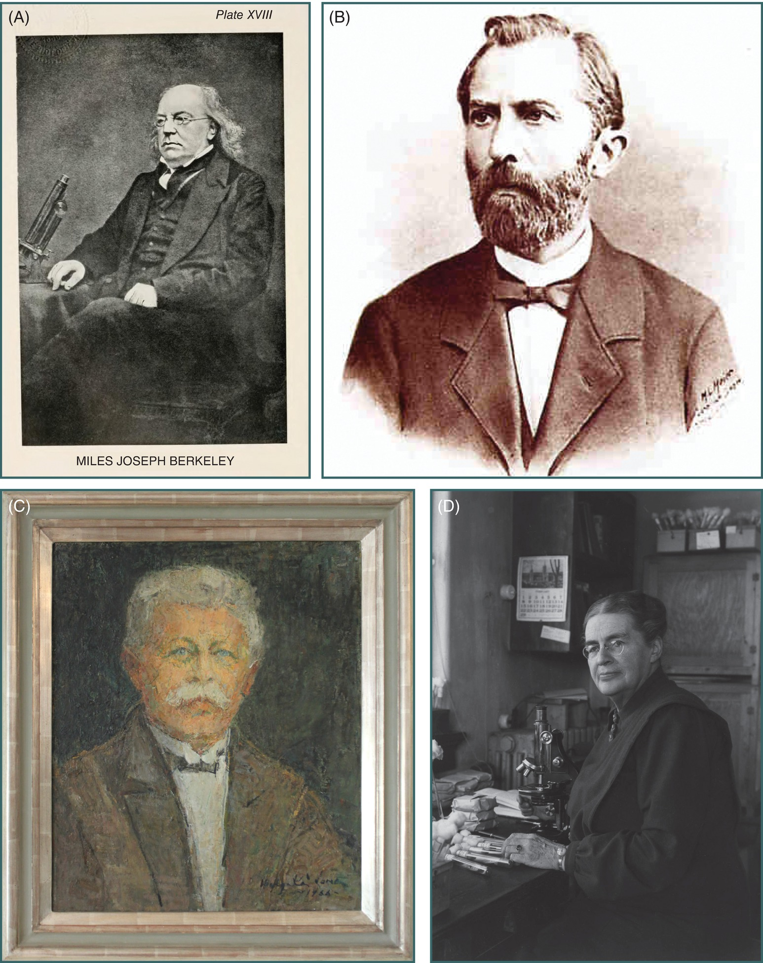
Fig. 2.1
(A) Miles J. Berkeley; (B) Anton de Bary; (C) Jakob Eriksson; (D) Johanna Westerdijk. (ABD: ©Wikipedia commons. C: © J. Yuen.)
Plant Pathology and Plant Diseases © Anne Marte Tronsmo, David B. Collinge, Annika Djurle, Lisa Munk, Jonathan Yuen and Arne Tronsmo 2020

