Slide 1
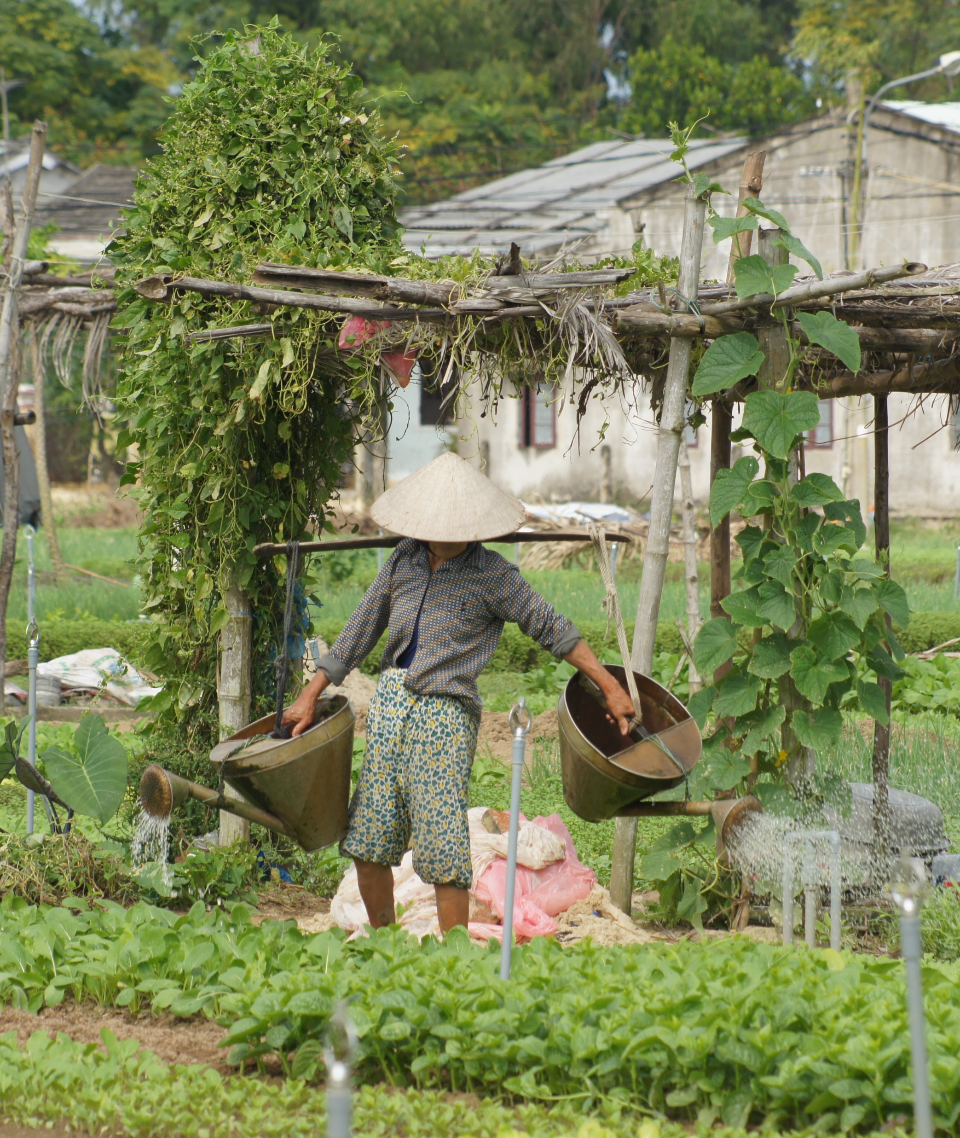





The Netherlands (NL) –CGIAR Research Programme
Leveraging science excellence and development impact through partnerships
CGIAR Science week, 09-04-2025
Gerrie Tuitert, NWO Dutch Research Council

Slide 2
NL-CGIAR Research Programme (2017-2023; 2024-2030)
Foster research cooperation to advance knowledge and enhance innovation for global food and nutrition security
Objectives:
  Enhance partnering in research and innovation in areas of mutual interest
  of CGIAR and NL policy
  Enhance joint engagement with NARES, civil society organisations, private sector and governmental organisations
  Leverage Dutch knowledge and expertise for performance and impact
  of CGIAR’s portfolio
  Leverage CGIAR expertise, science and networks for NL knowledge institutions

Slide 3
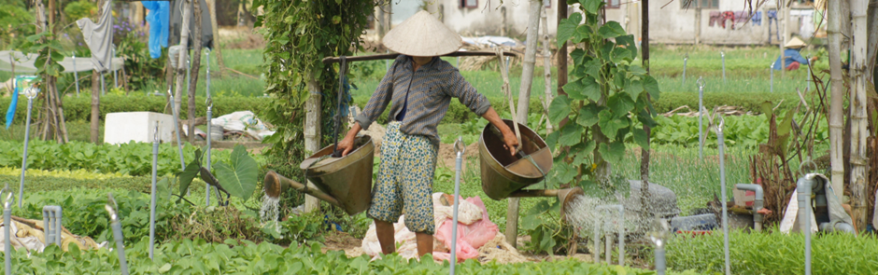
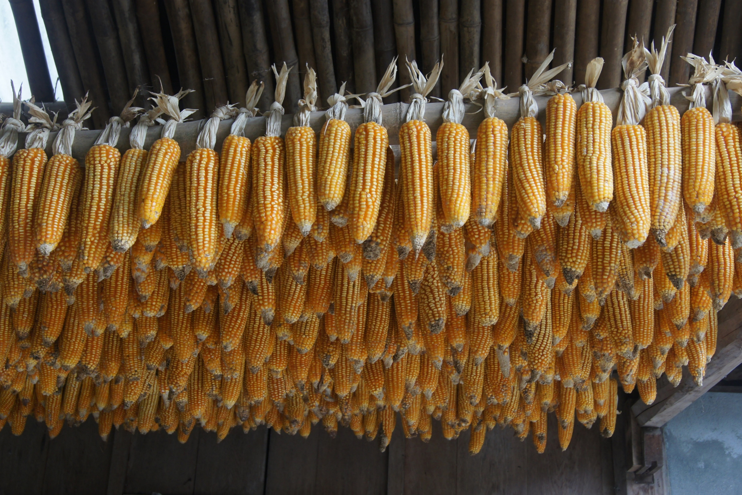
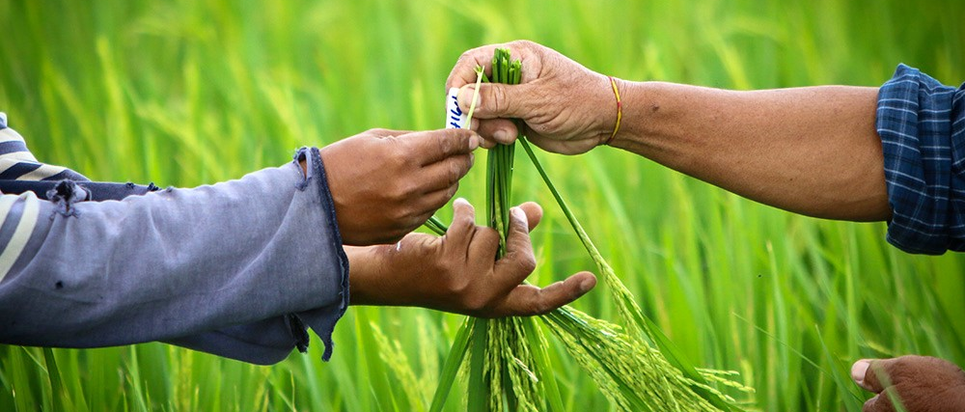
NL-CGIAR main subprogrammes
Thematic calls: joint NL-CGIAR research + local partners
- Seed Systems Development: 9 projects (2017-2022)
- Water-Food-Nexus: 6 to be awarded (end of 2025)
Senior Expert Programme (SEP)
- Facilitating Senior Experts of NL knowledge institutes to work
part-time at CGIAR
- 2017-2023: 17 Senior experts & 1 PPP expert
- 2025: 22 Senior experts have started
- 2025: a next round to be released

Slide 4

NL-CGIAR Research programme: SO FAR
        (2017-2023)
Positive external evaluations
  Facilitating NL engagement at senior level with CGIAR
  Strengthening partnering NL institutions/researchers - CGIAR Research programmes
  Strengthening NL-CGIAR research partnerships, linking up expertises, systems approach
  Enhancing involvement of local stakeholders and private partners & co-creation
Joint contribution to the aims of CGIAR and NL-policy on food and nutrition security
Synthesis study highlighting approach & cross-cutting themes
Added value of close cooperation of NWO with CGIAR in developing the programme
And close engagement with Dutch MoFA & MoA and Netherlands Food Partnership (NFP)

Slide 5

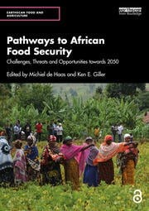
NL-CGIAR Senior Expert Programme
Embedding in & cooperation with CGIAR’s portfolio
Activities / value for CGIAR ànd NL:
research management expertise / knowledge sharing / mutual learning / innovation & scaling / capacity strengthening / strengthened & new partnerships / multitude of joint publications / contribution to global agenda’s & debate (UNFSS)
‘more time for meaningful engagement with CGIAR teams, strengthened interaction’
‘freed up time for jointly supervised PhDs’
Some assignments (finalised)
CGIAR Flagship leader Food Systems for Healthier Diets – global leadership, nutrition expertise, systems thinking, foodbased dietary guidelines
Examples of SE’s feedback
‘facilitated introduction of new topics
(e.g. gov’ce in food) or tools (scaling readiness)’
Improving planting material and access to new varieties (roots, tubers, banana’s, maize) - RTB toolbox & Scaling Readiness
Farming Systems Analysis for Inclusive and Resilient Agriculture – contribution to UN Food Systems Summit etc
‘linking up science with practical application, providing access to data, facilitated co-creation’

Slide 6
NL-CGIAR Senior Experts & the CGIAR portfolio
22 recently started Senior Experts
Examples:
Realisation of a Centre of Expertise on Food Systems Resilience in the Horn of Africa
Scenario trade-off analysis & foresight for food system transformations
Scaling for impact:
- Co-create, simulate, test intervention strategies for food systems in Africa;
- Transition pathways in Asian Megadelta’s
  Hosted at 10 CGIAR Research Centers
  5 NL organisations – 16 different faculties / groups

Slide 7
NL-CGIAR Research programme – Next …
A next round for Senior Experts is foreseen (publication around summer 2025)
A modest small grants facility is being developed
    - For CGIAR knowledge questions
    - To be addressed by NL experts
Synthesis studies are foreseen, e.g. to highlight synergy and cross-cutting themes

Slide 8
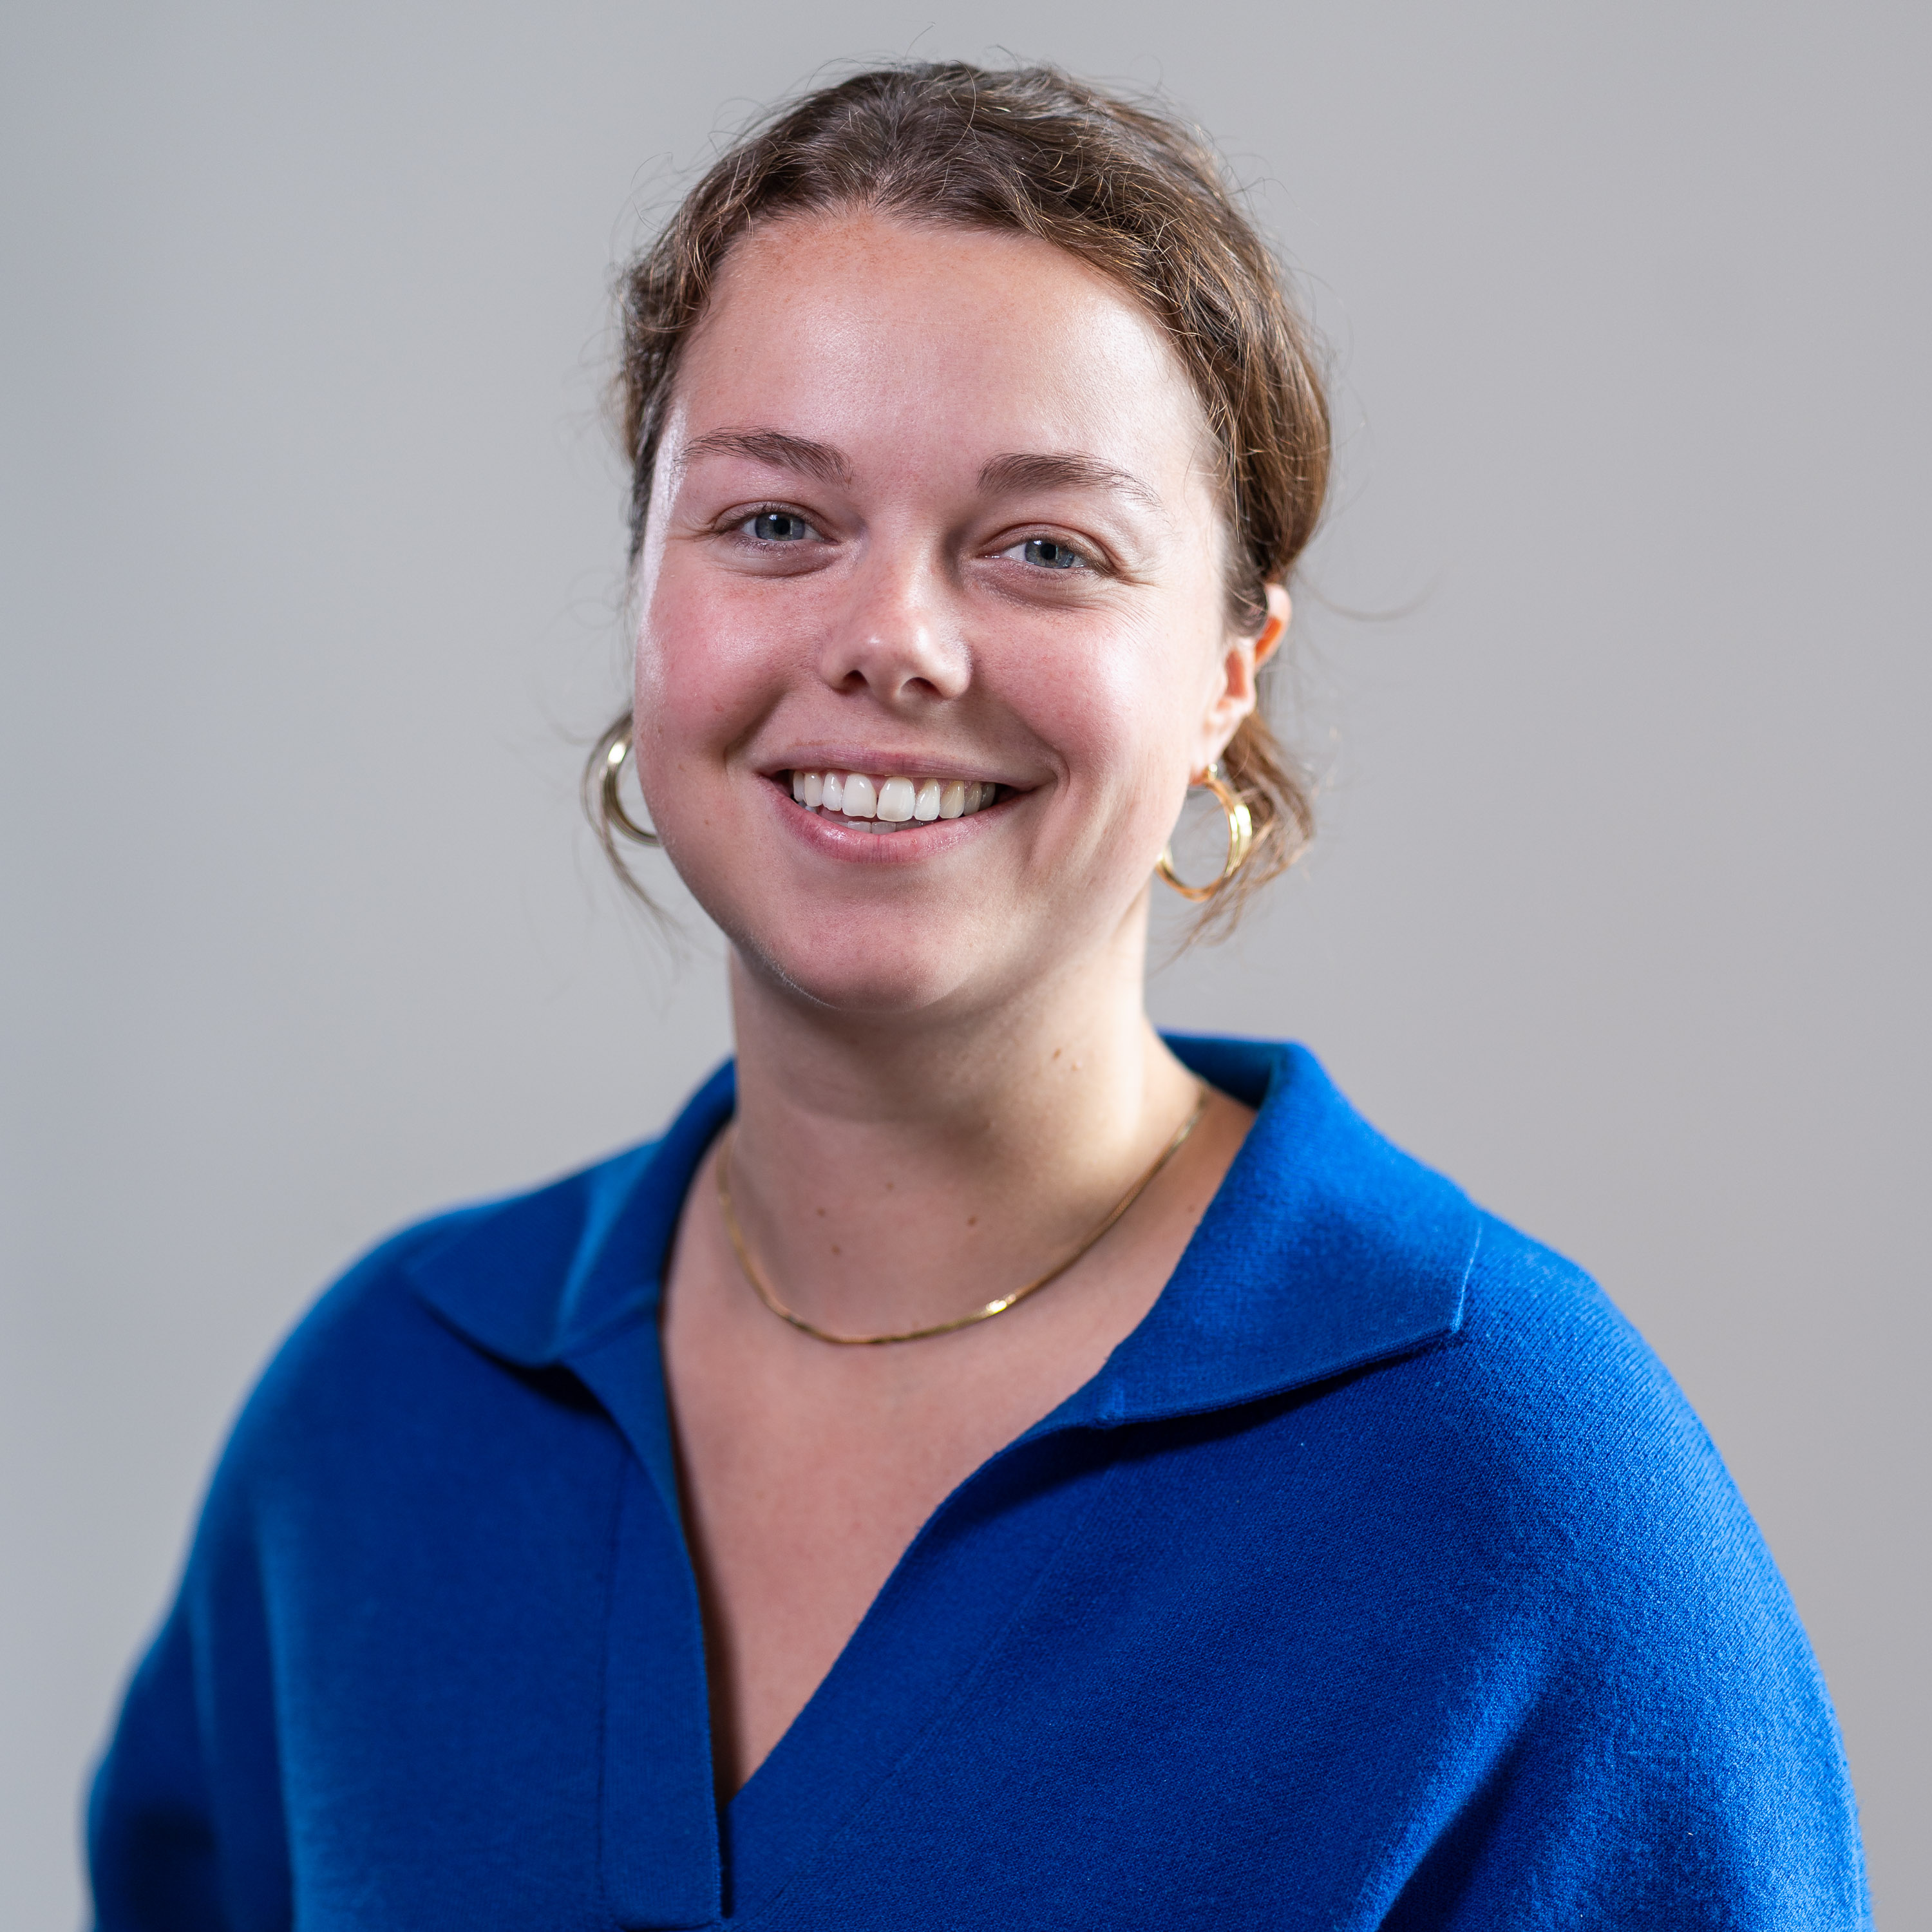
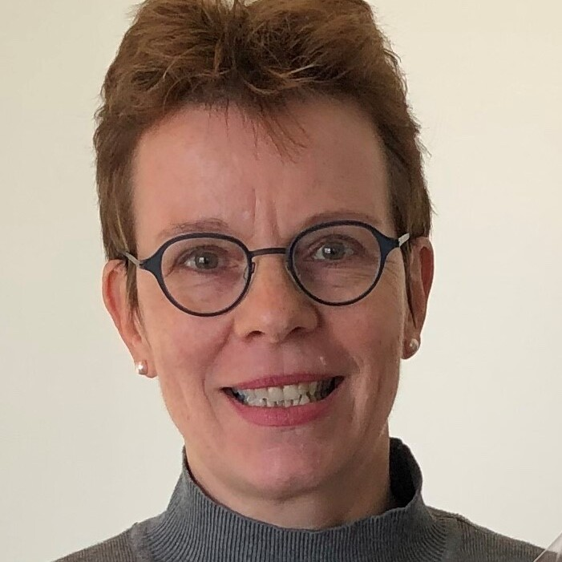
The Netherlands (NL) –CGIAR Research Programme
Information & contact:
www.nwo.nl/cgiar
NL-CGIAR@nwo.nl
Team members NWO:
Cannell van Dien (at Science Week)
Petra Griffioen, Greta van den Brand
Martijn Bal, Suzy Winklaar
THANK YOU FOR YOUR ATTENTION !
9 April 2025, Gerrie Tuitert, NWO, g.tuitert@nwo.nl
Coordinator NL-CGIAR Research programme
Notes:
Available on the website: from first phase External evaluations, Synthesis reports and animations, and an NL-CGIAR magazine.

