Slide 1
UK-CGIAR Centre
Collaboration in Science and Innovation
CGIAR Science Week
9 April 2025, UN Office, Nairobi

Slide 2
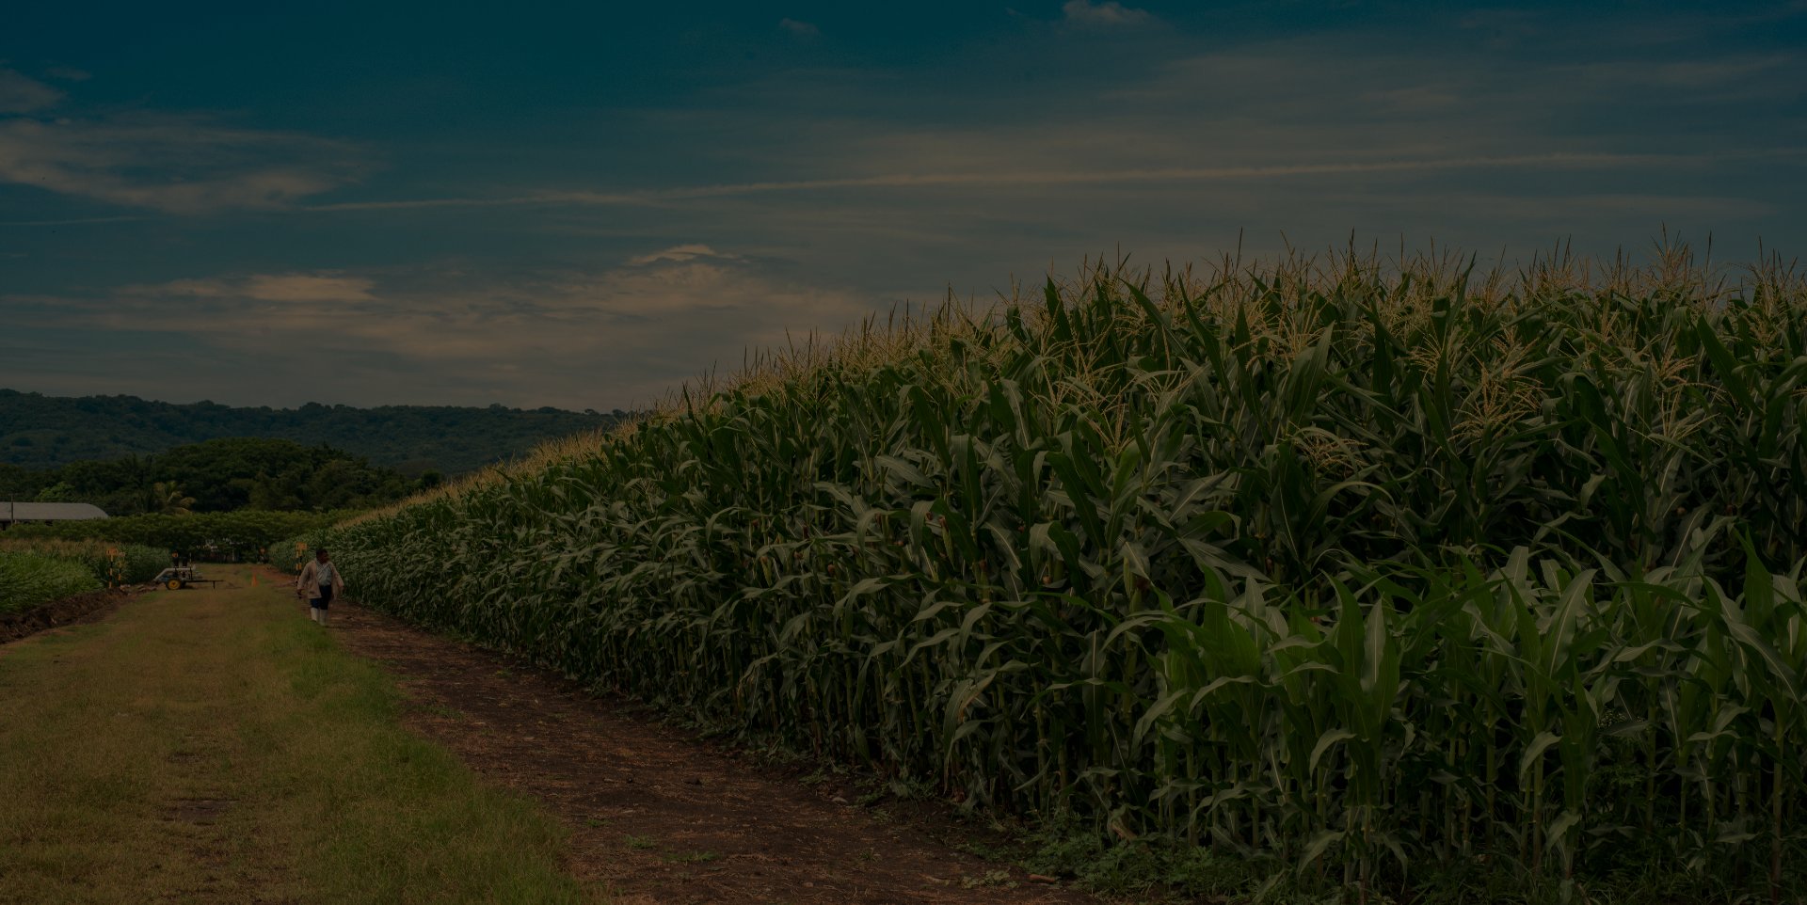
The UK-CGIAR Centre was set up to address two key problems:
The UK-CGIAR Centre was set up to address two key problems
Valuable research by UK Institutes not having sufficient impact in global agricultural practice
The CGIAR doesn’t have systematic access to valuable UK research outputs
Notes:
The food system is facing unprecedented challenges. Exacerbated by the war in Ukraine, the cost of food has reached a 50-year high. Conflict and climate change is hitting some of the world’s most fragile regions hard, exacerbating the vulnerability of food supplies. Simultaneously agriculture is negatively affecting the environment, it is the main driver of biodiversity loss and accounts for 30% of GHG emissions.
Past UK-CGIAR links were dispersed, with many examples of already successful partnerships
Scope for increased impact (and benefit to UK) through greater focus: leverage UK and CGIAR world-class research infrastructure and science and technology strengths
UK can contribute specialist knowledge not currently available in CGIAR, and UK researchers can access tools and resources unavailable nationally
Pursue research which cannot be conducted by a single country

Slide 3
The solutions
Support global food security by bringing together scientists from the UK and the CGIAR to form impact-focused research collaborations
Take a creative approach to commissioning to ensure CGIAR has full access to the best of British agricultural science and the provision of funding to support it
Collaboration in science and innovation
Notes:
International partnerships are essential for strengthening and maintaining the vibrancy of the bioscience research base.
Through international partnerships, researchers are able to collaborate with the best scientists overseas, work across nations to tackle global challenges and ensure that there is impact from our bioscience research, skills and innovation for public good.
Seed funding can bring together leading scientists with shared objectives that can flourish and develop - Partnerships may access funding partners outside of CGIAR and the UK

Slide 4
Objectives
The UK CGIAR Centre has three objectives:
Strengthen relationships between UK and CGIAR
Strengthen local impact of research with NARS partners
Ensure alignment with the CGIAR 2025-30 Portfolio
Notes:
1. Recent Science Forum in London – building a portfolio approach with a matrix of collaboration across projects as well as within
2. Support and demand partners to be explicit and intentional about the pathways that are needed to translate great, and really inspiring, science into transformative development impact. Involve NARS partners from the beginning of the design and implementation process – fair allocation of resources – added “NARS partners” into the objective to be explicit and remind everyone
3. UK sits on the CG system council – keen to ensure this work aligns with the new programmes as far as possible – docking into MELIA system, co-developing the funding application formats, adopting W3 principles with some specificities to this project

Slide 5
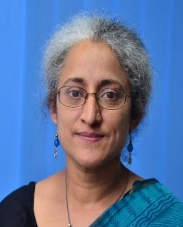
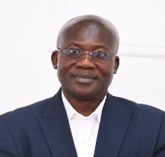
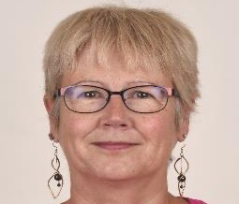
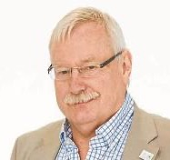
Creating governance structures
The Centre Board, served by CABI as host of the Secretariat, has four core member originations:
CABI also recruited the Science Impact and Advisory Group:
Nitya Rao
Eric Danquah
Jane Langdale
Wayne Powell
Notes:
Vital to include the CG presence on the board – senior science director has been able to navigate and identify the key people and best approaches and ensure that the programem development is in alignment with CG priorities
SIAG – Nitya Rao – Prof of Gender and development at the U East Anglia and Director of the Norwich Institute for Sustainable Development
Prof Eric Danquah - founding director of the West Africa Centre for Crop Improvement and Professor of Plant Molecular Genetics at the U of Ghana
Prof Jane Langdale – Prof of Plant Development at Uni of Oxford – author of the UK PLANT SCIENCE RESEARCH STRATEGY, an impactful report in the UK system which proposed the idea of the Centre
Prof Wayne Powell – Principal and Chief Executive of Scotland’s Rural College (SRUC), the UK’s leading agri-food-environment, tertiary education Institution and previously Chief Science officer for the CGIAR
Full bios:
Nitya Rao is Professor, Gender and Development, at the University of East Anglia, Norwich, United Kingdom and Director of the Norwich Institute for Sustainable Development, which brings together disciplines to achieve the shared goal of global food and nutrition security. She has worked as a researcher and advocate in the field of women’s rights. She has published extensively on the gendered changes in agrarian relations, migration and livelihoods, especially in contexts of climatic variability and economic precarity. She has consistently engaged with policy and practice, at both the global and local levels.
Apart from supporting networks of women farmers in India, she served on the Global Advisory Committee of the United Nations Girls Education Initiative for over a decade. She has served as a member of the Steering Group of the High-Level Panel of Experts to the Committee on World Food Security for two terms. She is currently Commissioner, EAT-Lancet 2.0 on healthy and sustainable diets, member of the Scientific Advisory Committee of the United Nations Food Systems Coordination Hub, member of the UKRI International Strategic Advisory Group and External Adviser, People-Centered Food Systems Project at Columbia University.
Eric Yirenkyi Danquah holds a professorship in Plant Molecular Genetics at the University of Ghana (UG). He is a former Dean of International Programmes, UG. As the founding Director of the West Africa Centre for Crop Improvement (WACCI), UG, he has helped train a new wave of researchers who are working toward enhancing varieties of staple crops in Africa. His role extends internationally as an Adjunct Professor at Cornell University, USA, the University of Western Australia, and Murdoch University, Australia. He is a member of the Standing Advisory Group on Nuclear Applications (SAGNA) at the International Atomic Energy Agency (IAEA) based in Vienna, Austria. Danquah laid the groundwork for the African Plant Breeders Association (APBA) by serving as its first and incumbent president, and he contributes his expertise to various international boards across the globe.
Eric’s work has earned him several accolades, including the UG Distinguished Award for Meritorious Service in 2013, the 2018 Laureate, Global Confederation of Higher Education Associations in Agriculture and Life Sciences (GCHERA) World Agriculture Prize, and the 2022 Laureate, Africa Food Prize. In January 2023, Reputation Poll International recognized him as one of the 100 most Reputable Africans. The African Genius Awards also honored him recently with an Outstanding African Achiever Award.
Jane Langdale is currently Professor of Plant Development in the Biology Department at the University of Oxford and Professorial Fellow at The Queen’s College. Jane’s research focusses on understanding the genetic mechanisms that underpin how leaves develop and how they evolved (www.langdalelab.com) and she is currently co-ordinator of the Bill & Melinda Gates Foundation funded ‘C₄ Rice Project’ (www.c4rice.com). In 2021 she co-ordinated a community initiative to produce the ‘UK plant science research strategy: a green roadmap for the next 10 years’, which set out clear goals for research and innovation involving plants.
She was elected a Member of the European Molecular Biology Organization in 2007, a Fellow of the Royal Society in 2015, an International Member of the US National Academy of Sciences in 2019 and a Corresponding Member of the Australian Academy of Sciences in 2020. She was awarded a CBE in 2018 for services to plant science.
Professor Wayne Powell is Principal and Chief Executive of Scotland’s Rural College (SRUC), the UK’s leading agri-food-environment, tertiary education Institution. His previous roles include Chief Science Officer at CGIAR, a global agri-food partnership, Professor & Founding Director of the Institute of Biological, Environmental and Rural Sciences (IBERS), Aberystwyth University, and CEO & Director NIAB, Cambridge. He is a Senior Fullbright Scholar and worked for the DuPont Company in Wilmington, Delaware, USA. Wayne is a member of Scotland’s Science Advisory Council, Board member of NatureScot and member of the FCDO Research Advisory Group (RAG). Until recently he was a member of both DEFRA and DFID’s Science Advisory Council and Convenor of the Research and Knowledge Exchange Committee of Universities Scotland. He maintains an active research group and is an elected Fellow of the Learned Society of Wales and the Royal Society of Edinburgh.

Slide 6
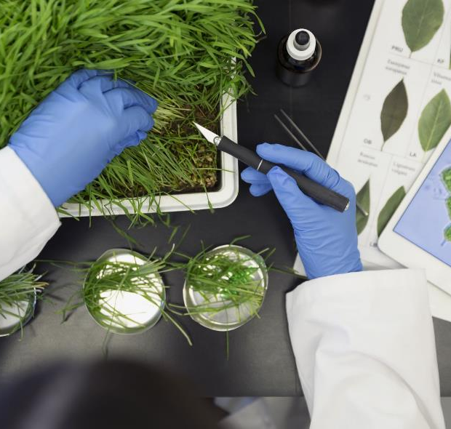
Development of Research Areas
Mapping of strategic priorities
Bibliometric review
Alignment with global priorities
Board decision
Focus on Vision for Adapted Crops and Soils
Collaboration in science and innovation
Notes:
Mapping of strategic priorities of funders and CGIAR to identify areas of alignment
Bibliometric review to identify areas where UK publications hold a leading role
Other factors (funding from other sources, changes in context, alignment with global trends etc)
Board decision on the primary research areas
2024 funding round to focus on leveraging UK science to support the Vision for Adapted Crops and Soils

Slide 7
Research Areas and Topics
Climate change adaptation and mitigation in agriculture
Crop genetic improvement for future climate resilience
Enhancing nutrition
Livestock improvement, animal health, nutrition and welfare
​​
Notes:
1. Climate change adaptation and mitigation in agriculture
Sustainable and resilient agriculture: Supporting decision-making with evidence in small farming contexts
2. Crop genetic improvement for future climate resilience Leveraging UK genetic innovations to accelerate CGIAR-NARS crop breeding
3. Enhancing nutrition
Increasing the intake of fruit and vegetables as components of healthier diets among marginalized populations
4. Livestock improvement, animal health, nutrition and welfare
Feeds/forages and emissions. Pilot testing feeds/forage species and their impact on emissions

Slide 8
Identification of Partnerships
UK leaders
CGIAR validation
BBSRC verification and Board selection
Two types of partnership:
A supercharging project
A new collaboration
Semi competitive process
Notes:
A further bibliometric analysis was carried out to identify the UK institutions best suited​ to conduct the research for each of the confirmed research topics.
These were cross-checked with CGIAR suggestions for UK partners.
BBSRC verified suitability and the Board selected those to approach.
After identifying partners, the Centre created two types of partnership:
A supercharging project
A new collaboration
Semi-competitive process – proposals peer reviewed and further reviewed by SIAG

Slide 9
UK-CGIAR Centre – Global Projects
Leveraging genetic innovations for accelerated breeding of climate
Innovation in sustainability, policy, adaptation and resilience in Kenya (iSPARK)
Defining new phenotypes for forage and crop by-products improvement based on rumen function and greenhouse gas emissions
Fruits and Vegetables for Sustainable Healthy Diets (FRESH) – Expanded Network with UK Partners (FRESH-EN UP)
Notes:
The project aims to speed up the wheat breeding process by incorporating recent discoveries and embracing innovative breeding techniques, such as genome editing and data-driven sequence-based discovery. The teams will work in Kenya, Egypt, and Pakistan.​
ISPARK will use the iFEED integrated modelling approach (Jennings et al., 2022) developed under ClimBeR to summarise model outputs across scales and assess the impact of three innovations to create and use evidence to support the changes needed for sustainable, climate-resilient nutrition security in Kenya. ​
This project aims to increase fruit and vegetable intake among nutritionally at-risk populations such as women of reproductive age and adolescents in Tanzania.​
The project aims to develop feed stuffs that allow animals to meet their genetic potential whilst providing the means to develop feedstuffs that minimise the environmental footprint of ruminant agriculture. The teams will work together in Kenya and Ethiopia.​

Slide 10
The Centre is funded by UK International Development and BBSRC
Notes:
Say UK International Development is the funder (as opposed to FCDO)

