Slide 1
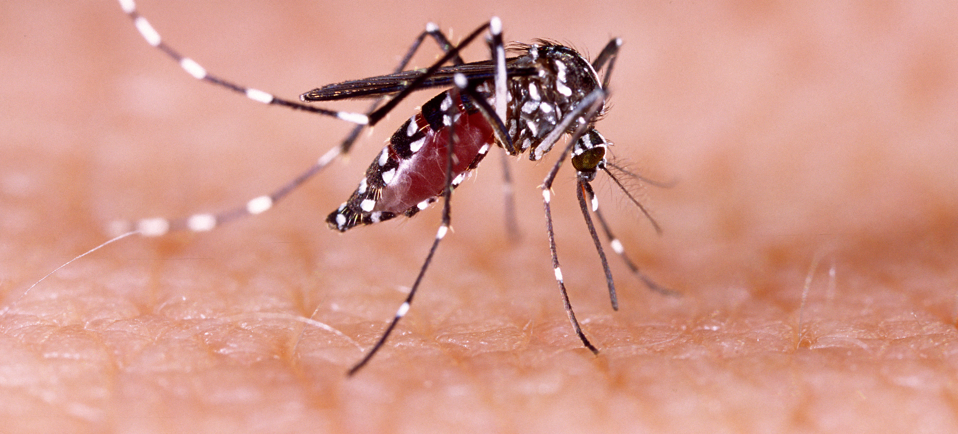
Communicable Diseases, 6th Edition
A Global Perspective
Roger Webber

Slide 2
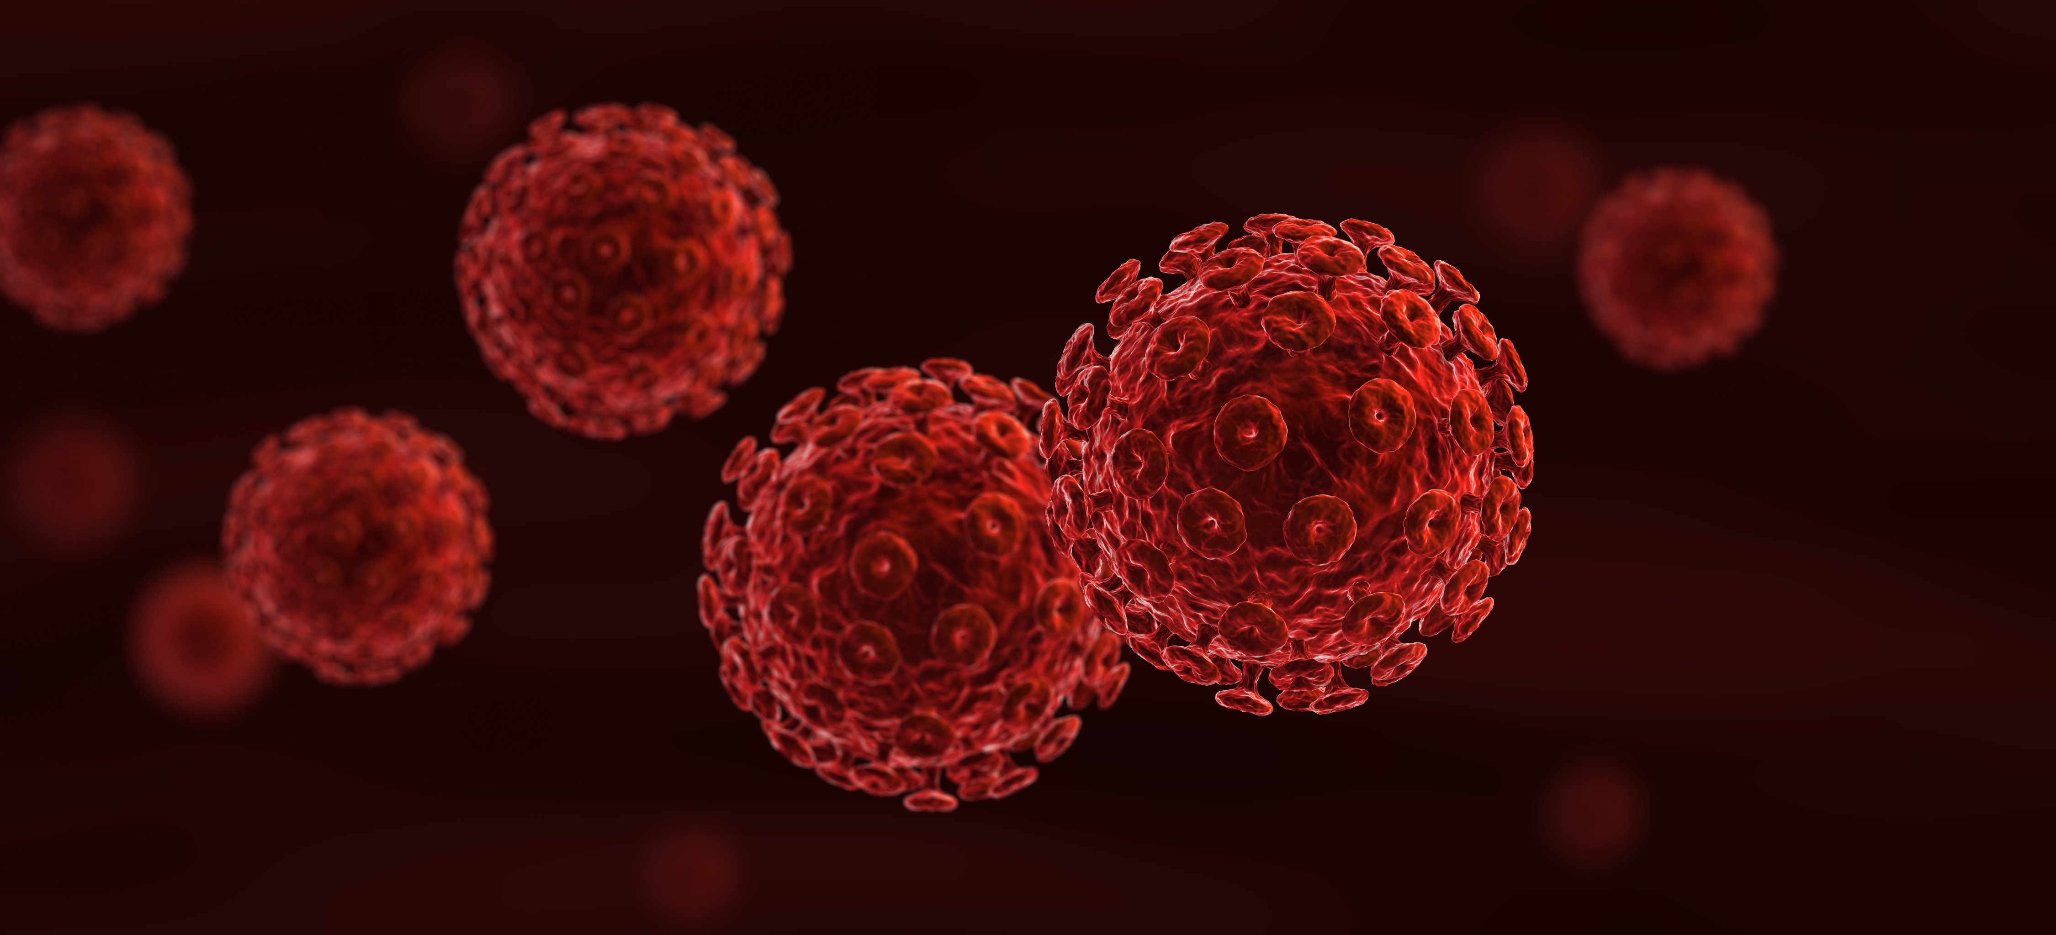
Chapter 9: Food-borne Diseases

Slide 3
Summary
Infections such as food poisoning can cause disease in any kind of food, whereas helminth diseases and trichinosis result from specific foods in which the organism has a developmental cycle.
Where food poisoning is suspected, questioning of those involved and a relative risk assessment will determine the likely cause.
There has been an increase in food-borne diseases due to the globalization and international transportation of foods, particularly meat and poultry.
Helminth diseases can nearly always be diagnosed by finding the specific egg in the faeces.
Preventing the contamination of food by good hygiene and its proper cooking are the main methods of control.

Slide 4
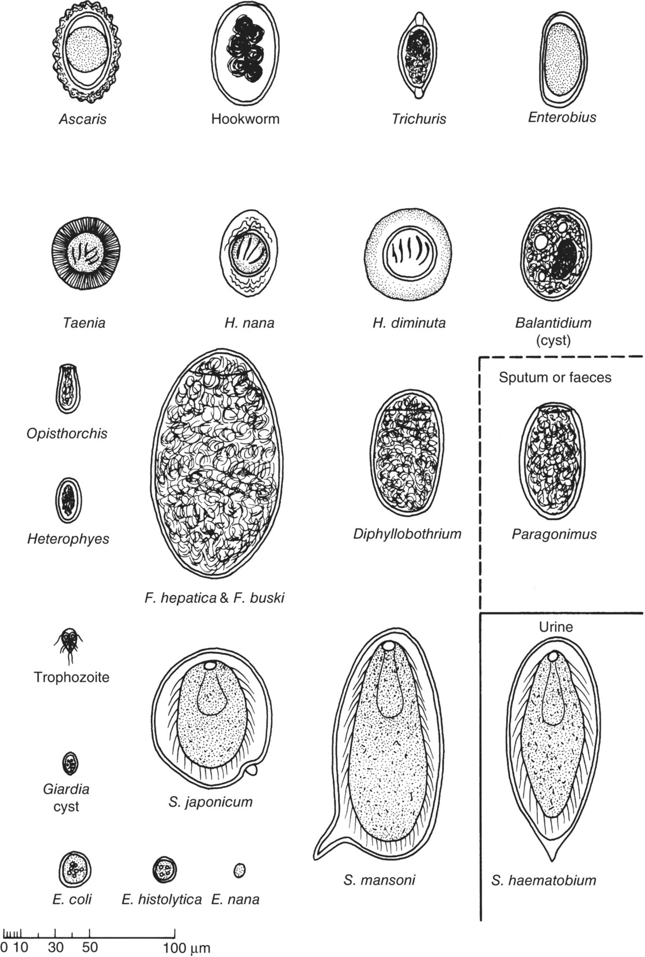
Fig. 9.1. Parasite eggs found in faeces, urine and sputum: E. (nana), Endolimax; E. (coli), E. (histolytica), Entamoeba; F. (hepatica), Fasciola; F. (buski), Fasciolopsis; H. (diminuta), H. (nana), Hymenolepis; S. (haematobium), S. (japonicum), S. (mansoni), Schistosoma.

Slide 5
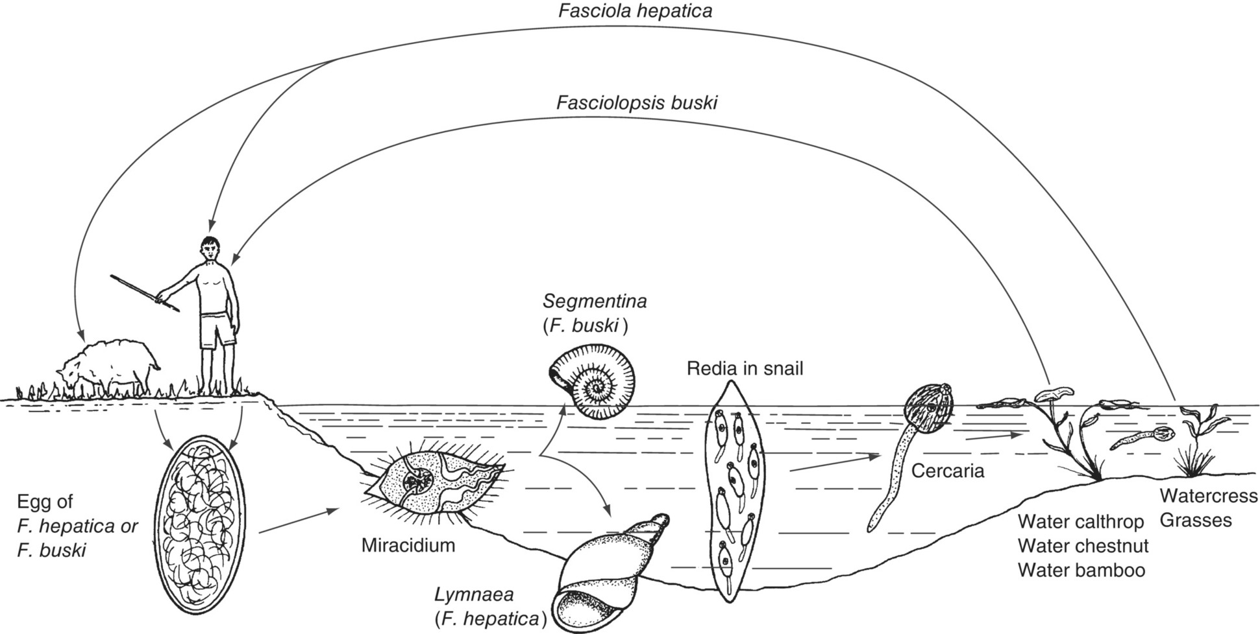
Fig. 9.2. Life cycle of intestinal (Fasciolopsis) and sheep liver (Fasciola) flukes.

Slide 6
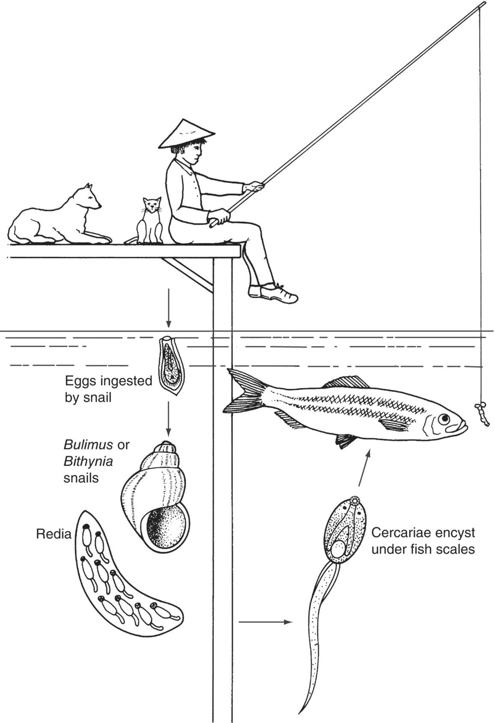
Fig. 9.3. The life cycle of the fish-transmitted liver flukes, Clonorchis sinensis, Opisthorchis felineus, Opisthorchis viverrini, Heterophyes heterophyes and Metagonimus yokogawai.

Slide 7
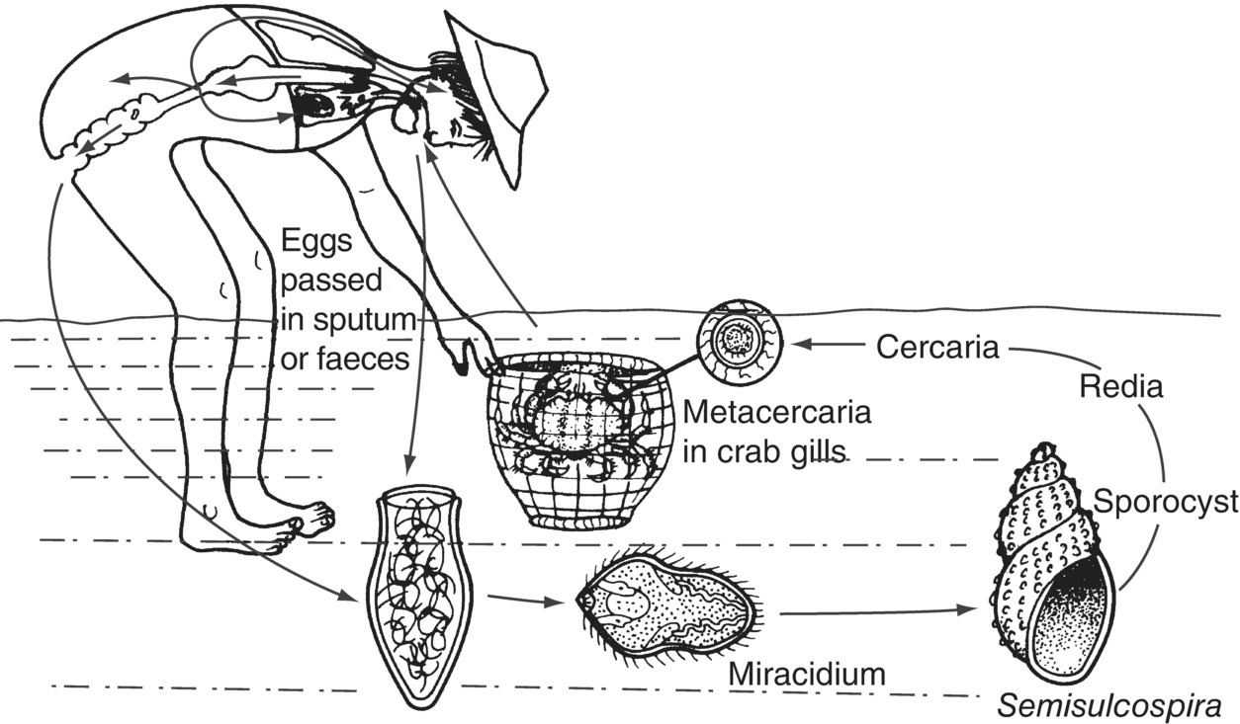
Fig. 9.4. Life cycle of the lung fluke, Paragonimus westermani.

Slide 8
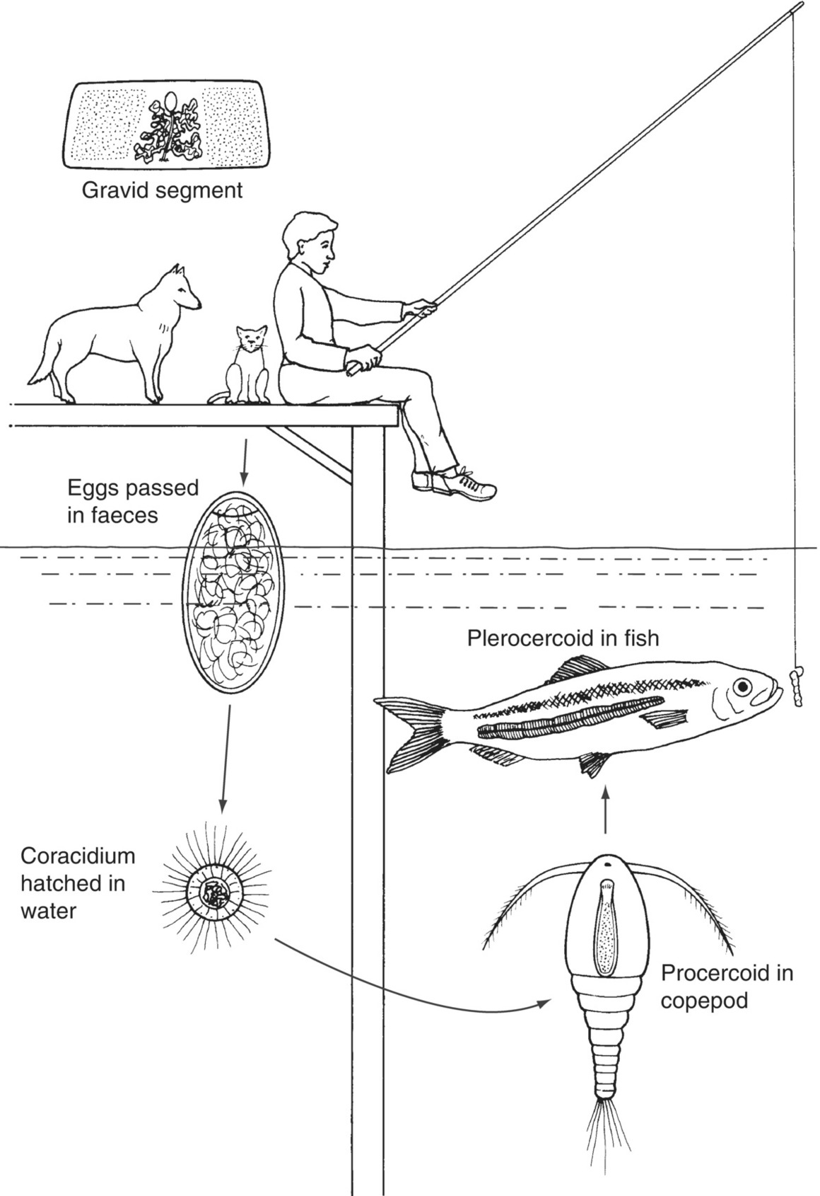
Fig. 9.5. Life cycle of the fish tapeworm, Diphyllobothrium latum.

Slide 9
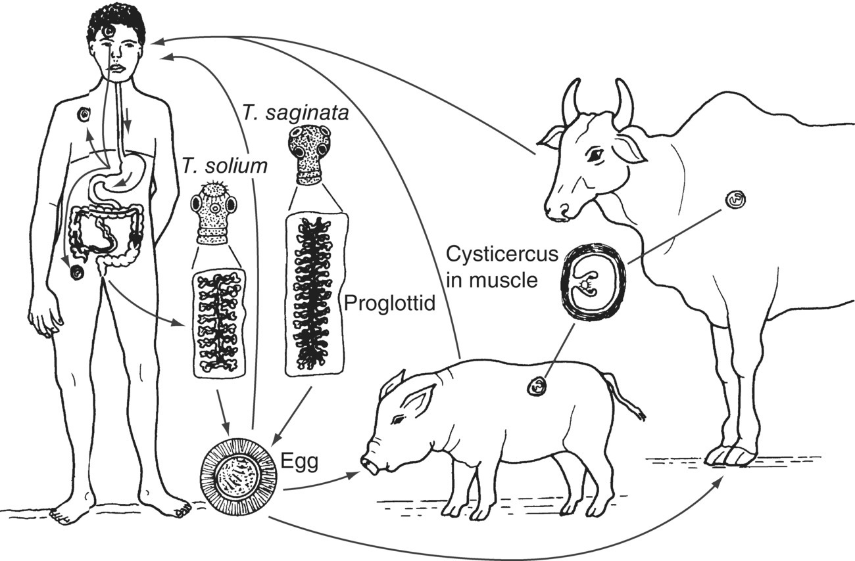
Fig. 9.6. Life cycle of the tapeworms Taenia solium and Taenia saginata.

Slide 10
Fig. 9.7. Endemicity of Taenia solium 2015.
(Reproduced by permission of the World Health Organization, Geneva.)

Slide 11
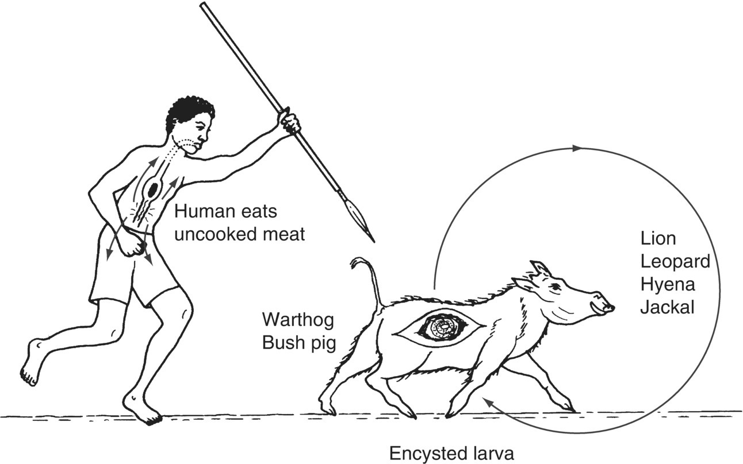
Fig. 9.8. Life cycle of Trichinella spiralis.

Slide 12
Further reading
Cheesbrough, M. (2006) District Laboratory Practice in Tropical Countries, Part 1, 2nd edn. Cambridge University Press, Cambridge, UK.
Cheesbrough, M. (2009) District Laboratory Practice in Tropical Countries, Part 2, 2nd edn. Cambridge University Press, Cambridge, UK.
Chiodini, P.L., Moody, D.H. and Manser, D.W. (2001) Atlas of Medical Helminthology and Protozoology, 4th edn. Churchill Livingstone, Edinburgh, UK.
Muller, M. (2001) Worms and Human Disease, 2nd edn. CAB International, Wallingford, UK.
Pasvol, G. and Peters, W. (2006) Atlas of Tropical Medicine and Parasitology. Mosby-Wolfe, London.

Slide 13
Web resources
Global Foodborne Infections Network (GFN): www.who.int/gfn/en (accessed 21 December 2015).

