Slide 1
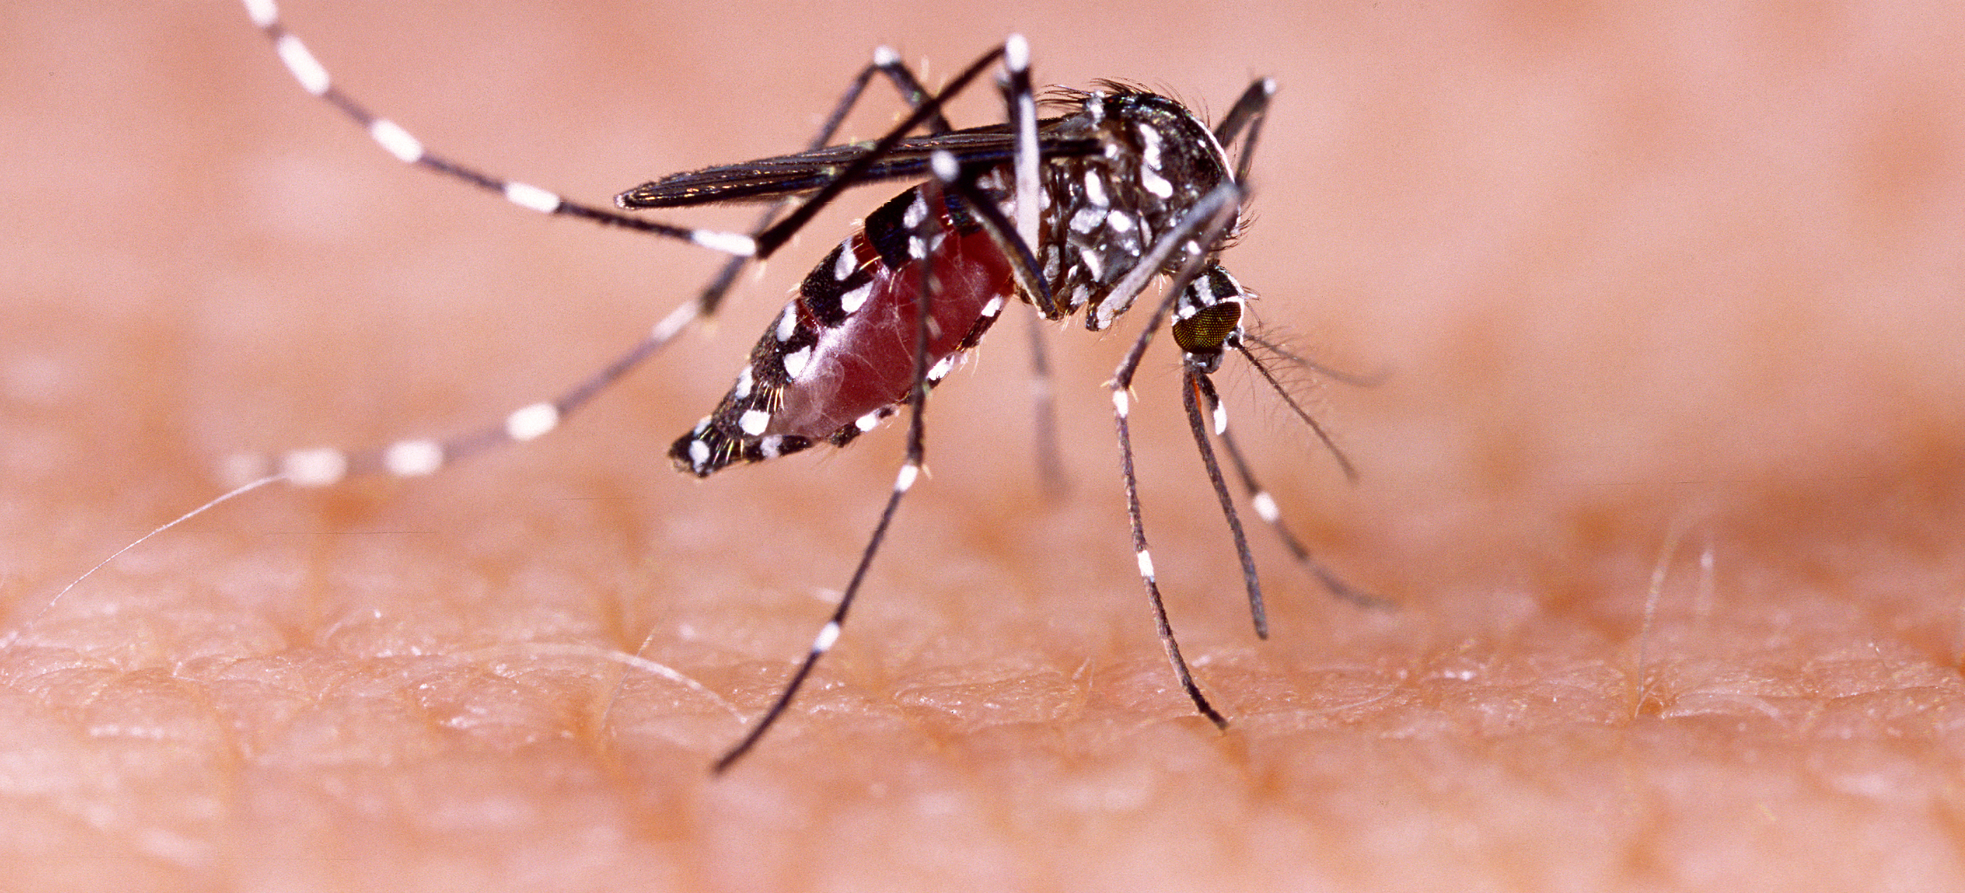
Communicable Diseases, 6th Edition
A Global Perspective
Roger Webber

Slide 2
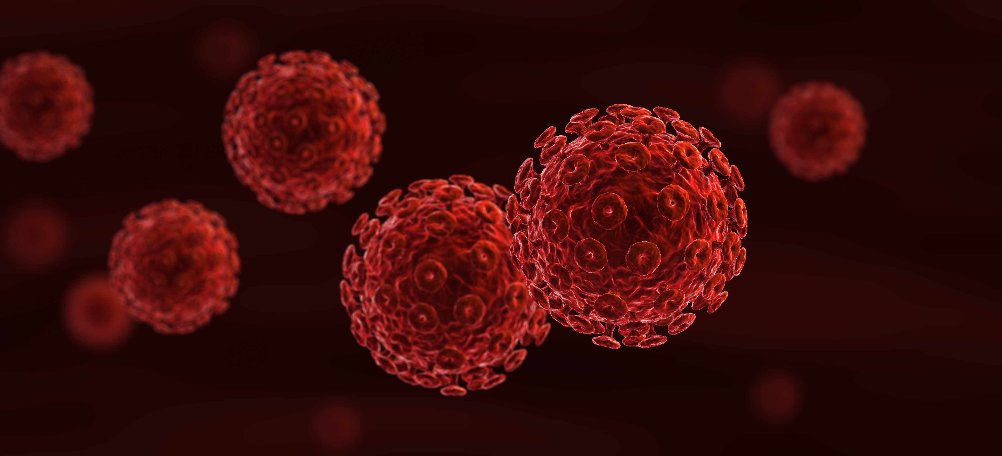
Chapter 8: Faecal–Oral Diseases

Slide 3
Summary
A large number of infections are transferred by faecally contaminated fingers, food or water.
Many of these infections produce diarrhoea, often adequately treated by oral rehydration solution.
In cholera and bacillary dysentery outbreaks, emergency treatment centres should be set up, standardized treatment and rehydration regimes instigated and the outbreak fully investigated.
Vaccinations are available for the prevention of rotavirus, cholera, typhoid, hepatitis A and poliomyelitis.
The prevention of faecal–oral transmitted infections is by the improvement of water supplies, provision of safe sanitation and hand washing, especially before preparing or eating food.

Slide 4
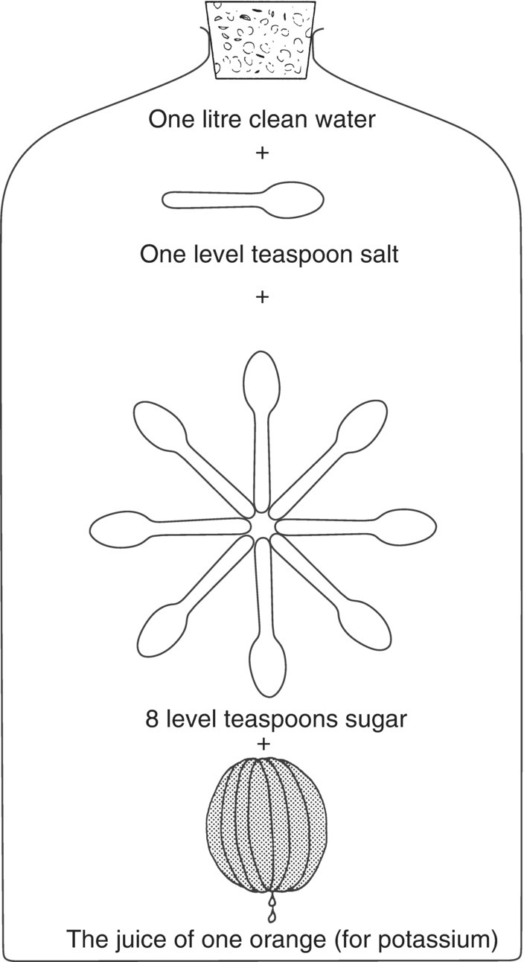
Fig. 8.1. Preparing a simple oral rehydration solution.

Slide 5
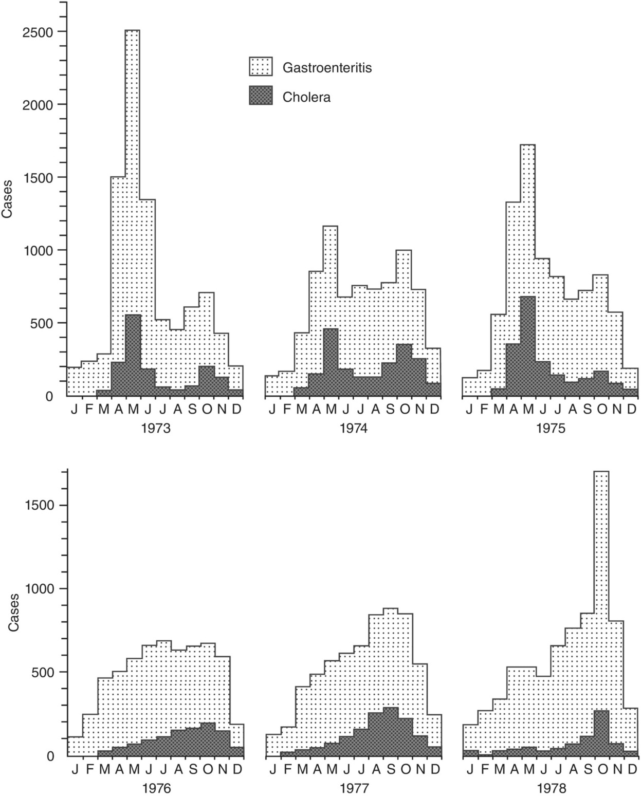
Fig. 8.2. Similar pattern of gastroenteritis and cholera in Calcutta (now Kolkata), India (1973–1978).
(Reproduced by permission from the Indian Council of Medical Research (1978) National Institute of Cholera and Enteric Diseases, Annual Report. Indian Council of Medical Research, Calcutta.)

Slide 6
Fig. 8.3. Cholera cases and deaths, 2017.
(Reproduced by permission of the World Health Organization, Geneva, Switzerland.)

Slide 7
Fig. 8.4. Annual cholera cases and mortality, 1989–2017.
(Reproduced by permission of the World Health Organization, Geneva, Switzerland.)

Slide 8
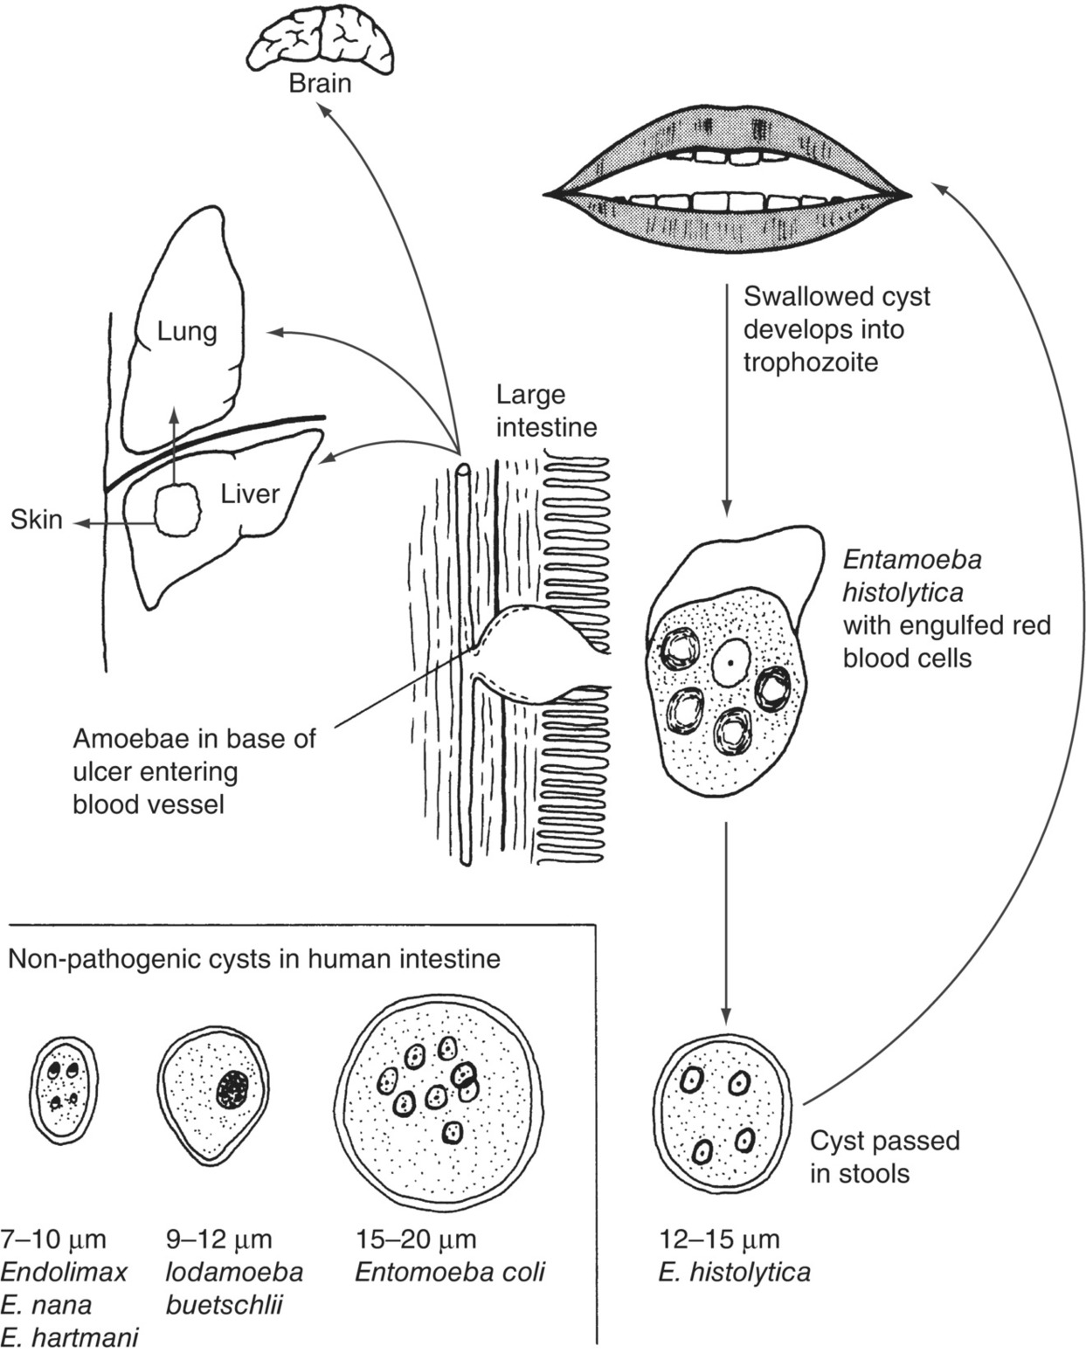
Fig. 8.5. Amoebiasis.

Slide 9
Further reading
Olsen, B.E., Olsen, M.E. and Wallis, P.M. (2002)
Giardia: the Cosmopolitan Parasite. CAB International, Wallingford, UK.
Ravdin, J.I. (2000) Amebiasis (Tropical Medicine: Science and Practice Vol. 2). World Scientific Publishing, Singapore/Hackensack, New Jersey/London.
World Health Organization (2004) Cholera Outbreak, Assessing the Outbreak Response and Improving Preparedness. WHO, Geneva, Switzerland.
World Health Organization (2005) Guidelines for the Control of Shigellosis, Including Epidemics Due to Shigella dysenteriae type 1. WHO, Geneva, Switzerland.
World Health Organization (2017) 14th Meeting of SAGE Polio Working Group. WHO, Geneva, Switzerland.

Slide 10
Web resources
Global Task Force on Cholera Control: www.who.int/cholera/en (accessed 28 February 2012).

