Slide 1
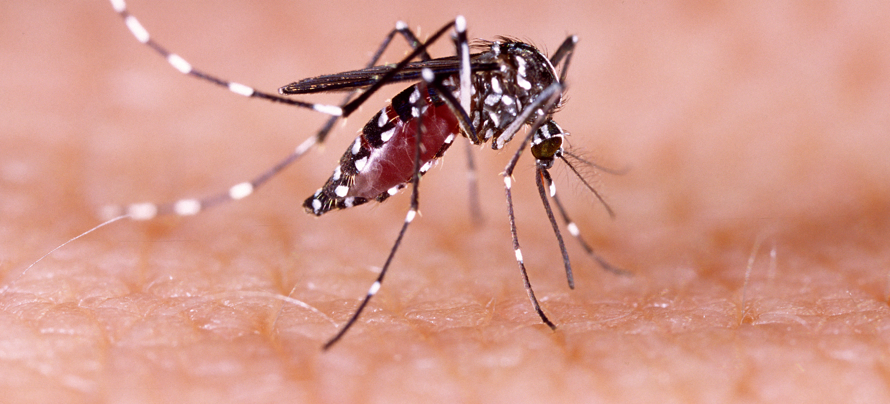
Communicable Diseases, 6th Edition
A Global Perspective
Roger Webber

Slide 2
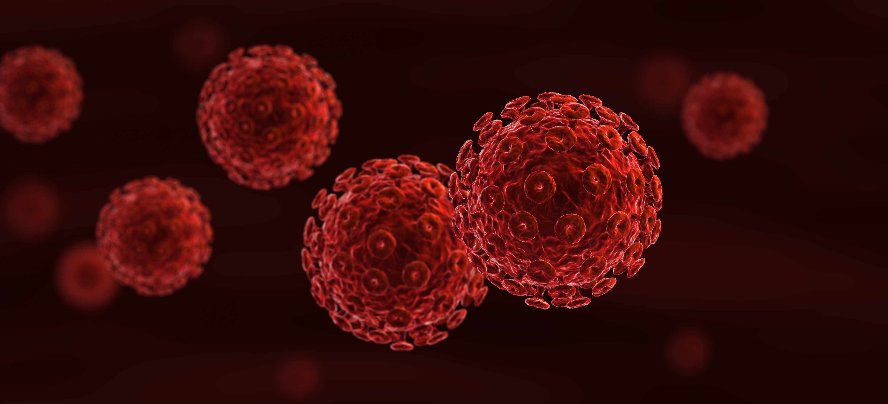
Chapter 7: Diseases of Poor Hygiene

Slide 3
Summary
Poor hygiene is responsible for a number of diseases that include skin infections, eye infections and tropical treponematoses.
Conditions of poverty and large families, with the sharing of clothes, bedding and personal items, are common factors.
Flies, by their habits, are ready carriers of disease organisms, and specific control measures may need to be undertaken to control them (Box 7.1).
Adequate quantities of water, with frequent washing, especially of the face where trachoma is common, is the main control method.
Long-term control is to provide water supplies with an adequate quantity of water. Good sanitation should also be practised.

Slide 4
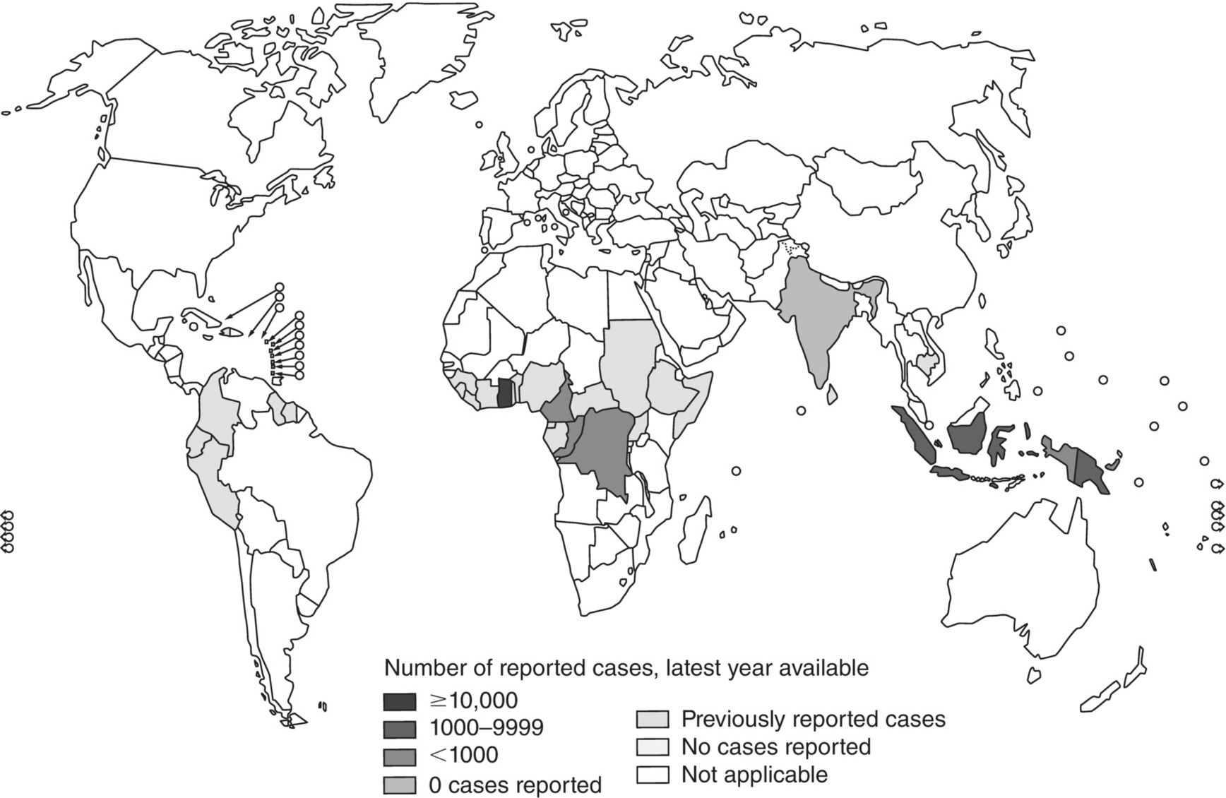
Fig. 7.1. Endemic treponematoses and its elimination 2017.
(Reproduced by permission of the World Health Organization, Geneva.)

Slide 5
Fig. 7.2. Distribution of trachoma, worldwide, 2018.
(Reproduced by permission of the World Health Organization, Geneva.)

Slide 6
Further reading
Antal, G.M., Lukehart, S.A. and Matheus, A. (2002) Review: the endemic treponematoses. Microbes and Infection 4, 83–94.
Perine, P.L., Hopkins, D.R., Niemel, P.L.A., St John, R.K., Causse, G. and Antal, G.M. (1984) Handbook of Endemic Treponematoses: Yaws, Endemic Syphilis and Pinta. World Health Organization, Geneva, Switzerland (under revision).
World Health Organization/London School of Hygiene and Tropical Medicine/International Trachoma Initiative (2006) Trachoma Control: A Guide for Programme Managers. WHO, Geneva, Switzerland.

