Slide 1
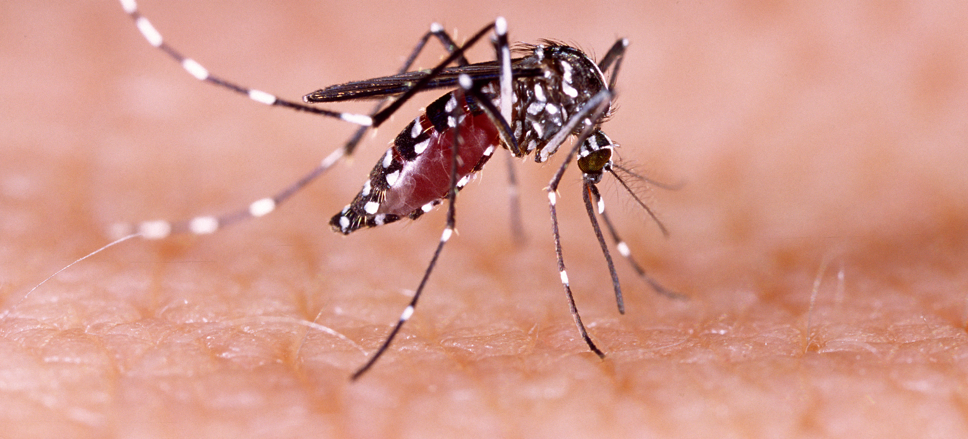
Communicable Diseases, 6th Edition
A Global Perspective
Roger Webber

Slide 2
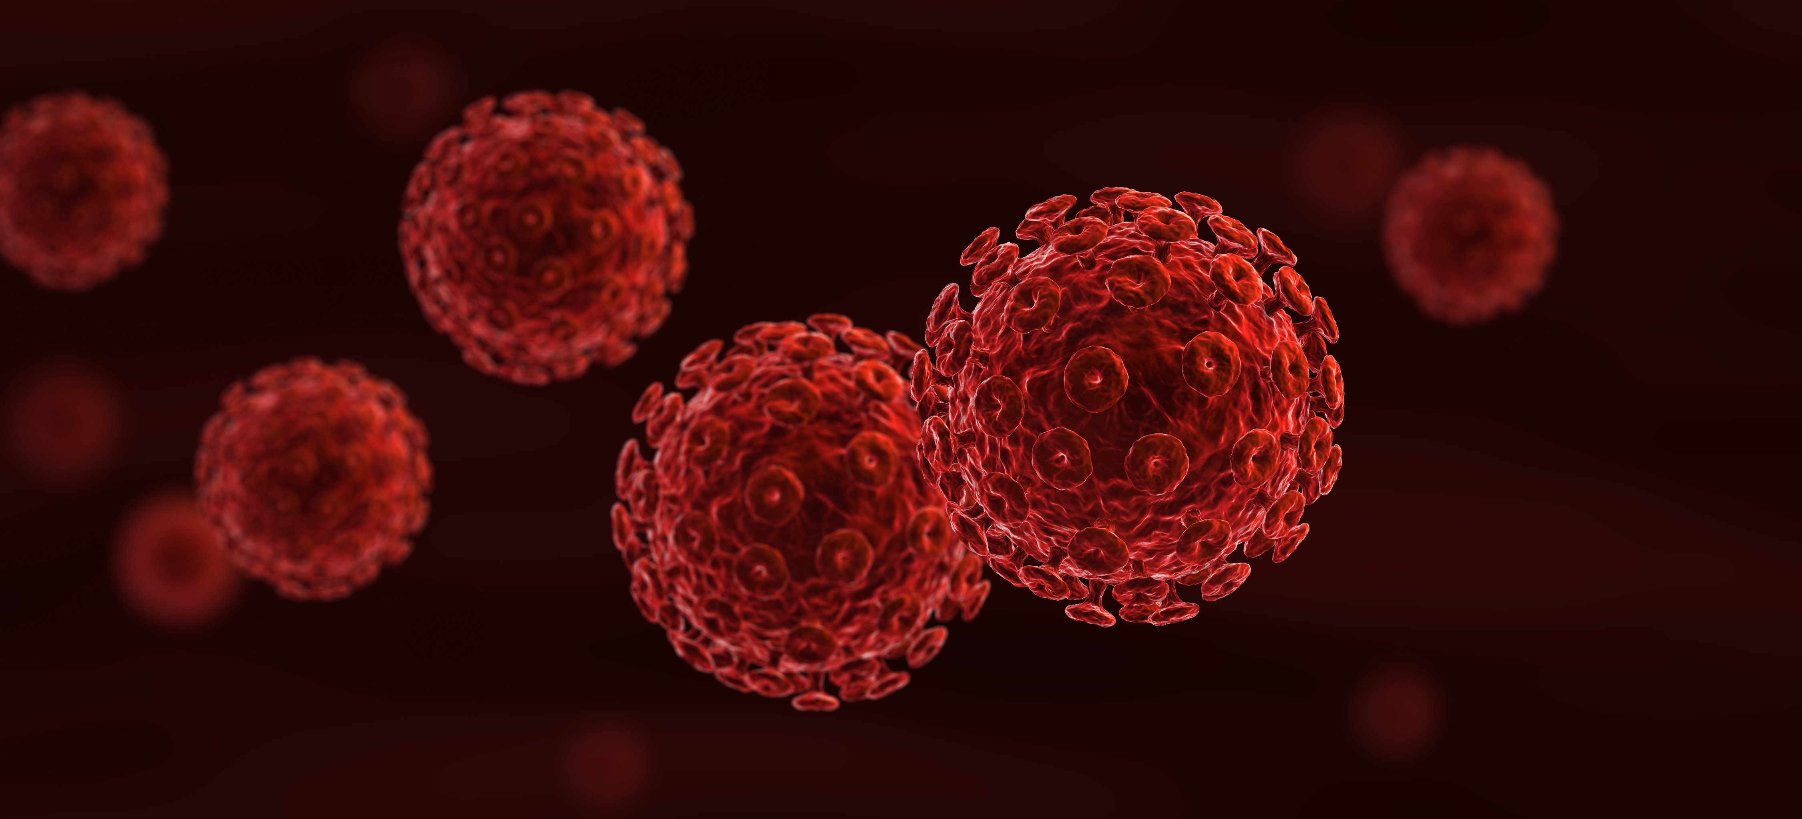
Chapter 6: Classification of Communicable Diseases

Slide 3
Summary
Communicable diseases are grouped into their main methods of transmission, enabling common control methods to be applied.
The commonest causative organism is the virus, with arboviruses responsible for 118 diseases which, with other organisms transmitted by mosquitoes, make this numerically the commonest cause of infection.
After vector control, hand washing and personal hygiene are the most important method in the prevention of communicable diseases.

Slide 4
Further reading
World Health Organization (2018) ICD-11, International Classification of Diseases for Mortality and Morbidity Statistics 11th Revision. WHO, Geneva, Switzerland. Available at: https://icd.who.int/en/ (accessed 13 June 2019).

