Slide 1
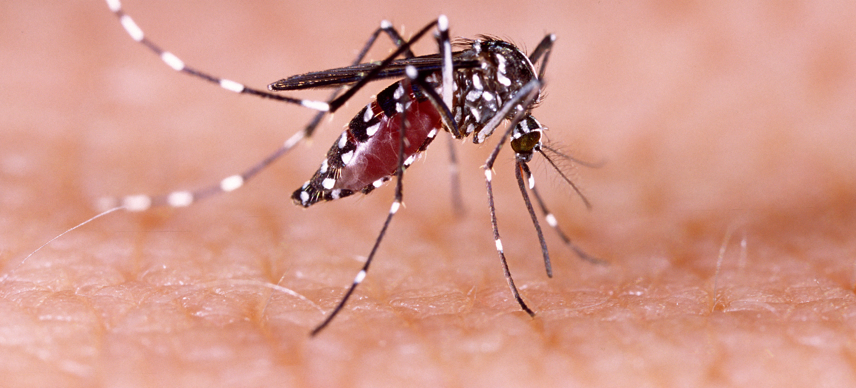
Communicable Diseases, 6th Edition
A Global Perspective
Roger Webber

Slide 2
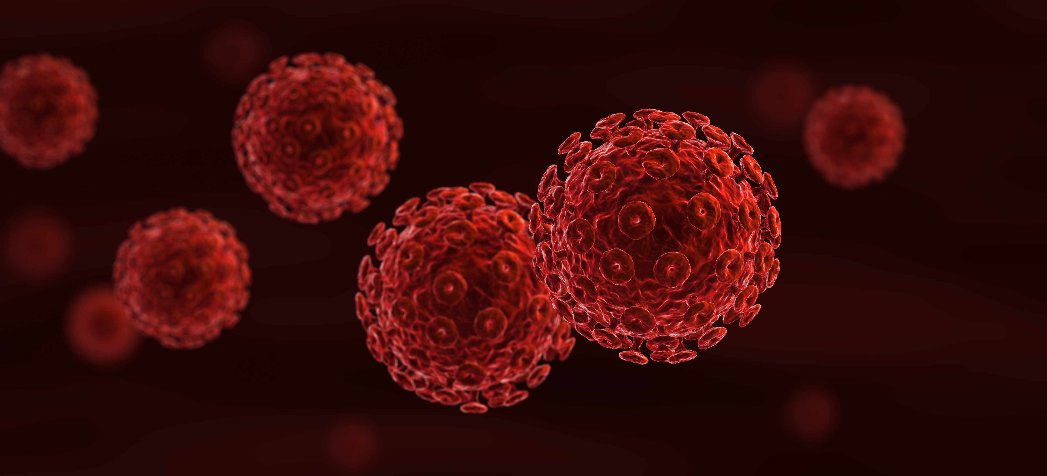
Chapter 5: Notification and Health Regulations

Slide 3
Summary
Any disease or event of international importance must be notified to WHO.
Countries will have their own or regional list of notifiable diseases and may need to set up special surveillance systems to detect cases.
Yellow fever is the only vaccination required for international travel.

Slide 4
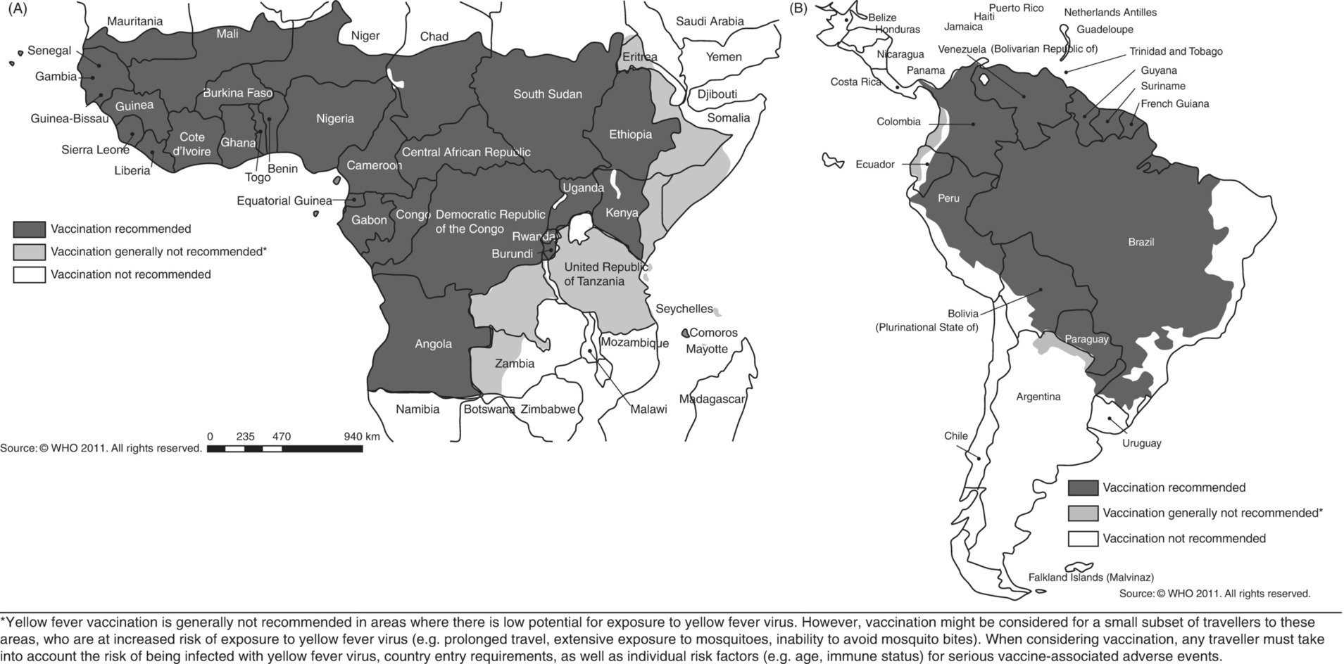
Fig. 5.1. Yellow fever vaccination recommendations in 2010 for Africa (A) and for the Americas (B).
(Reproduced by permission of the World Health Organization, Geneva.)

Slide 5
Further reading
World Health Organization (2005) International Health Regulations. WHO, Geneva, Switzerland.
World Health Organization (2019) International Travel and Health, Vaccination Requirements and Health Advice. WHO, Geneva, Switzerland.

Slide 6
Web resources
www.patient.co.uk/doctor/Notifiable-Diseases.htm (accessed 12 December 2015)
http://www.who.int/healthsystems/topics/health-law/chapter11.pdf (accessed 27 October 2018)

