Slide 1
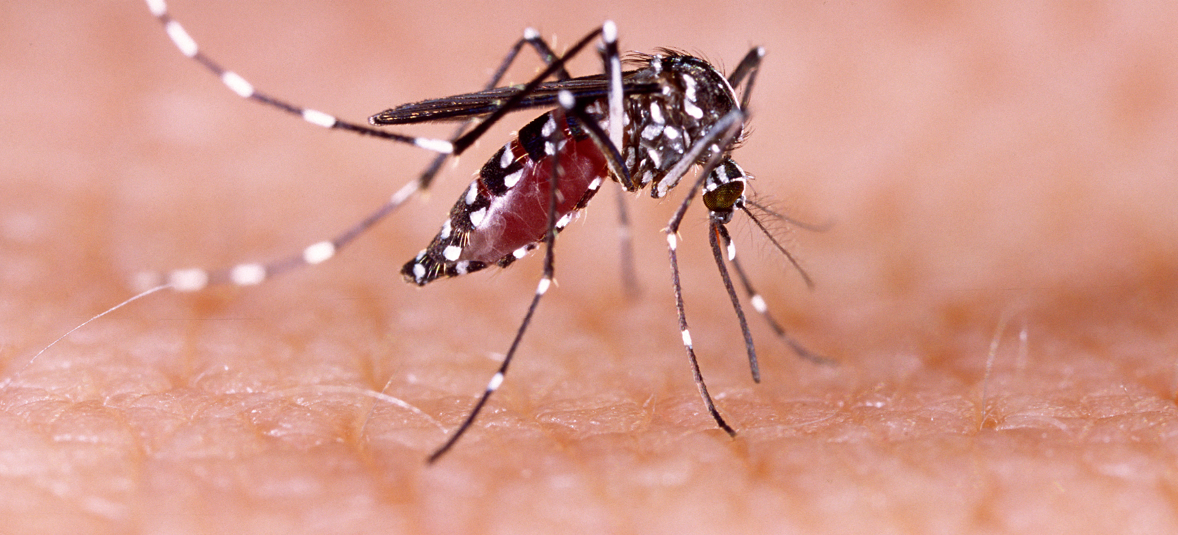
Communicable Diseases, 6th Edition
A Global Perspective
Roger Webber

Slide 2
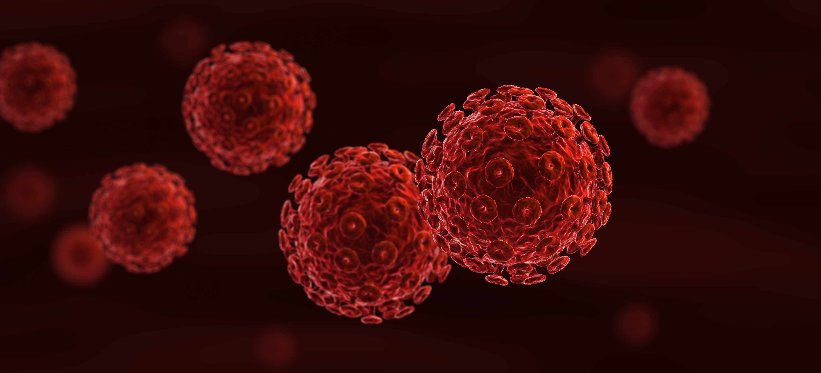
Chapter 4: Control Strategy and Organization

Slide 3
Summary
In the investigation of an epidemic, the cause needs to be identified, investigated, notified and the extent determined, while cases will need to be treated and transmission interrupted. The epidemic must be reported and a surveillance system developed to prevent the epidemic from starting again.
Disease control should be integrated with the general health services but in special circumstances an eradication or elimination programme can be set up.
Social factors such as the stigma of disease, alternative treatment by traditional healers and resistance to health interventions have to be sensitively approached with health promotion.
Self-help schemes are good methods of involving the community in their own health care.
Social marketing, using posters and advertising is an effective method of promoting disease control.

Slide 4
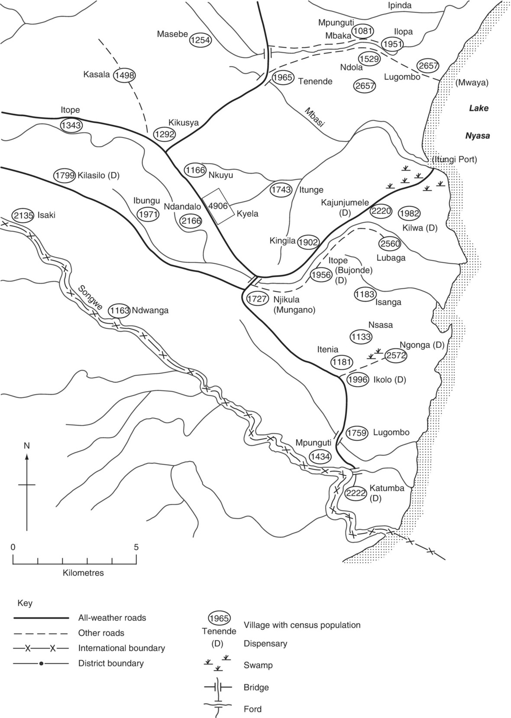
Fig. 4.1. Part of a village location map prepared for the investigation of a cholera outbreak in Tanzania.

Slide 5
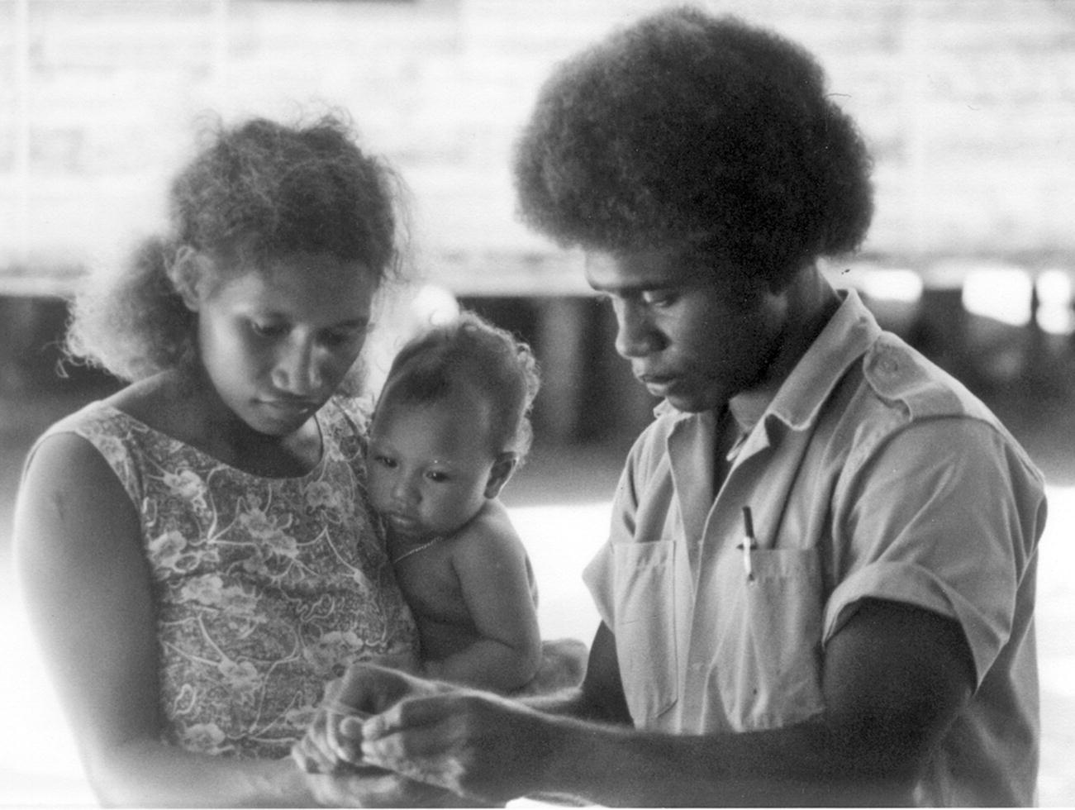
Fig. 4.2. An active case detection (ACD) technician taking a blood slide from a woman suffering from fever in a malaria eradication programme (Santa Isabel, Solomon Islands).

Slide 6
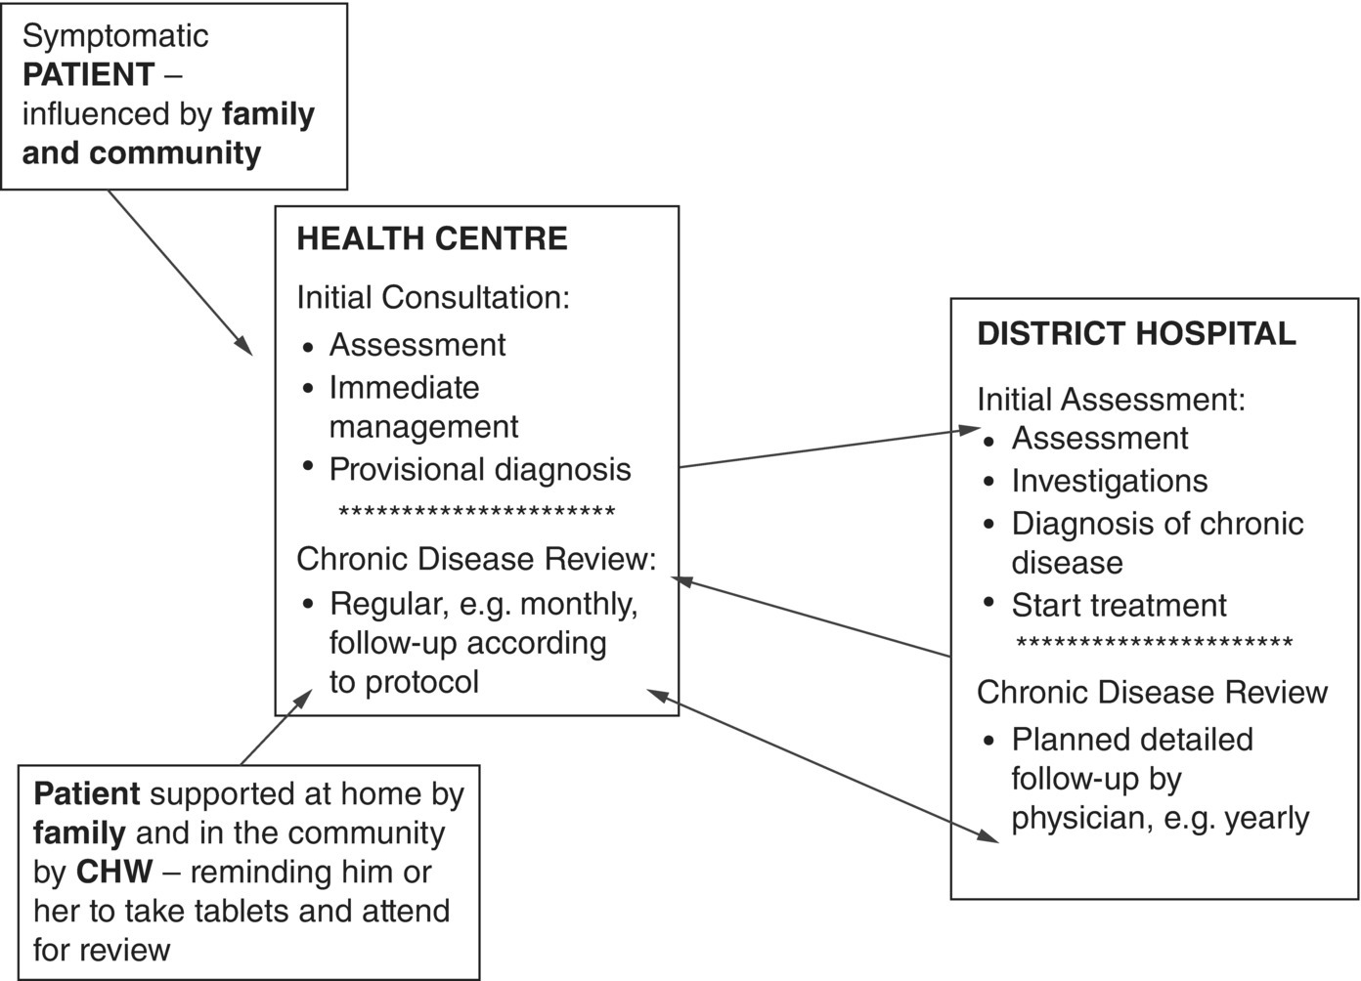
Fig. 4.3. The integrated care of patients with chronic disease within a district health service. CHW, community health worker.
(Reproduced by permission of the World Health Organization, Geneva.)

Slide 7
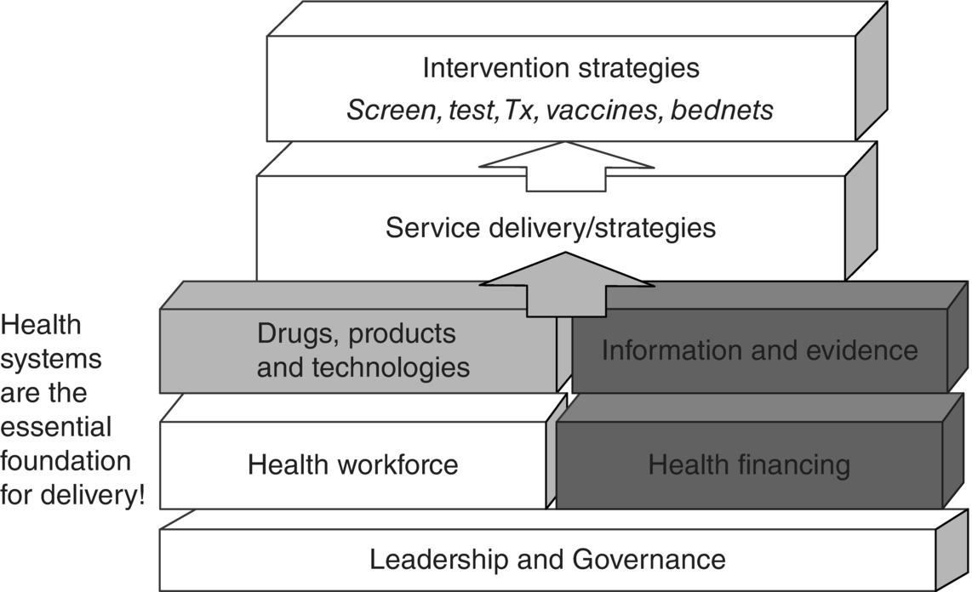
Fig. 4.4. The WHO health system building blocks.
(Reproduced by permission of the World Health Organization, Geneva.)

Slide 8
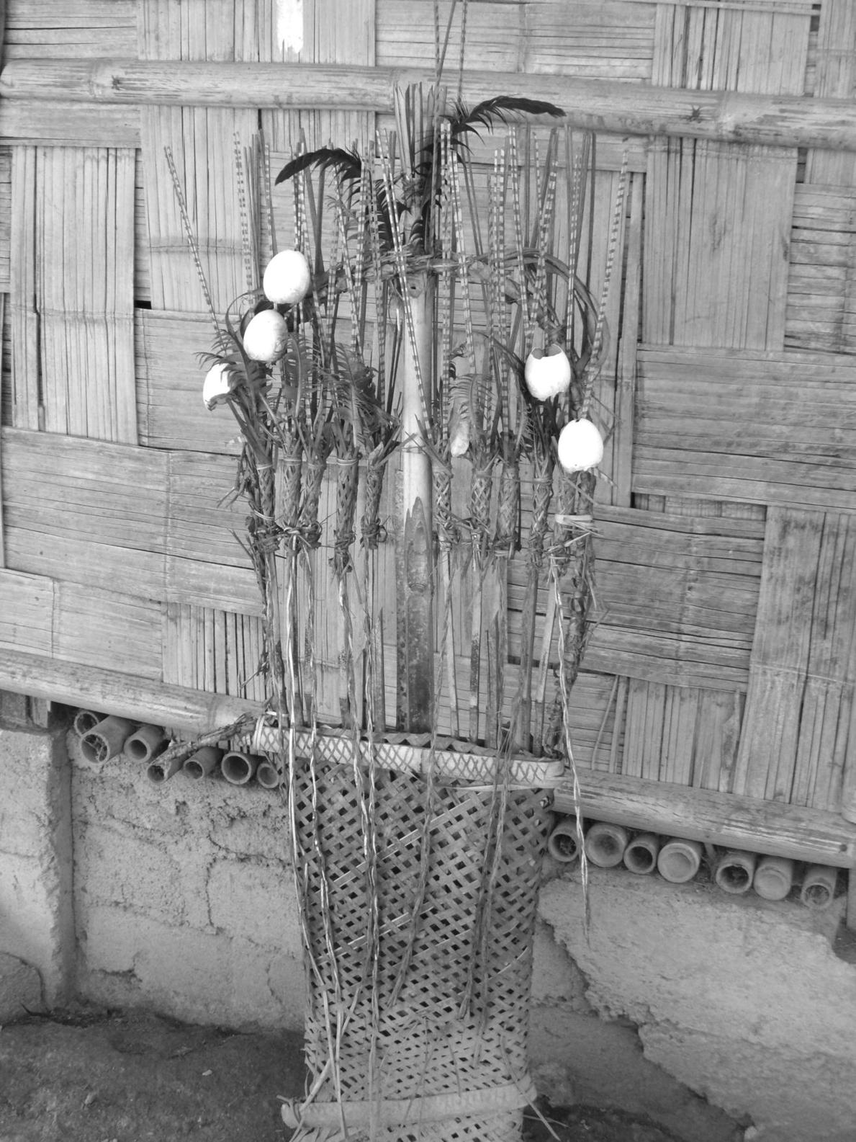
Fig. 4.5. A request for divine help for a sick person is placed outside a house in Nagaland, north-east India.

Slide 9
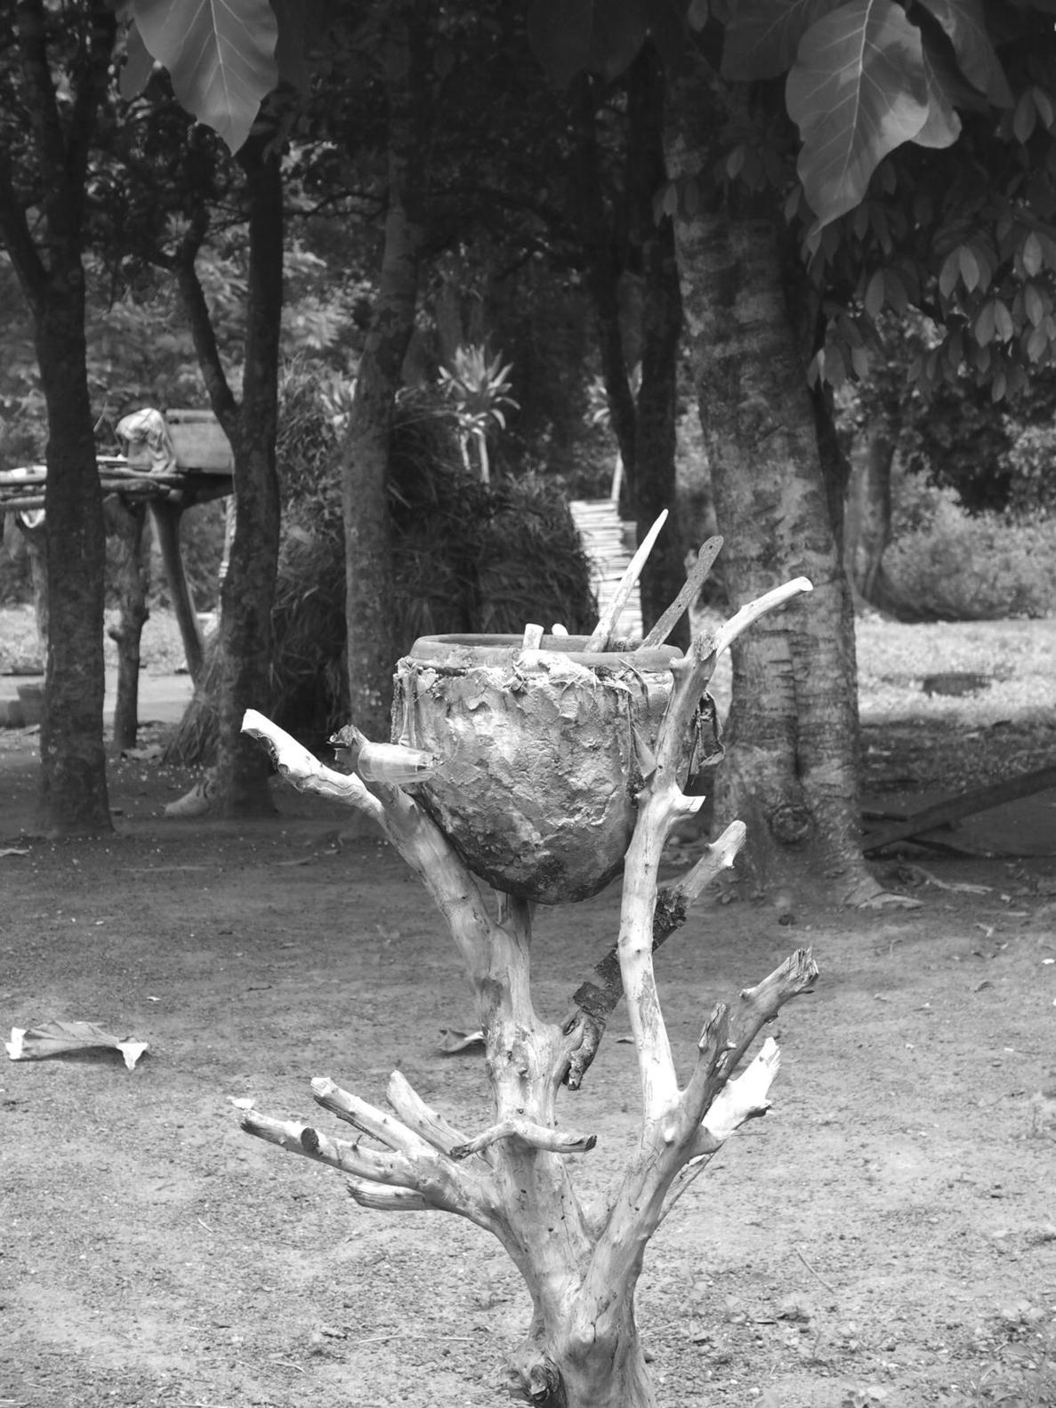
Fig. 4.6. A bowl used for mixing concoctions in voodoo ceremonies to exorcise evil spirits causing illness, with a sacred grove of trees behind, in Togo, West Africa.

Slide 10
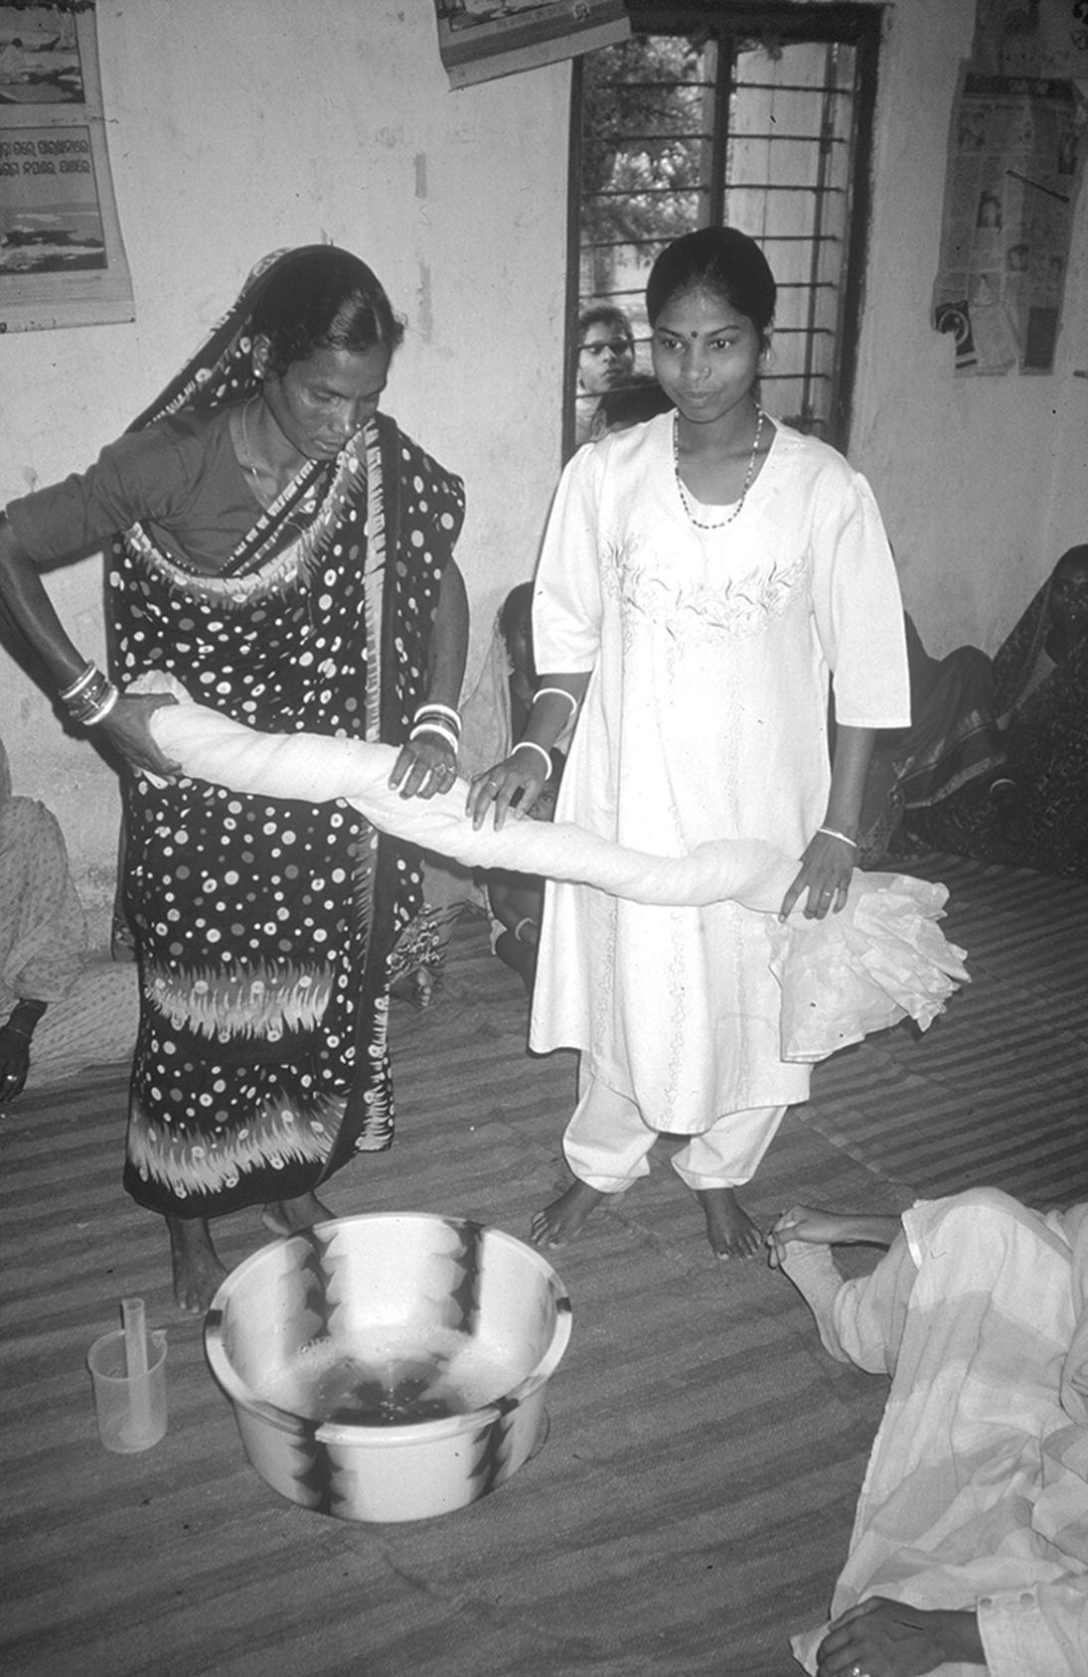
Fig. 4.7. Treatment of a mosquito net in a subsidized scheme in Orissa, India; aid worker on the right. Women’s groups managed a revolving fund for the manufacture, sale and treatment of the nets.

Slide 11
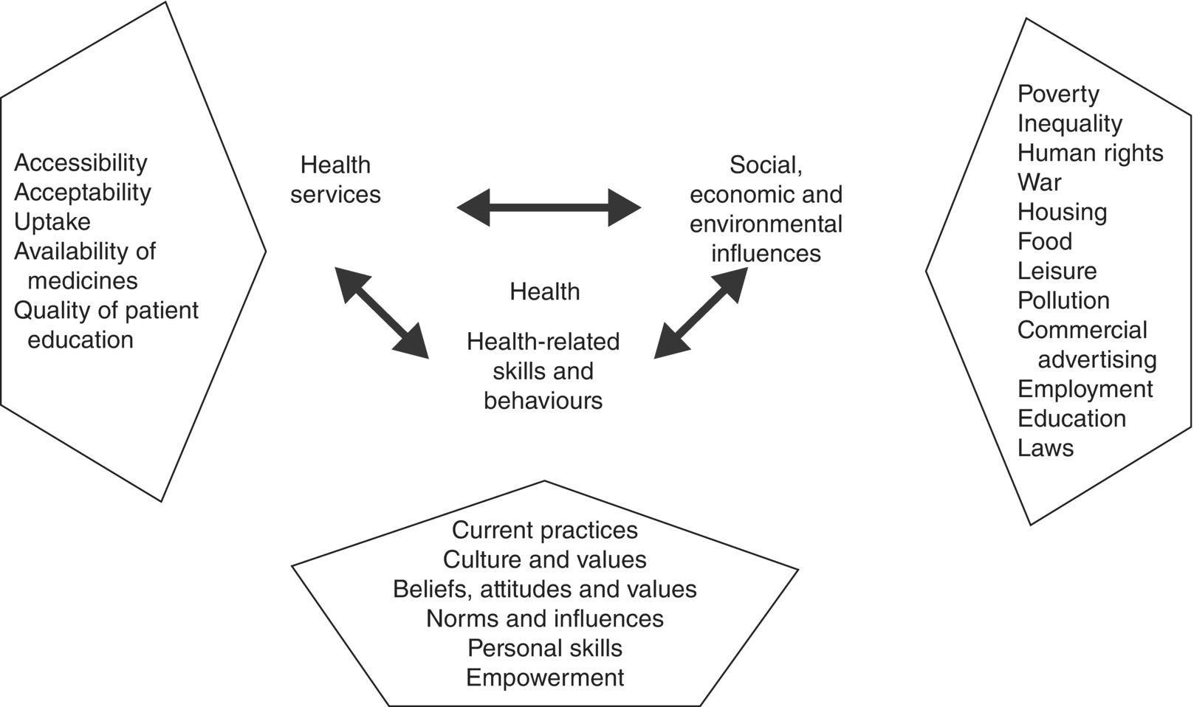
Fig. 4.8. Information required from situation assessment to determine the role of health promotion.
(Reproduced by permission of the World Health Organization, Geneva.)

Slide 12
Further reading
Abramson, J.H. and Abramson, Z.H. (2008) Research Methods in Community Public Health: Surveys, Epidemiological Research, Programme Evaluation, Clinical Trials, 6th edn. John Wiley and Sons, Chichester, UK.
Connolly, M.A. (2006) Communicable Disease Control in Emergencies: A Field Manual. World Health Organization, Geneva, Switzerland.
Green, A. (2007) Introduction to Health Planning for Developing Health Systems. Oxford University Press, Oxford, UK.
Heymann, D.L. (2014) Control of Communicable Diseases Manual, 20th edn. American Public Health Association, Washington, DC.
Lerberghe, W. and Lafort, Y. (1990) The Role of the Hospital in the District: Delivering or Supporting Primary Health Care. WHO/SIIS/CC/90.2. World Health Organization, Geneva, Switzerland.
Lucas, A.O. and Gilles, H.M. (2002) Short Textbook of Public Health Medicine for the Tropics. Hodder Arnold, London.
Noah, N.D. (2006) Controlling Communicable Disease. Open University Press, Milton Keynes, UK.
Sellwood, C. and Wapling, A. (eds) (2016) Health Emergency Preparedness and Response. CAB International, Wallingford, UK.
Smith, P.G., Morrow, R.H. and Ross, D.A. (2015) Field Trials of Health Interventions: A Toolbox, 3rd edn. Oxford University Press, Oxford, UK.
Vaughan, J.P. and Morrow, R.H. (2011) Manual of Epidemiology for District Health Management, 2nd edn. World Health Organization, Geneva, Switzerland.
Walley, J. and Wright, J. (2010) Public Health: An Action Guide to Improving Health, 2nd edn. Oxford University Press, Oxford, UK. (New edition in preparation.)
Walley, J., Wright, J. and Hubley, J. (2009) Public Health, 2nd edn. Oxford University Press, Oxford, UK.
World Health Organization (2008) A Systematic Review of The Effectiveness of Shortening Integrated Management of Childhood Illness Guidelines Training: Final Report. WHO, Geneva, Switzerland.
World Health Organization (2017) 2030 Agenda for Sustainable Development. Bulletin of the World Health Organization 95, 537–539. Available at: http://dx.doi.org/10.2471/BLT.16.187476 (accessed 13 June 2019).
World Health Organization/UNICEF (2008) Integrated Management of Childhood Illness for High HIV Settings, Chart Booklet. WHO, Geneva, Switzerland.
Wright, J. (1998) Health Needs Assessment in Practice. BMJ Books, London.

Slide 13
Web resources
https://www.cdc.gov/publichealth101/surveillance.html (accessed 18 March 2019)

