Slide 1
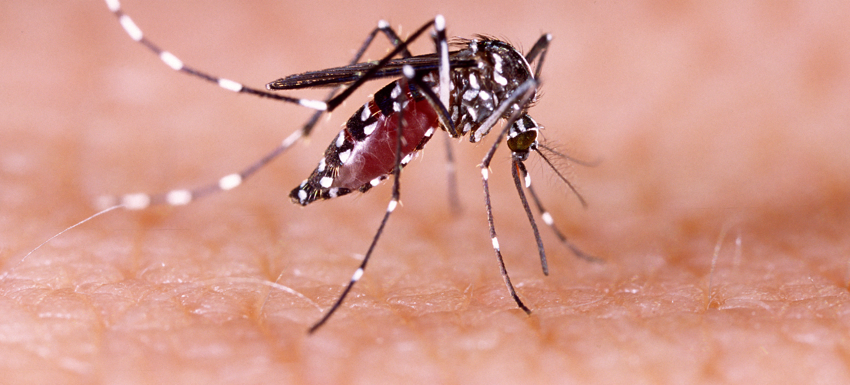
Communicable Diseases, 6th Edition
A Global Perspective
Roger Webber

Slide 2
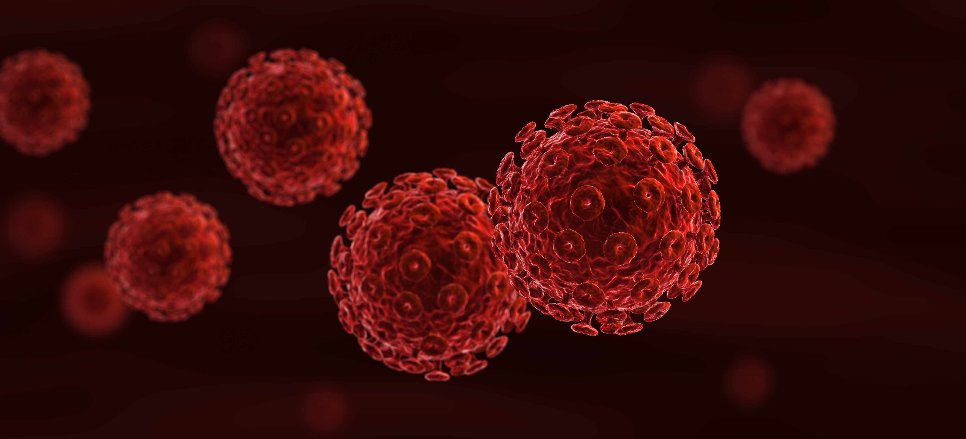
Chapter 3: Control Principles and Methods

Slide 3
Summary
Control methods can be against the agent, the means of transmission, by treating or protecting the host, or through modification of the environment.
Vaccination stimulates the person to produce antibodies and is used against an increasing number of infections.
Environmental control methods are personal hygiene, protection and preparation of food, protection of water supplies and proper methods of sanitation.
Vector control is by personal protection, through the use of insecticides sprayed on surfaces, used as space sprays or larvicides or impregnated into netting, and by biological control or environmental modification.
Mass drug administration can be used where none of the other methods are applicable and there is a safe and effective medicine.

Slide 4
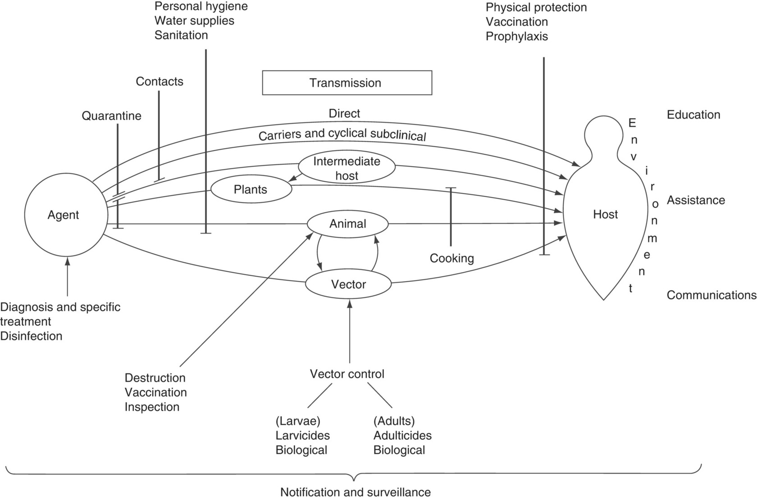
Fig. 3.1. Control principles.

Slide 5
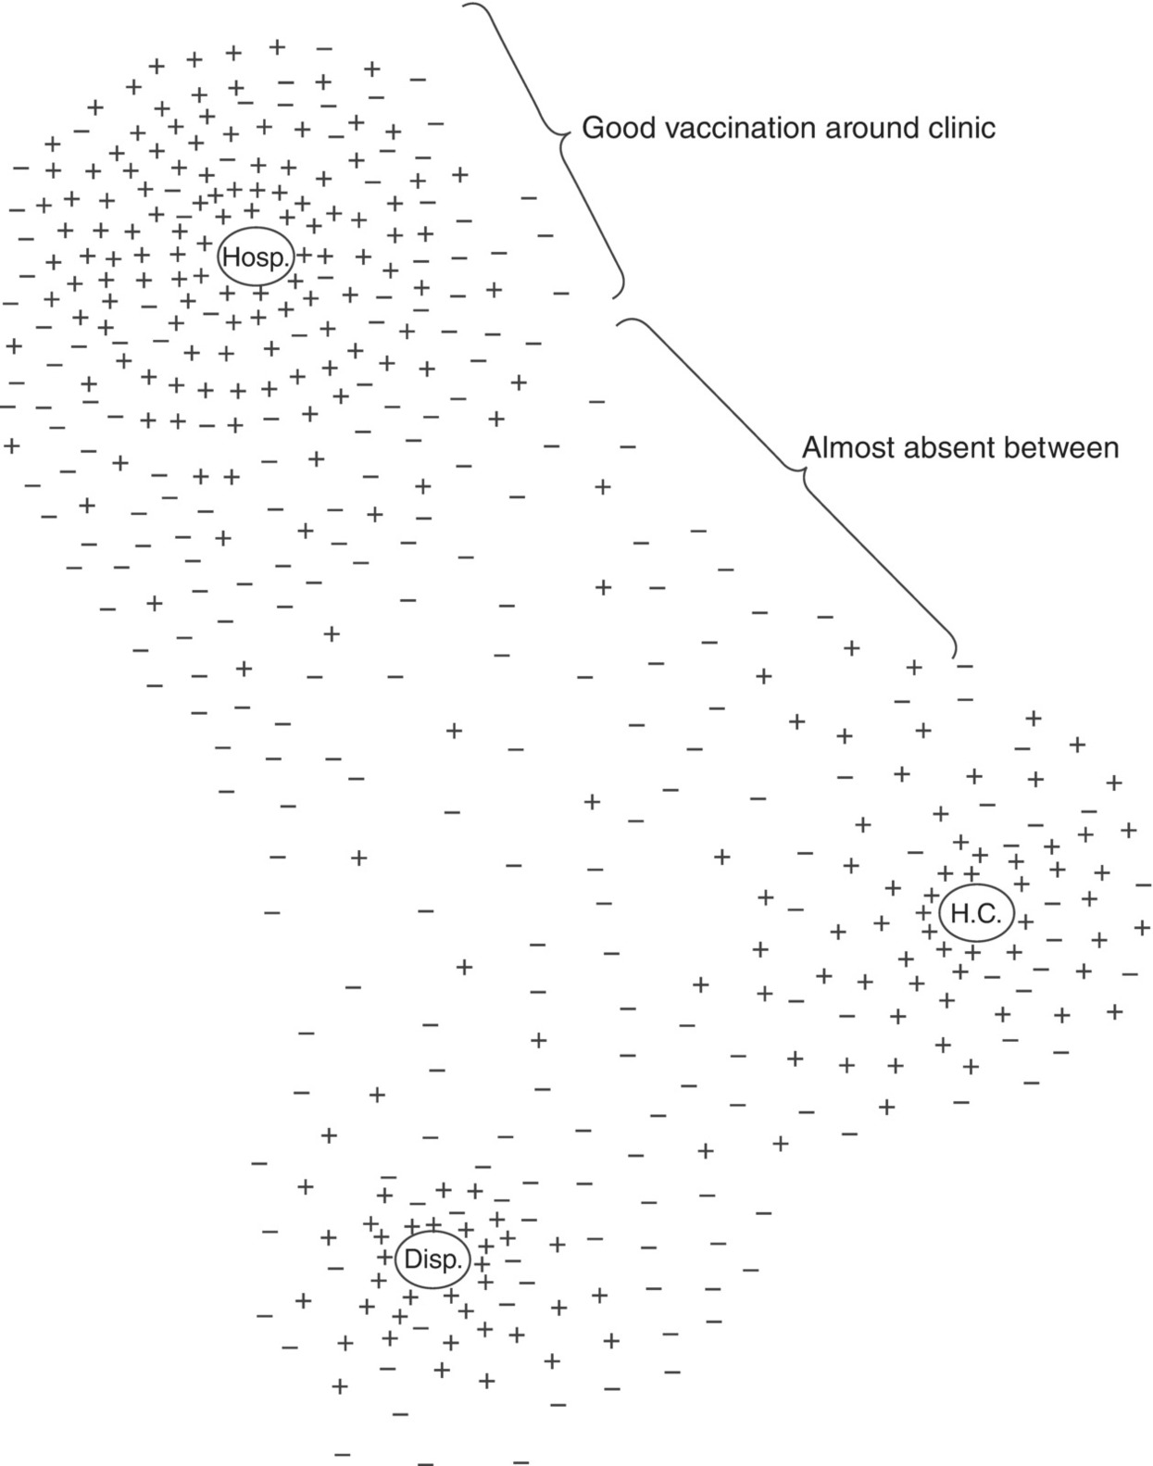
Fig. 3.2. Unequal vaccination coverage from static clinics. +, Vaccinated child; −, non-vaccinated child; Hosp., hospital; H.C., health centre; Disp., dispensary.

Slide 6
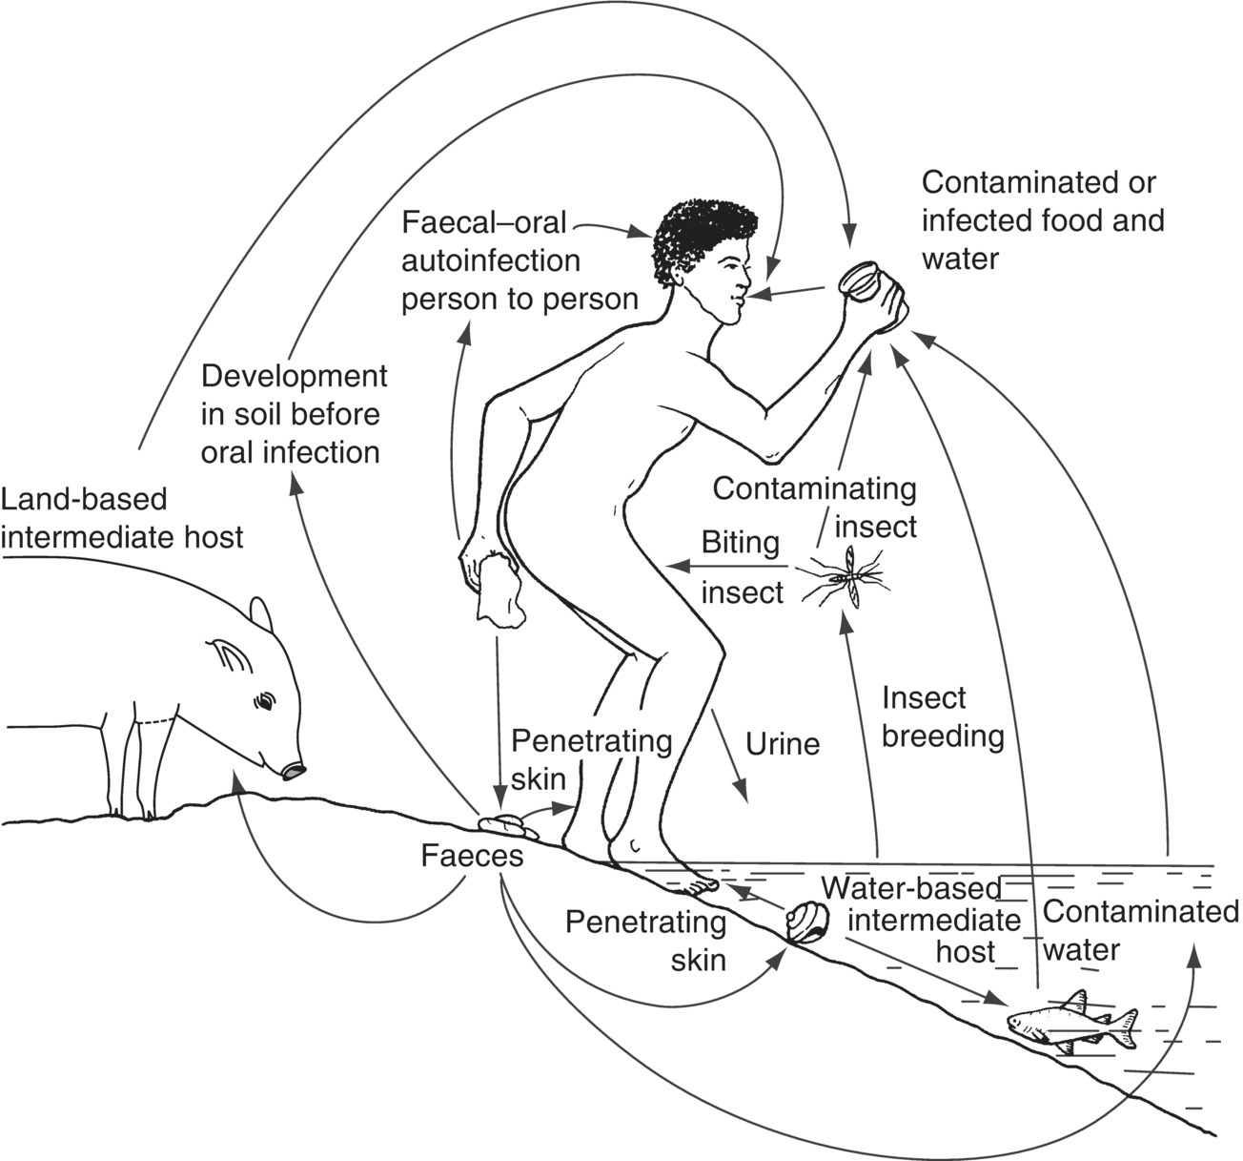
Fig. 3.3. Routes of transmission of the water- and sanitation-related diseases.

Slide 7
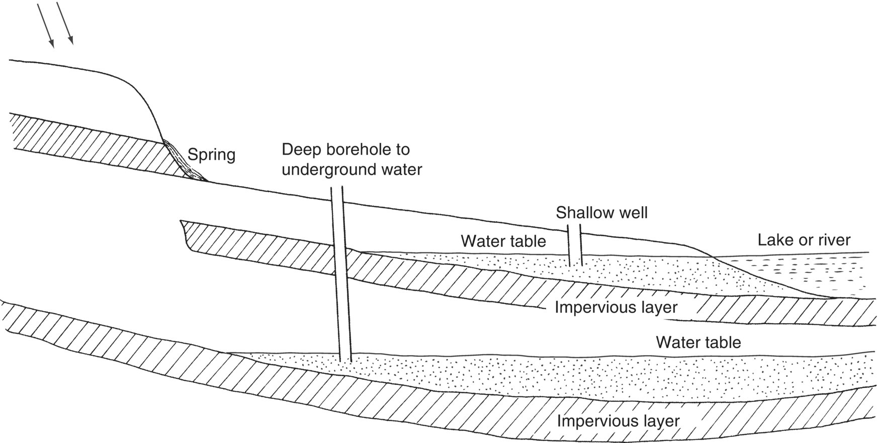
Fig. 3.4. Sources of water.

Slide 8
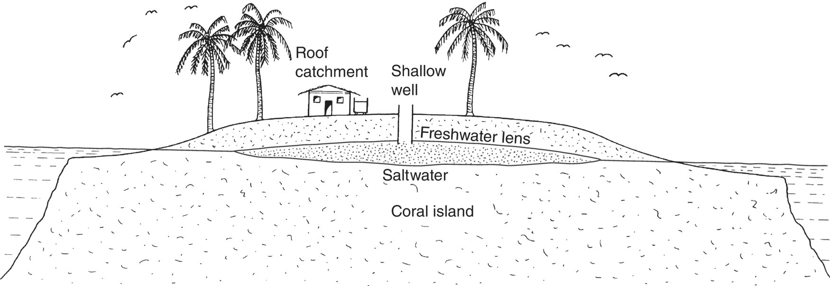
Fig. 3.5. Water catchment and the freshwater lens of coral islands.

Slide 9
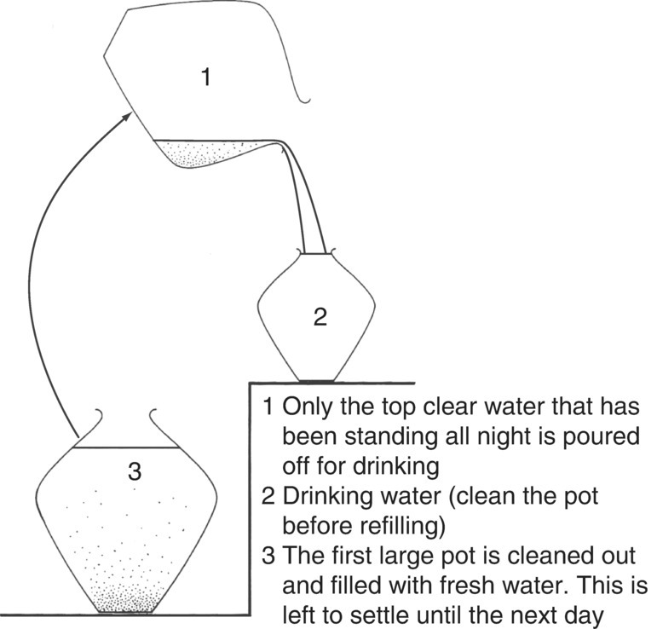
Fig. 3.6. The three-pot system – a simple means of improving water quality.

Slide 10
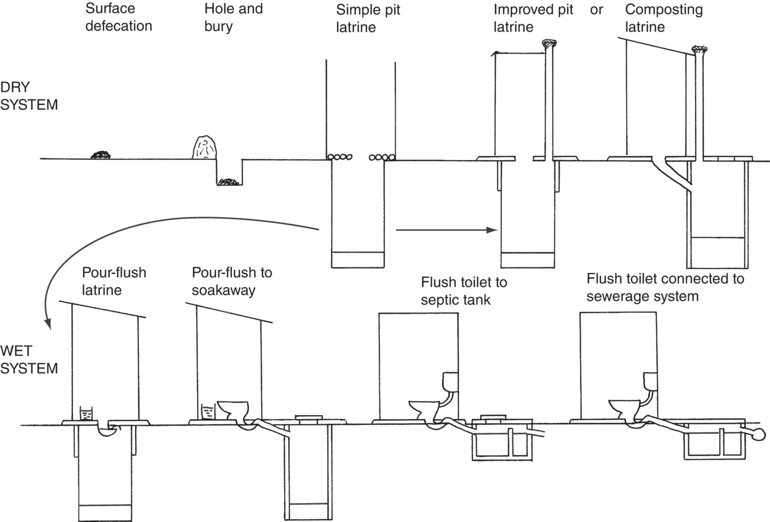
Fig. 3.7. Types of excreta disposal systems – incremental sanitation.

Slide 11
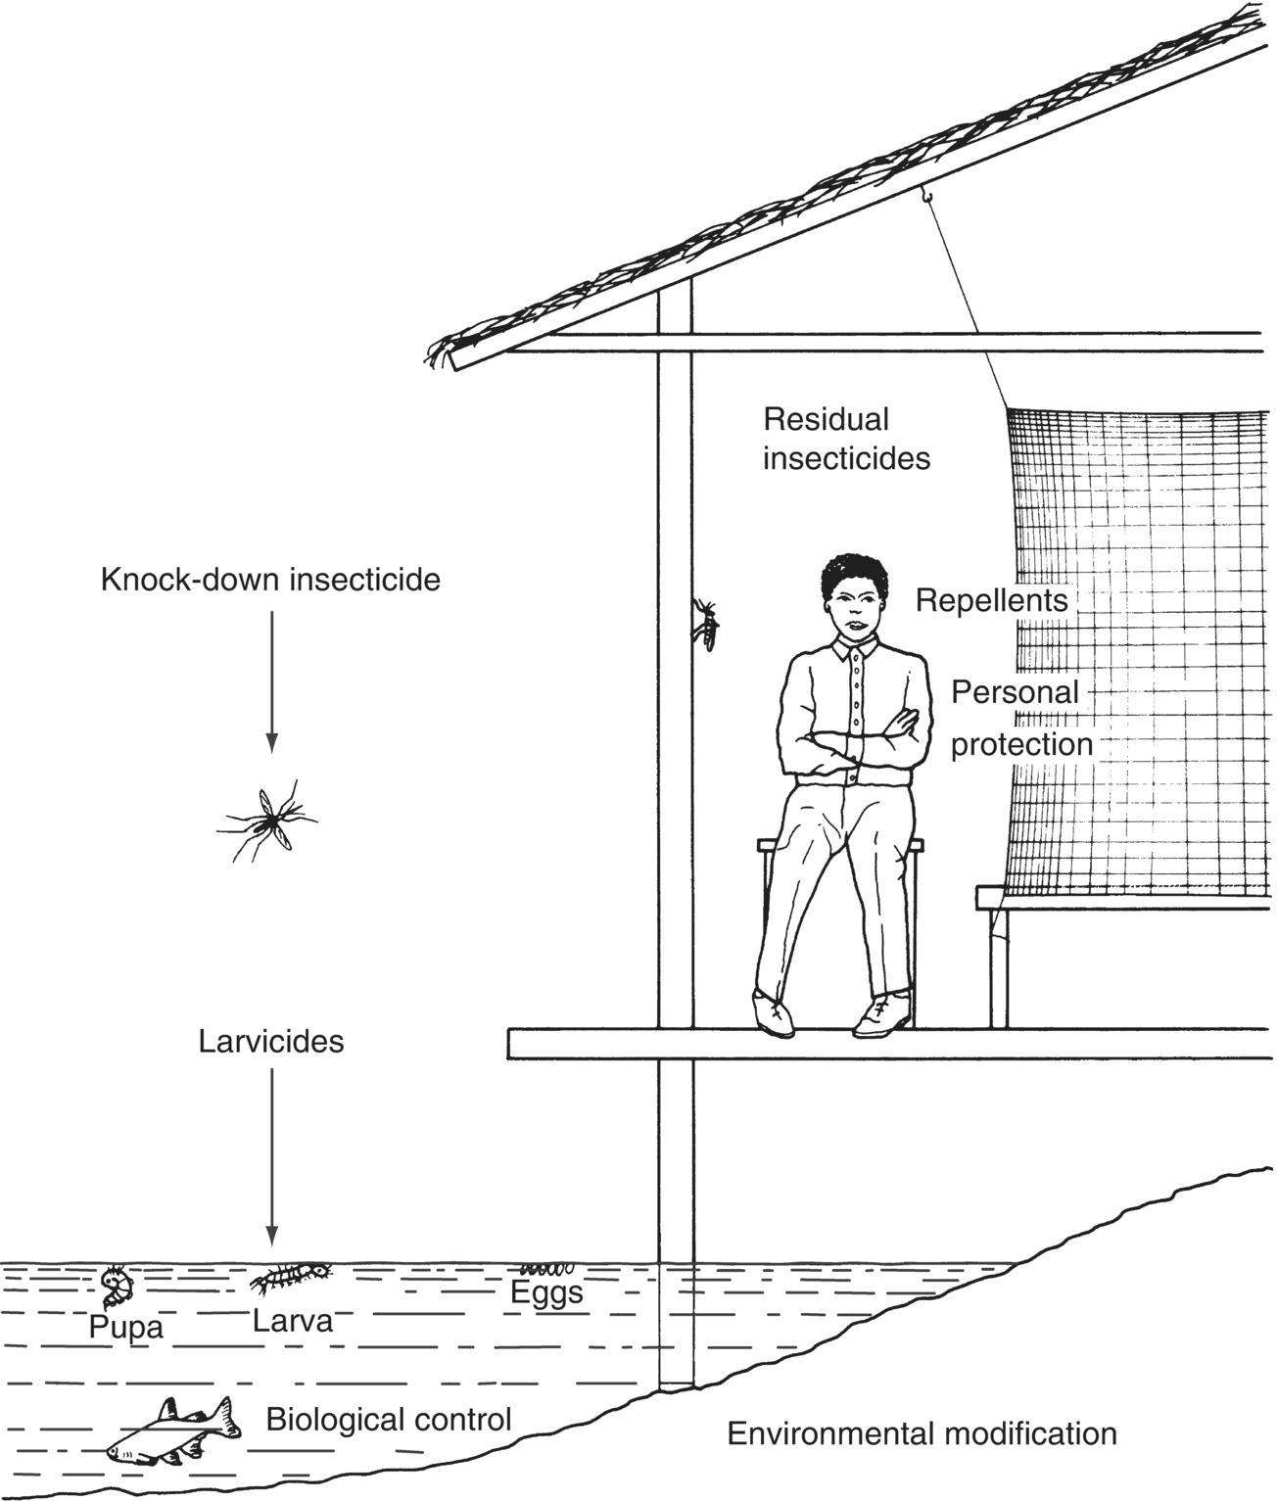
Fig. 3.8. Mosquito control methods.

Slide 12
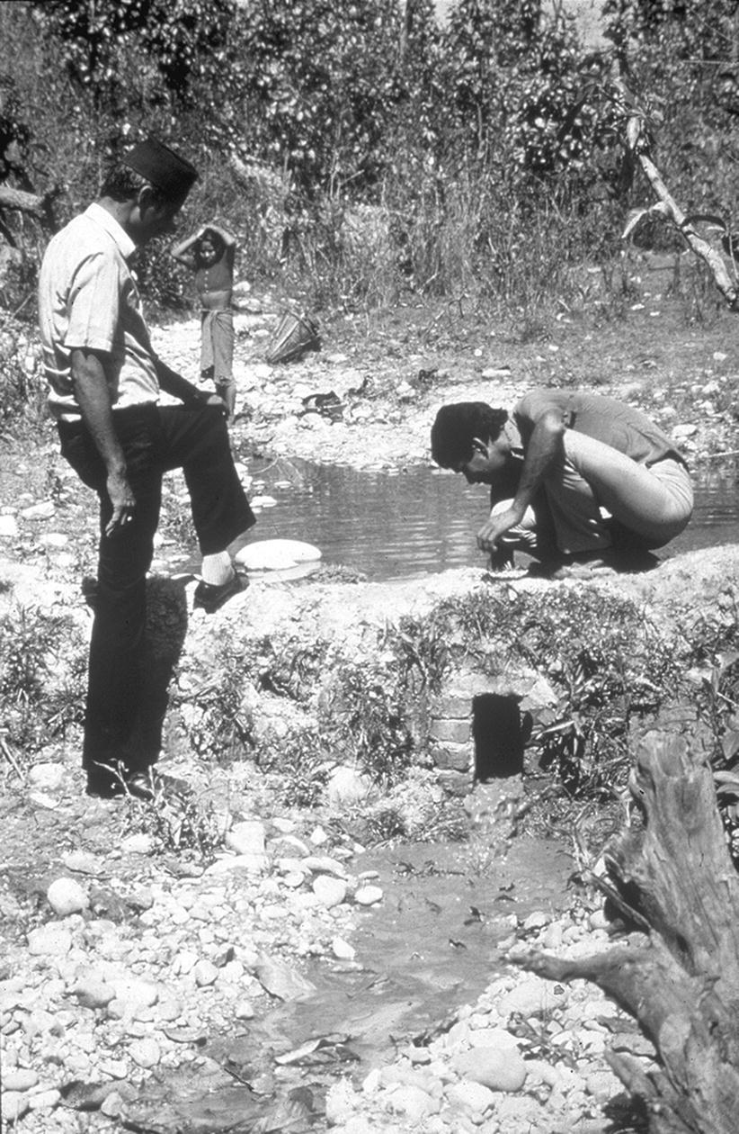
Fig. 3.9. A locally constructed dam for the control of Anopheles fluviatilis in Nepal. Every 3 days, the bung is removed and the head of water rushing down the stream is sufficient to dislodge mosquito larvae.

Slide 13
Further reading
Cairncross, S. and Feachem, R. (2015) Environmental Health Engineering in the Tropics: An Introductory Text. John Wiley, Chichester, UK.
Cameron, M. and Lorenz, L. (eds) (2013) Biological and Environmental Control of Disease Vectors. CAB International, Wallingford, UK.
Feachem, R.G., McGarry, M.A. and Mara, D. (1978) Water, Wastes and Health in Hot Climates. John Wiley, Chichester, UK (out of print).
Feachem, R.G., Bradley, D.J., Garelick, H. and Mara, D.D. (1983) Sanitation and Disease: Health Aspects of Excreta and Wastewater Management. World Bank Studies in Water Supply and Sanitation 3. John Wiley, Chichester, UK (out of print).
Heymann, D.L. (2014) Control of Communicable Diseases Manual, 20th edn. American Public Health Association, Washington, DC.
Smith, P.G., Morrow, R.H. and Ross, D.A. (2015) Field Trials of Health Interventions: A Toolbox, 3rd edn. Oxford University Press, Oxford.
World Health Organization (2006) Pesticides and Their Application, 6th edn. Document No. WHO/CDS/NTD/WHOPES/GCDPP/2006.1. WHO, Geneva, Switzerland.
World Health Organization (2007) Long-lasting Insecticidal Nets for Malaria Prevention, 3rd edn. WHO, Geneva, Switzerland.
World Health Organization (2014) WHO recommended insecticide products for treatment of mosquito nets for malaria vector control. WHO, Geneva, Switzerland.
World Health Organization (2015) Recommended Routine Immunization. WHO, Geneva, Switzerland.

Slide 14
Web resources
www.nhs.uk/conditions/vaccinations/Pages/vaccination-schedule-age-checklist.aspx (The NHS vaccination schedule; accessed 11 December 2018).
www.who.int/immunization/documents/positionpapers/ (Vaccine position papers from WHO; accessed 11 December 2018).

