Slide 1
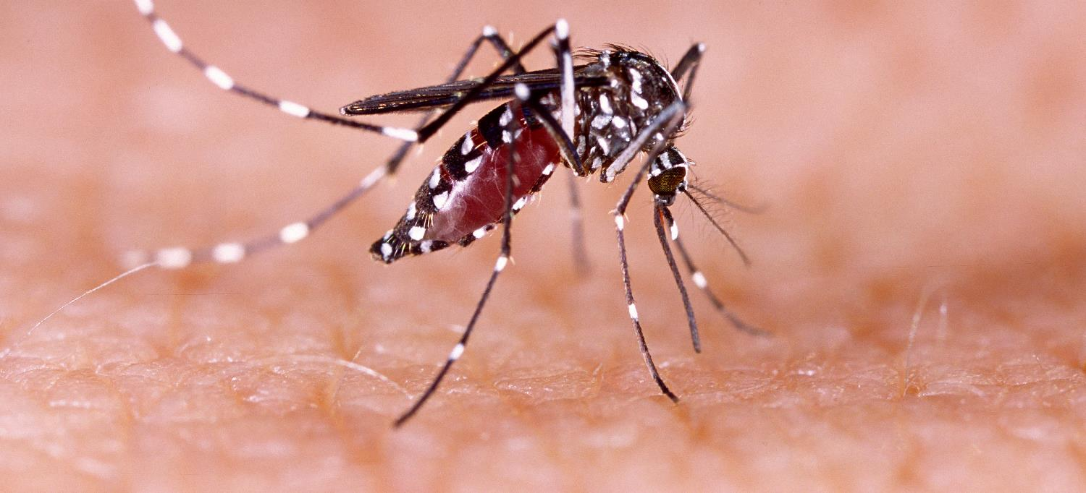
Communicable Diseases, 6th Edition
A Global Perspective
Roger Webber

Slide 2

Chapter 2: Communicable Disease Theory

Slide 3
Summary
A disease can either be epidemic or endemic.
Epidemic diseases can be common source or propagated, but by measuring the minimum and maximum incubation period from the first case, the time of infection can be determined.
The size of the population will determine the frequency of epidemics and the number that need to be vaccinated to produce herd immunity.
An endemic disease is described by its incidence and prevalence, but foci of infection can also occur.
Mathematical models can look at different parameters of a disease and deter-mine the best strategy for control.

Slide 4
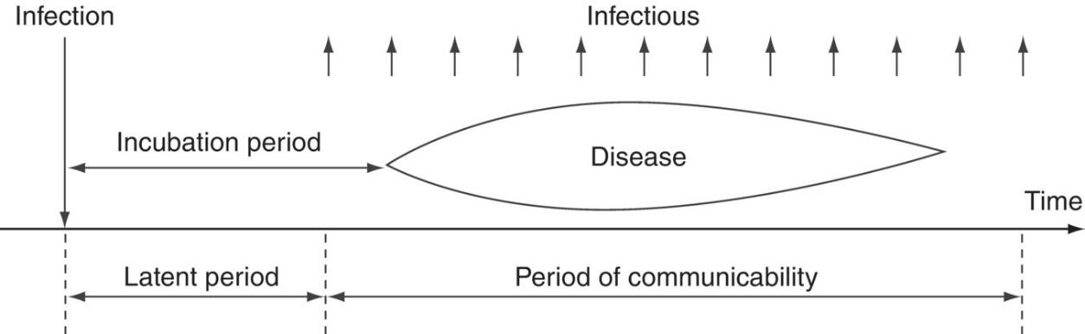
Fig. 2.1. Parameters of an infection

Slide 5
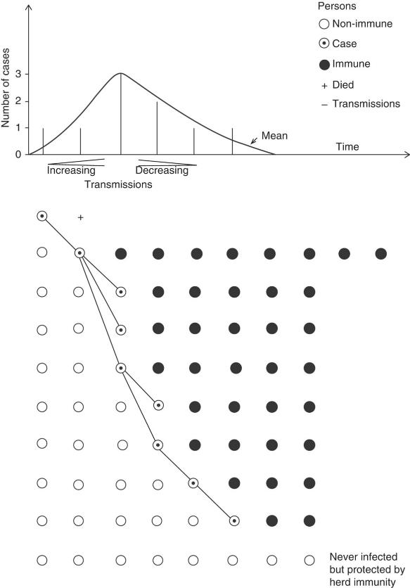
Fig. 2.2. The epidemic curve of an extended source epidemic in a limited population (simplified).

Slide 6
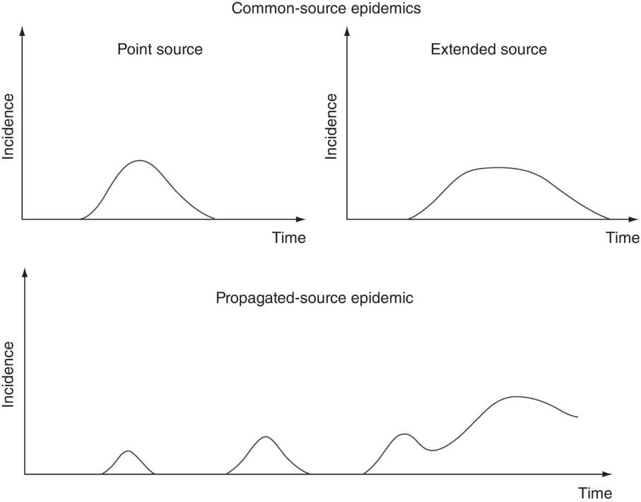
Fig. 2.3. Epidemic types

Slide 7
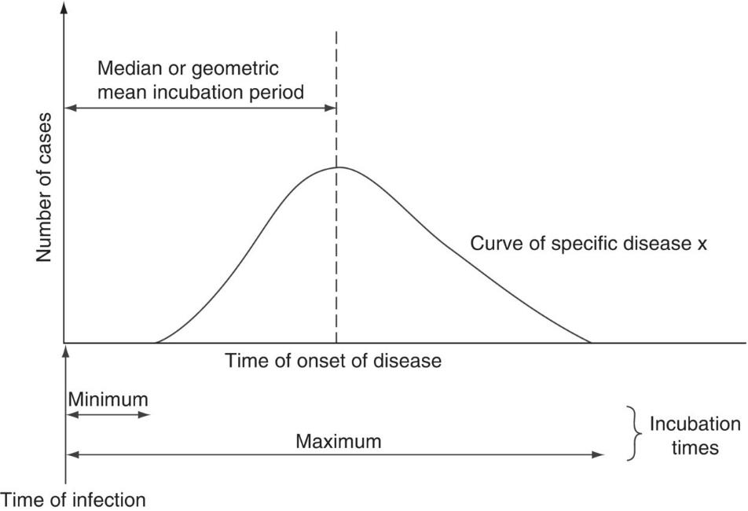
Fig. 2.4. Investigation of a point-source epidemic.

Slide 8
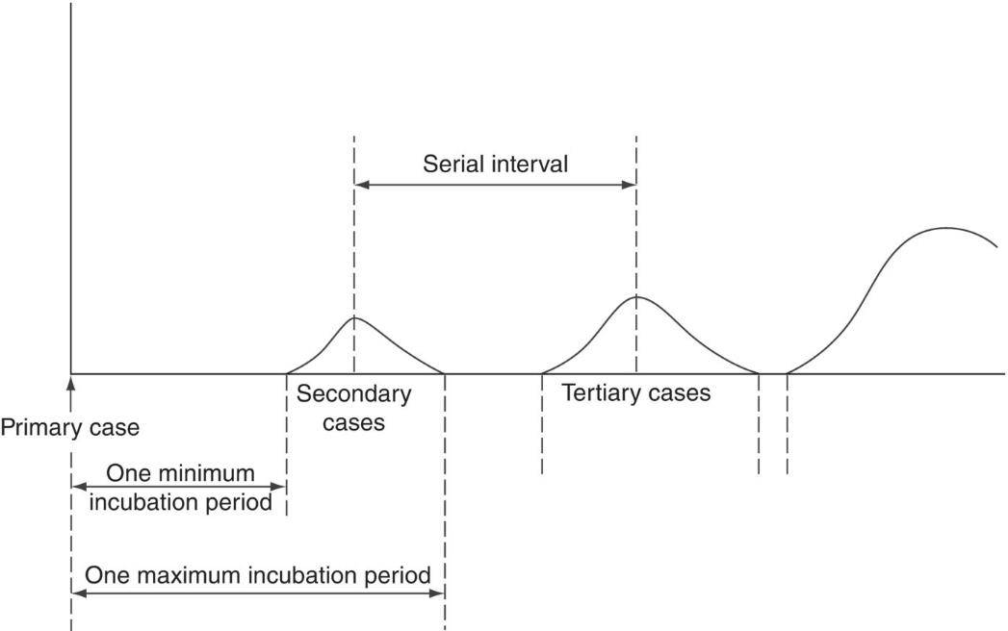
Fig. 2.5. Investigation of a propagated-source epidemic.

Slide 9
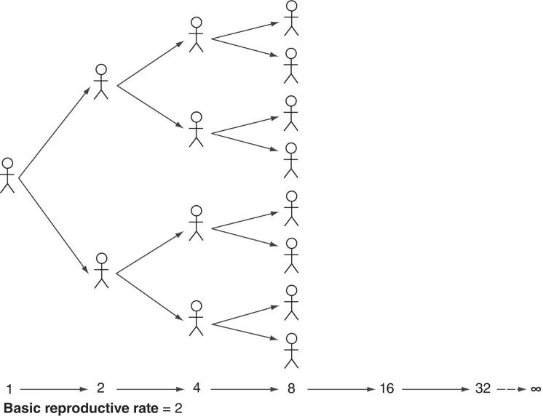
Fig. 2.6. Basic reproductive rate increasing, i.e. >1. Maximal transmission: every infection produces a new case.

Slide 10
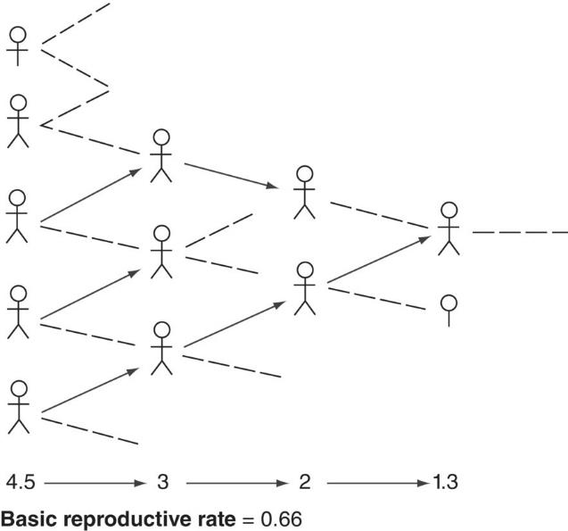
Fig. 2.7. Basic reproductive rate decreasing, i.e. <1. Unsustained transmission: each transmission gives rise to less than one new case and the infection dies out.

Slide 11
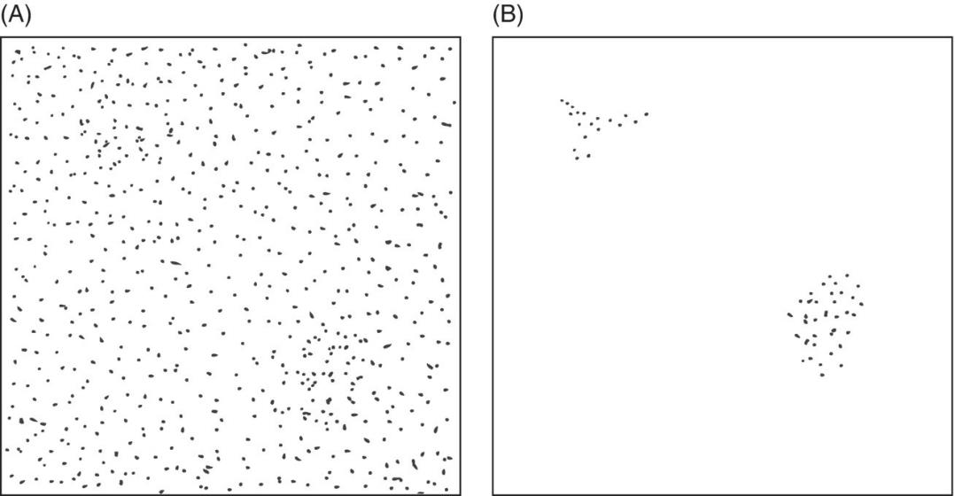
Fig. 2.8. The focality of endemic disease. (A) A universally homogeneous prevalence rate is measured in an area. (B) Once control measures have been implemented, foci of persistent transmission are revealed.

Slide 12
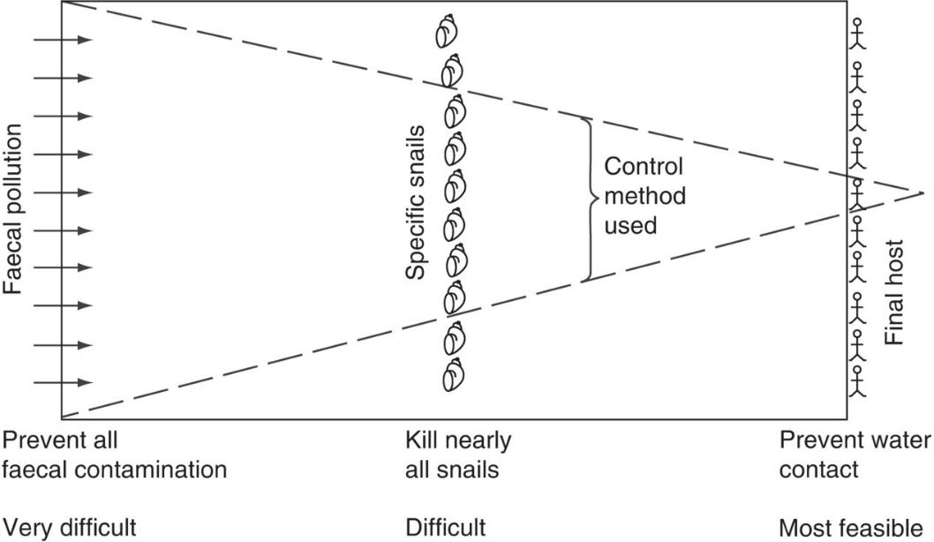
Fig. 2.9. Theoretical environmental control of schistosomiasis.

Slide 13
Further reading
Barker, D.J.P. and Cooper, C. (1998) Epidemiology in Medical Practice, 5th edn. Churchill Livingstone, London.
Bonita, R. and Beaglehole, R. (2006) Basic Epidemiology, 2nd edn. World Health Organization, Geneva, Switzerland.
Giesecke, J. (2016) Modern Infectious Disease Epidemiology, 3rd edn. Hodder Arnold, London.
Kirkwood, B.R. (2016) Essential Medical Statistics, 3rd edn. Blackwell Scientific Publications, Oxford, UK.
Porta, M. (2014) A Dictionary of Epidemiology, 6th edn. Oxford University Press, New York.
Schneider, D. and Lilienfield, D.E. (2015) Lilienfield’s Foundations of Epidemiology. Oxford University Press, New York.

