Slide 1
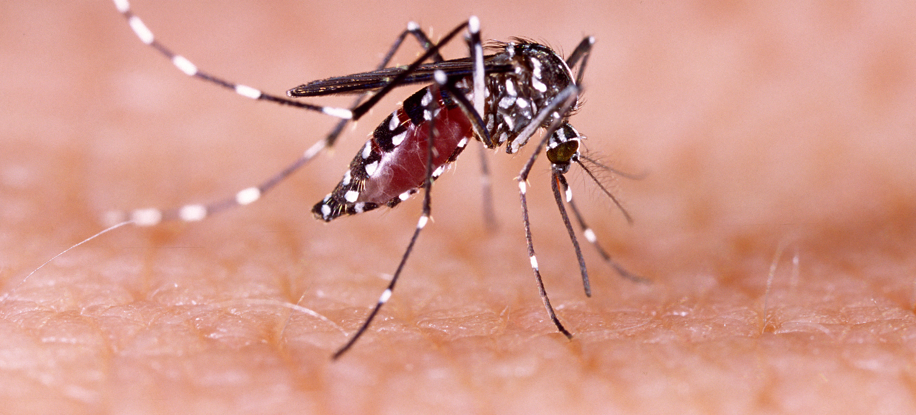
Communicable Diseases, 6th Edition
A Global Perspective
Roger Webber

Slide 2
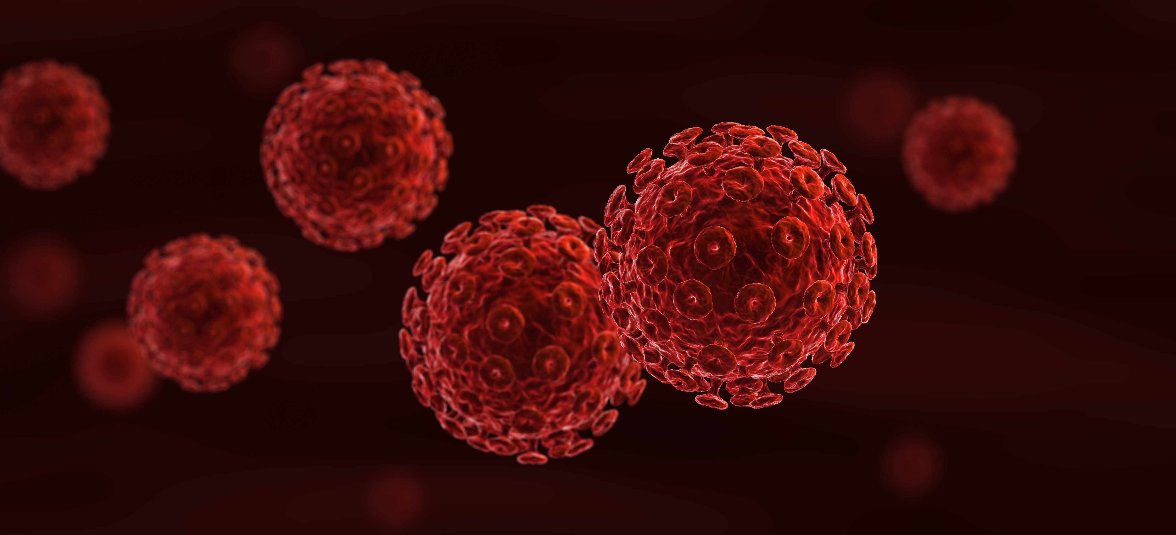
Chapter 19: New and Emerging Diseases

Slide 3
Summary
New infections will continue to appear and organisms that have caused us illness will continue to evolve into different forms.
Our close association with animals, both domestic and wild, has led to species transfer and several new diseases appearing in humans. This has been the commonest cause of new communicable diseases and is likely to be their main source in the future.
More stringent methods need to be used to prevent this animal–human contact, including the modification of feeding and husbandry practices of domestic animals that might have an effect on human health.
Sadly, several serious infections have resulted from the excessive use – and often misuse – of antimicrobials, while terrorists have used disease organisms to attack people.
Basic methods of cleanliness, antisepsis and careful control of organisms and treatments will go a long way to reducing these threats, but new methods are required.

Slide 4
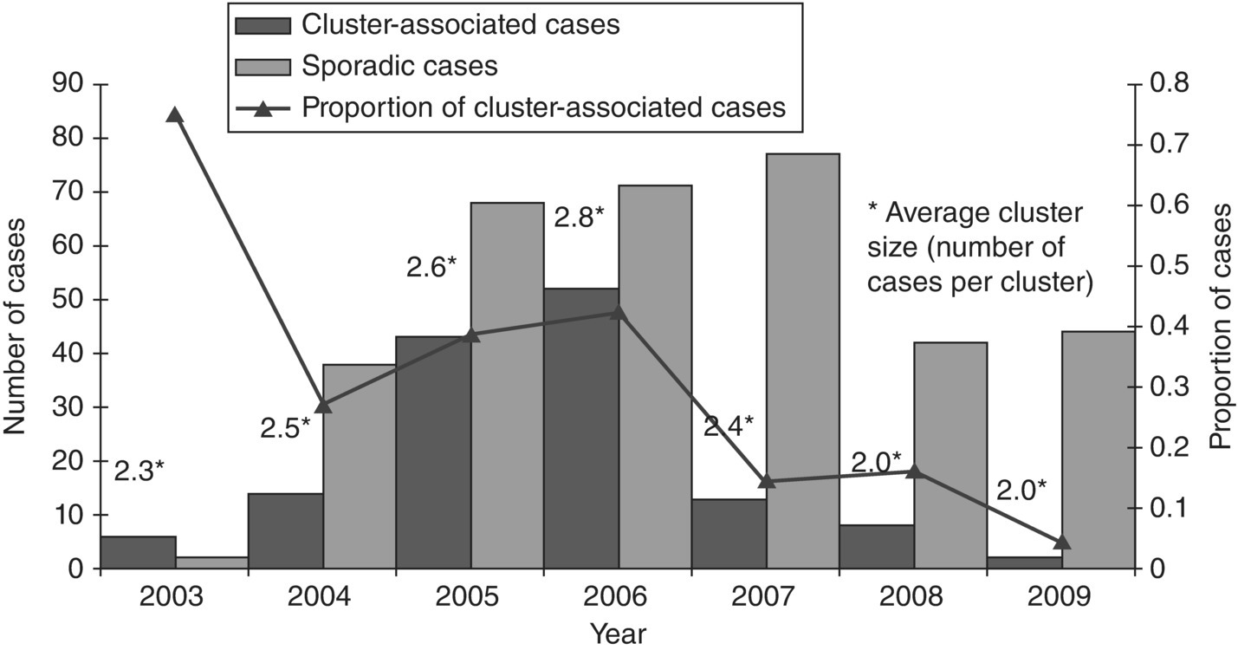
Fig. 19.1. Worldwide distribution of sporadic and cluster-associated cases of human influenza A(H5N1) virus infections, January 2003–March 2009.
(Reproduced by permission of the World Health Organization, Geneva, Switzerland.)

Slide 5
Fig. 19.2. African countries reporting human monkeypox cases 2010–2017.
(Reproduced by permission of the World Health Organization, Geneva, Switzerland.)

Slide 6
Fig. 19.3. Zika virus outbreaks and local transmission 2015–2016.
(Reproduced by permission of the World Health Organization, Geneva, Switzerland.)

Slide 7
Further reading
This section also includes general works relevant to preceding chapters.
Brent, A., Davidson, R. and Seale, A. (2014) Oxford Handbook of Tropical Medicine. Oxford University Press, New York.
Childs, J.E., Mackenzie, J.S. and Richt, J.A. (eds) (2007) Wildlife and Emerging Zoonotic Diseases: The Biology, Circumstances and Consequences of Cross-Species Transmission. Current Topics in Microbiology and Immunology Vol. 315. Springer, Berlin, Heidelberg, New York.
Emond, R.T., Welsby, P.D. and Rowland, H.A. (2003) Colour Atlas of Infectious Diseases, 4th edn. Mosby-Wolfe, London.
Farrar, J. and Hotez, P. (eds) (2013) Manson’s Tropical Diseases, 23rd edn. Saunders, Elsevier Health Sciences, Philadelphia, Pennnsylvania. Online access at Expert Consult.
Gilles, H.M. and Lucas, A.O. (2002) Short Textbook of Public Health Medicine for the Tropics, 4th edn. Hodder Arnold, London. (New edition scheduled for 2017.)
Guerrant, R.L., Walker, D.H. and Weller, P.F. (eds) (2011) Tropical Infectious Diseases: Principles, Pathogens and Practice, 3rd edn. Saunders, Elsevier Health Sciences, Philadelphia, Pennsylvania. Online access at Expert Consult.
Hawker, J., Begg, N., Blair, I., Reintjes, R., Weinberg, J. and Ekdahl, K. (2012) Communicable Disease Control and Health Protection Handbook, 3rd edn. Wiley-Blackwell, Oxford, UK.
Heymann, D.L. (ed.) (2014) Control of Communicable Diseases Manual, 20th edn. American Public Health Association, Washington, DC.
Mabey, D. and Gill, G. (eds) (2013) Principles of Medicine
in Africa, 4th edn. Cambridge University Press, Cambridge, UK.
Noah, N.D. (2006) Controlling Communicable Disease. Understanding Public Health Series. Open University Press/McGraw-Hill Education, Maidenhead, UK.
Peters, W. and Pasvol, G. (2006) Atlas of Tropical Medicine and Parasitology, 6th edn. Mosby-Wolfe, London.
Van-Tam, J. and Sellwood, C. (eds) (2013) Pandemic Influenza, 2nd edn. CAB International, Wallingford, UK.
Warrell, D.A., Cox, T.M. and Firth, J.D. (eds) (2010) Oxford Textbook of Medicine, 5th edn. Oxford University Press, New York.

Slide 8
Web resources
Emerging Infections Monthly Summaries (from the UK Health Protection Agency). Available at: www.hpa.org.uk/Topics/InfectiousDiseases/InfectionsAZ/EmergingInfections/EmergingInfectionsMonthlySummaries/ (accessed 13 March 2012).
Global Health Archive (from CAB International, Wallingford, UK). Available at: www.cabi.org/globalhealth (accessed 13 March 2019).
Journal of Emerging Infectious Diseases (from the US Centers for Disease Control). Available at: www.cdc.gov/ncidod/eid/index.htm (accessed 13 March 2019).
MedlinePlus (with links to journal articles; from the US National Library of Medicine, National Institutes of Health). Available at: www.nlm.nih.gov/medlineplus/ (accessed 13 March 2019).
Weekly Epidemiological Record (WER). Available at: www.who.int/wer/2019/en/ (accessed 26 March 2019).

