Slide 1
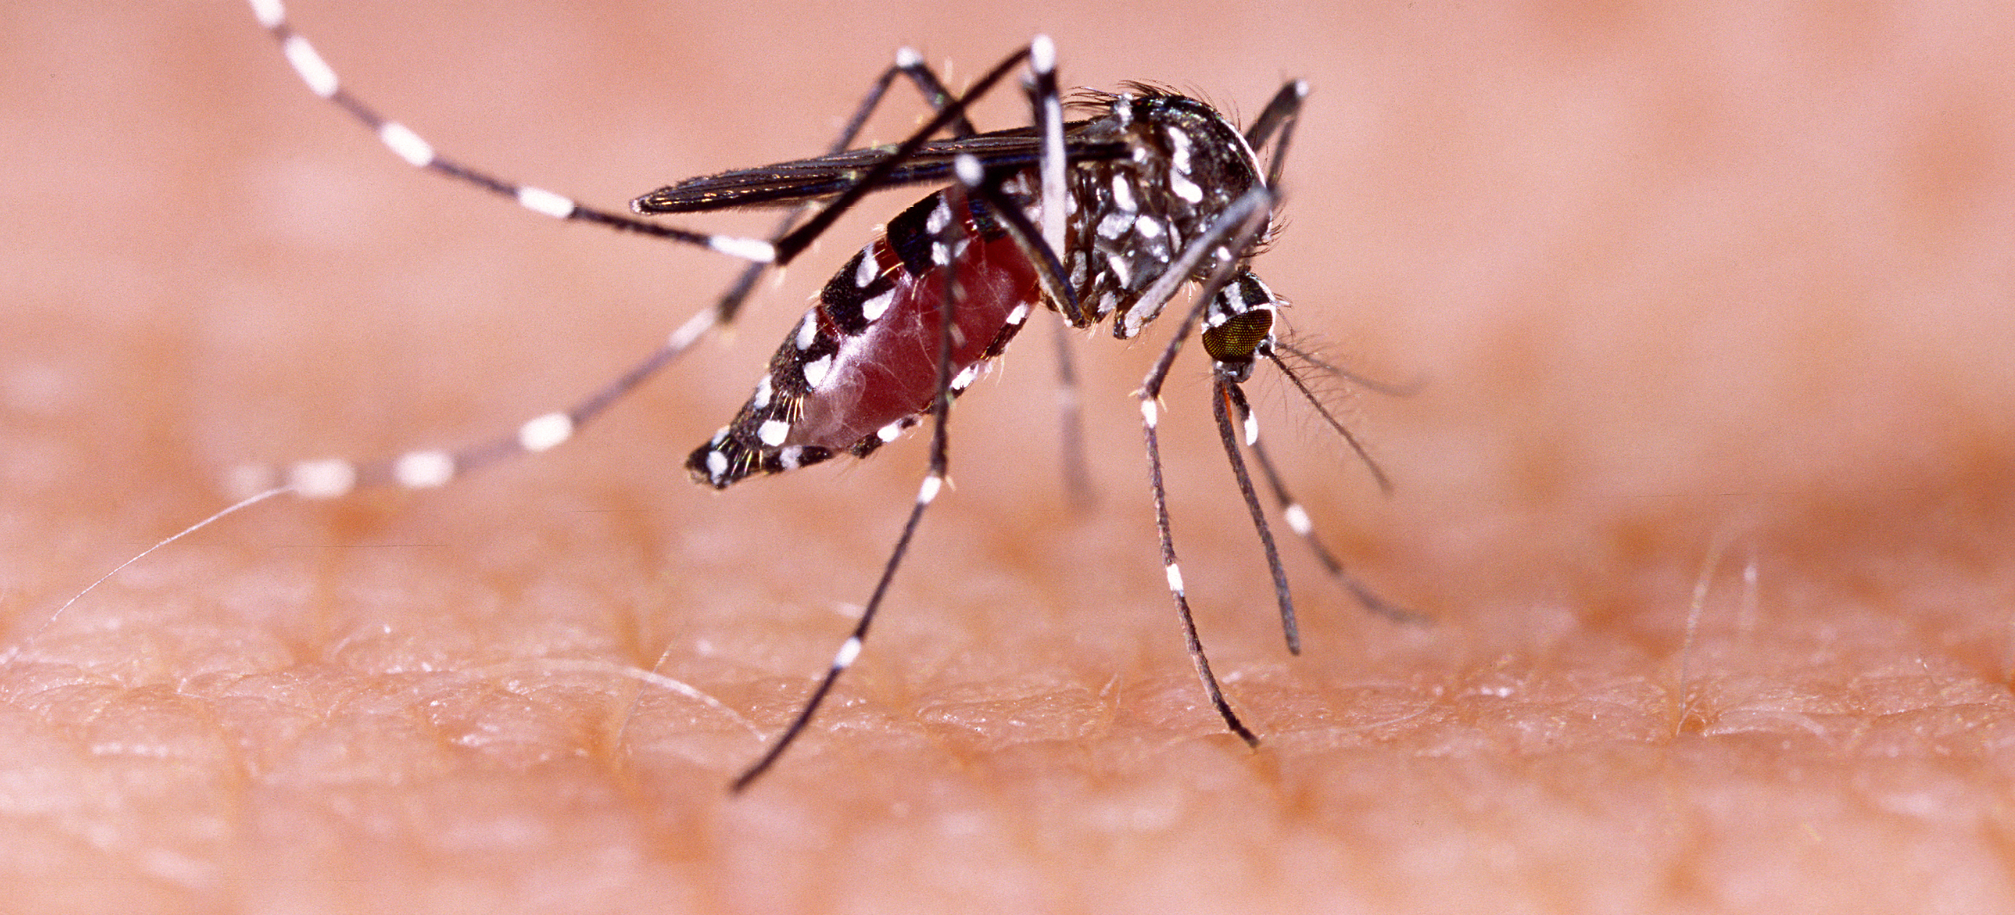
Communicable Diseases, 6th Edition
A Global Perspective
Roger Webber

Slide 2
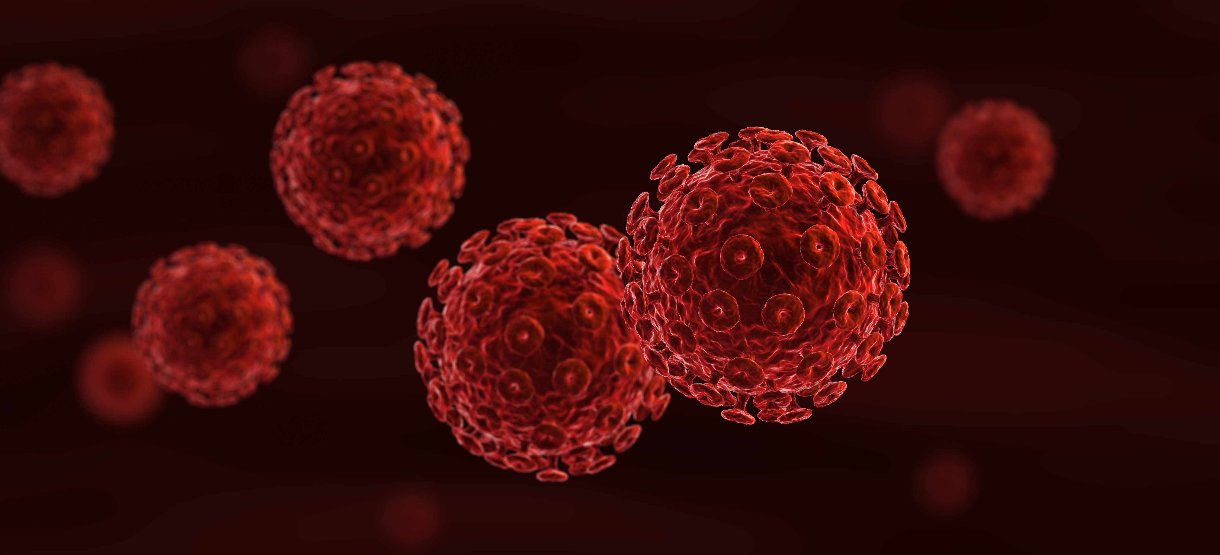
Chapter 18: Pregnancy and Infection

Slide 3
Summary
Before pregnancy, disfiguring diseases such as filariasis and leprosy will reduce the woman’s chance of marrying, while the STIs can cause infertility and damage to the fetus.
HIV infection is a serious disease in the woman in all stages of her life, the severity of infection measured by the CD4 level determining her chance of surviving pregnancy and the likelihood of transmitting infection to her offspring.
It is while the mother’s immunity is compromised during pregnancy that the most serious threat is posed to her from chickenpox, influenza and malaria, while there are threats to her fetus from syphilis, genital herpes, rubella, toxoplasmosis, cytomegalovirus, listeriosis, zika and parvovirus B19. Also at this time are the risk of contracting pyelonephritis, which if untreated can lead to renal failure, and of relapsing fever, which can cause abortion and stillbirth.
During delivery, ophthalmia neonatorum due to maternal gonococcal or chlamydial infection can cause blindness to the infant, and unhygienic delivery practices can cause neonatal tetanus and puerperal sepsis.
Seeing the mother antenatally is crucial in detecting and treating infections early and ensuring that she is adequately protected by vaccination to give her and her infant the best chance of a successful outcome to her pregnancy. The use of ITNs by the mother and child will do much to prevent all the consequences of malaria, filariasis and relapsing fever.

Slide 4
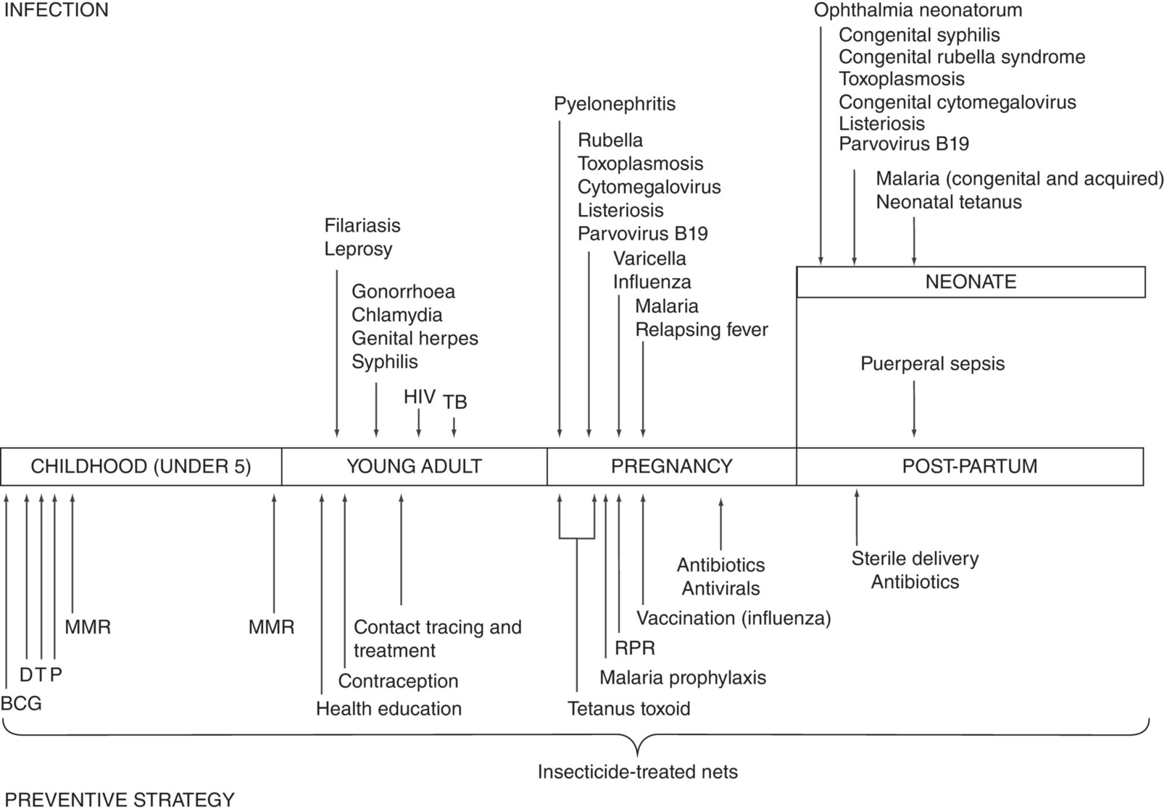
Fig. 18.1. Infections that impinge on the woman at different stages in her life and preventive measures that can be taken. BCG, Bacillus Calmette–Guérin vaccine; DTP, diphtheria, tetanus, pertussis vaccine; HIV, human immunodeficiency virus; MMR, measles, mumps, rubella vaccine; RPR, rapid plasma reagin test (for syphilis); TB, tuberculosis.

Slide 5
Further reading
Berg, C., Daniel, I., Atrash, H., Zane, S. and Bartlett, L. (eds) (2001) Strategies to Reduce Pregnancy Related Deaths: From Identification and Review to Action. Centers for Disease Control and Prevention, Atlanta, Georgia.
Dolea, C. and Stein, C. (2003) Global Burden of Maternal Sepsis in the Year 2000. WHO, Geneva, Switzerland.
Fried, M. and Duffy, P.E. (2007) Malaria in Pregnancy: Deadly Parasite, Susceptible Host. Taylor & Francis, London/Informa Healthcare, New York.
Family Planning New South Wales (2011) Reproductive and Sexual Health: An Australian Clinical Practice Handbook, 2nd edn. Family Planning New South Wales, Sydney, Australia.
Hogan, M.C., Foreman, K.J., Naghavi, M., Ahn, S.Y., Wang, M., Makela, S.M., Lozano, R. and Murray, C.J.L. (2010) Maternal mortality for 181 countries, 1980–2008: a systematic analaysis of progress towards Millennium Development Goal 5. The Lancet 375, 1609–1623. Published online 12 April doi:10.1016/S0140-6736(10)60518-1.
Hussein, J., McCaw-Binns, A. and Webber, R. (eds) (2012) Maternal and Perinatal Health in Developing Countries. CAB International, Wallingford, UK.
Kuhn, L., Aldrovandi, G.M., Sinkala, M., Kankasa, C., Semrau, K., Kasonde, P., Mwiya, M., Tsai, W.Y. and Thea, D.M. (2009) Zambia Exclusive Breastfeeding Study (ZEBS). Differential effects of early weaning for HIV-free survival of children born to HIV-infected mothers by severity of maternal disease. PloS One 4(6):e6059.
Mayani, C.N. and MacIntyre, J.A. (2010) Tuberculosis in pregnancy. BJOG: An International Journal of Obstetrics and Gynaecology 118(2), 226–231.
Mullick, S., Watson-Jones, D., Beksinka, M. and Mabey, D. (2005) Sexually transmitted infections in pregnancy; prevalence, impact on pregnancy outcomes, and approach to treatment in developing countries. Sexually Transmitted Infections 81, 294–302.
Omer, S.B. (2017) Maternal immunization. New England Journal of Medicine 376, 1256–1267.
Prakash, A., Swain, S. and Seth, A. (1991) Maternal mortality in India: current status and strategies for reduction. Indian Pediatrics 28, 1395–4000.
Shetty, P. (2010) Nutrition, Immunity and Infection. CAB International, Wallingford, UK.
Tiono, A.B., Ouedraogo, A., Bongouma, E.C., Diarra, A., Konaté, A.T., Nébié, I. and Sirima, S.B. (2009) Placental malaria and low birth weight in pregnant women living in a rural area of Burkina Faso following the use of three preventive regimes. Malaria Journal 7, 224. Published online 2009 October 7. doi: 10.1186/1475-2875-8-224.
van Dillen, J., Zwart, J., Schutte, J. and van Roosmalen, J. (2010) Maternal sepsis: epidemiology, etiology and outcome. Current Opinion in Infectious Diseases 23, 249–254.
World Health Organization (2004a) Integrating Care for Reproductive Health, Sexually Transmitted Infections in Pregnancy: A Guide to Essential Practice. WHO, Geneva, Switzerland.
World Health Organization (2004b) Strategic Framework For Malaria Control During Pregnancy in the African Region, Document No. AFR/MAL/04/01, WHO Regional Office for Africa, Brazzaville, Congo. Available at: http://www.afro.who.int/index.php?option=com_docman& task=doc_download&gid=147 (accessed 12 March 2012).
World Health Organization (2005) Interim WHO Clinical Staging of HIV/AIDS and HIV/AIDS Case Definitions for Surveillance, African Region. Document Ref. No. WHO/HIV/2005.02, WHO, Geneva, Switzerland. Available from: http://www.who.int/hiv/pub/guidelines/clinicalstaging.pdf (accessed 12 March 2012).
World Health Organization (2011) Intermittent Preventive Treatment for Infants using Sulfadoxine-Pyrimethamine (SP-IPTi) for Malaria Control in Africa. Implementation Field Guide. WHO/IVB/11.07, WHO, Geneva, Switzerland.
World Health Organization (2012) Use of Antiretroviral Drugs for Treating Pregnant Women and Preventing HIV Infection in Infants: Programmatic Update. WHO, Geneva, Switzerland.
World Health Organization (2014) WHO Policy Brief for the Implementation of Intermittent Preventive Treatment of Malaria in Pregnancy using Sulfadoxine-Pyrimethamine (IPTp-SP). WHO, Geneva, Switzerland.

Slide 6
Web resources
HIV Treatment. Available at: http://www.who.int/hiv/pub/arv/adult2010/en/ (accessed 3 July 2019).
Swine flu (H1N1). Available at: www.nhs.uk/Conditions/Pandemic-flu/Pages/Introduction.aspx (accessed 3 July 2019).

