Slide 1
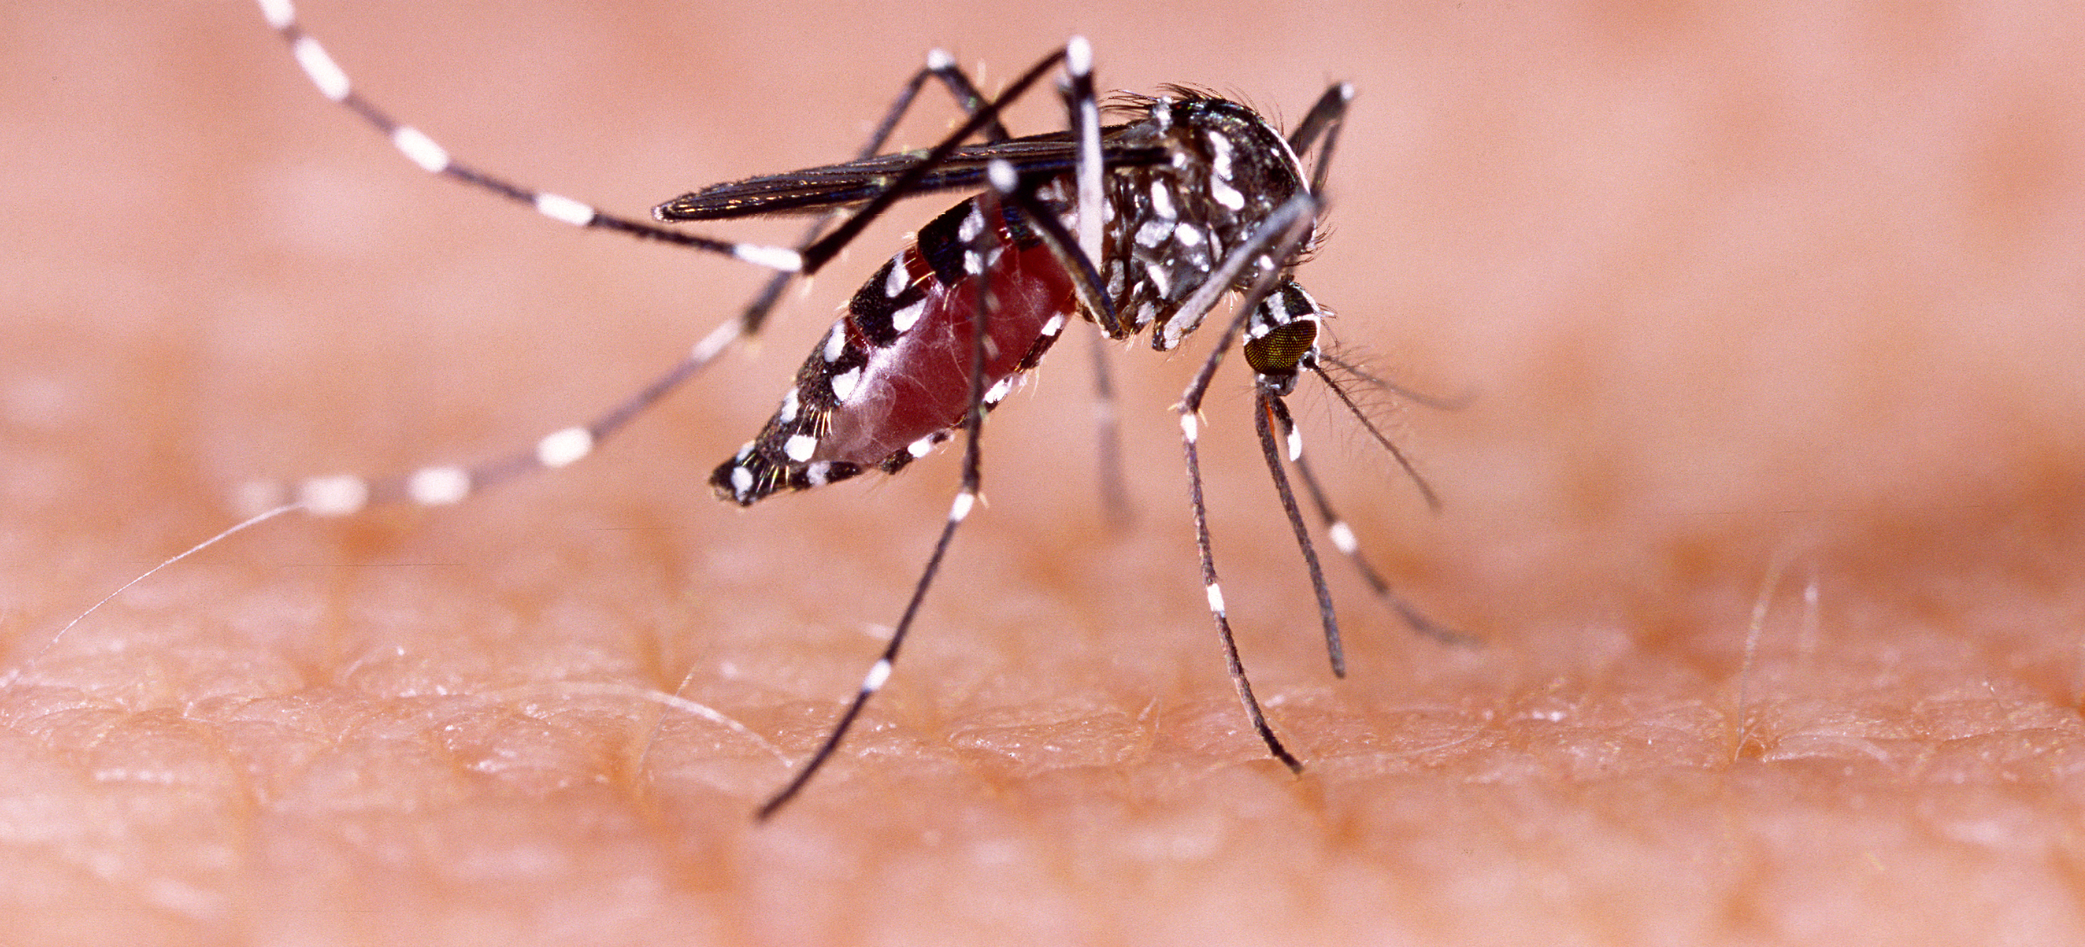
Communicable Diseases, 6th Edition
A Global Perspective
Roger Webber

Slide 2
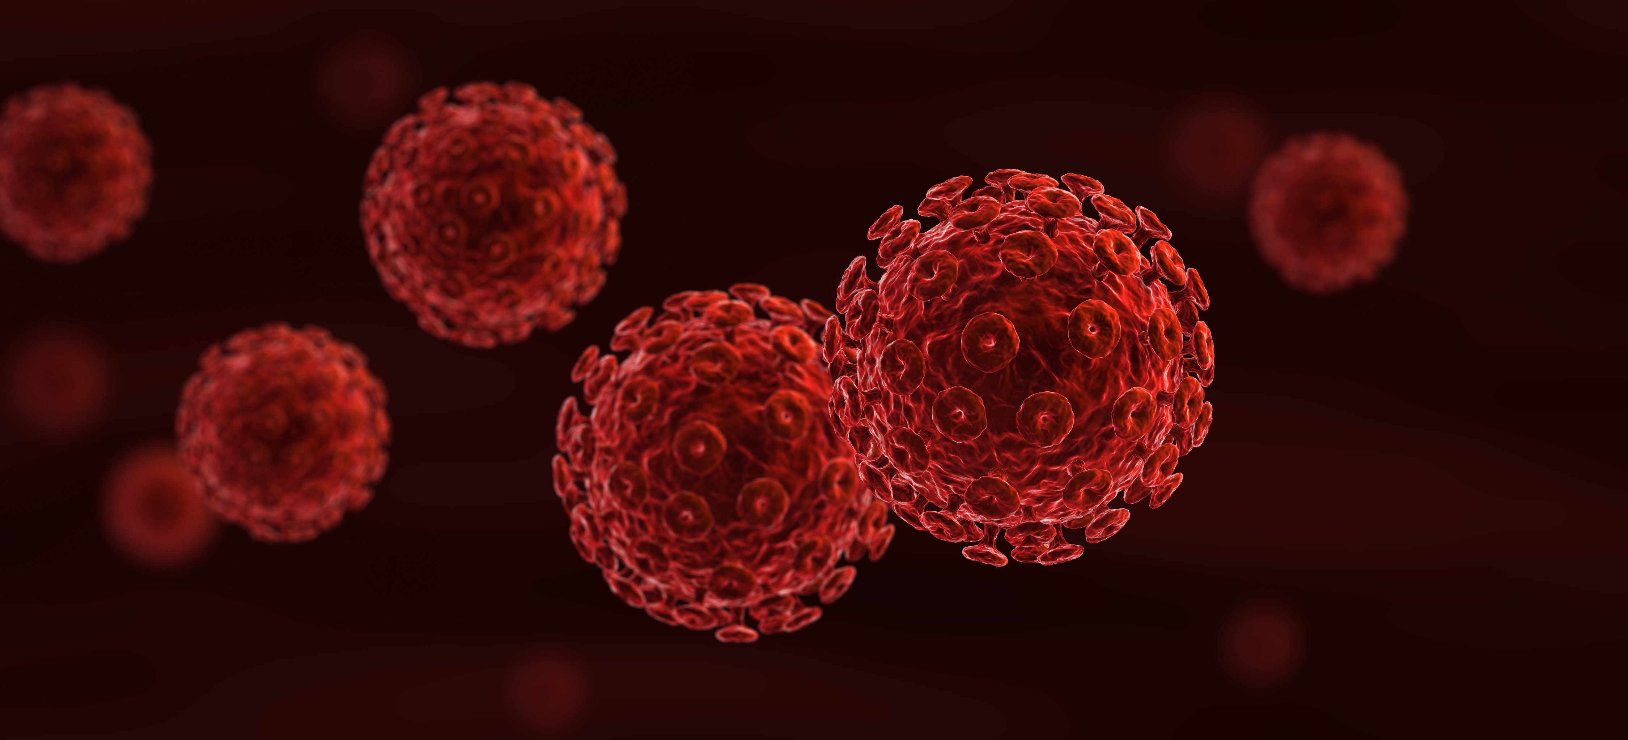
Chapter 17: Domestic and Synanthropic Zoonoses

Slide 3
Summary
Zoonoses are infections that are transmitted between animals and humans with dogs, cats, cattle and pigs as the main source, while the domestic rat is inadvertently involved.
Understanding the nature of these diseases and the animals that transmit them, especially pets, is a necessary precaution.
Proper animal husbandry and good personal hygiene are general preventive measures.
Unwanted animals should be destroyed, vaccinated or controlled, and rats actively eliminated.

Slide 4
Fig. 17.1. Dog-transmitted rabies 2016.
(Reproduced by permission of the World Health Organization, Geneva, Switzerland.)

Slide 5
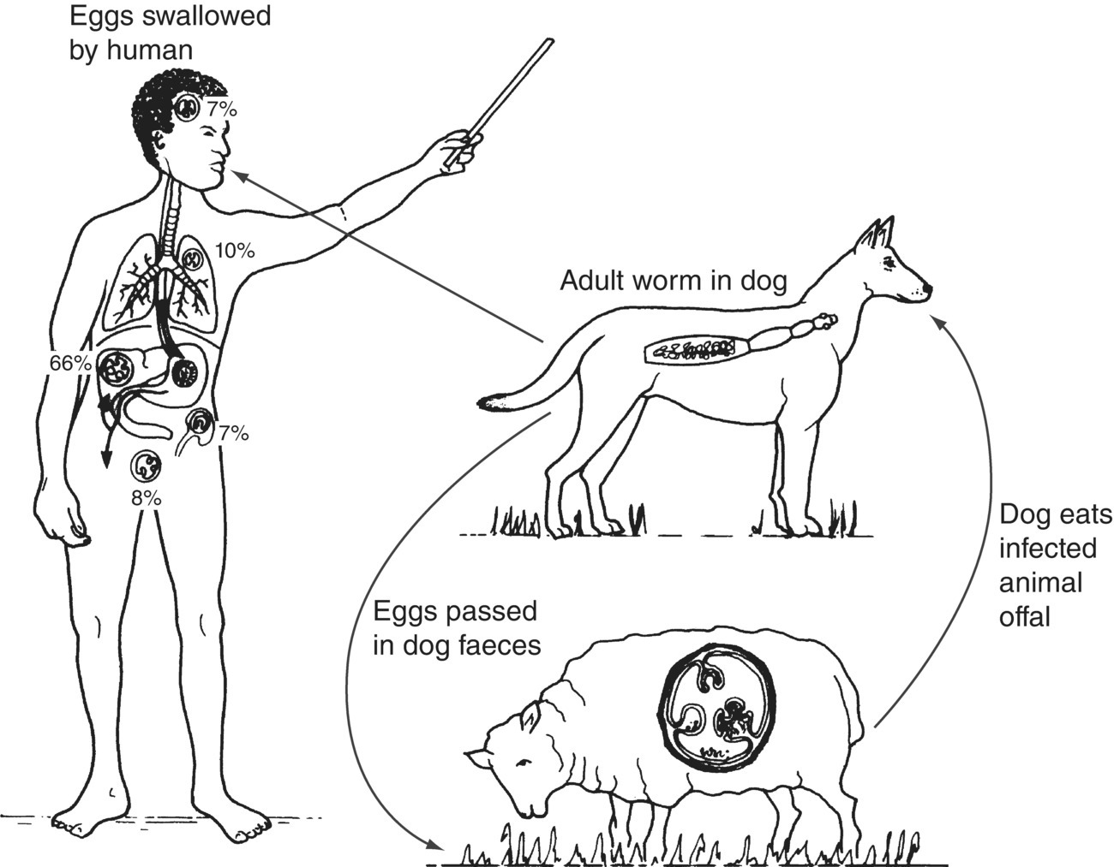
Fig. 17.2. Hydatid disease, the life cycle of Echinococcus granulosus.

Slide 6
Further reading
Eckert, J., Gemmell, M.A., Meslin, F.-X. and Pawlowski, Z.S. (2001) WHO/OIE Manual on Echinococcosis in Humans and Animals: a Public Health Problem of Global Concern. WHO, Geneva and World Organization for Animal Health, Paris.
Macpherson, C.N., Meslin, F.-X. and Wandeler, A.L. (2013) Dogs, Zoonoses and Public Health, 2nd edn. CAB International, Wallingford, UK.
World Health Organization (2003) Human Leptospirosis: Guidance for Diagnosis, Surveillance and Control. WHO, Geneva, Switzerland.
World Health Organization (2005) WHO Expert Consultation on Rabies, First Report, Geneva 5–8 October 2004. Technical Report Series No. 931, WHO, Geneva, Switzerland.
World Health Organization (2008) Anthrax in Humans and Animals, 4th edn. WHO, Geneva, Switzerland.

Slide 7
Web resources
Rabies ‘Rabnet’, an interactive information system able to generate interactive maps and graphs using human and animal rabies data. Available at: www.who.int/rabies/rabnet/en/ (accessed 12 March 2012).

