Slide 1
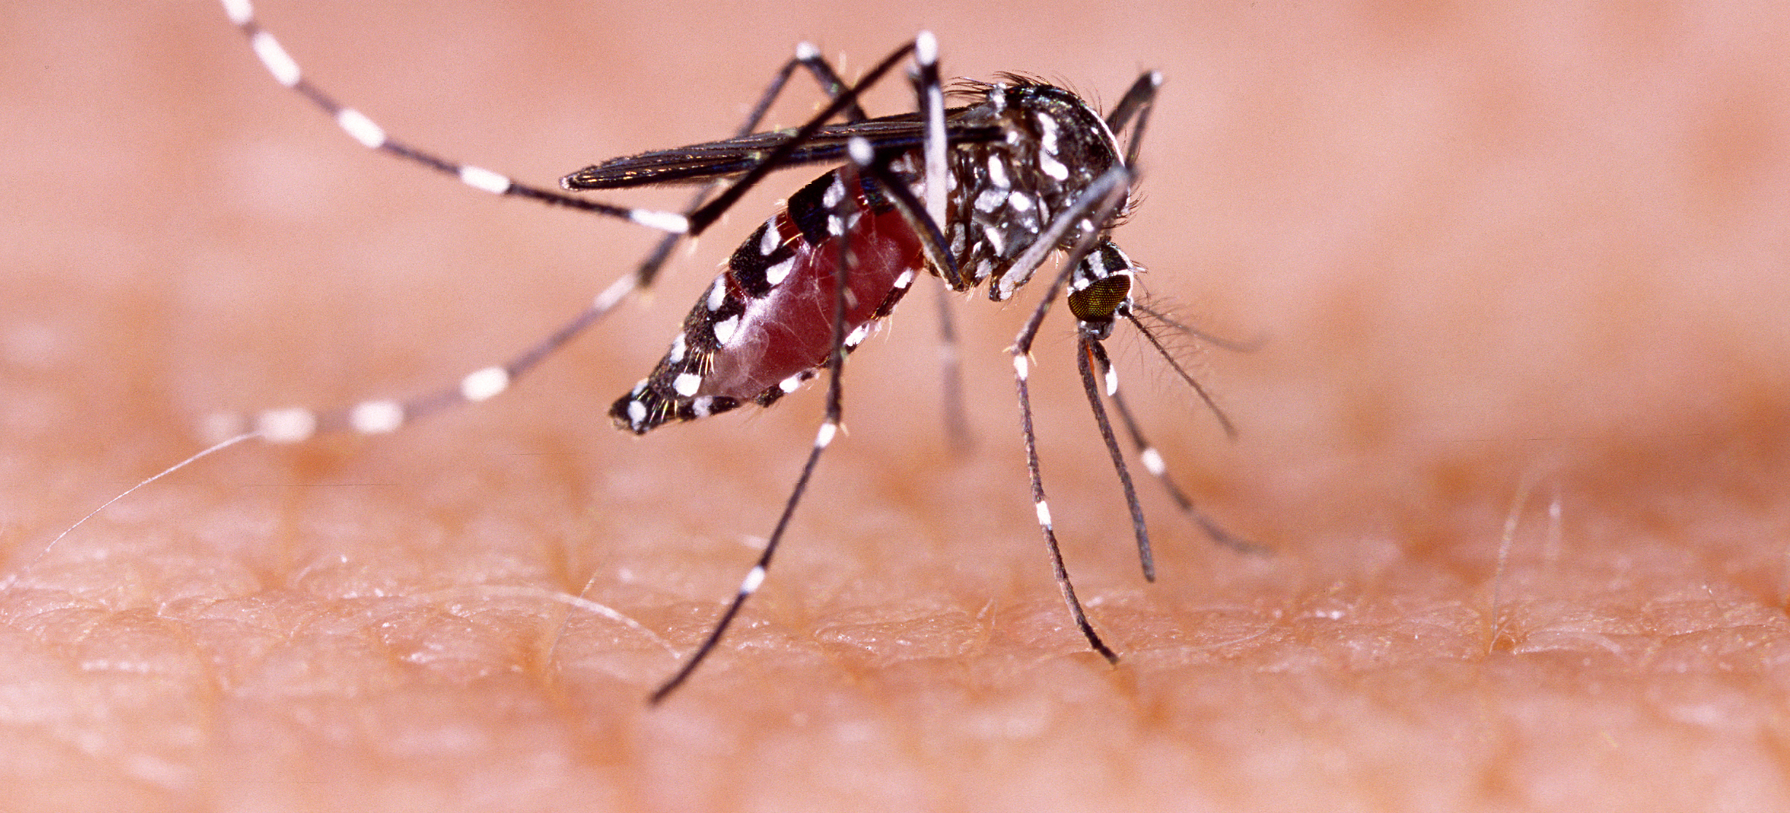
Communicable Diseases, 6th Edition
A Global Perspective
Roger Webber

Slide 2
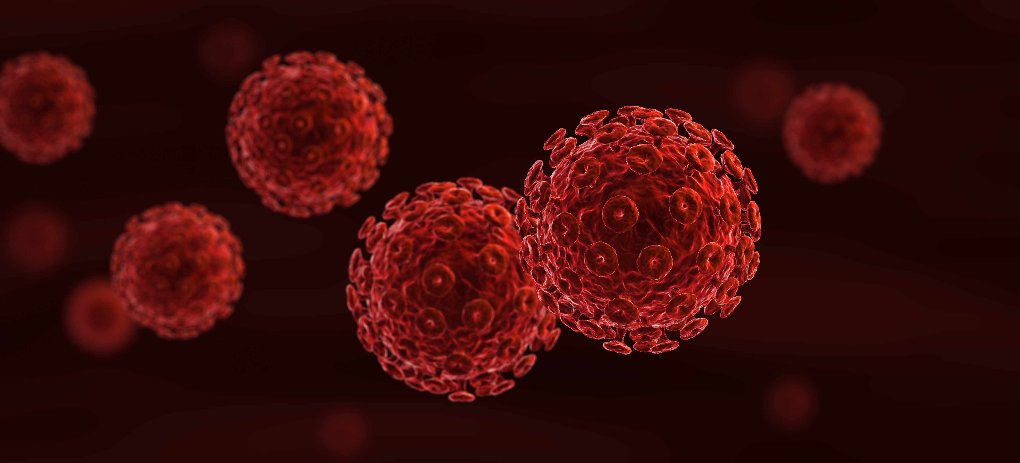
Chapter 16: Ectoparasite Zoonoses

Slide 3
Summary
The close proximity of humans and their ectoparasites, particularly fleas, lice and ticks, can be a cause of several important illnesses.
These ectoparasites often live in close association with small mammals in delineated areas, and when humans accidentally enter these foci, infection takes place.
Knowledge of their ecology and vector characteristics is essential in understanding the nature of these infections.
Avoiding endemic foci and taking precautions against ectoparasites are the main preventive actions.
Personal hygiene, especially in situations of overcrowding such as occurs in cold weather, or in emergency situations such as refugee camps, will prevent ectoparasite infestation.

Slide 4
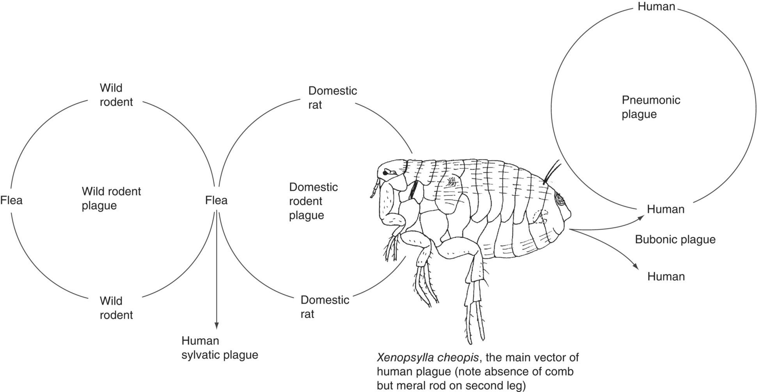
Fig. 16.1. Plague vector and life cycles.

Slide 5
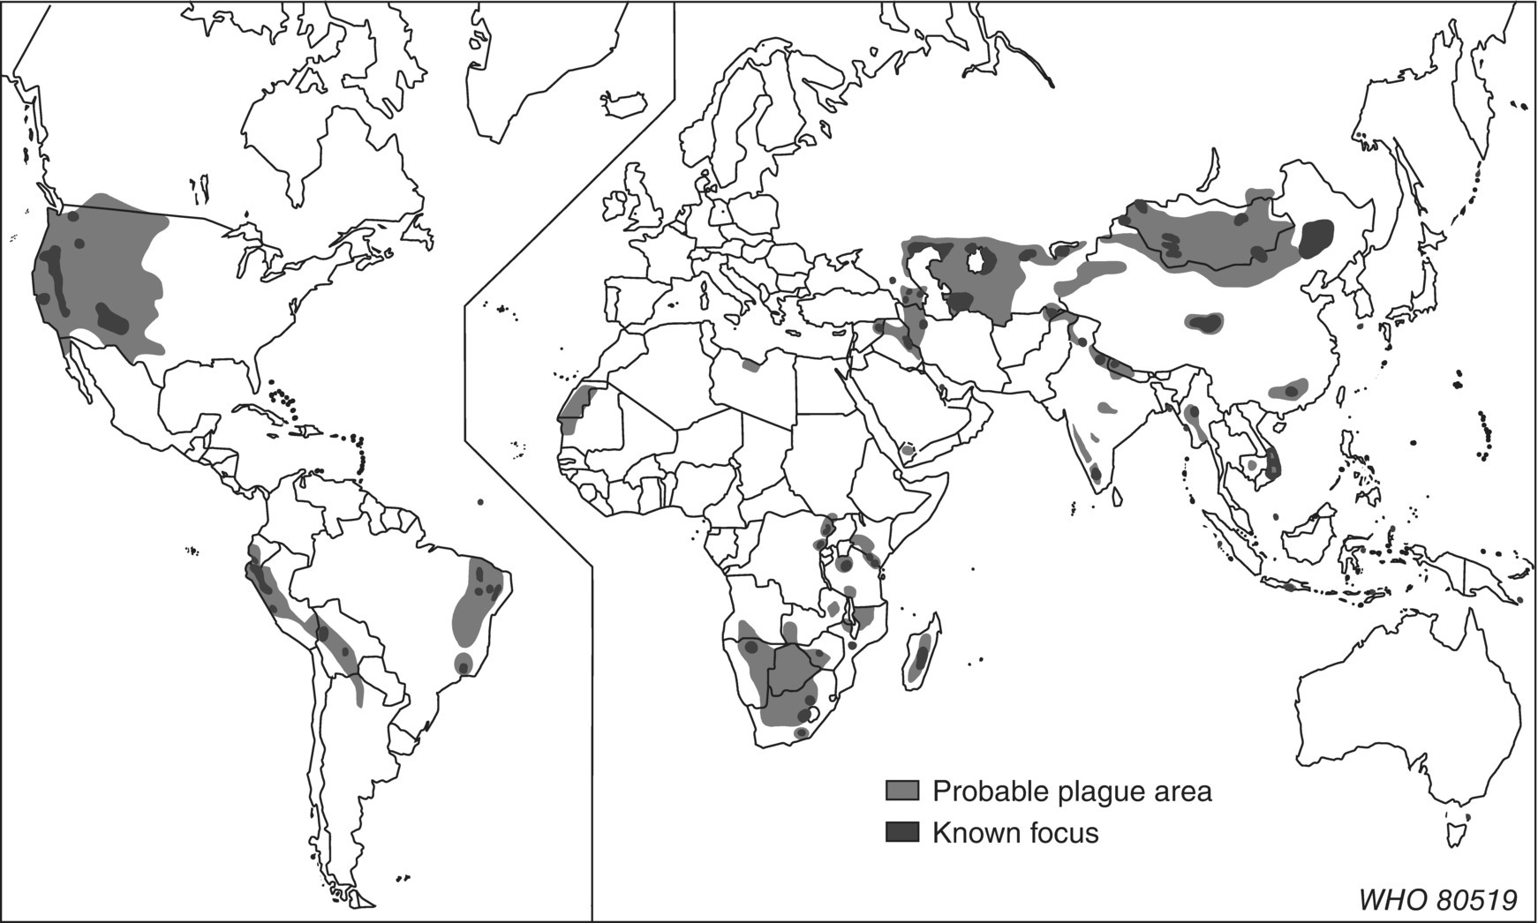
Fig. 16.2. Known and probable foci of plague.
(Reproduced by permission of the World Health Organization, Geneva.)

Slide 6
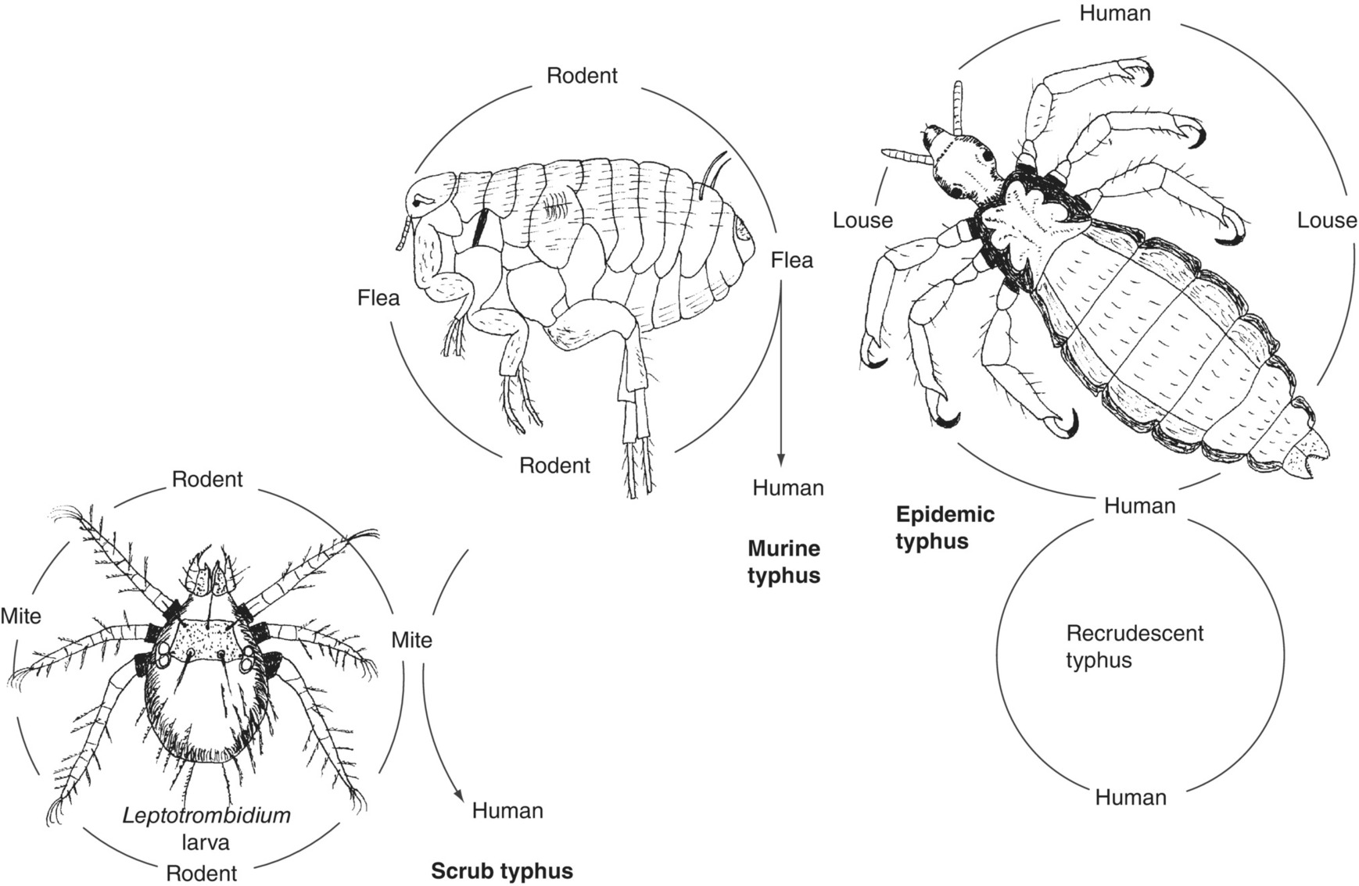
Fig. 16.3. The transmission cycles and vectors of scrub, murine and epidemic typhus.

Slide 7
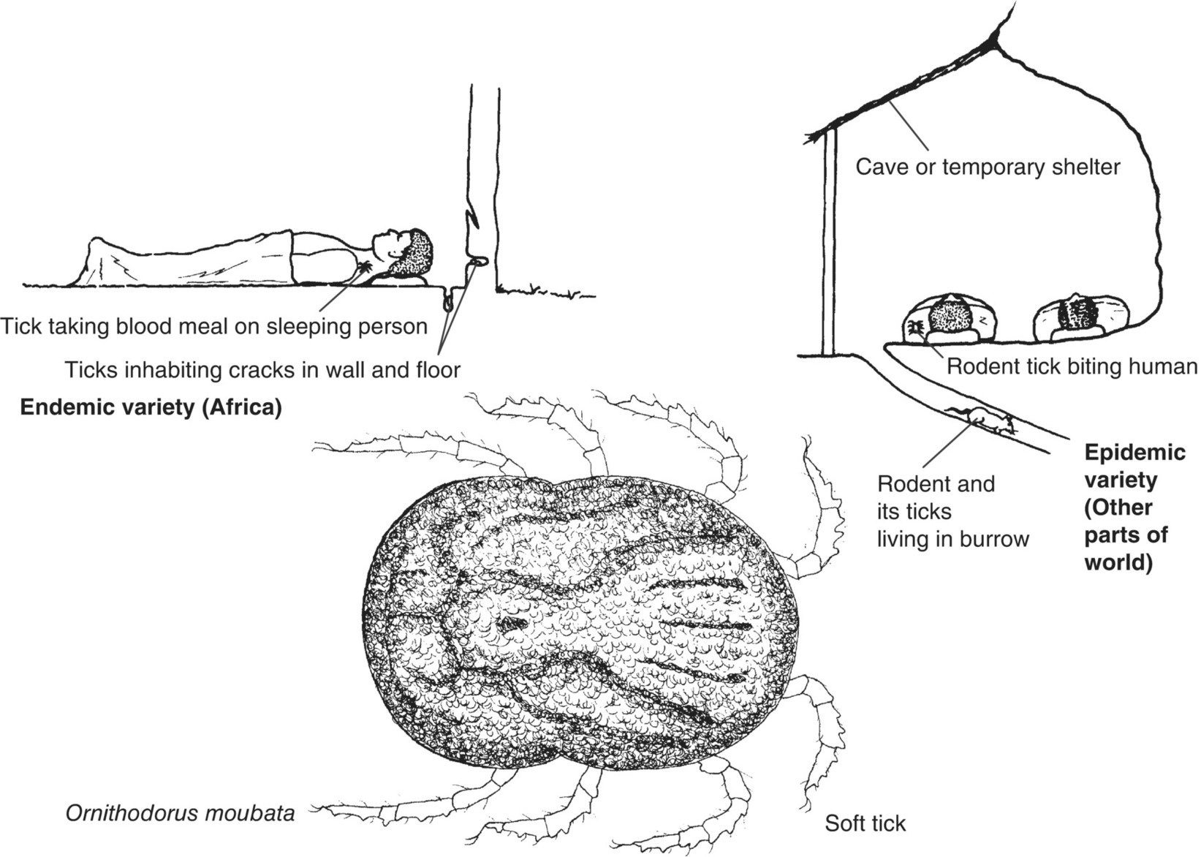
Fig. 16.4. The vector and epidemiology of tick-borne relapsing fever.

Slide 8
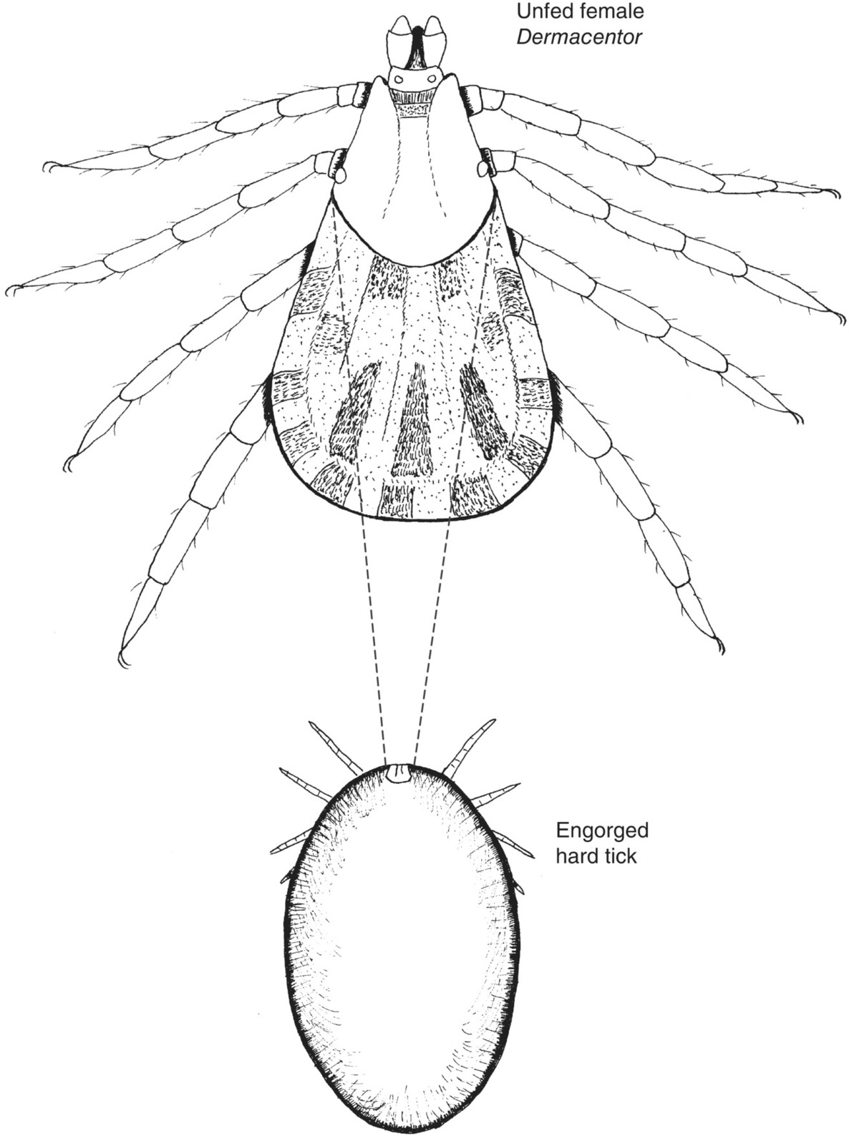
Fig. 16.5. Characteristics of hard ticks as exemplified by Dermacentor.

Slide 9
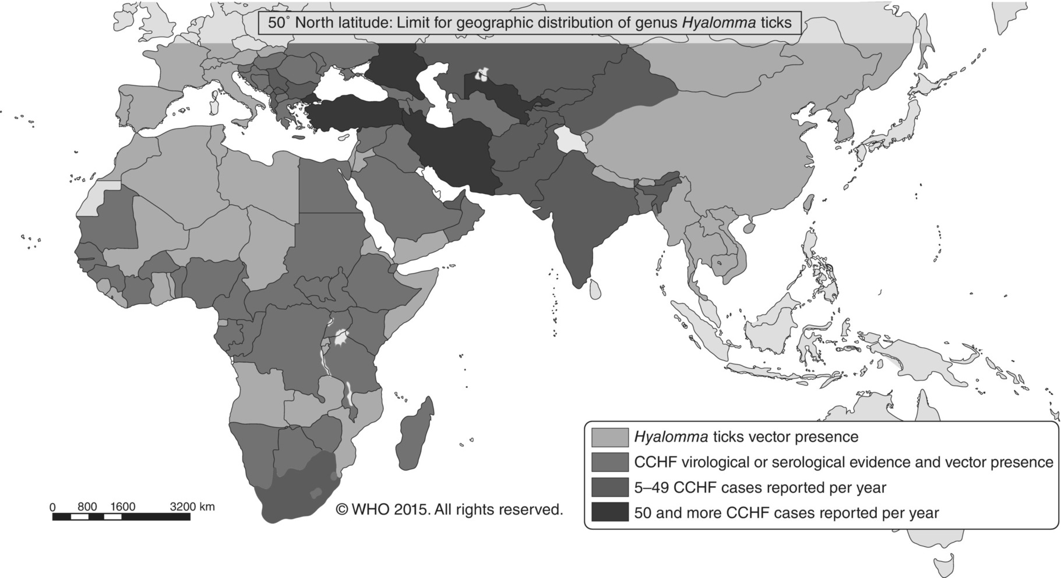
Fig. 16.6. Geographic distribution of Crimean–Congo haemorrhagic fever (CCHF).
(Reproduced by permission of the World Health Organization, Geneva.)

Slide 10
Further reading
Ergonul, O. and Whitehouse, C.A. (2007) Crimean–Congo Hemorrhagic Fever: A Global Perspective. Springer, Dordrecht, the Netherlands.
Githeko, A.K., Lindsay, S.W., Confalonieri, U.E. and Patz, J.A. (2000) Climate change and vector-borne diseases: a regional analysis. Bulletin of the World Health Organization 78, 1136–1147. Available at: www.who.int/bulletin/archives/78(9)1136.pdf (accessed 22 February 2012).
Goddard, J. (2008) Infectious Diseases and Arthropods, 2nd edn. Humana Press/Springer Science, Totowa, New Jersey.
Service, M.W. (2001) The Encyclopedia of Arthropod-transmitted Infections of Man and Domesticated Animals. CAB International, Wallingford, UK.
Service, M.W. (2012) Medical Entomology for Students, 5th edn. Cambridge University Press, Cambridge, UK.
World Health Organization (1999) Plague Manual: Epidemiology, Distribution, Surveillance and Control. Document No. WHO/CDS/CSR/EDC/99.2, WHO, Geneva, Switzerland.
World Health Organization (2006) Pesticides and Their Application, 6th edn. Document No. WHO/CDS/NTD/WHOPES/GCDPP/2006.1, WHO, Geneva, Switzerland.
World Health Organization (2007) Long-lasting Insecticidal Nets for Malaria Prevention, 3rd edn. WHO, Geneva, Switzerland.
World Health Organization (2009) Frequently Asked Questions: Scrub Typhus. WHO Regional Office for South-East Asia, New Delhi, India. Available at: www.searo.who.int/LinkFiles/CDS_faq_Scrub_Typhus.pdf (accessed 9 March 2012).

Slide 11
Web resources
Plague vaccines. WHO Initiative for Vaccine Research (IVR), Zoonotic Infections, Plague. Available at: www.who.int/vaccine_research/diseases/zoonotic/en/index3.html (accessed 9 March 2012).

