Slide 1
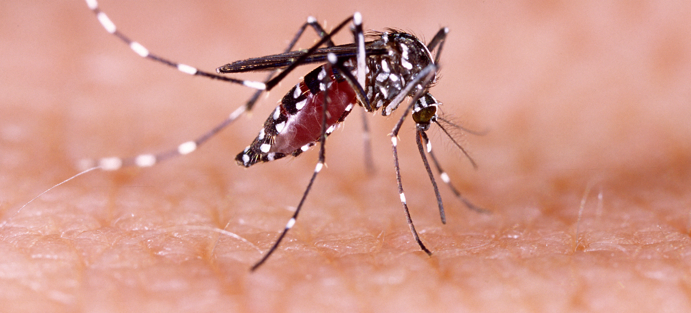
Communicable Diseases, 6th Edition
A Global Perspective
Roger Webber

Slide 2
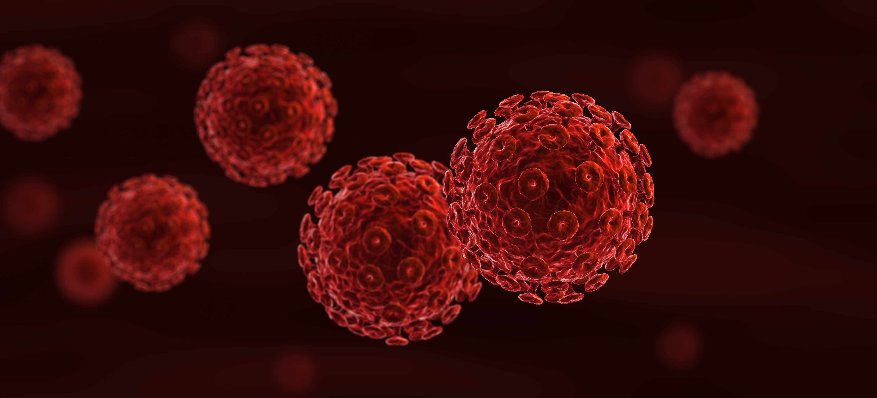
Chapter 15: Insect-borne Diseases

Slide 3
Summary
Vectors are a more specific way of carrying the infective organism direct to the host.
The most important flying vector is the mosquito, but Simulium, tsetse flies, sandflies and the reduviid bugs transmit other serious infections.
The dynamics of the vector need to be understood in defining the parameters of the infection and how to control it.
Control is aimed at reducing the vector numbers, the biting rate and length of life to below a level where the parasite is unable to develop or is of a sufficiently small number to be unable to propagate the infection.
Insecticide-treated nets are the main method of control, with residual spraying, larviciding, environmental modification and MDA also being used.

Slide 4
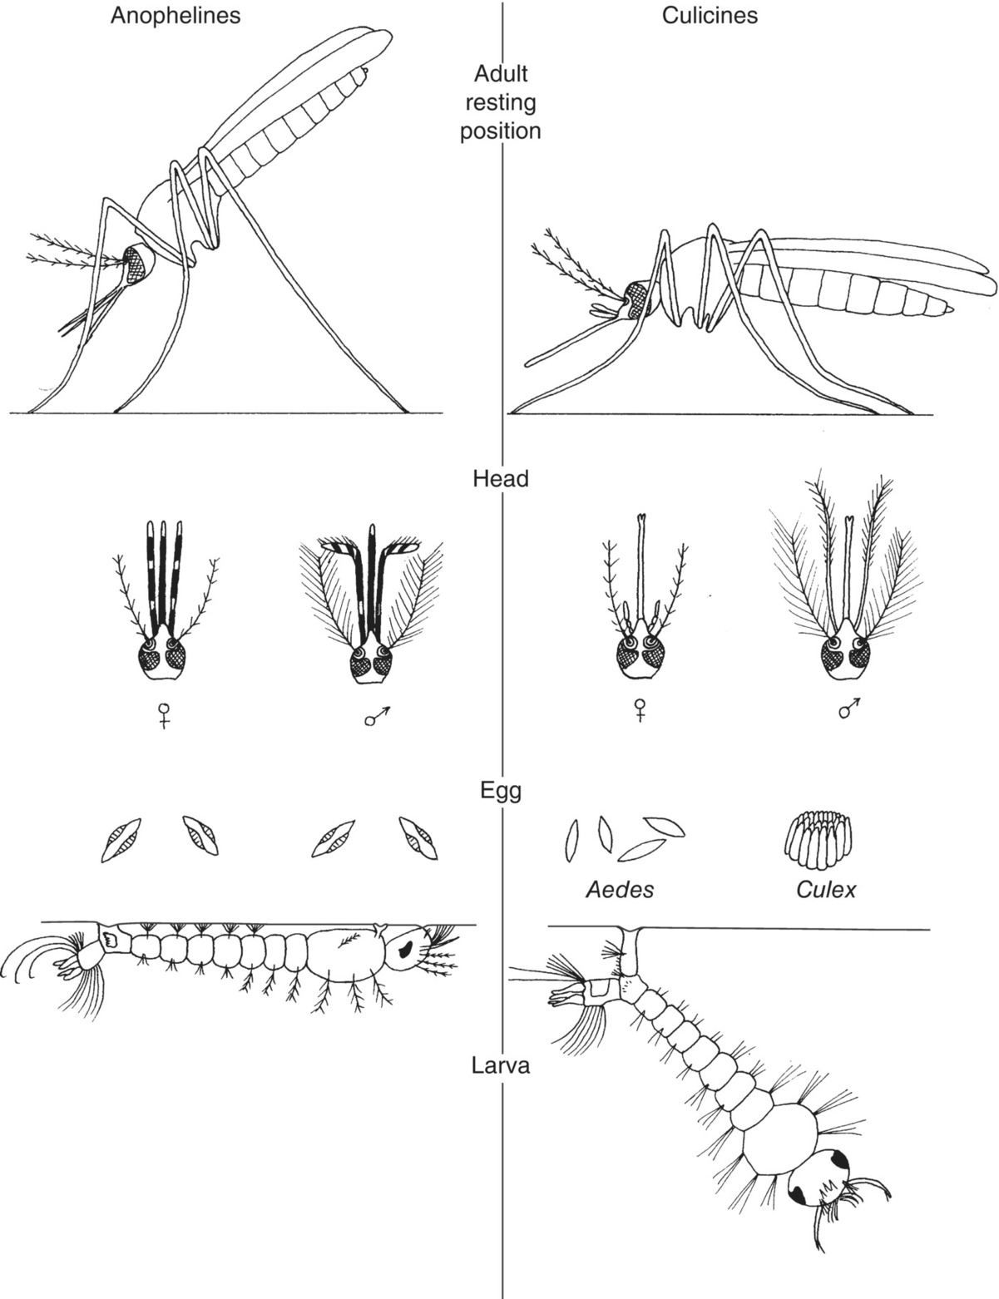
Fig. 15.1. The main differences between anopheline and culicine mosquitoes.

Slide 5
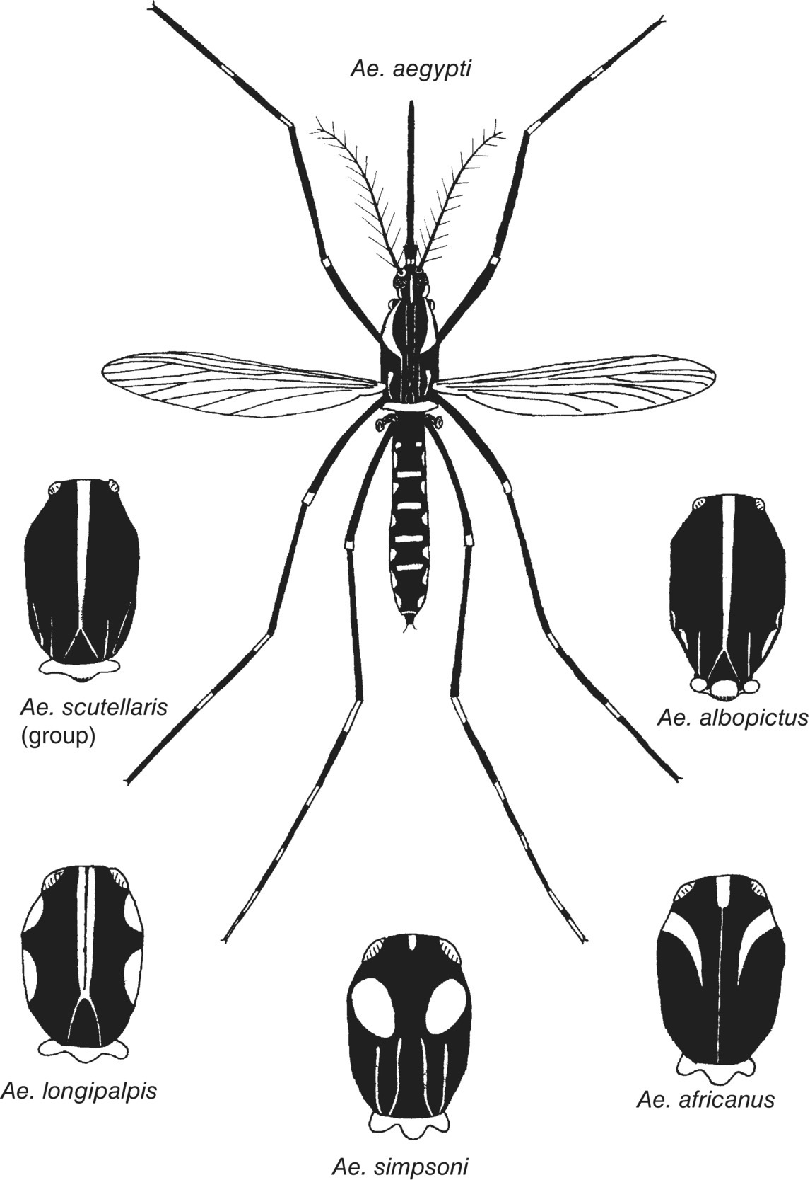
Fig. 15.2. Aedes, the black and white mosquitoes. Note the thorax markings of the different species.

Slide 6
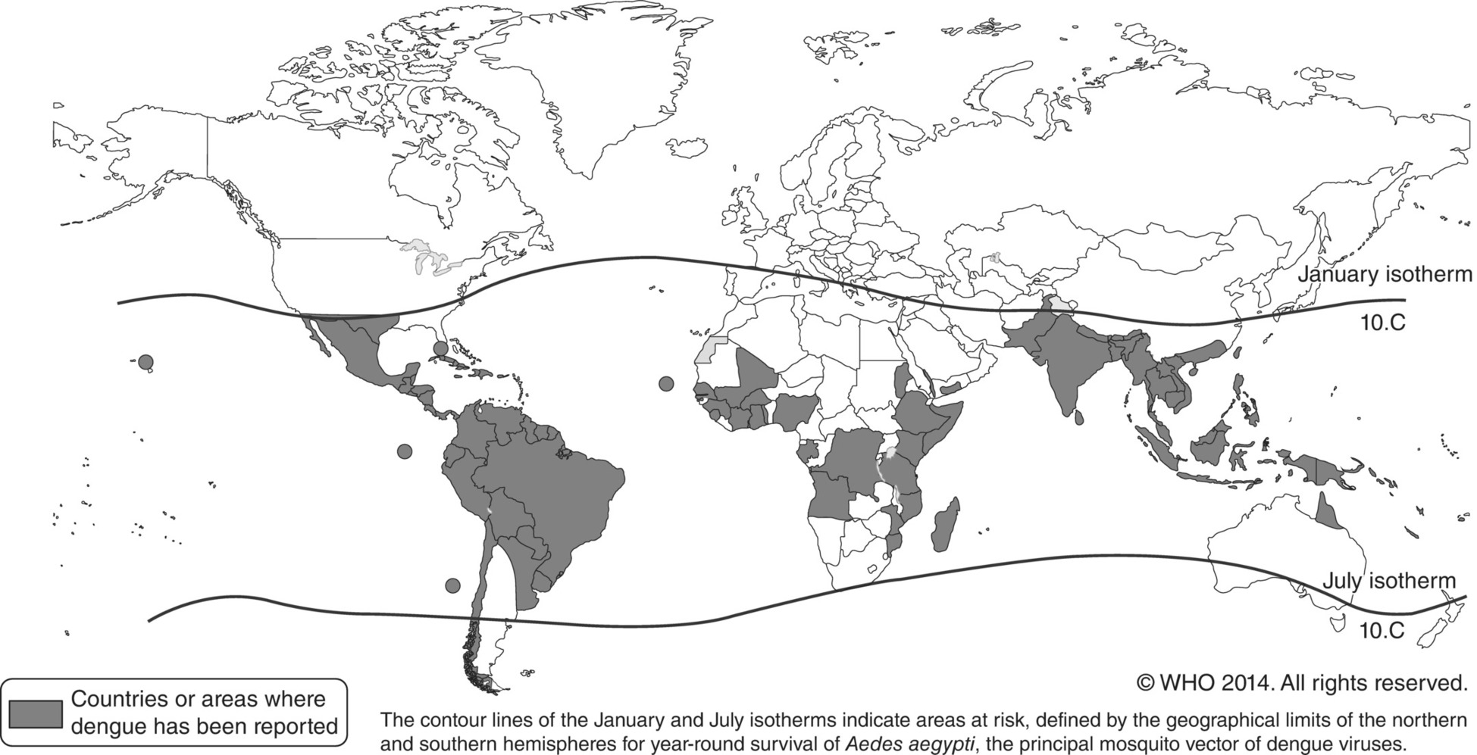
Fig. 15.3. Dengue, countries or areas at risk, 2013.
(Reproduced by permission of the World Health Organization, Geneva, Switzerland.)

Slide 7
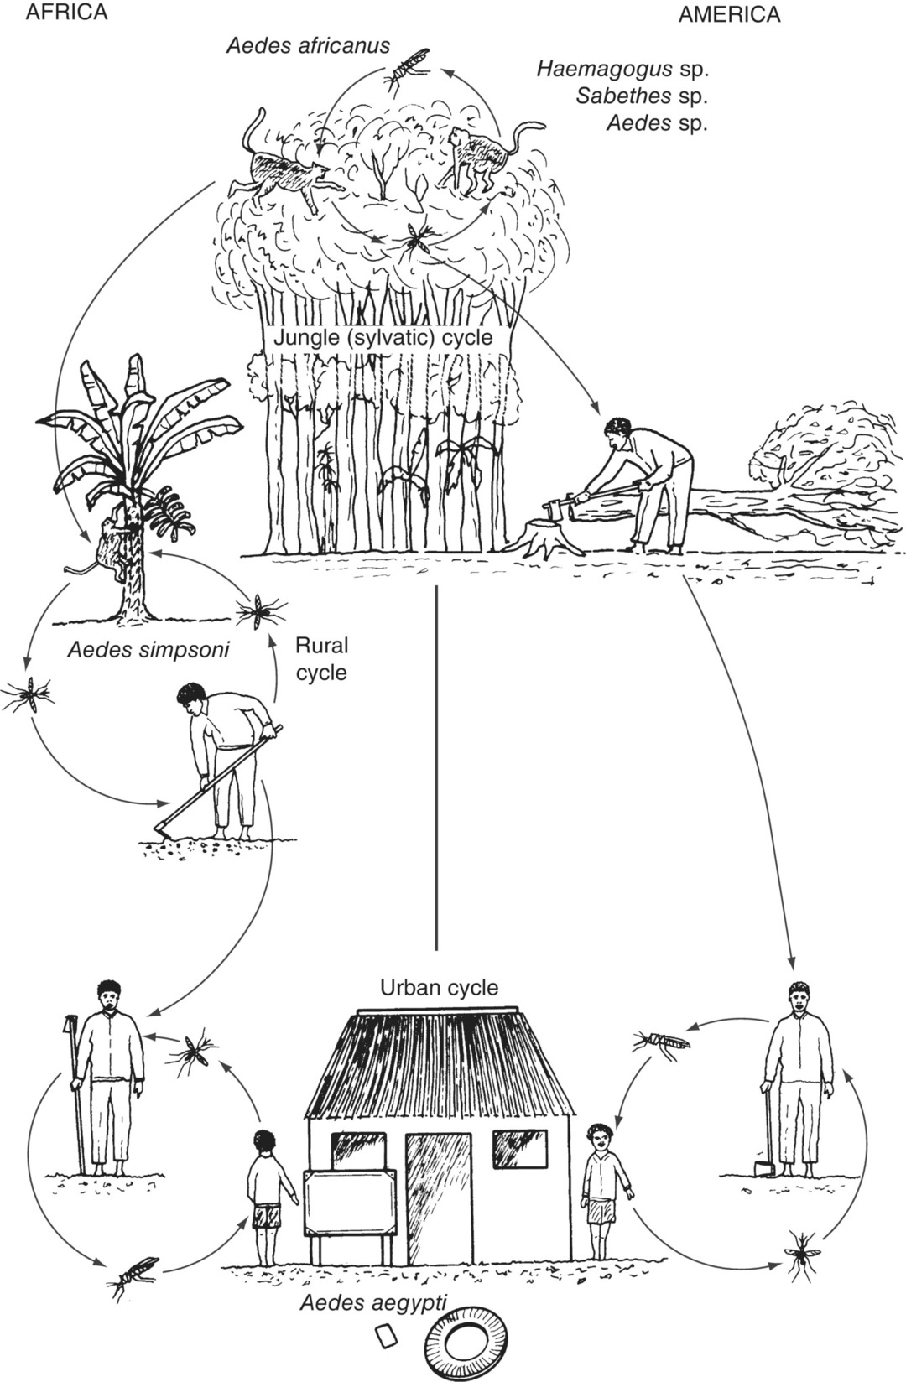
Fig. 15.4. Yellow fever transmission cycles in Africa and South America (including Panama).

Slide 8
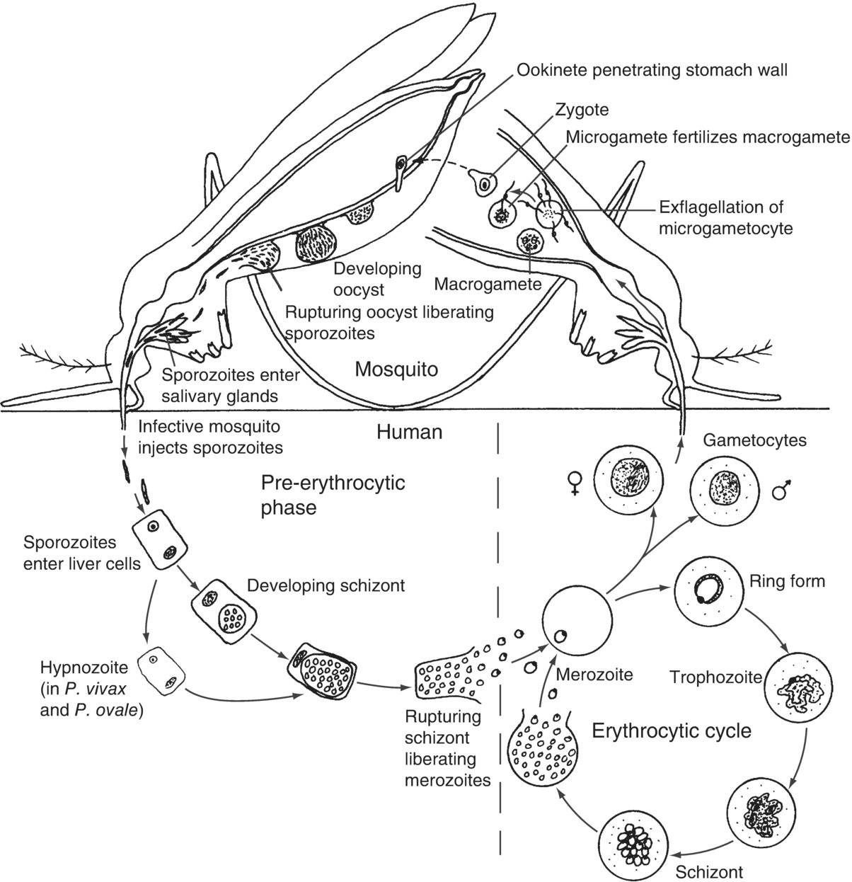
Fig. 15.5. The malaria (Plasmodium spp.) life cycle.

Slide 9
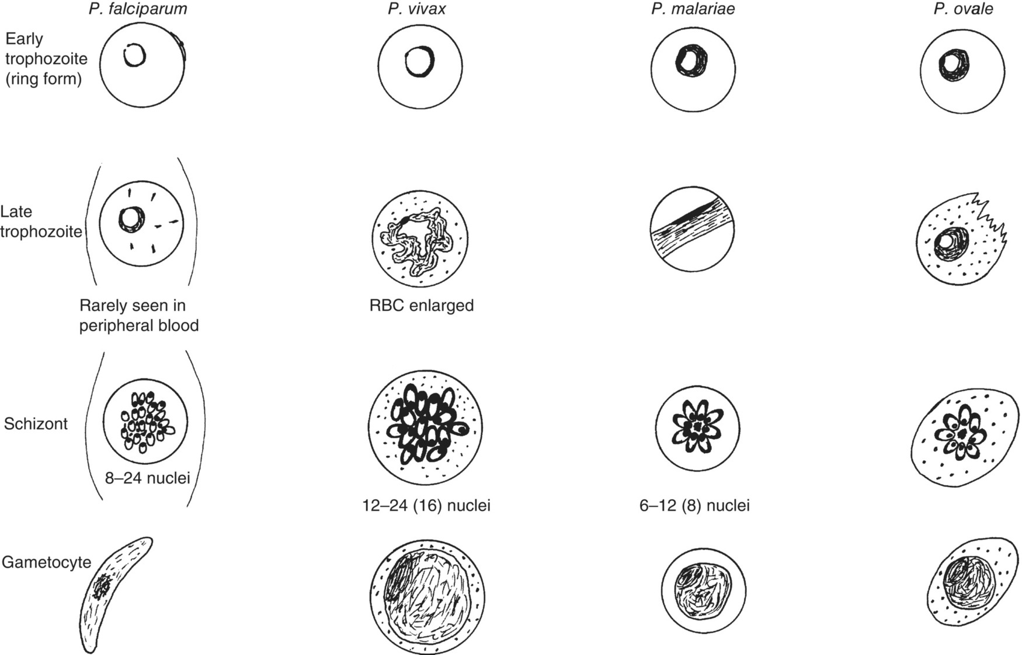
Fig. 15.6. Differential diagnosis of Plasmodium spp. RBC, red blood cell.

Slide 10
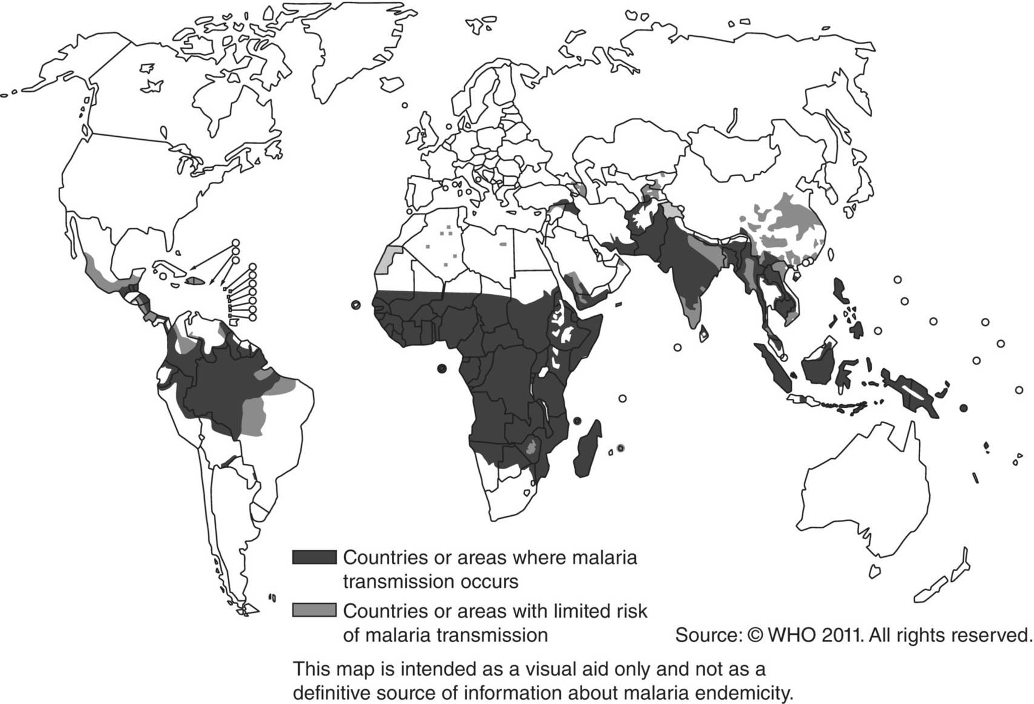
Fig. 15.7. Malaria, countries or areas at risk of transmission, modified 2019.
(Reproduced by permission of the World Health Organization, Geneva, Switzerland.)

Slide 11
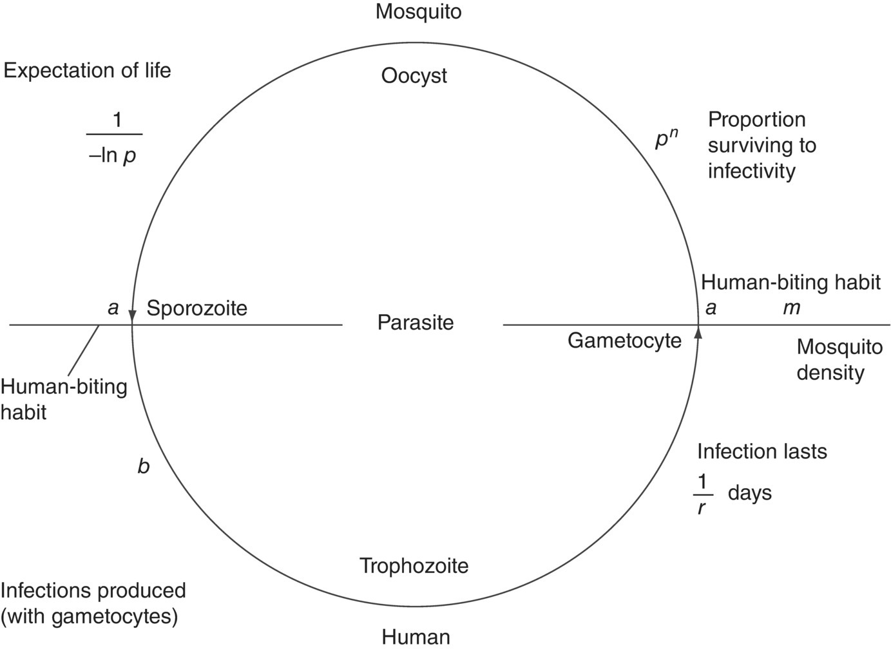
Fig. 15.8. Mathematical model of malaria based on the schematic life cycle of the parasite.

Slide 12
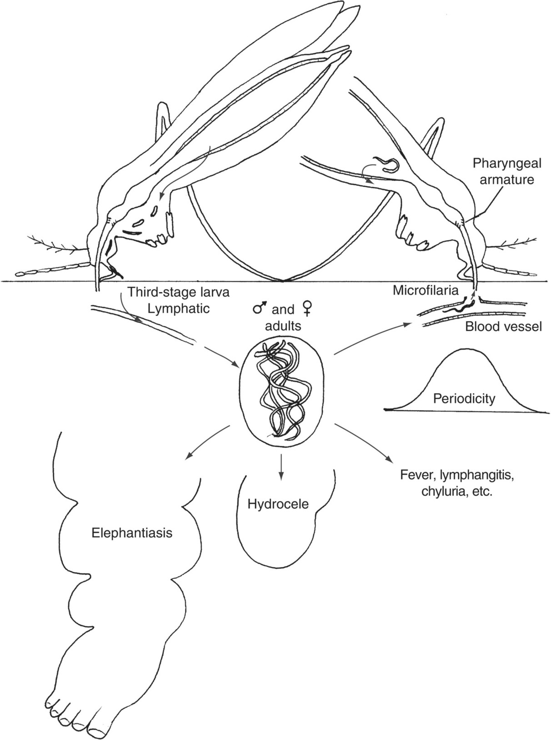
Fig. 15.9. Life cycle and clinical features of lymphatic filariasis.

Slide 13
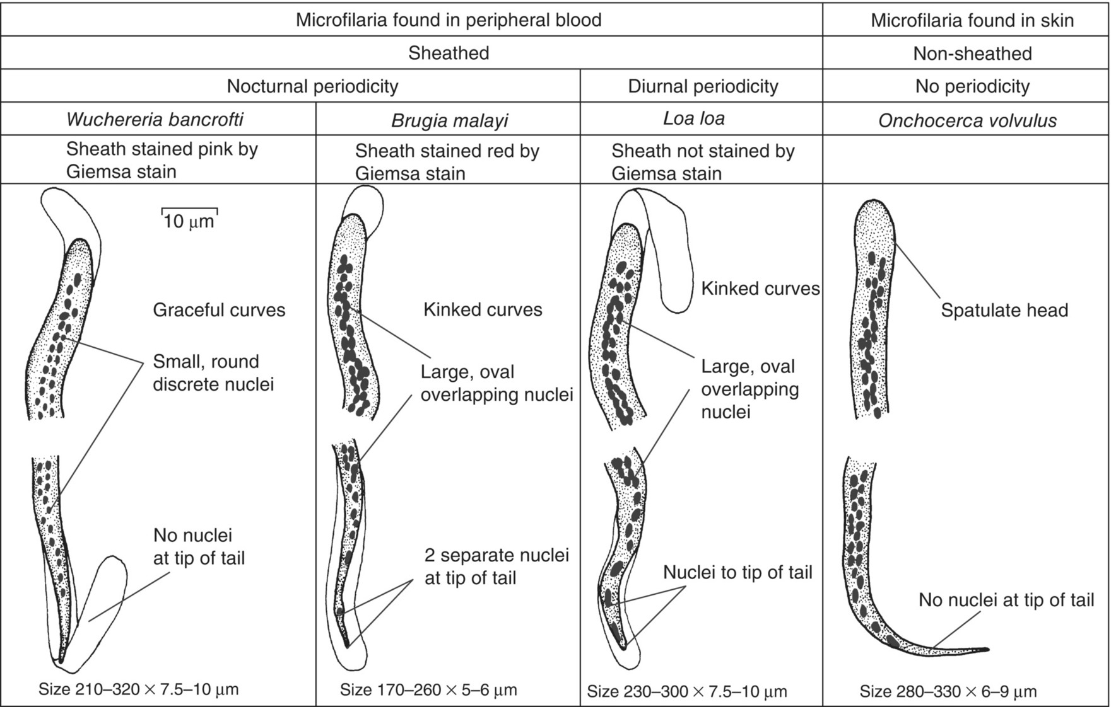
Fig. 15.10. Differential features of microfilariae of medical importance.
(Courtesy Department of Medical Parasitology, London School of Hygiene and Tropical Medicine.)

Slide 14
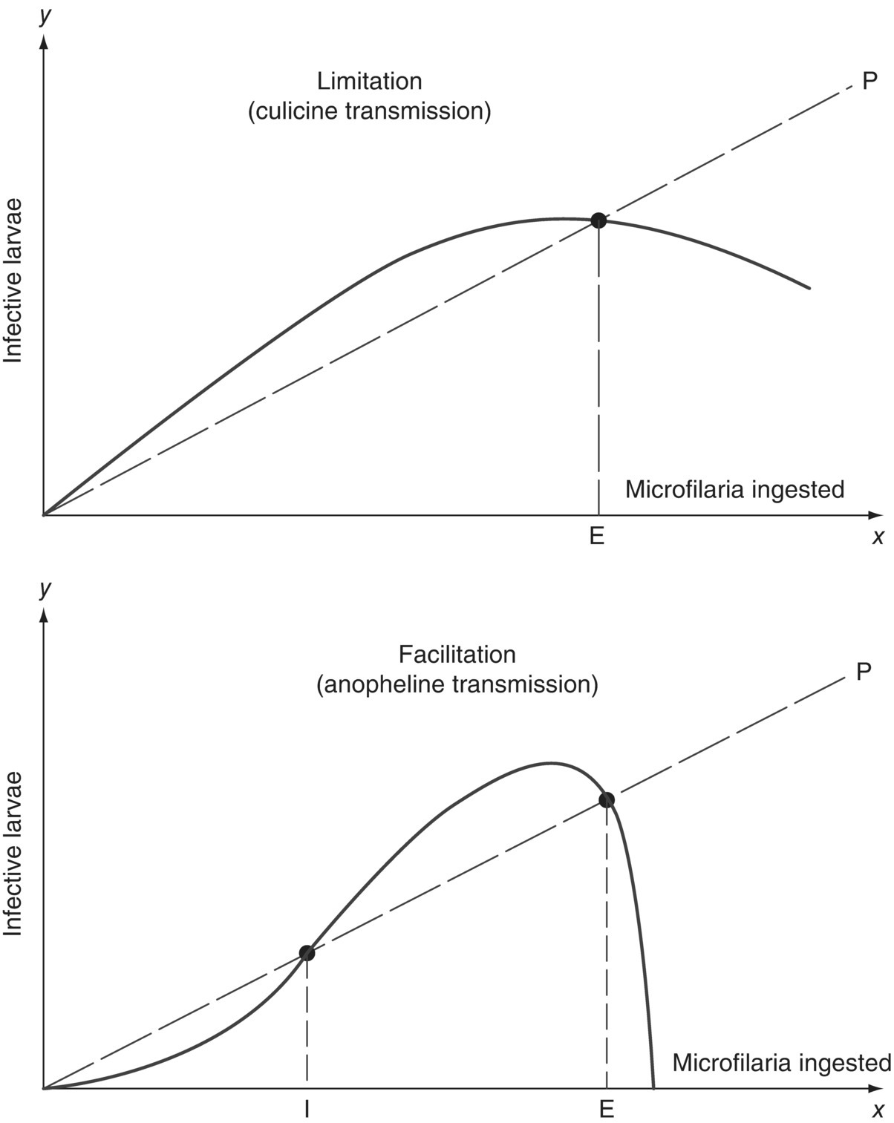
Fig. 15.11. The dynamics of culicine and anopheline transmitted filariasis. filarioses.
(Reproduced, by permission, from Pichon, G., Perrault, G. and Laigret, J. (1975) Rendement parasitaire chez les vecteurs de filarioses. (WHO/FIL/75.132), World Health Organization, Geneva, Switzerland.)

Slide 15
Fig. 15.12. Countries where lymphatic filariasis is endemic and status of mass drug administration (MDA) in those countries, 2015.
(Reproduced by permission of the World Health Organization, Geneva, Switzerland.)

Slide 16
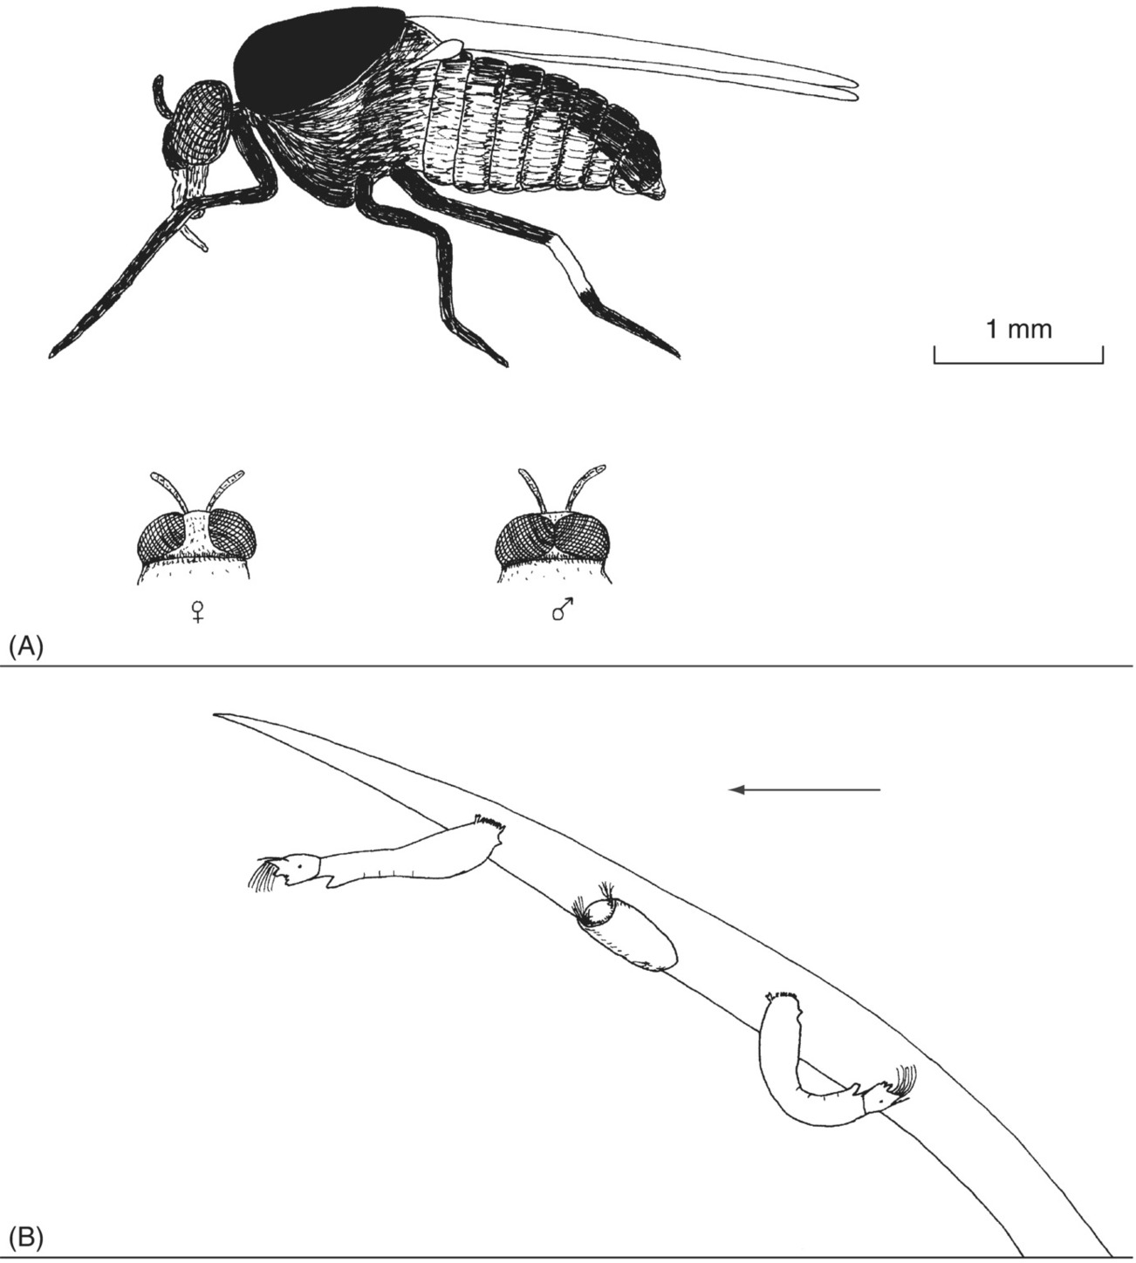
Fig. 15.13. Simulium, the vector of onchocerciasis. (A) Adult. (B) Larvae and a pupa attached to a water plant, the stream flowing in the direction of the arrow.

Slide 17
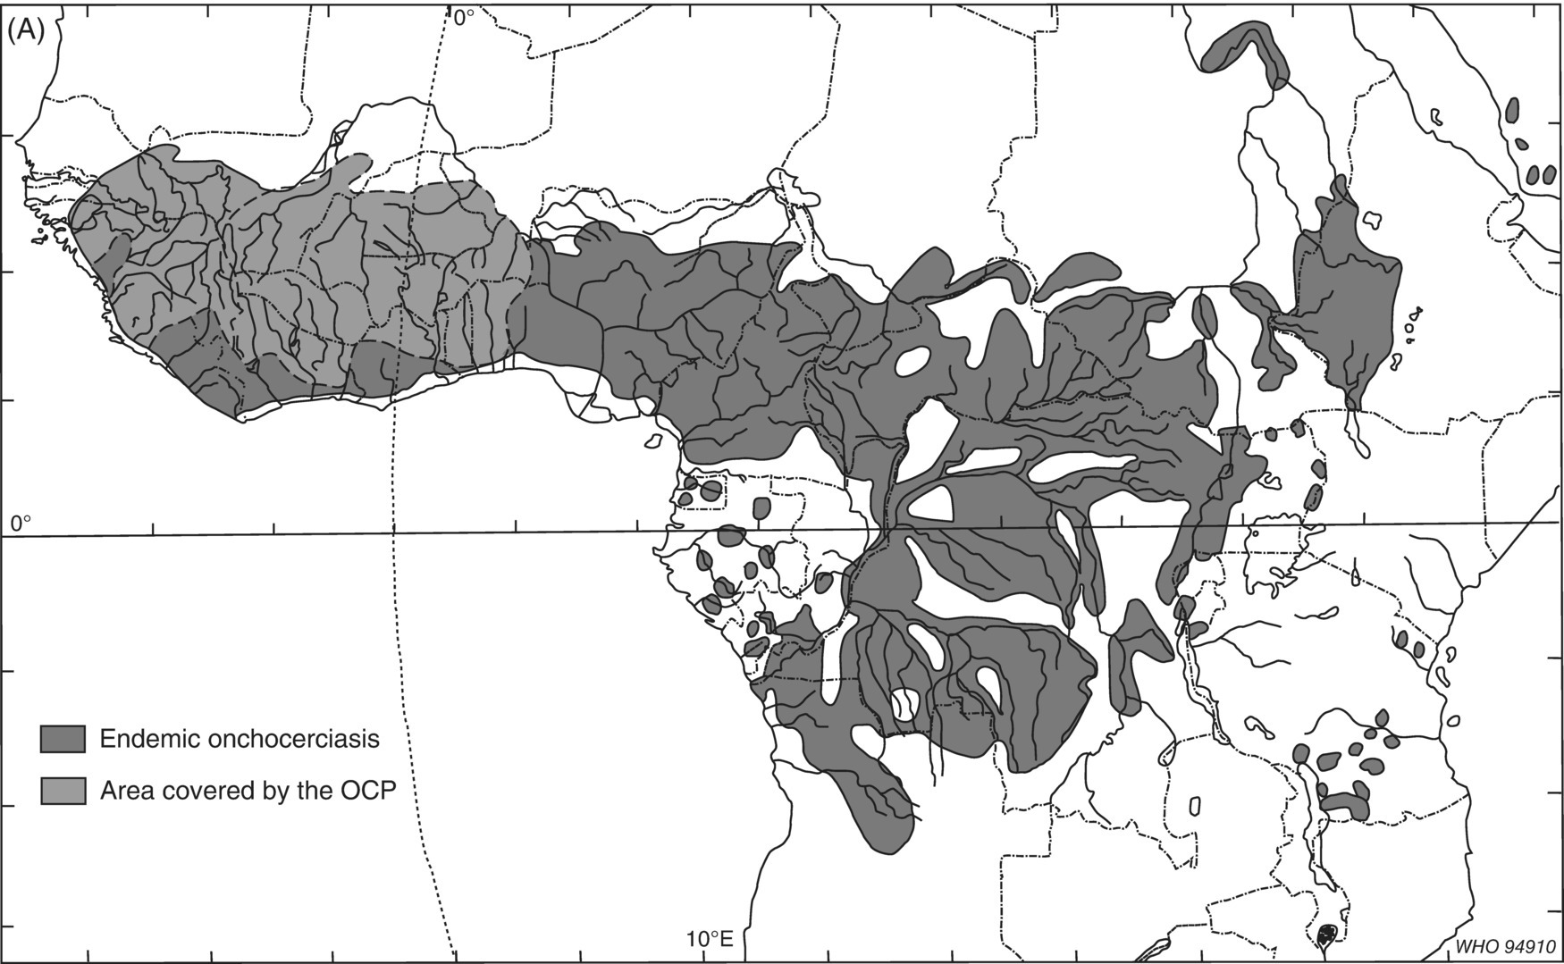
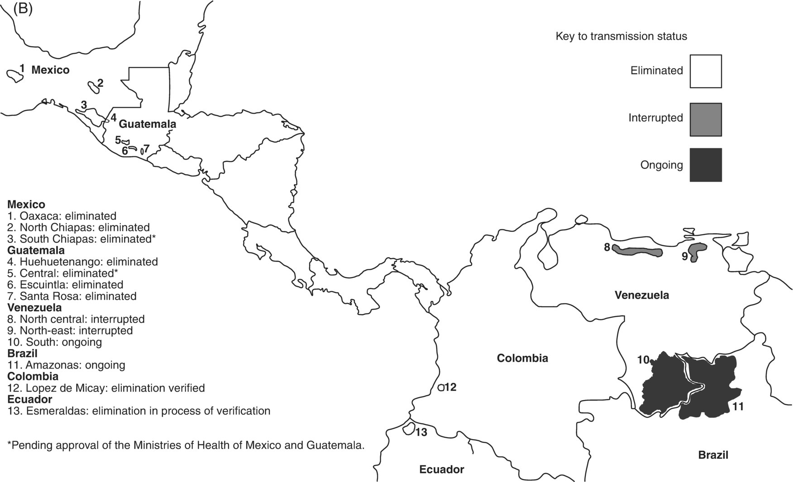
Fig. 15.14. Distribution of onchocerciasis. (A) Africa and Yemen. (B) the Americas. OCP, former Onchocerciasis Control Programme area. NB some of these foci have since been eliminated
(Part A from World Health Organization (1995) Onchocerciasis and its Control. Technical Report Series No. 852. Part B from Weekly Epidemiological Record No. 37, 12 November 2014. Both reproduced by permission of the World Health Organization, Geneva, Switzerland.)

Slide 18
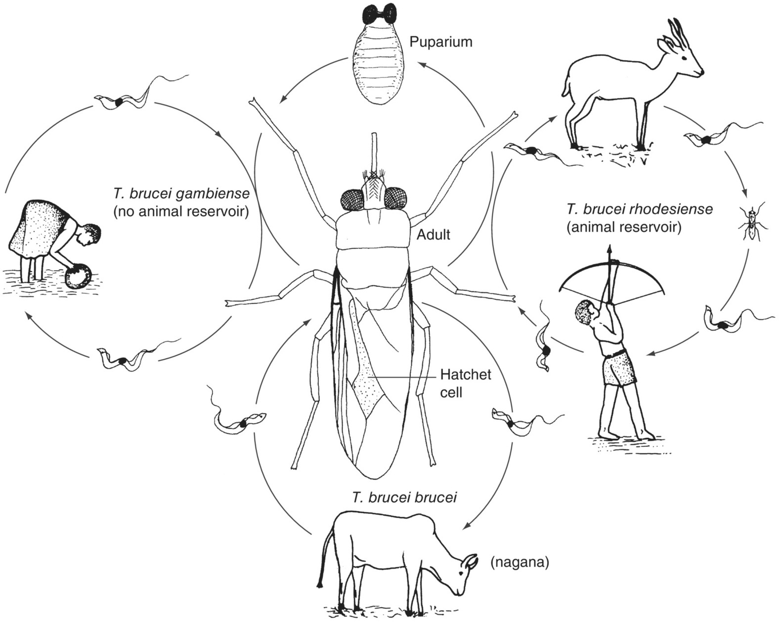
Fig. 15.15. African trypanosomiasis (caused by three subspecies of Trypanosoma brucei) life cycles and the tsetse fly.

Slide 19
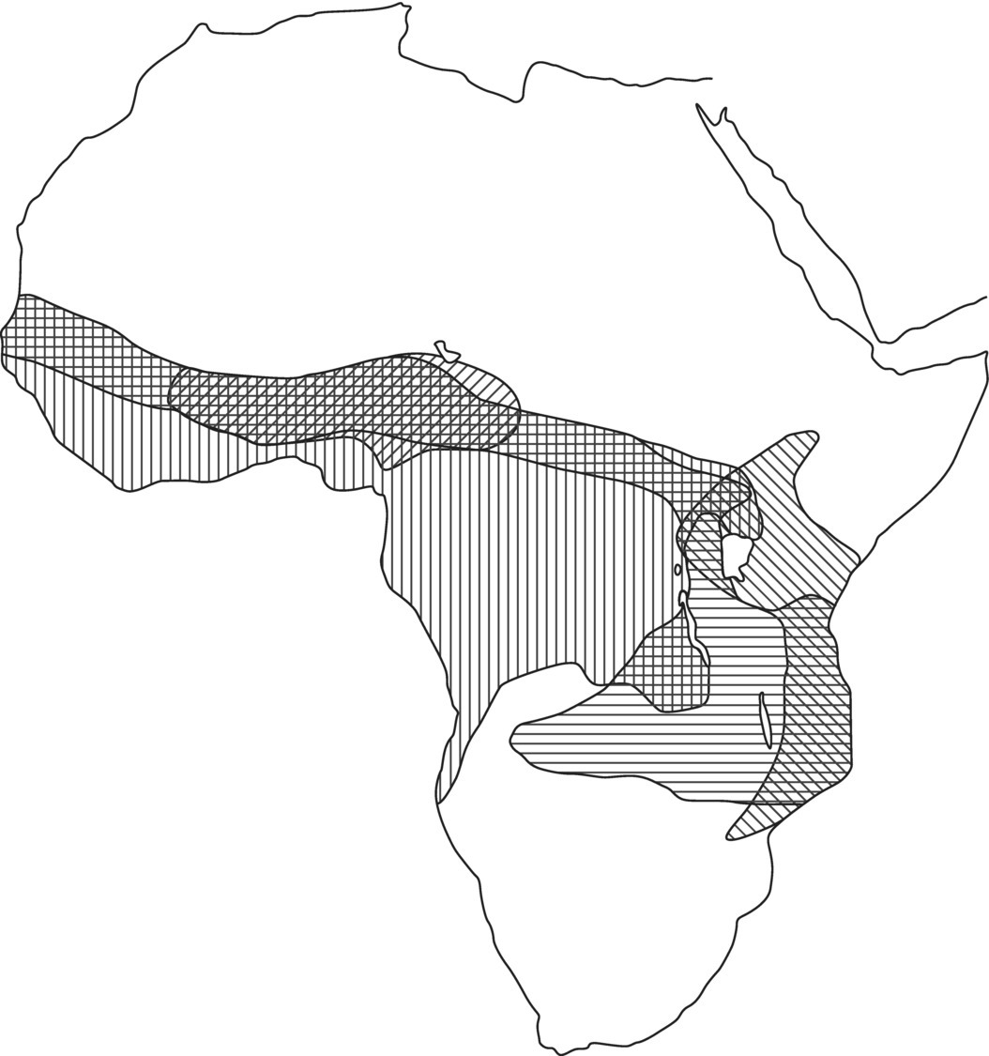




Fig. 15.16. Tsetse fly distribution in Africa.
, Glossina morsitans;
, Glossina pallidipes;
, Glossina palpalis and Glossina fuscipes;
, Glossina tachinoides.

Slide 20
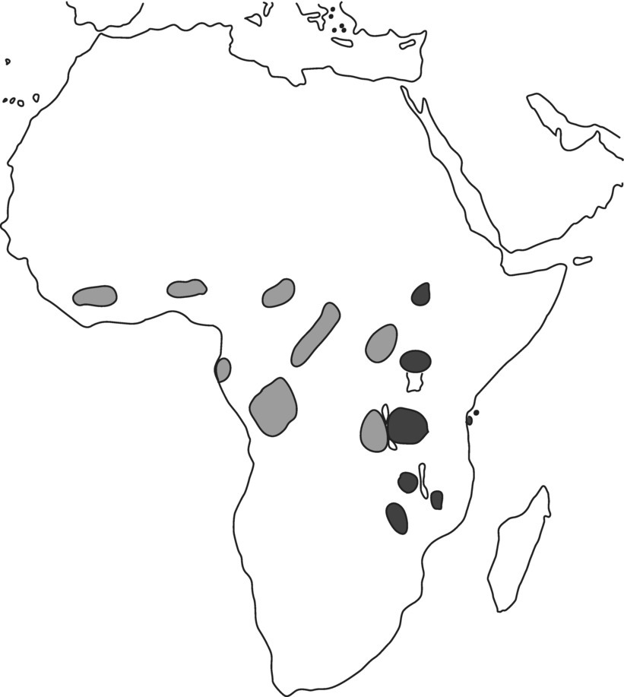
Fig. 15.17. Sleeping sickness foci in Africa. Light grey, Trypanosoma brucei gambiense; dark grey, Trypanosoma brucei rhodesiense.

Slide 21
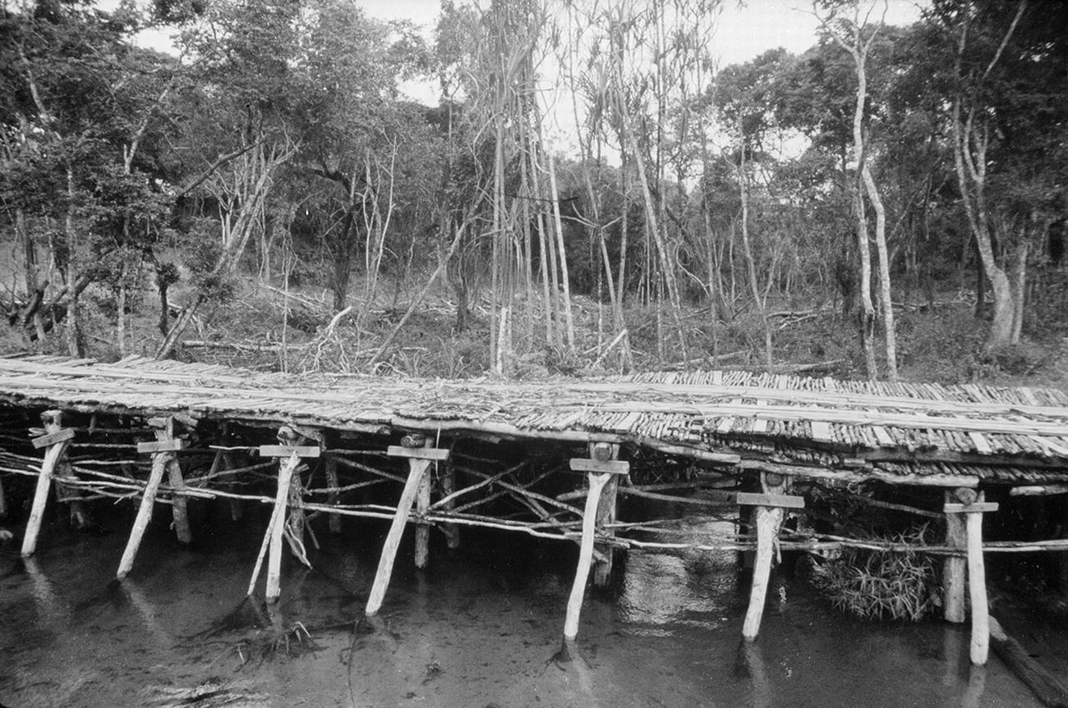
Fig. 15.18. Tunnel of forest along the banks of a river with selective clearance (leaving the big trees).

Slide 22
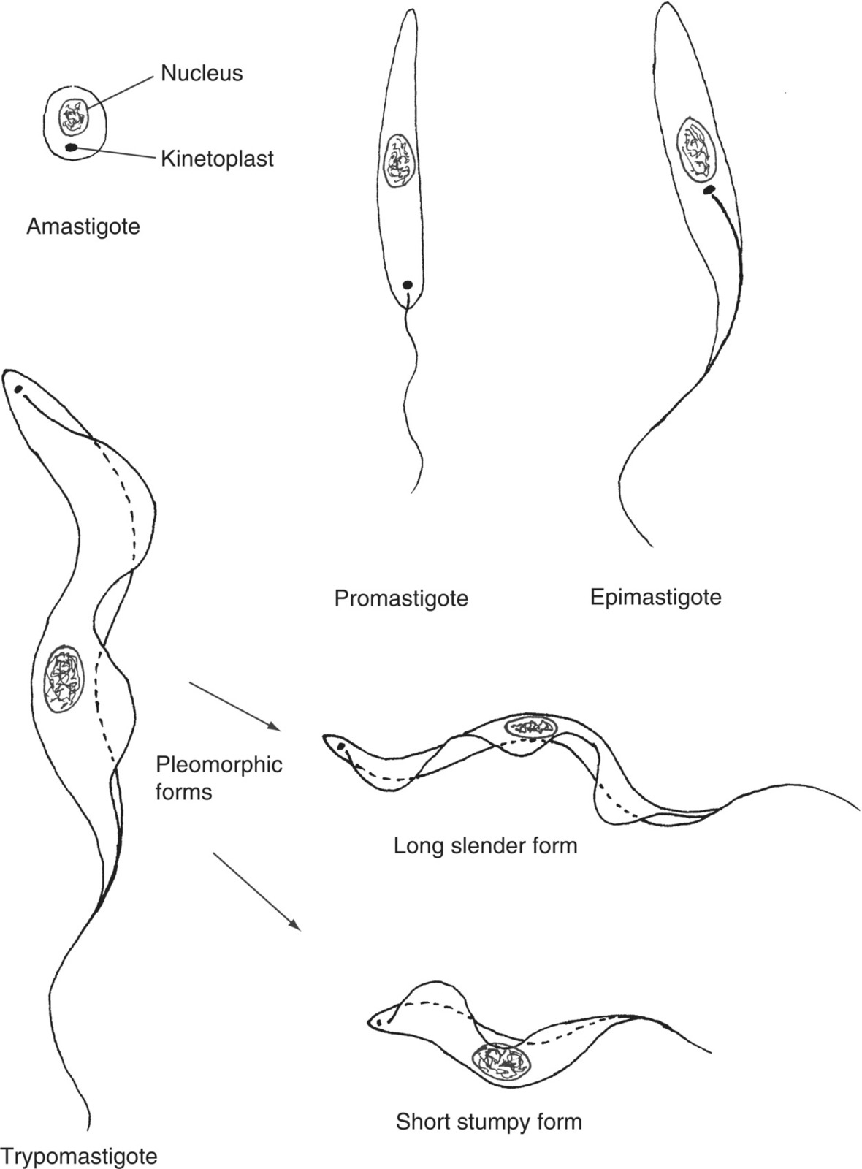
Fig. 15.19. Different forms of trypanosomes.

Slide 23
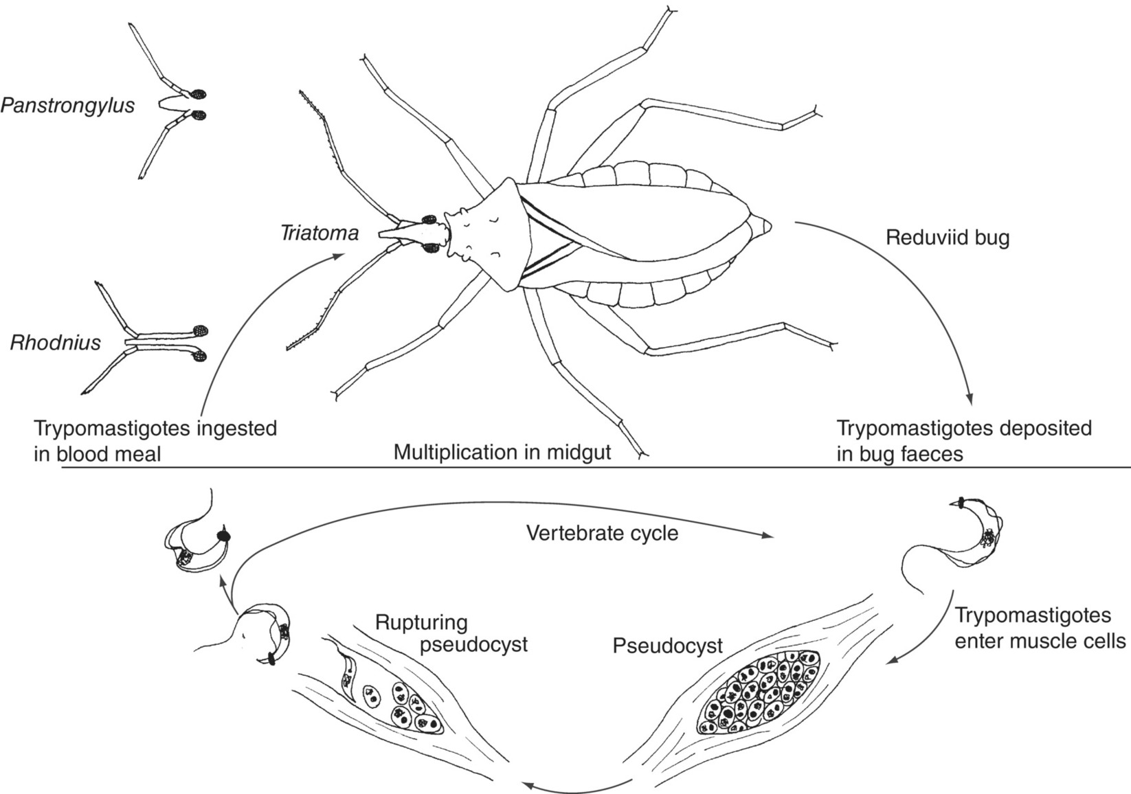
Fig. 15.20. Life cycle and vectors of American trypanosomiasis (Chagas’ disease).

Slide 24
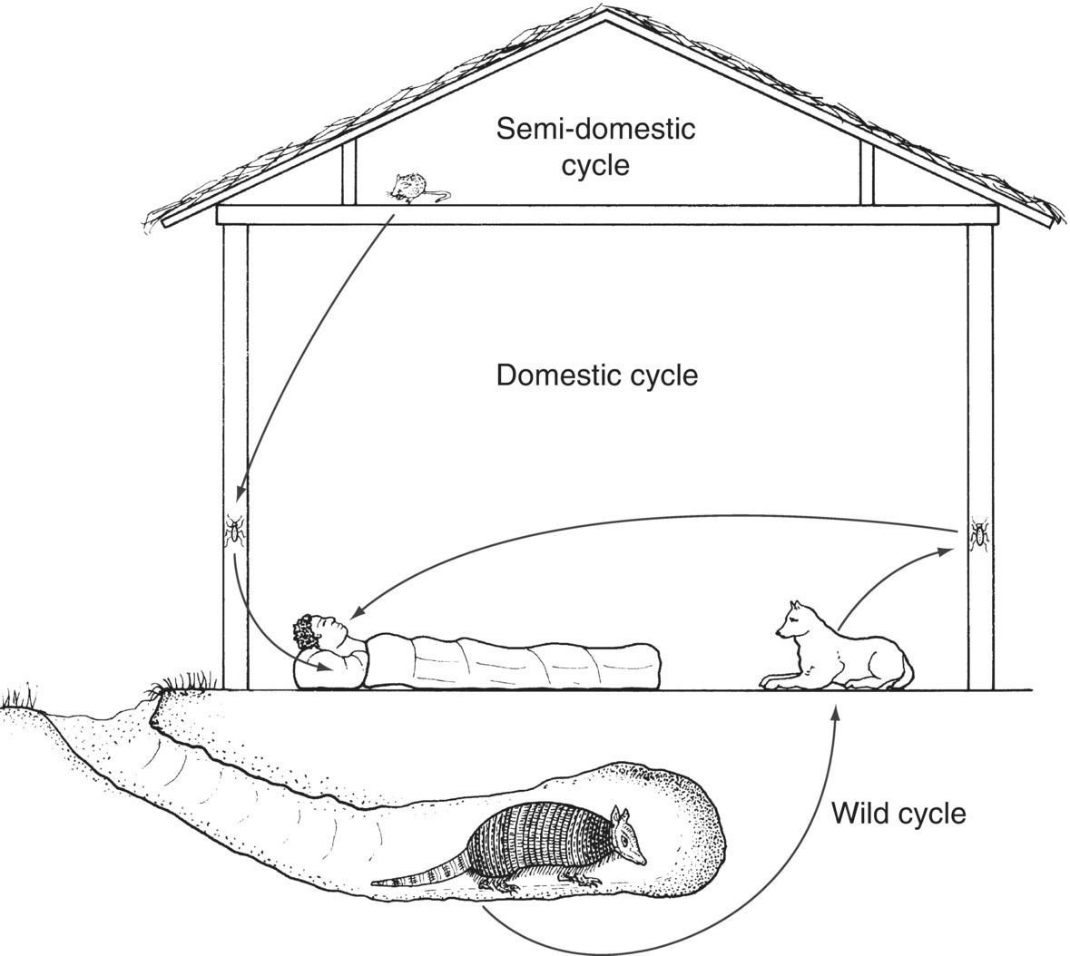
Fig. 15.21. Transmission cycles of American trypanosomiasis.

Slide 25
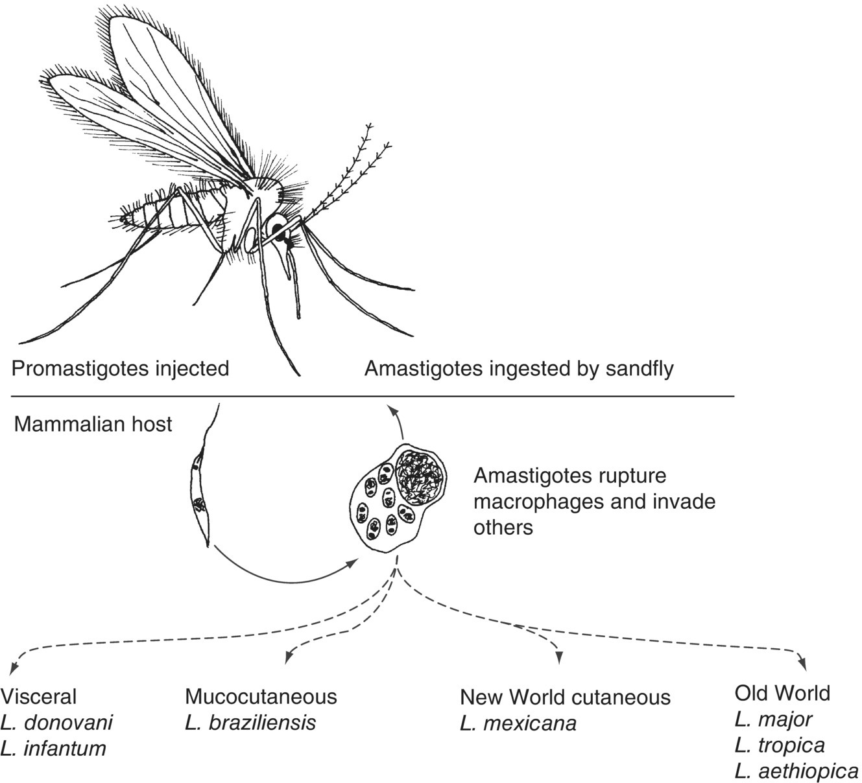
Fig. 15.22. Leishmania vector, parasite and life cycle.

Slide 26
Fig. 15.23. The distribution of new cutaneous leishmaniasis (CL) cases in 2016.
(Reproduced in a modified form by permission of the World Health Organization, Geneva, Switzerland.)

Slide 27
Fig.15.24. The distribution of new visceral leishmaniasis (VL) cases in 2016.
(Reproduced in a modified form by permission of the World Health Organization, Geneva, Switzerland.)

Slide 28
Further reading
Cameron, M. and Lorenz, L. (2013) Biological and Environmental Control of Disease Vectors. CAB International, Wallingford, UK.
Fried, M. and Duffy, P.E. (2007) Malaria in Pregnancy: Deadly Parasite, Susceptible Host. Taylor & Francis, London/Informa Healthcare, New York.
Githeko, A.K., Lindsay, S.W., Confalonieri, U.E. and Patz, J.A. (2000) Climate change and vector-borne diseases: a regional analysis. Bulletin of the World Health Organization 78, 1136–1147. Available at: www.who.int/bulletin/archives/78(9)1136.pdf (accessed 22 February 2012).
Halstead, S. (2008) Dengue (Tropical Medicine: Science and Practice). World Scientific Publishing, Singapore/Hackensack, New Jersey/London.
Malaria Consortium (2007) Malaria: A Handbook for Health Professionals. Macmillan, Basingstoke, UK.
Maudlin, I., Holmes, P.H. and Miles, M.A. (eds) (2004) The Trypanosomiases. CAB International, Wallingford, UK.
Reithinger, R., Kamya, R.M., Whitty, J.M., Dorsey, G. and Vermund, S.H. (2009) Interaction of malaria and HIV. British Medical Journal 338, elocator b2141, 1400–1401.
Service, M.W. (ed.) (2001) The Encyclopedia of Arthropod-transmitted Infections of Man and Domesticated Animals. CAB International, Wallingford, UK.
Service, M.W. (2012) Medical Entomology for Students, 5th edn. Cambridge University Press, Cambridge, UK.
Warrell, D. and Gilles, H.M. (2002) Essential Malariology, 4th edn. Hodder Arnold, London.
World Health Organization (1992) Lymphatic Filariasis: The Disease and its Control. Fifth Report of the WHO Expert Committee on Filariasis. Technical Report Series, No. 821, WHO, Geneva, Switzerland.
World Health Organization (1995) Onchocerciasis and its Control. Report of a WHO Expert Committee on Onchocerciasis Control. Technical Report Series, No. 852. WHO, Geneva, Switzerland.
World Health Organization (2000) Expert Committee on Malaria, 20th Report. Technical Report Series, No. 892. WHO, Geneva, Switzerland.
World Health Organization (2000) Management of Severe Malaria: A Practical Handbook, 2nd edn. WHO, Geneva, Switzerland.
World Health Organization (2006) Pesticides and Their Application: For the Control of Vectors and Pests of Public Health Importance, 6th edn. Publication No. WHO/CDS/
NTD/WHOPES/GCDPP/2006.1, Geneva, Switzerland.
World Health Organization (2007) Long-lasting Insecticidal Nets for Malaria Prevention, 3rd edn. WHO, Geneva, Switzerland.
World Health Organization (2015) Guidelines for the Treatment of Malaria, 3rd edn. WHO, Geneva, Switzerland.

