Slide 1
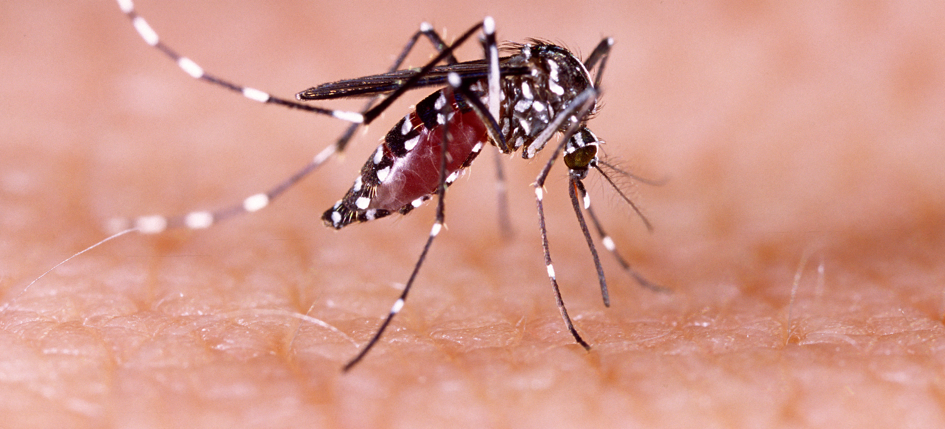
Communicable Diseases, 6th Edition
A Global Perspective
Roger Webber

Slide 2
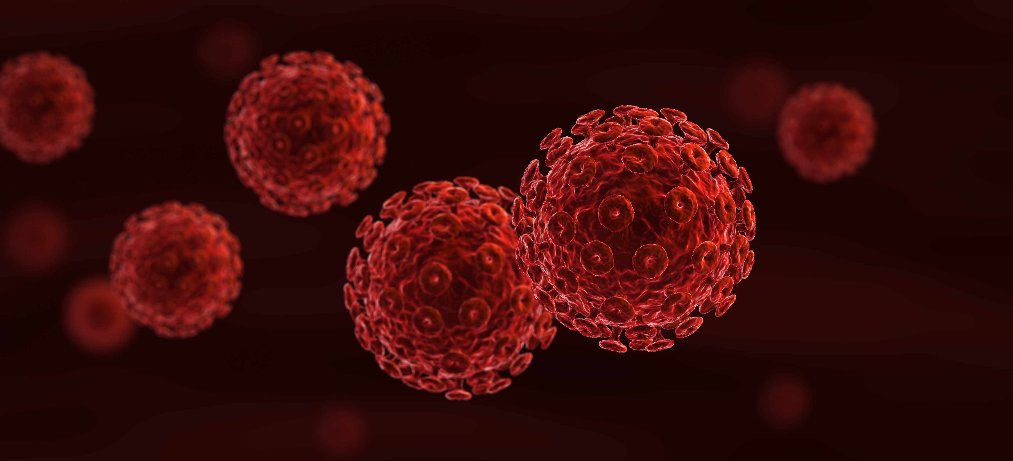
Chapter 14: Diseases Transmitted via Body Fluids

Slide 3
Summary
A number of important infections are transmitted by the body fluids of blood, serum, semen, saliva and various other discharges, and include the sexually transmitted diseases, HIV, hepatitis viruses and haemorrhagic fevers.
Sexual transmission is increased by contact with commercial sex workers and having multiple partners, and then generally transferred to the spouse, also often affecting the children.
Health education of both sexes, the use of condoms, provision of detection and treatment facilities, screening of blood and the use of disposable needles and syringes are methods of prevention.
HBV vaccination should be started following birth, while an effective vaccination for HIV infection is still hoped for.

Slide 4
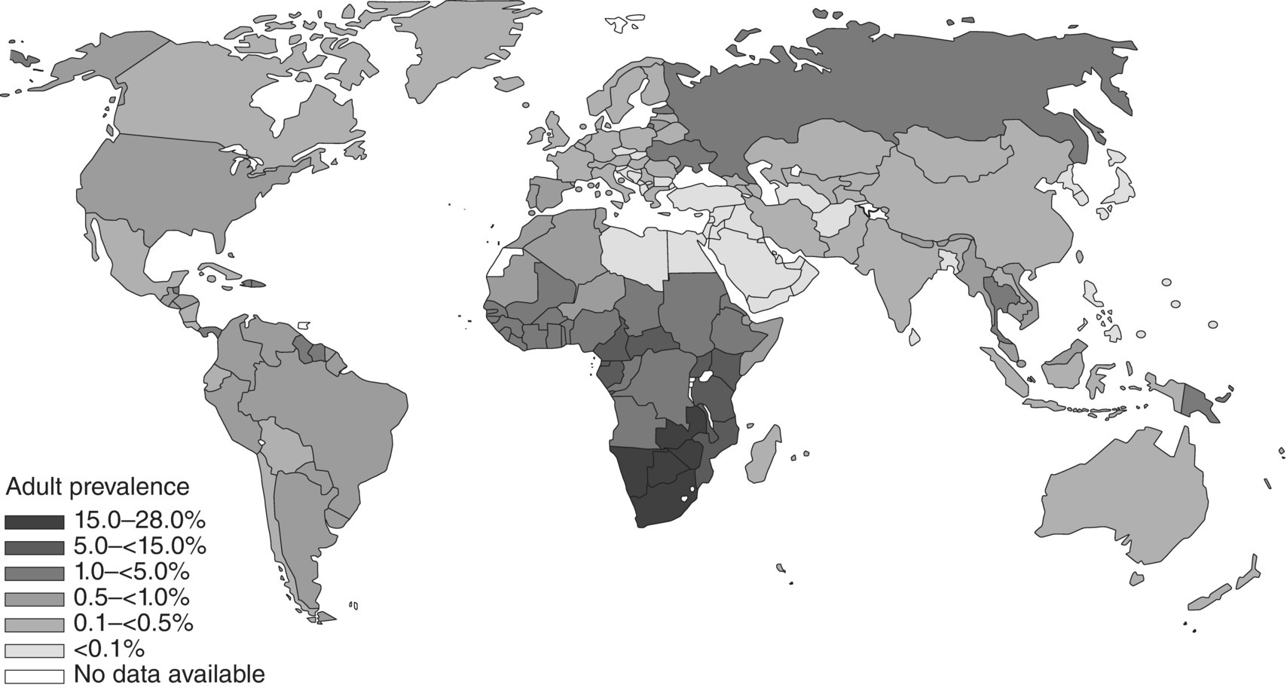
Fig. 14.1. A global view of HIV infection in 2007, 33 million people (range: 30–36 million) living with HIV.
(Reproduced by permission of the World Health Organization, Geneva, Switzerland.)

Slide 5
Fig. 14.2. Hepatitis B prevalence in the world.
(Reproduced by permission of the World Health Organization, Geneva, Switzerland.)

Slide 6
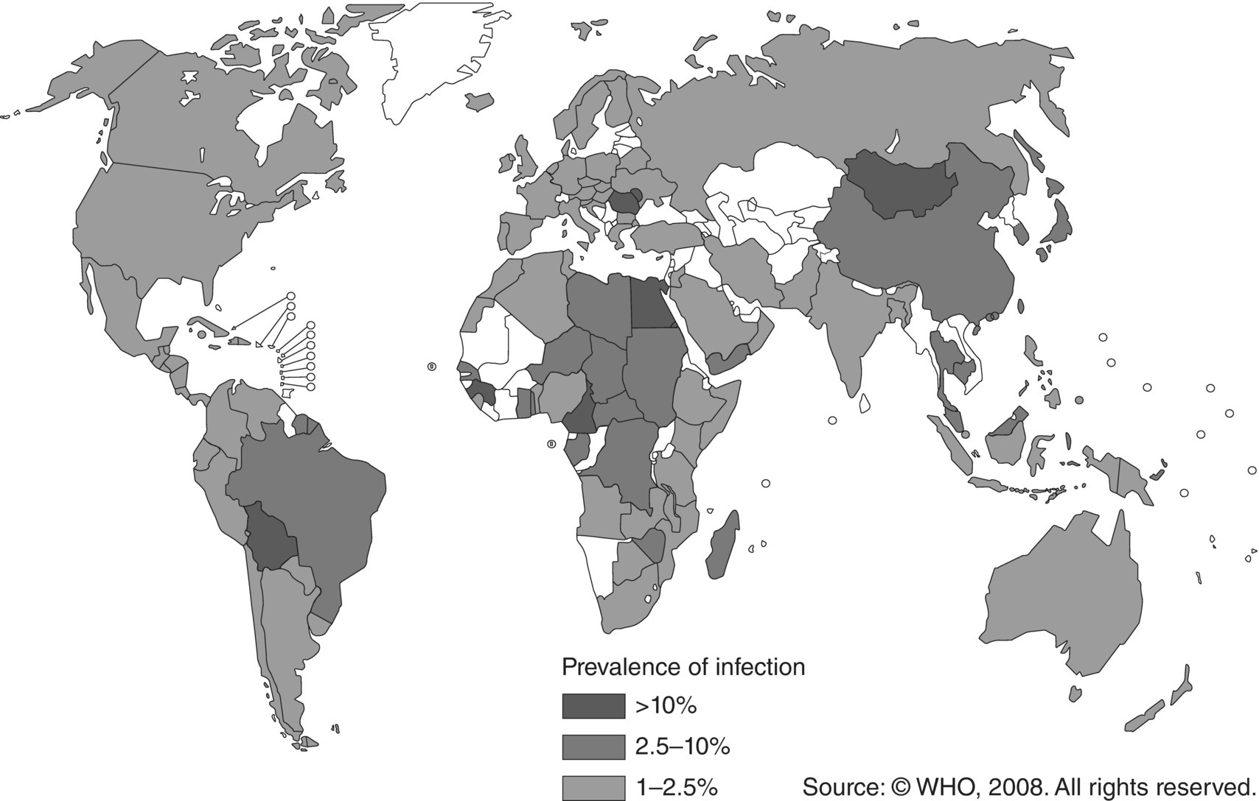
Fig. 14.3. Hepatitis C prevalence, 2007.
(Reproduced by permission of the World Health Organization, Geneva, Switzerland.)

Slide 7
Further reading
Bert, F., Gualano, M.R., Biancone, P., Brescia, V., Camussi, E., Martorana M. et al. (2018) HIV screening in pregnant women: A systematic review of cost-effectiveness studies. International Journal of Health Planning & Management 33(1), 31–50.
Clutterbuck, D. (2004) Sexually Transmitted Infections and HIV. Mosby-Wolfe, London.
Family Planning New South Wales (2011) Reproductive and Sexual Health: An Australian Clinical Practice Handbook, 2nd edn. Family Planning New South Wales, Sydney, Australia.
Reithinger, R., Kamya, R.M., Whitty, J.M., Dorsey, G. and Vermund, S.H. (2009) Interaction of malaria and HIV. British Medical Journal 338, elocator b2141, 1400–1401.
Rogstad, K. (ed.) (2011) ABC of Sexually Transmitted Infections, 6th edn. Wiley-Blackwell, Oxford and Chichester, UK.
World Health Organization (2005) Interim WHO Clinical Staging of HIV/AIDS and HIV/AIDS Case Definition for Surveillance, African Region. Document Ref. No. WHO/HIV/2005.02, WHO, Geneva, Switzerland. Also available at: http://www.who.int/hiv/pub/guidelines/casedefinitions/en/ (accessed 21 December 2015).
World Health Organization (2007) Tuberculosis Care with TB-HIV Co-management: IMAI. WHO, Geneva, Switzerland. Also available at: http://www.who.int/hiv/pub/imai/TB_HIVModule23.05.07.pdf (accessed 6 March 2012).
World Health Organization (2010) Antiretroviral Therapy for HIV Infection in Adults and Adolescents: Recommendations for a Public Health Approach, 2010 Revision. WHO, Geneva, Switzerland. Also available at: http://whqlibdoc.who.int/publications/2010/
9789241599764_eng.pdf (accessed 6 March 2012).
World Health Organization (2012) Use of Antiretrovial Drugs for Treating Pregnant Women and Preventing HIV Infection in Infants: Programmatic Update. WHO, Geneva, Switzerland..

Slide 8
Web resources
HIV Treatment. Available at: http://www.who.int/hiv/pub/arv/adult2010/en/ (accessed 21 December 2015).

