Slide 1
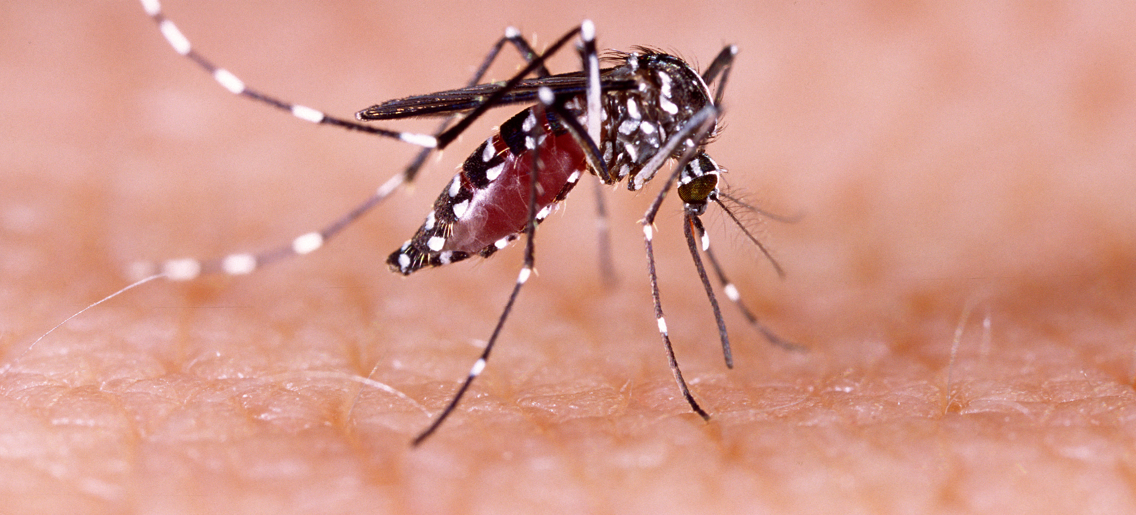
Communicable Diseases, 6th Edition
A Global Perspective
Roger Webber

Slide 2
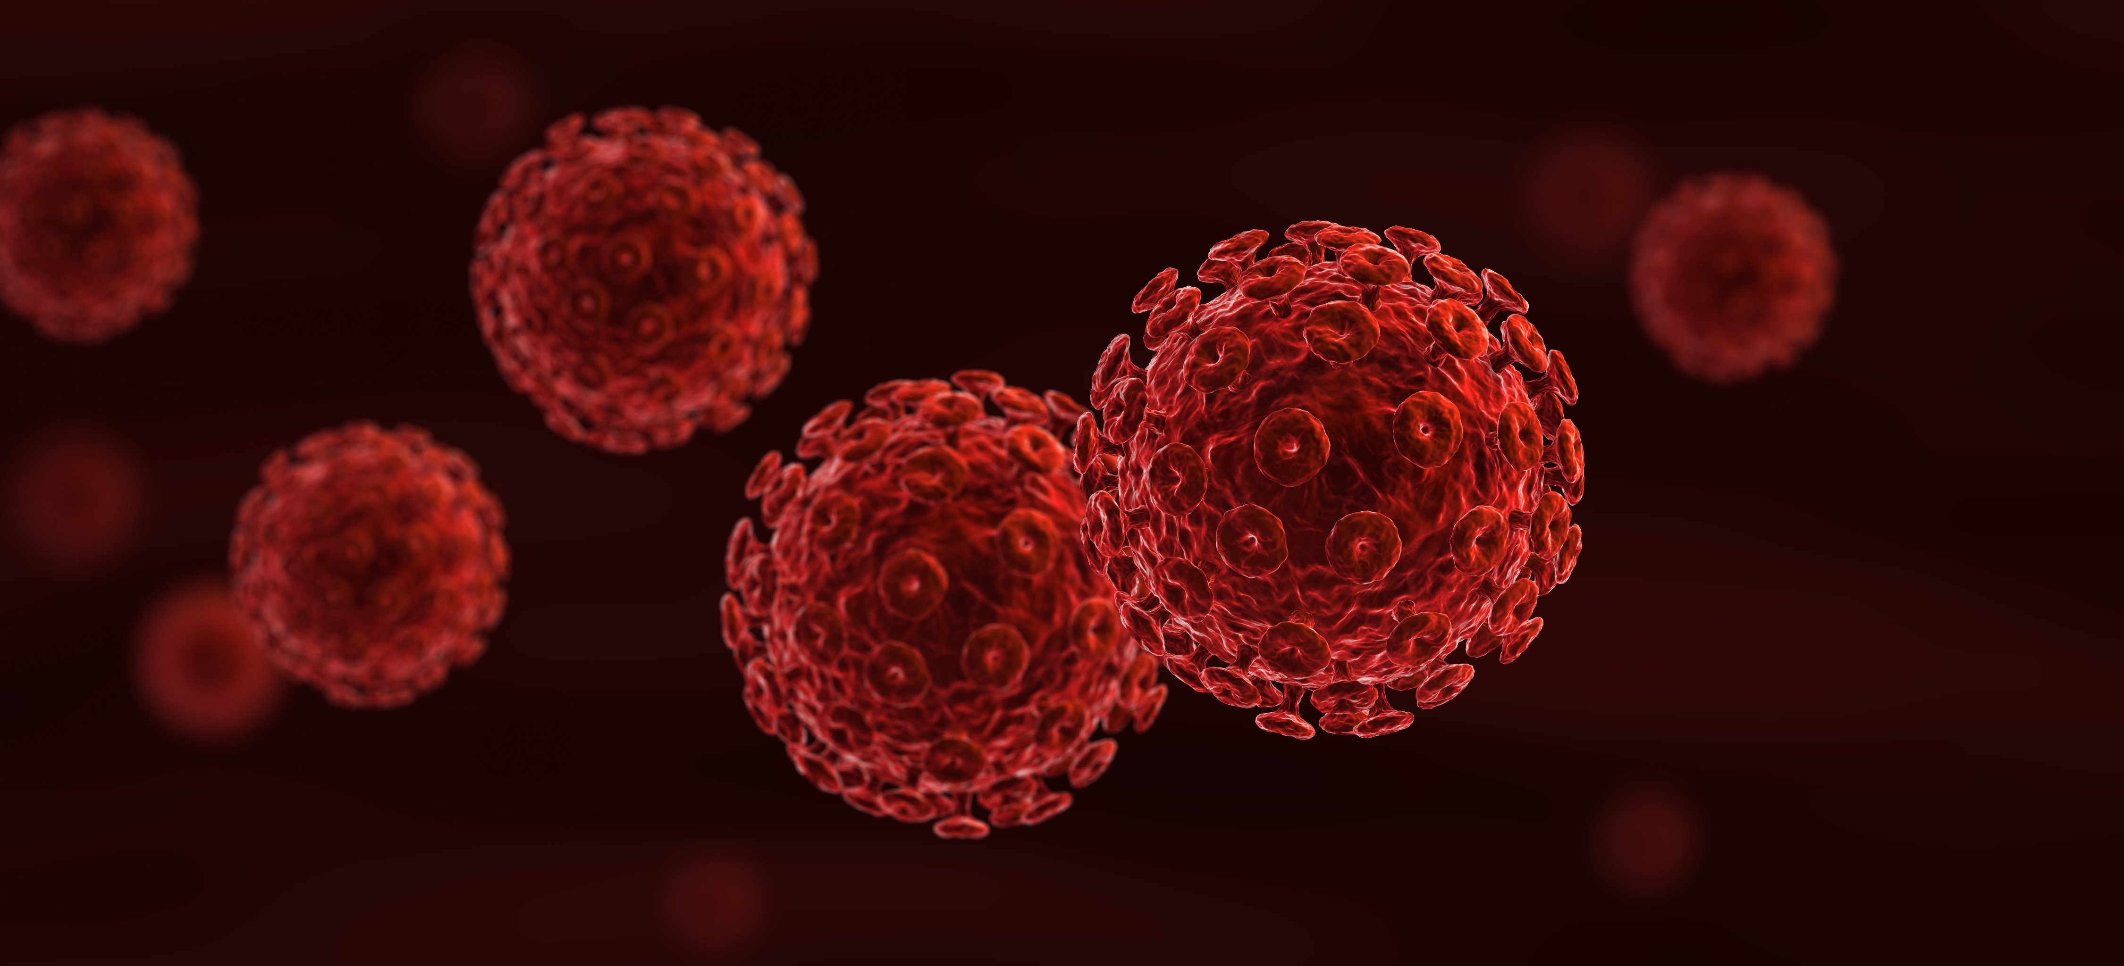
Chapter 13: Respiratory Diseases and Other Airborne-transmitted Infections

Slide 3
Summary
Infections of the respiratory system are the most important cause of morbidity and mortality in the world.
Although numerous organisms are responsible for producing infection, it is the response of the host that determines the severity of the disease.
The main method of transmission is by droplets, either coughed directly on to another person or on to surfaces from which they are inadvertently transferred to mucous membranes.
Additional factors such as age (the young and the old), overcrowding, malnutrition, smoking and other concurrent infections increase the frequency and severity of infection.
Epidemic infections, particularly influenza, have a seasonality during the rainy season in the tropics and during the cooler months in northern climates.
Meningitis, otitis media and rheumatic fever are also due to infection acquired by the respiratory route.
Many of the respiratory infections are prevented by vaccination, which is the main method of immediate control, but established personal hygiene habits, the raising of living standards and the control of family size are long-term preventive measures.

Slide 4
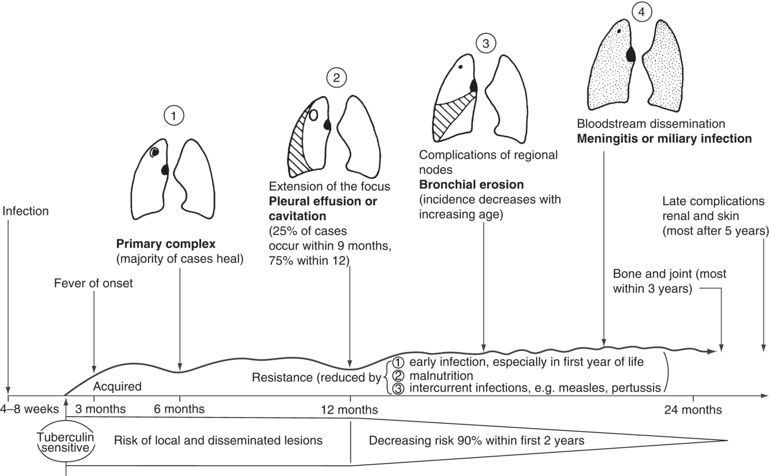
Fig. 13.1. The evolution of untreated primary tuberculosis.
(Modified figure. Reproduced by permission from Miller, F.J.W. (1982) Tuberculosis in Children. Churchill Livingstone, Edinburgh, UK.)

Slide 5
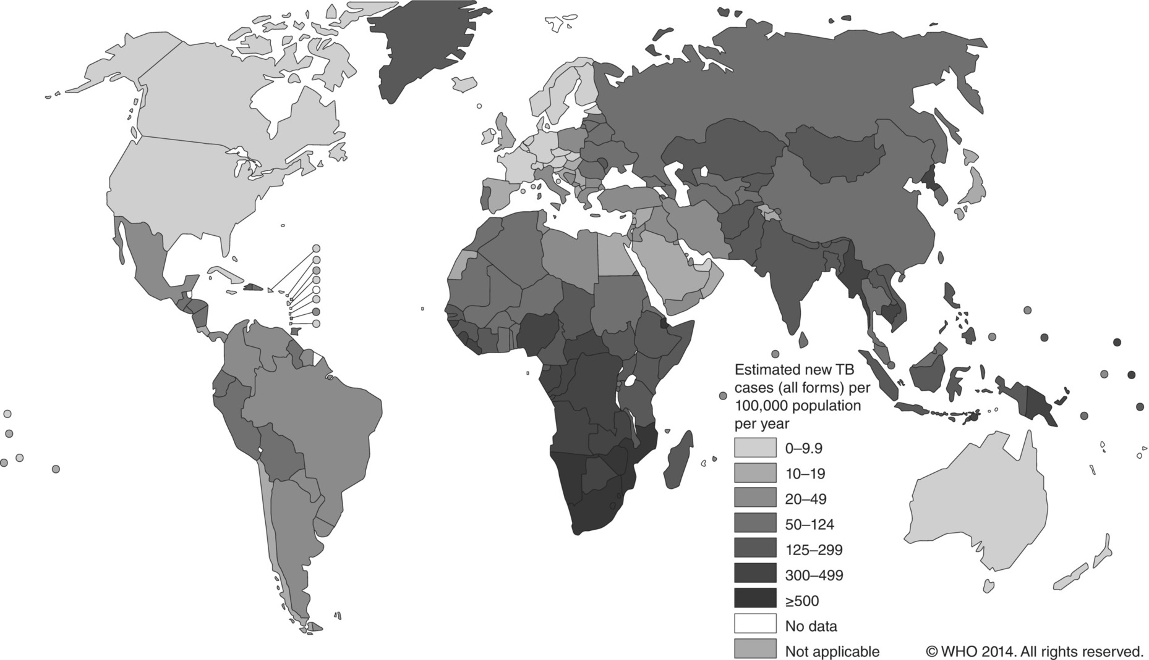
Fig. 13.2. Estimated TB (tuberculosis) incidence rates, 2013.
(Reproduced by permission of the World Health Organization, Geneva.)

Slide 6
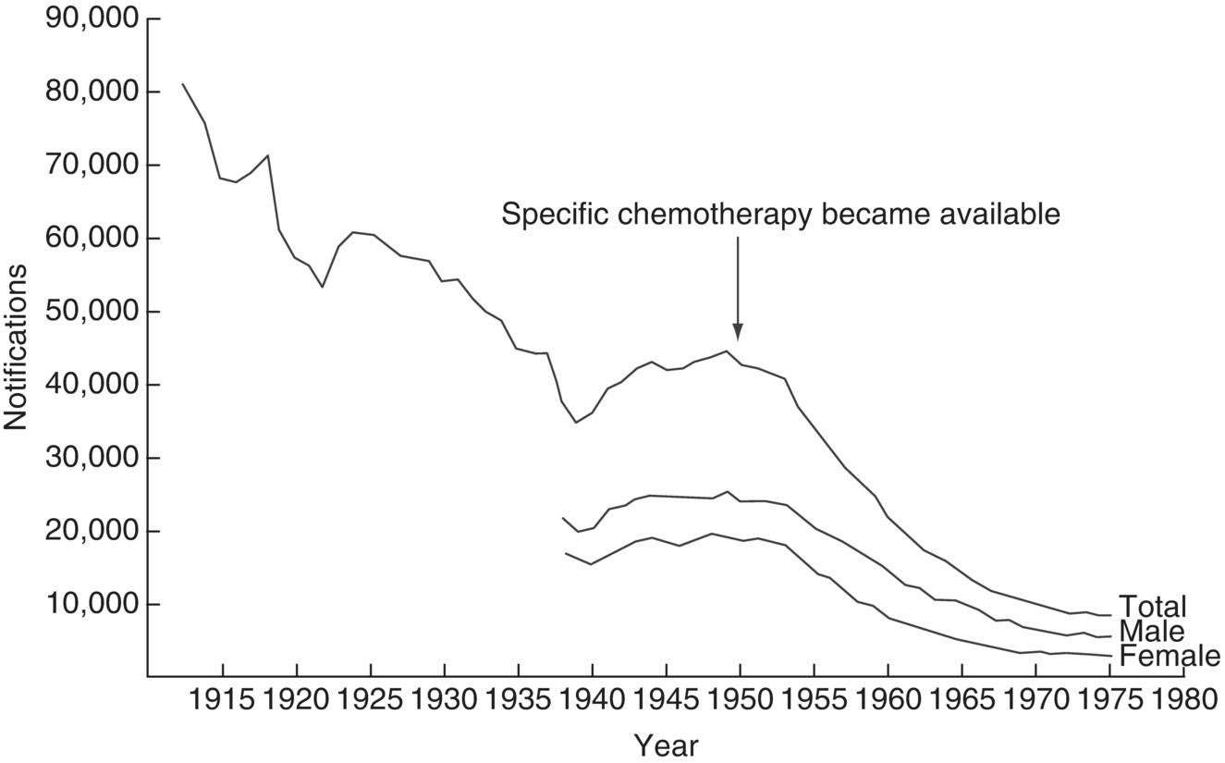
Fig. 13.3. The decline of tuberculosis (TB) in England and Wales 1912–1975.
(From DHSS (1977) Annual Report of the Chief Medical Officer, Department of Health and Social Security for 1976, Her Majesty’s Stationary Office, London. Contains public service sector information licensed under the Open Government Licence v 3.0.)

Slide 7
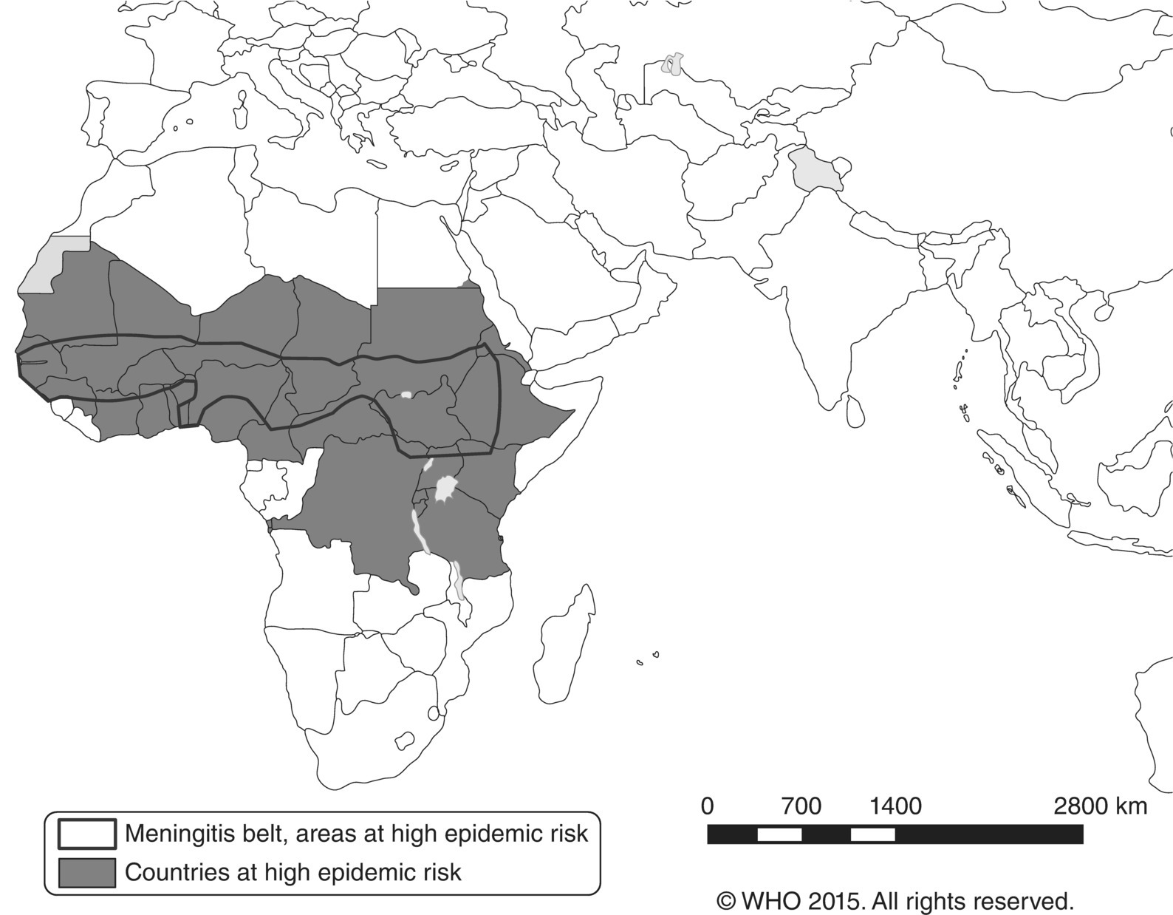
Fig. 13.4. Meningococcal meningitis, countries or areas at high risk, 2014.
(Reproduced by permission of the World Health Organization, Geneva.)

Slide 8
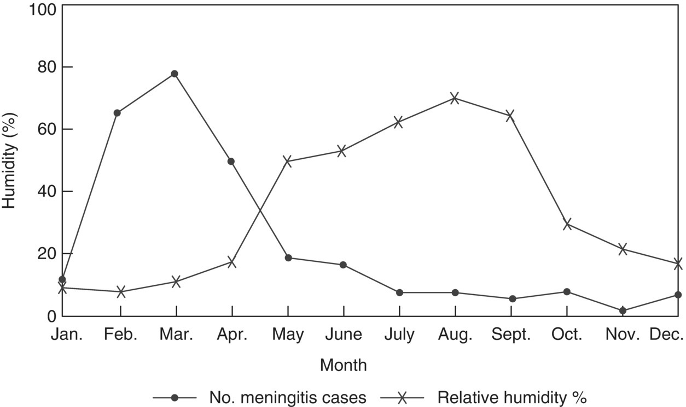
Fig. 13.5. The seasonal variation of meningococcal meningitis in relation to relative humidity in the Sahel region of Africa.

Slide 9
Further reading
Van-Tam, J. and Sellwood, C. (2012) Pandemic Influenza, 2nd edn. CAB International, Wallingford, UK.
World Health Organization (2004) Rheumatic Fever and Rheumatic Heart Disease: Report of a WHO Expert Consultation, Geneva, 29 October–1 November 2001. WHO Technical Report Series 923. WHO, Geneva, Switzerland.
World Health Organization (2005) The Current Evidence for the Burden of Group A Streptococcal Disease. Discussion Papers on Child Health, No. WHO/FCH/CAH/05.07. WHO Ref. No. WHO/FCH/CAH/05.07; WHO/IVB/05.12. WHO, Geneva, Switzerland.
World Health Organization (2010) Treatment of Tuberculosis: Guidelines, 4th edn. Document No. WHO/HTM/TB/2009.420, WHO, Geneva, Switzerland.
World Health Organization (2014) Meningitis Outbreak Response in Sub-Saharan Africa. WHO Guidelines. WHO, Geneva, Switzerland. Available at: https://www.who.int/csr/resources/publications/meningitis/guidelines2014/en/ (accessed 14 June 2019).

Slide 10
Web resources
FluNet: international flu network of virological data. Available at: www.who.int/flunet (accessed 5 March 2019).
Influenza: WHO influenza home page. Available at: www.who.int/csr/disease/influenza/en/ (accessed 5 March 2019).
NHS Choices: Swine flu (H1N1). Available at: http://www.nhs.uk/conditions/pandemic-flu/Pages/Introduction.aspx (accessed 21 December 2015).
Tuberculosis (TB): WHO tuberculosis home page. Available at: www.who.int/tb/en (accessed 5 March 2019).

