Slide 1
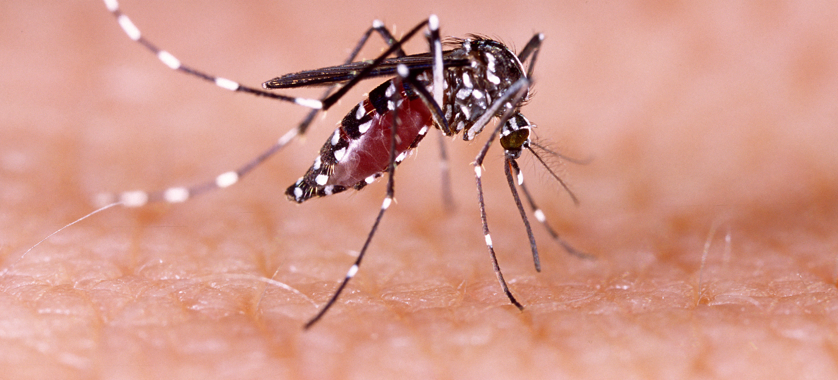
Communicable Diseases, 6th Edition
A Global Perspective
Roger Webber

Slide 2
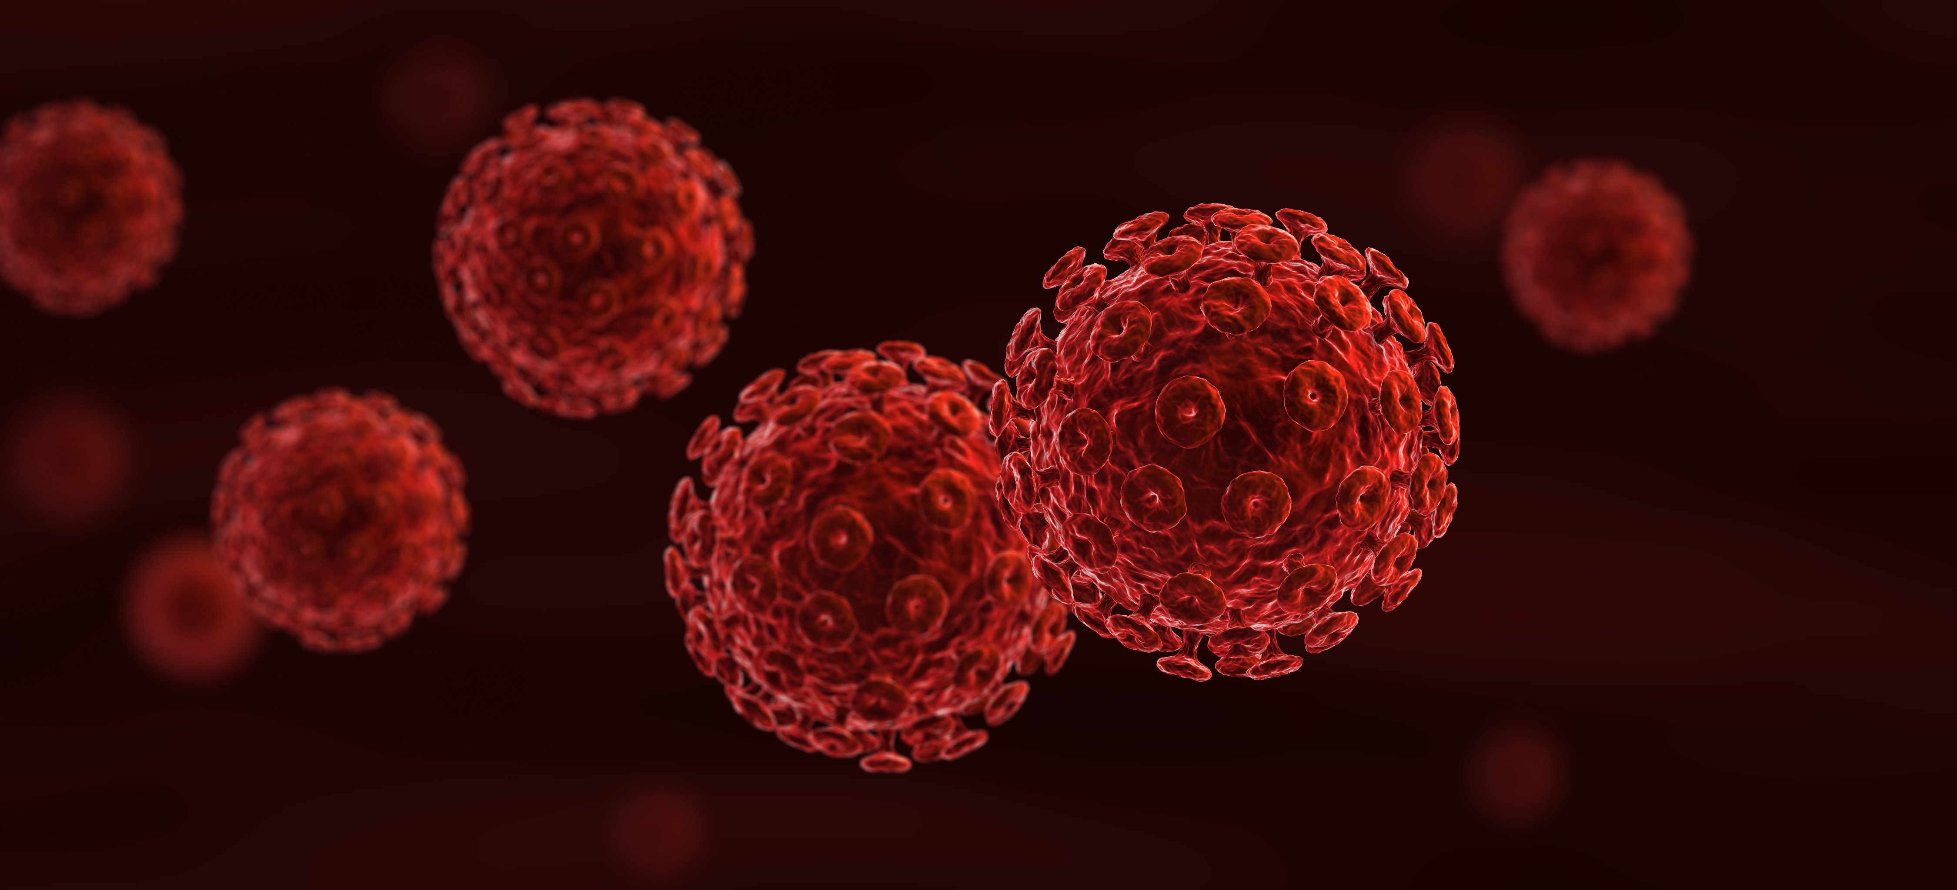
Chapter 12: Skin Infections

Slide 3
Summary
A number of infections present with skin rashes; they are mainly transmitted by droplets or contact with contaminated surfaces and articles.
Reduction in contact and personal hygiene are important, but measles, mumps and rubella are all prevented by vaccination.
Leprosy is a decreasing problem in the world as a result of active searching and a well-managed treatment regime.

Slide 4
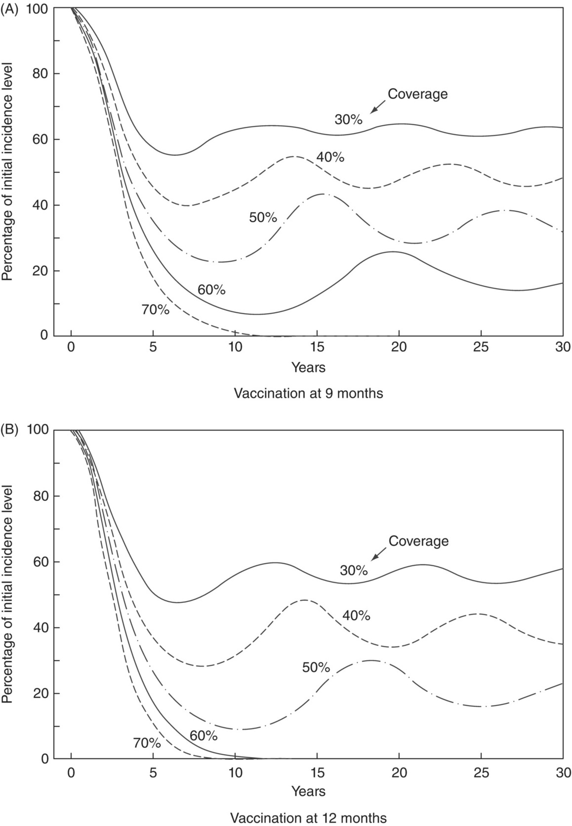
Fig. 12.1. The relative impact of immunization programmes on measles incidence in the age group 0–19 years, according to age at vaccination and population coverage.
(Reproduced by permission from Cvetanović, B., Grab, B. and Dixon, H. (1982) Bulletin of the World Health Organization 60(3), 405–422.)

Slide 5
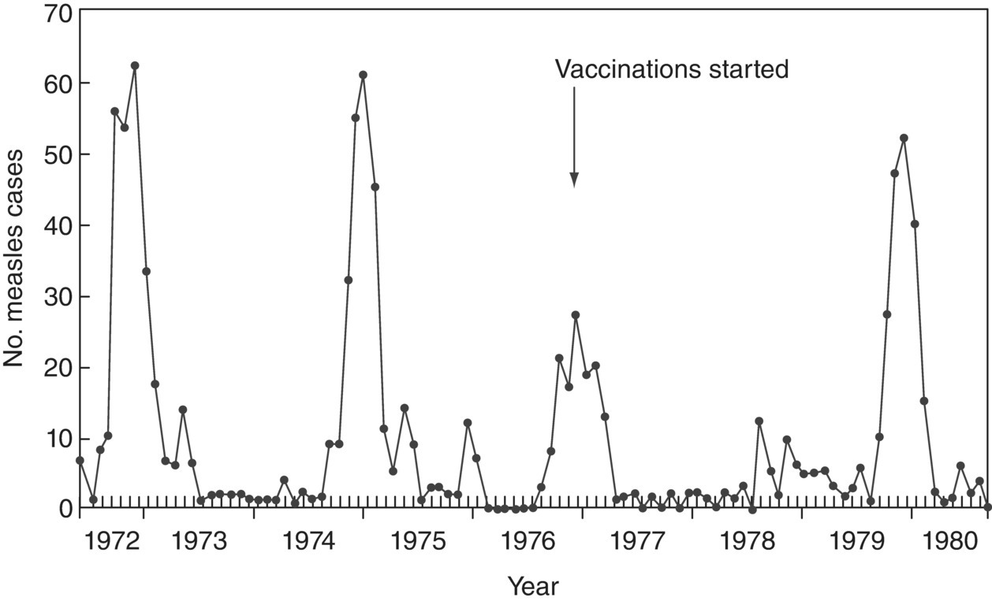
Fig. 12.2. Prolongation of the time interval between measles epidemics due to vaccination in Namanyere, Tanzania.

Slide 6
Fig. 12.3. Status of country rubella vaccination programmes and those that have achieved elimination.
(Reproduced by permission of the World Health Organization, Geneva, Switzerland.)

Slide 7
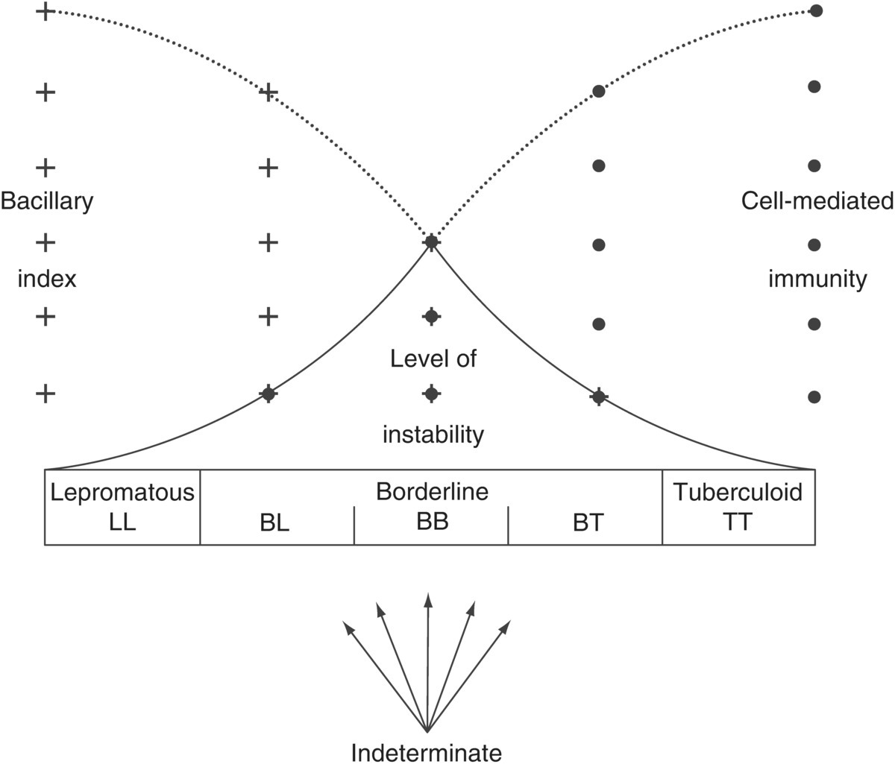
Fig. 12.4. The spectrum of leprosy, illustrating the proportion of bacilli present, the cell-mediated immune response and the level of instability in the different forms of the disease.

Slide 8
Fig. 12.5. Geographical distribution of new leprosy cases, 2017.
(Reproduced by permission of the World Health Organization, Geneva, Switzerland.)

Slide 9
Further reading
Dabbagh, A. et al. (2017). Progress toward regional measles elimination worldwide, 2000–2016. Morbidity and Mortality Weekly Report 66(42).
Grant, G.B., Reef, S.E., Patel, M., Knapp, J.K. and Dabbagh, A. (2017) Progress in Rubella and Congenital Rubella Syndrome Control and Elimination – Worldwide, 2000–2016. Morbidity and Mortality Weekly Report 66(45), 1256–1260. doi: 10.15585/mmwr.mm6645a4.
Grosset, J.H. (1998) WHO Expert Committee on Leprosy. Seventh Report-Technical Report Series No. 874, World Health Organization, Geneva, Switzerland.
Orenstein, W.A., Cairns, L., Hinman, A., Nkowane, B., Olivé, J.M. and Reingold, A.L. (2018) Measles and Rubella Global Strategic Plan 2012–2020 midterm review report: Background and summary. Vaccine Jan 11, 36 Suppl. 1, A35–A42. doi: 10.1016/j.vaccine.2017.10.065.
Steer, A.C. et al. (2016) Status of research and development of vaccines for Streptococcus pyogenes. Vaccine, 34(26), 2953–2958. doi: 10.1016/j.vaccine.2016.03.073. Epub 2016 Mar 29.
World Health Organization (2005) The Current Evidence for the Burden of Group A Streptococcal Disease. Discussion Papers on Child Health, No. WHO/FCH/CAH/05.07. WHO Ref. No. WHO/FCH/CAH/05.07; WHO/IVB/05.12. WHO, Geneva, Switzerland.

Slide 10
Web resources
WHO leprosy elimination home page. Available at: www.who.int/lep/en (accessed 2 July 2019).
WHO improved treatment guidelines. Available at: www.searo.who.int/entity/global_leprosy_programme/approved-guidelines-leprosy-executive-summary.pdf (accessed 06 February 2019)

