Slide 1
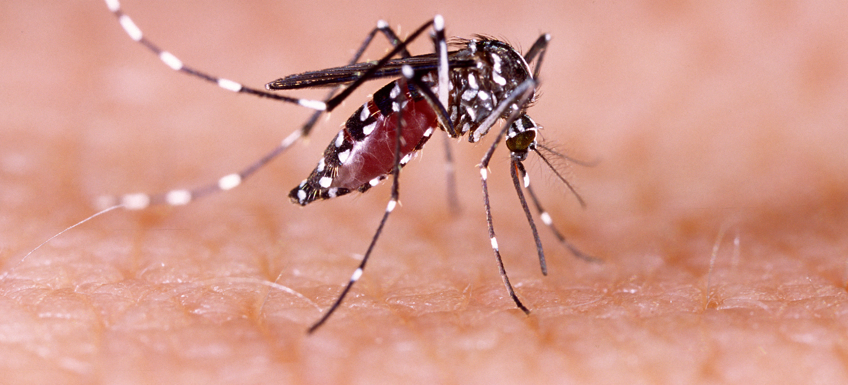
Communicable Diseases, 6th Edition
A Global Perspective
Roger Webber

Slide 2
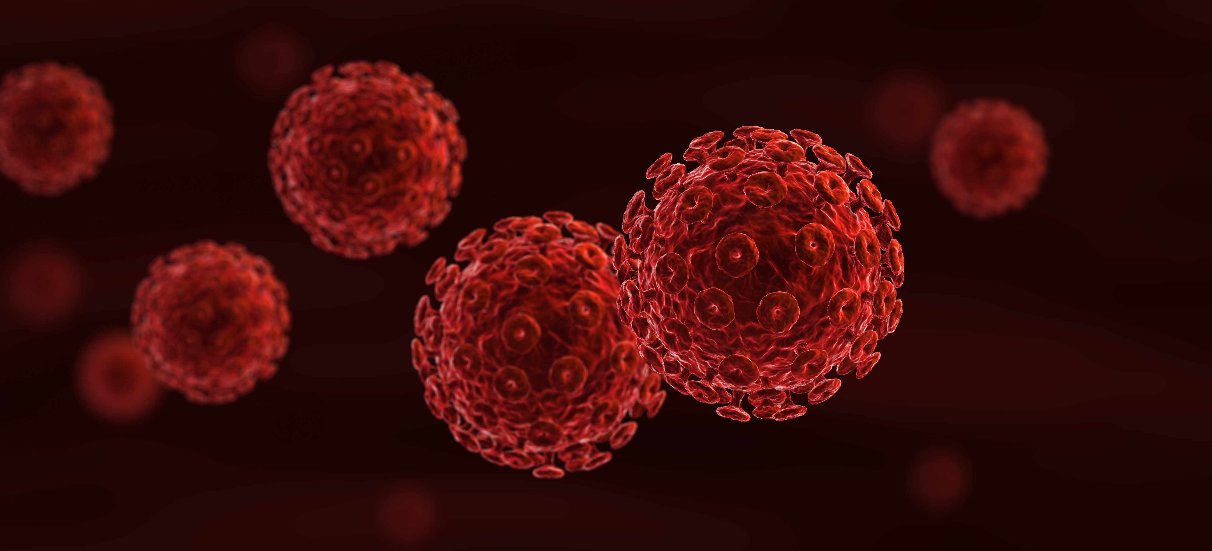
Chapter 11: Diseases of Water Contact

Slide 3
Summary
Infection with schistosomiasis is due to cercariae in water, which have developed in an intermediate host snail, penetrating the exposed skin.
Water becomes contaminated by faeces or urine, so effective sanitation, the reduction of snails and preventing water contact are methods of control in schistosomiasis. The most effective method is mass treatment, administering praziquantel to schoolchildren or selectively to those with serious pathology.
Guinea worm has been effectively controlled by mechanical methods to make water collection safe, leading to its eradication from many countries.
A water-involved method of transmission is indicated in Buruli ulcer, but this has not been fully worked out.

Slide 4
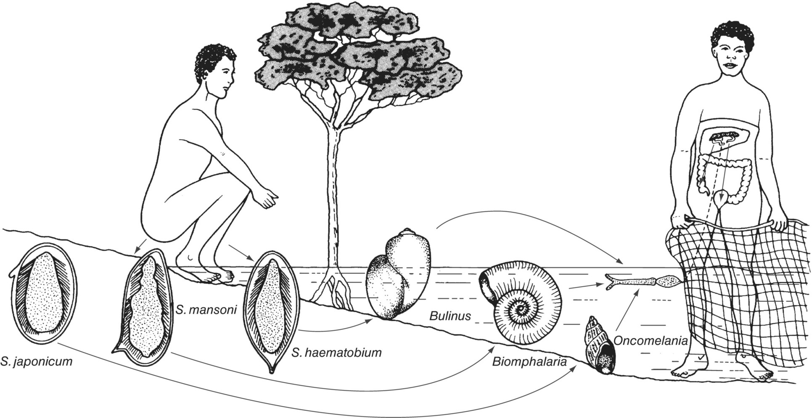
Fig. 11.1. Schistosomiasis life cycles and species.

Slide 5
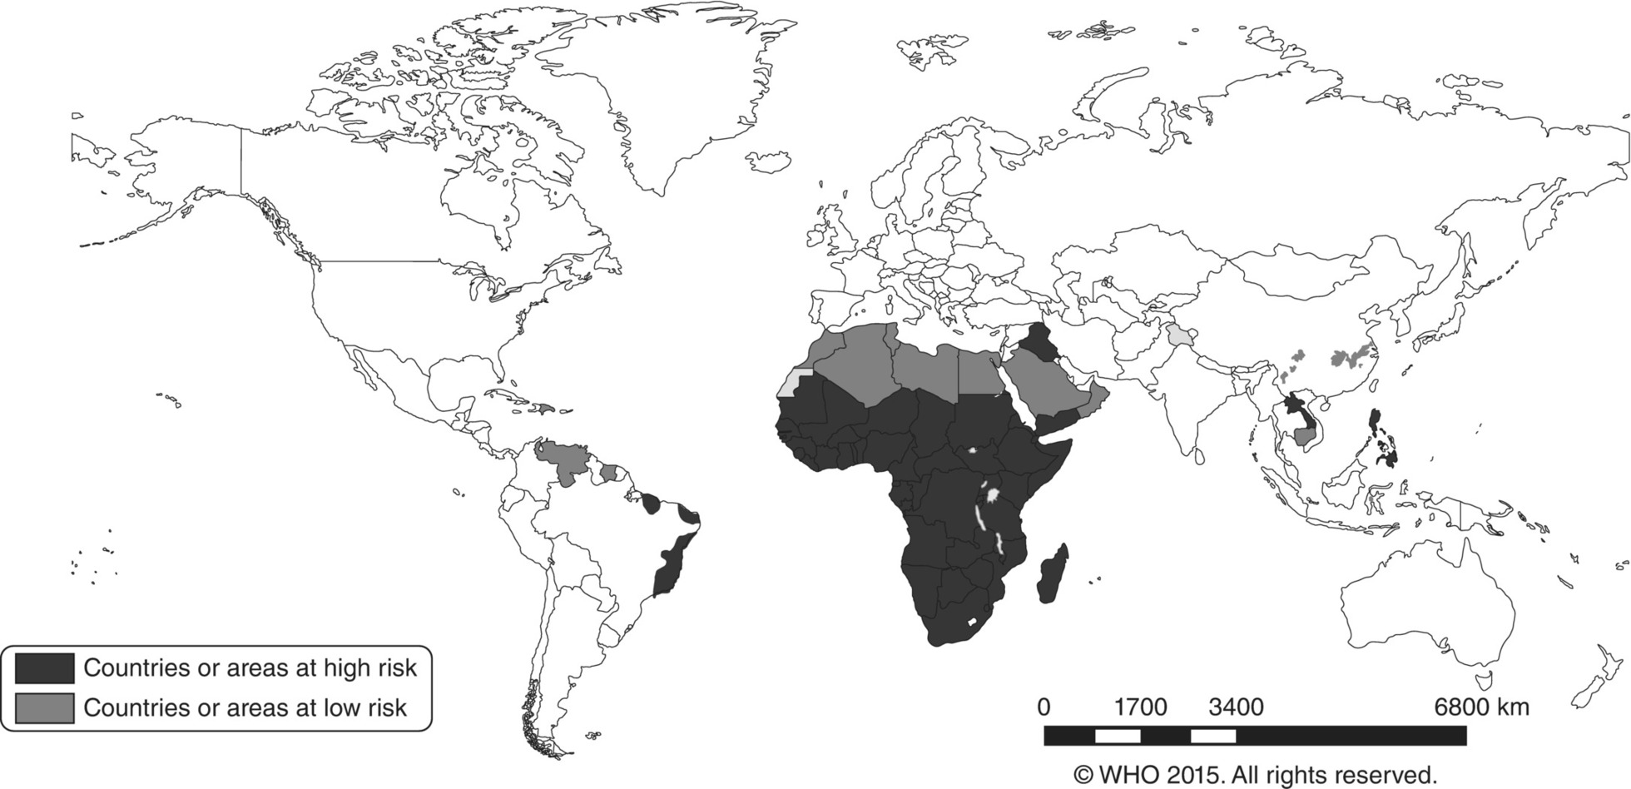
Fig. 11.2. Schistosomiasis, countries or areas at risk, 2014.
(Reproduced by permission of the World Health Organization, Geneva, Switzerland.)

Slide 6
Fig. 11.3. Annual number of dracunculiasis cases reported worldwide, 1989–2018.
(Reproduced by permission of the World Health Organization, Geneva, Switzerland.)

Slide 7
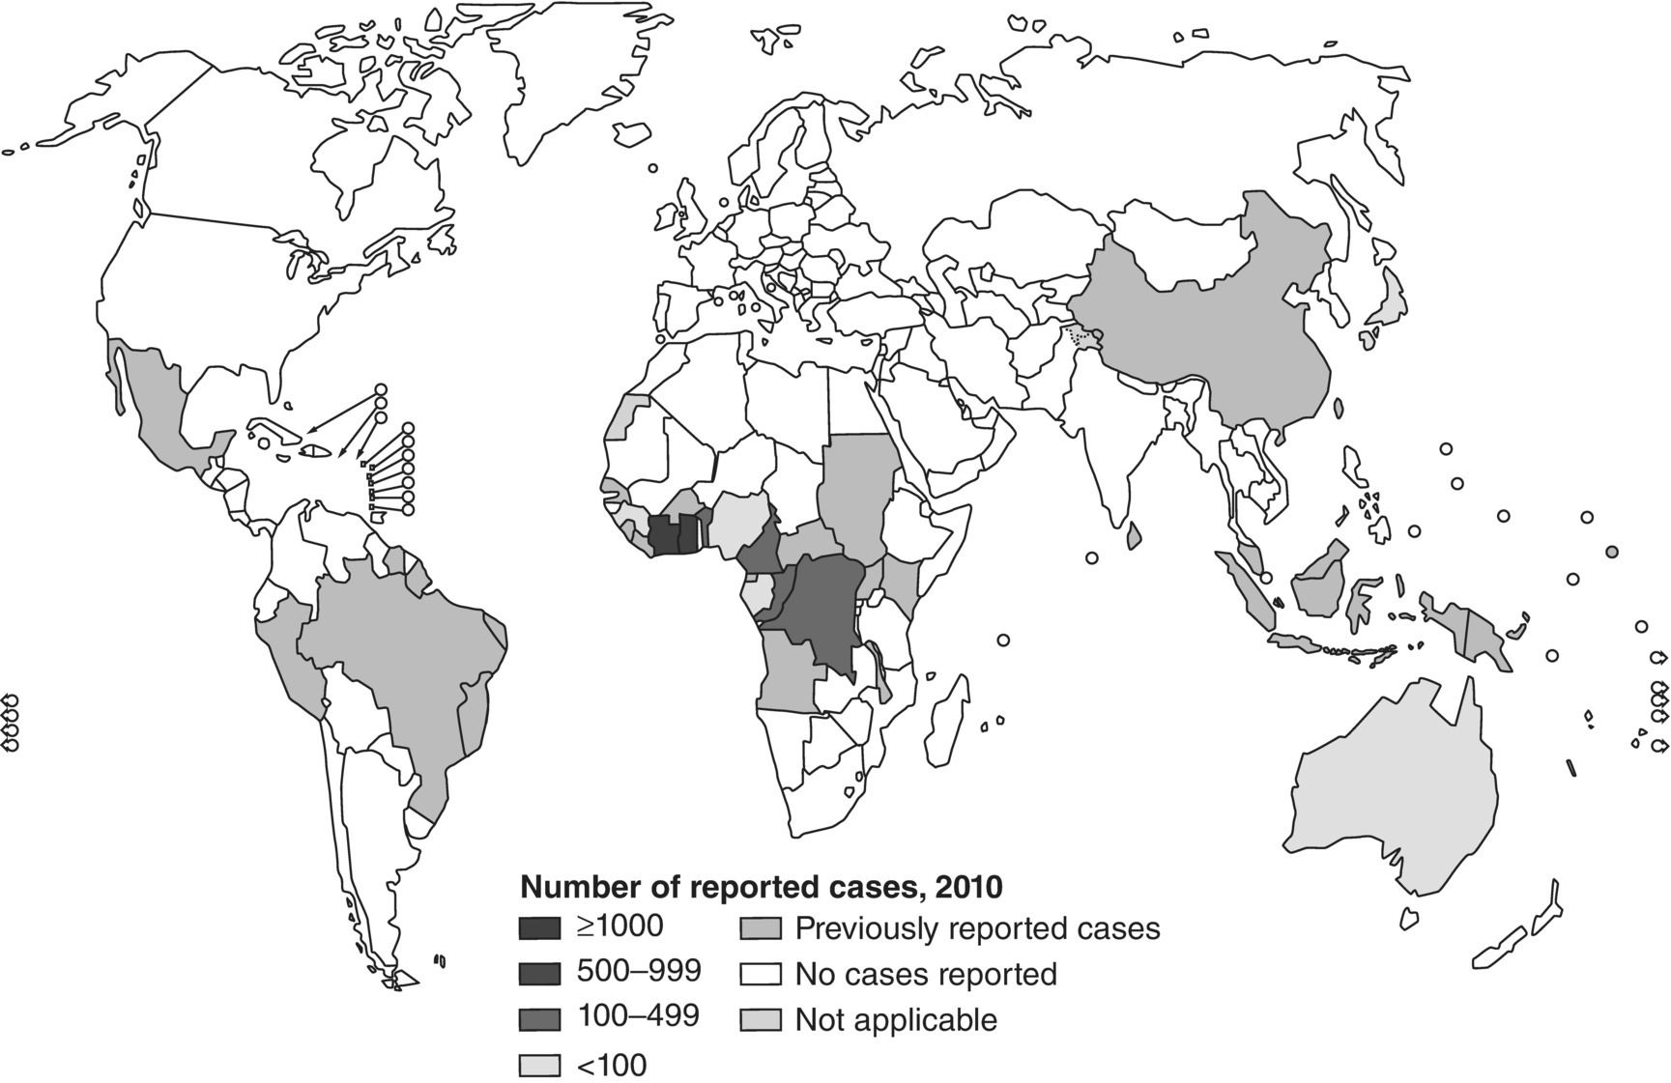
Fig. 11.4. Distribution of Buruli ulcer worldwide, 2010.
(Reproduced by permission of the World Health Organization, Geneva, Switzerland.)

Slide 8
Further reading
Mahmoud, A. (2001) Schistosomiasis, Tropical Medicine: Science and Practice – Tropical Medicine 3. Imperial College Press, London.
Società Italiana di Communicazione Scientifica e Sanitaria (2015) Schistosomiasis (Bilhatziasis). SICS srl, Milan, Italy.

Slide 9
Web resources
Schistosomiasis Control Initiative (SCI), Imperial College London. Available at: www.schistosomiasiscontrolinitiative.org/ accessed 2 July 2019).
www.who.int/news-room/fact-sheets/detail/schistosomiasis (accessed 27 October 2018).
WHO Buruli ulcer [information], World Health Organization, Geneva, Switzerland. Available at: www.who.int/buruli/en/ (accessed 1 March 2019).
apps.who.int/iris/bitstream/handle/10665/272647/WER9321.pdf?ua=1 (accessed 27 October 2018).

