Slide 1
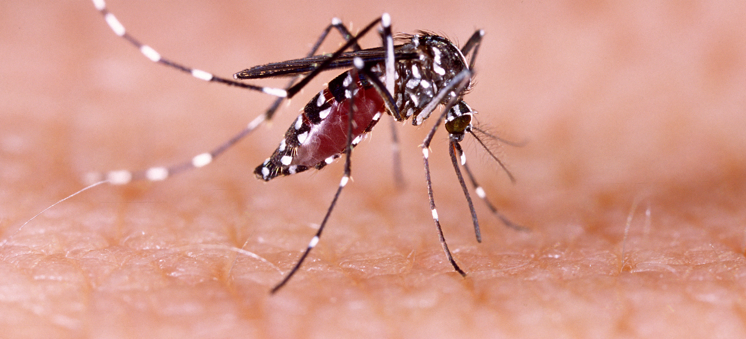
Communicable Diseases, 6th Edition
A Global Perspective
Roger Webber

Slide 2
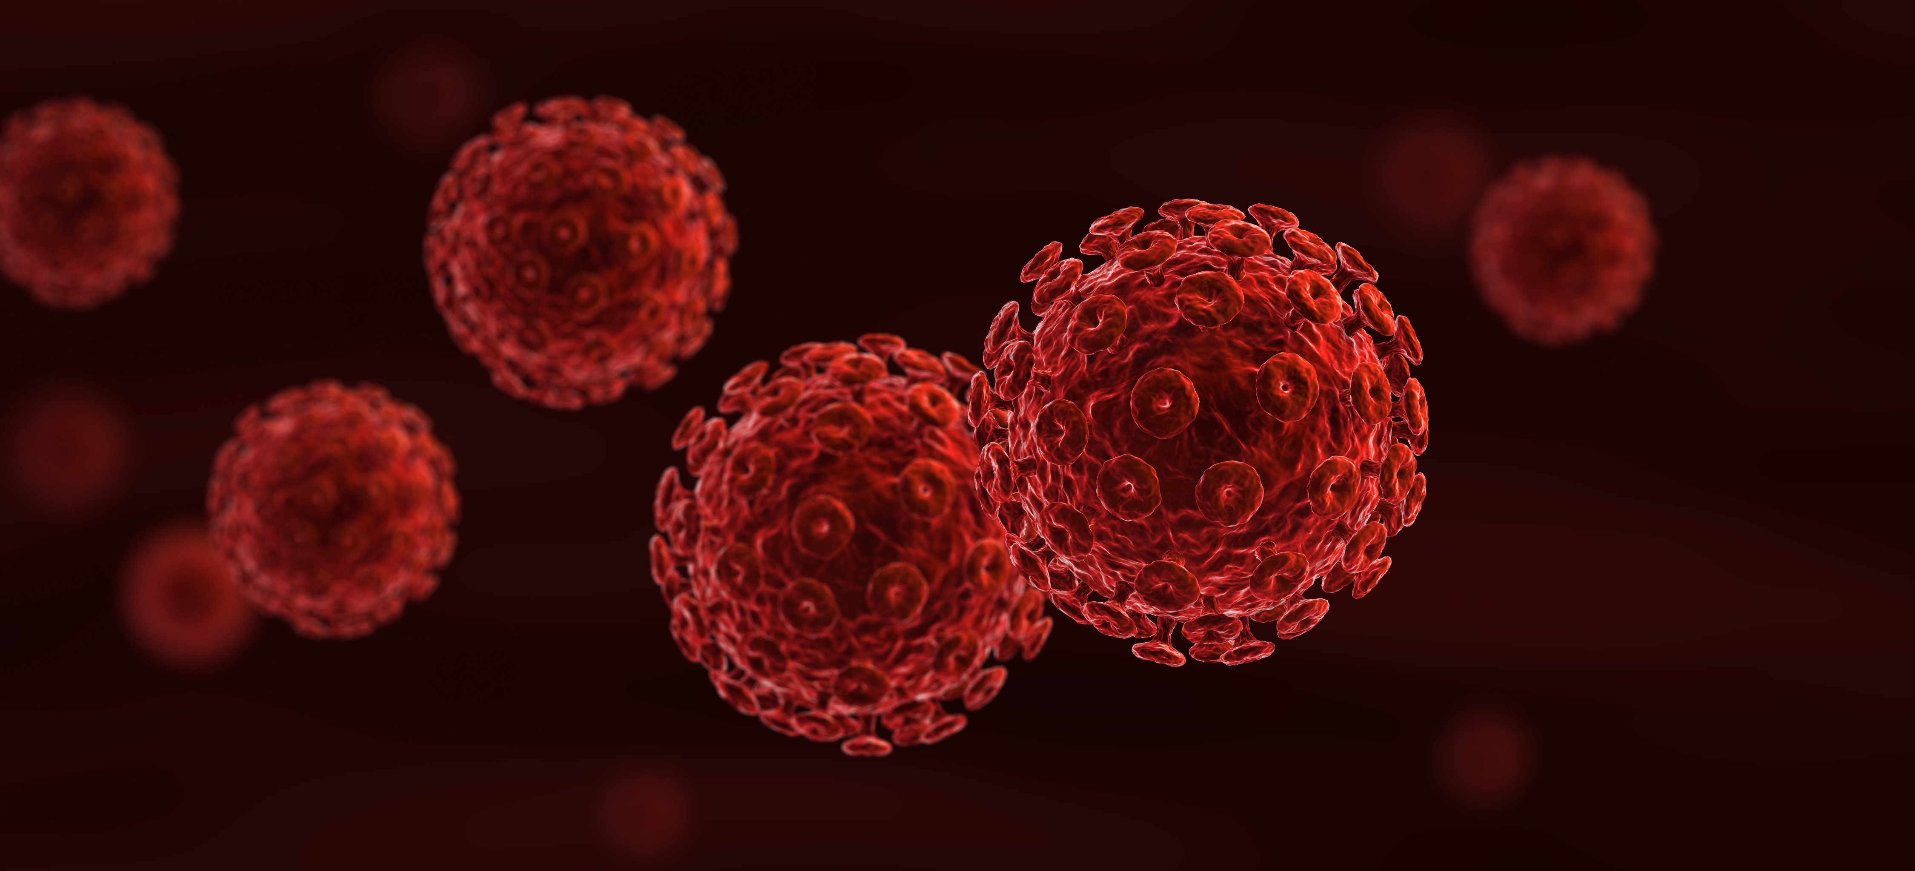
Chapter 10: Diseases of Soil Contact

Slide 3
Summary
Several helminths require soil for the infective stage to develop, whereas the tetanus bacillus lives in soil contaminated by animal excreta.
Infection is acquired either by eating the soil, as a contaminant of food or water, or by penetrating the skin (hookworms, Strongyloides) or via a wound (tetanus, melioidosis).
Personal hygiene and the prevention of soil contamination are preventive methods in the helminth infections and melioidosis, while clean delivery and vaccination prevent tetanus.

Slide 4
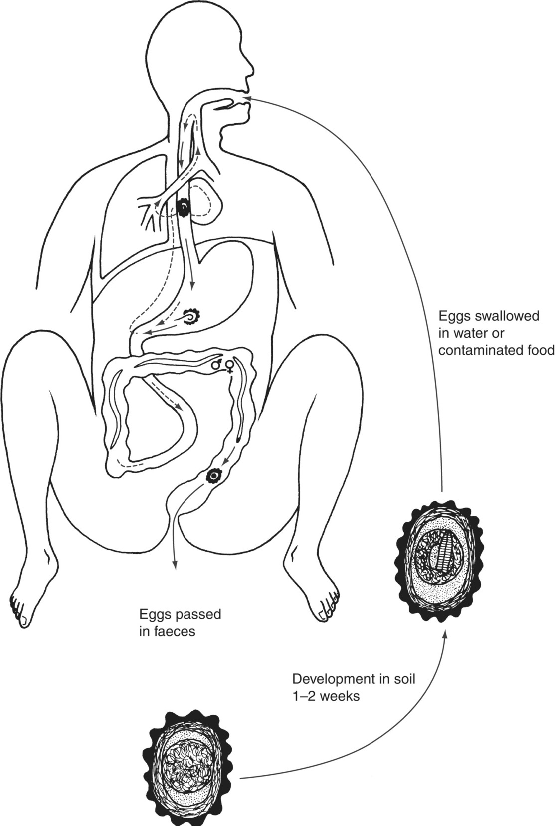
Fig. 10.1. Ascaris lumbricoides life cycle.

Slide 5
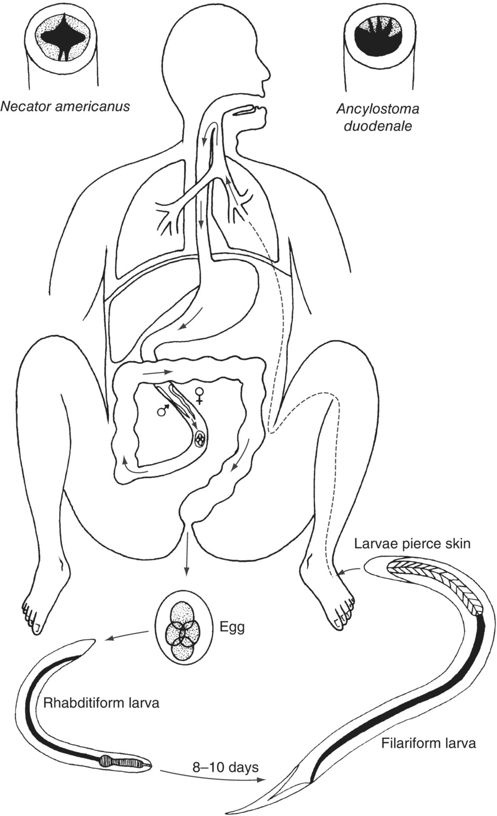
Fig. 10.2. The hookworm life cycle and identification from the mouthparts.

Slide 6
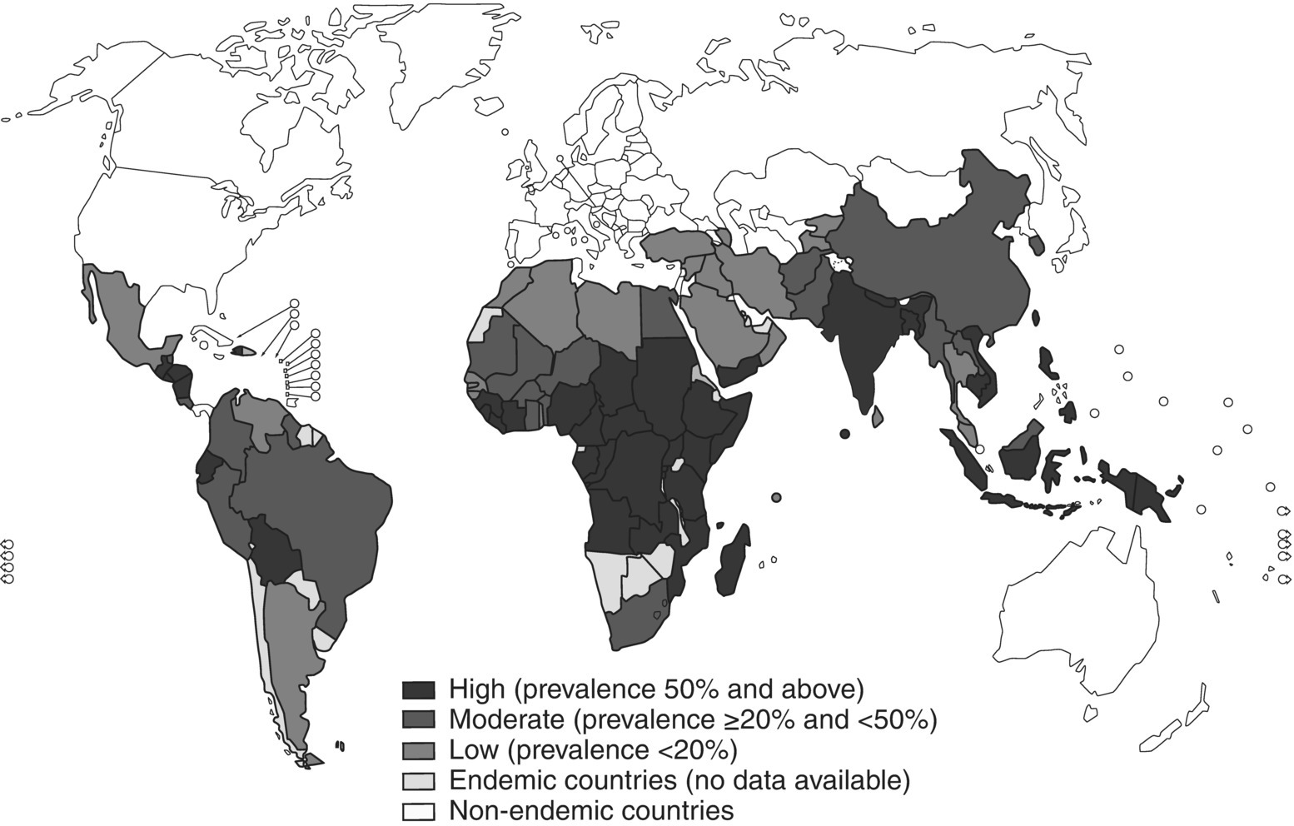
Fig. 10.3. Global distribution of soil-transmitted helminthiasis, 2008.
(Reproduced by permission of the World Health Organization, Geneva.)

Slide 7
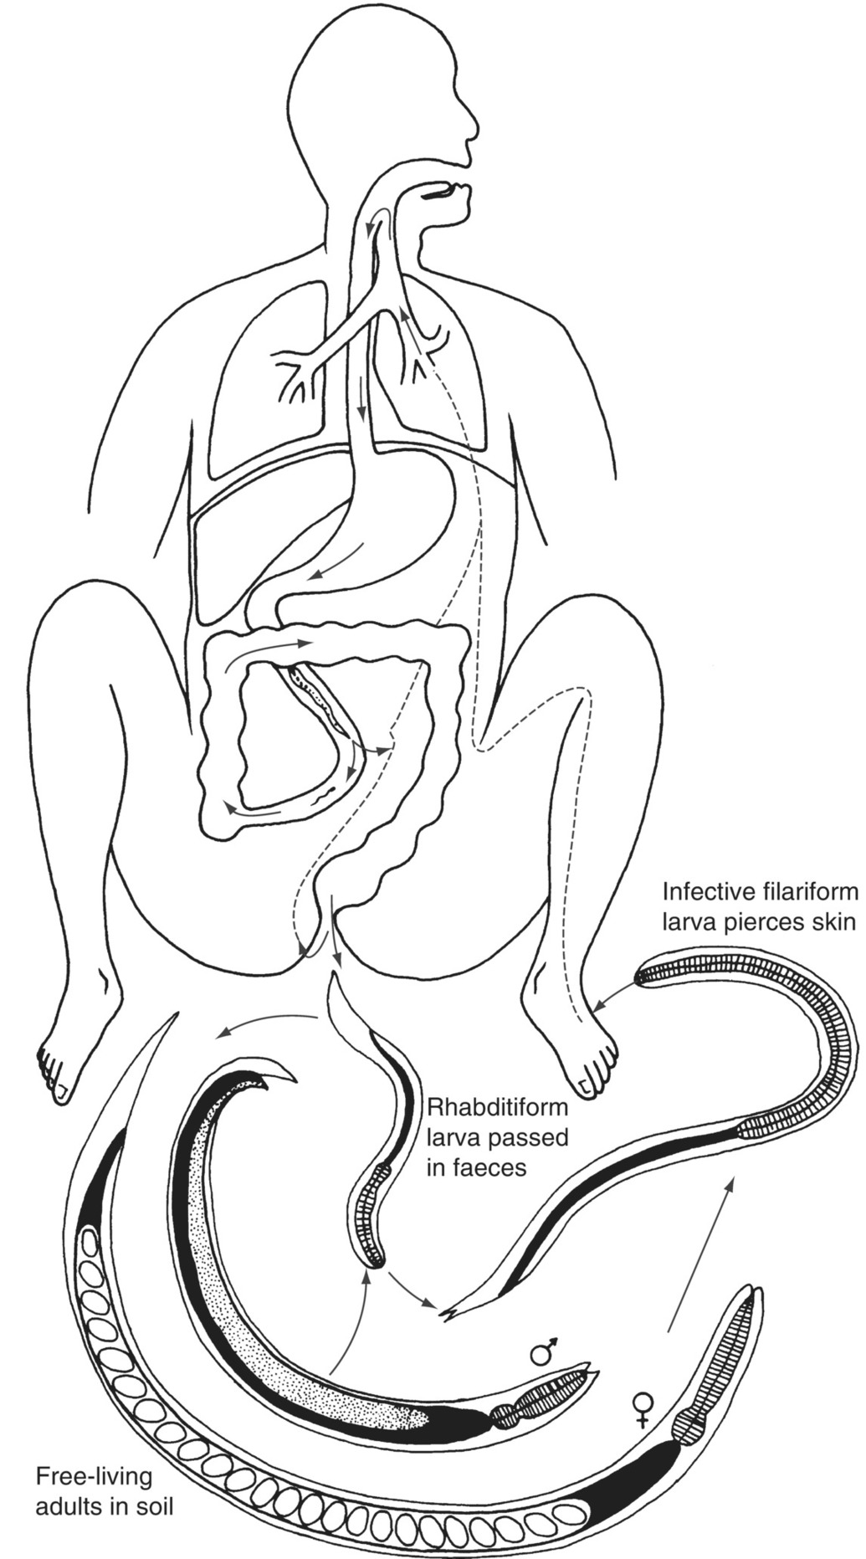
Fig. 10.4. Strongyloides stercoralis life cycles.

Slide 8
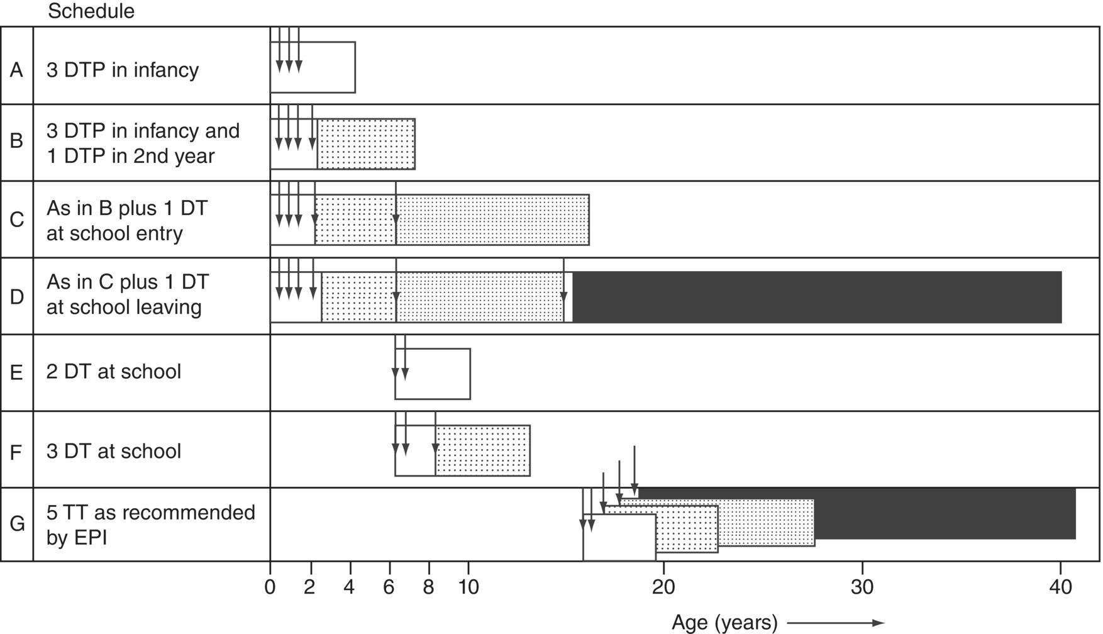
Fig. 10.5. Expected duration of tetanus immunity after different vaccination schedules. DTP, diphtheria, tetanus and pertussis; DT, diphtheria and tetanus; TT, tetanus toxoid; EPI, WHO Expanded Programme of Immunization.
(Reproduced by permission of the World Health Organization, Geneva.)

Slide 9
Further reading
Chiodini, P.L., Moody, D.H. and Manser, D.W. (2001) Atlas of Medical Helminthology and Protozoology, 4th edn. Churchill Livingstone, Edinburgh, UK.
Currie, B.J. and Kaestli, M. (2016) Epidemiology: A global picture of melioidosis. Nature 529, 290–291.
Muller, M. (2001) Worms and Human Disease, 2nd edn. CAB International, Wallingford, UK.
Pasvol, G. and Peters, W. (2006) Atlas of Tropical Medicine and Parasitology. Mosby-Wolfe, London.

Slide 10
Web resources
www.who.int/topics/intestinal_diseases_parasitic/en/ (accessed 10 December 2018)
www.who.int/immunization/diseases/MNTE_initiative/en/ (accessed 27 October 2018)

