Slide 1

Managing Tourism Enterprises
Chapter 9: Managing Financial Performance

Slide 2
Learning Outcomes:
Understand the importance of financial management for tourism organizations
Learn about determining costs and calculating break-even analysis
Learn to develop and understand the main financial statements – balance sheet, income statement (profit & loss), cash budget
Develop a working knowledge of capital budgeting for tourism businesses
Become confident with assessing the financial performance of an organization through the use of financial ratios

Slide 3
Business Costs
Two of the most common accounting costs associated with the operations of a business are direct and indirect costs.
Direct costs can be traceable and generally move in direct correlation to changes in sales, e.g., cost of goods sold, wages, laundry costs (for hotels).

Slide 4
Indirect costs (or overheads) are such that cannot be identified with and are untraceable to a particular division, and therefore cannot be allocated to any specific department, e.g., electricity, gas, building maintenance, etc.
These cannot be charged to any specific hotel departments such as rooms, food or beverage.

Slide 5
Fixed vs. Variable Costs
Fixed costs can be identified as those that are expected to remain fixed for short-term operations and do not vary with the changes in sales, e.g., lease/rent.
Variable costs change in direct proportion to any changes in sales revenue levels, e.g., stock purchases.

Slide 6
Break-even Analysis
The break-even point refers to the level of ‘breaking even’, i.e. sales revenue equalling expenses (fixed and variable).
To calculate the break-even point (BEP):
forecast and categorize expenses;
calculate the ratio of variable costs to net sales;
use the break-even point equation.

Slide 7
Break-event point calculation:

Slide 8
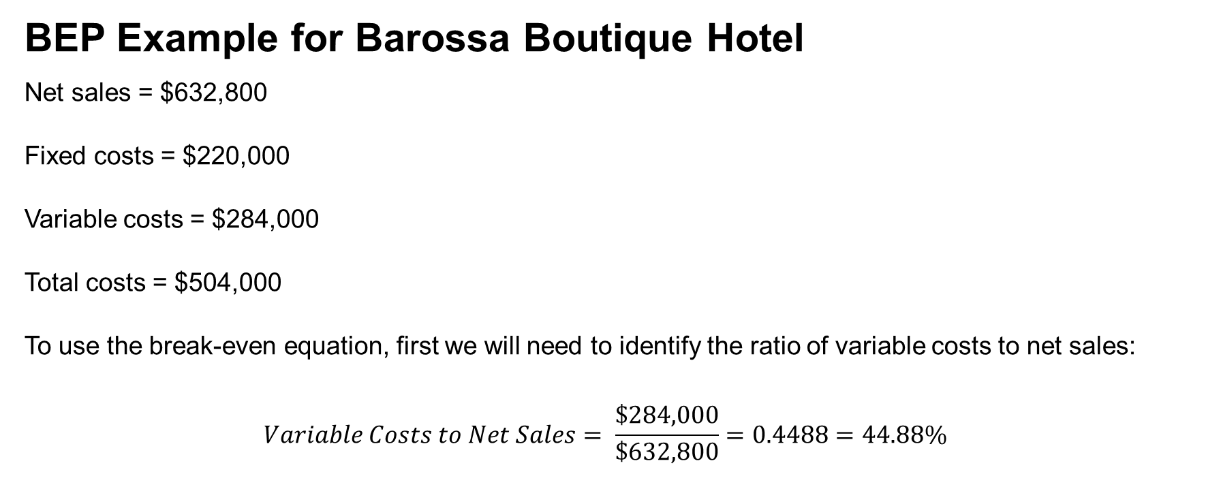
BEP Example for Barossa Boutique Hotel
Net sales = $632,800
Fixed costs = $220,000
Variable costs = $284,000
Total costs = $504,000
To use the break-even equation, first we will need to identify the ratio of variable costs to net sales:
$$Variable Costs to Net Sales= \frac{\$284,000}{\$632,800}=0.4488=44.88\%$$

Slide 9
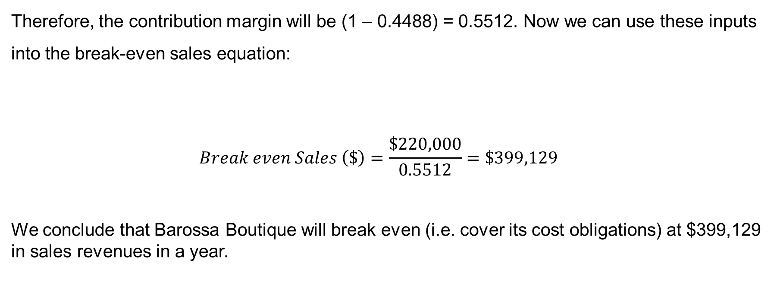
Therefore, the contribution margin will be (1 – 0.4488) = 0.5512. Now we can use these inputs into the break-even sales equation:
$$Break even Sales \left(\$\right)=\frac{\$220,000}{0.5512}=\$399,129$$
We conclude that Barossa Boutique will break even (i.e. cover its cost obligations) at $399,129 in sales revenues in a year.

Slide 10
Suppose that the general manager of the hotel wants to incorporate a profit component (before taxes) and determine how much sales revenue is required to break even and achieve target profit:

Slide 11
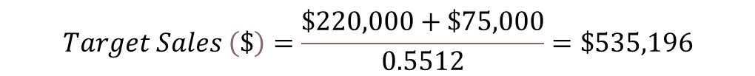
As an example, if target net income is $75,000 before taxes, Barossa Boutique Hotel must generate $535,196 in sales revenue, as evident from the following calculation:
$$Target Sales \left(\$\right)=\frac{\$220,000+\$75,000}{0.5512}=\$535,196$$

Slide 12
Understanding Financial Statements
Tourism SME operators need to set up the business accounting system using any popular computerized account program with the help of an accountant, and later have an employee or a book-keeping service to enter transactions and manage regular record-keeping tasks.
Tourism SME operators do not need to be accountants, but should read and understand financial statements to identify where potential cost savings can be made and how to improve the financial aspect of the business.

Slide 13
3 Main Financial Statements for a Tourism SME:
Balance Sheet
Income Statement (Profit & Loss Statement)
Cash Budget

Slide 14
The Balance Sheet
Balance sheet identifies the assets the business owns, and the claims held by its lenders and owners against those assets (i.e. liabilities), at a point in time.
The balance sheet is characterized by the fundamental accounting equation where the value of assets equals the combined values of liabilities and owner’s equity.
Current assets = cash and assets that can be converted to cash within a year such as accounts receivables and inventory
Non-current or fixed assets = usually acquired for use in the long term and are not expected to be converted to cash in one year
Current liabilities = creditors’ claims that are to be paid back within a year.
Long-term liabilities = to be paid to the creditors after one year, i.e. mortgage and long-term loan payables
Owner’s equity = owner’s equity contributions to the business in addition to all accumulated retained earnings not yet being distributed to the owner(s).

Slide 15
Barossa Boutique Hotel – Balance sheet (For the Year Ending 31 December 2017)
Assets |  |  | Liabilities and Shareholder's Equity
Current Assets |  |  | Current Liabilities
Cash |  | $ 30,000.00 | Trade payables |  | $ 10,000.00
Credit card receivables |  | $ 12,150.00 | Accrued expenses |  | $ 1,750.00
Accounts receivables |  | $ 21,500.00 | Income tax payable |  | $ 14,000.00
Inventory - Food & Beverage | $ 12,400.00 |  | Deposit and credit balances |  | $ 8,500.00
Inventory - Supplies | $ 10,000.00 |  | Current portion, long-term mortgage payable |  | $ 25,000.00
Prepaid expenses | $ 3,200.00 | $ 25,600.00 | Total Current Liabilities |  | $ 59,250.00
Total Current Assets |  | $ 89,250.00
 |  |  | Long-term Liabilities
Non-current Assets |  |  | Mortgage payable - Net of current portion payable | $ 500,000.00
Land (at cost) | $ 250,000.00 |  | Long-term bank loan payable | $ 200,000.00 | $ 700,000.00
Building (Net of depreciation) | $ 800,000.00 |  | Total Liabilities |  | $ 759,250.00
Equipment (Net of depreciation) | $ 60,000.00 |  | Owner's Equity
Furniture (Net of depreciation) | $ 70,000.00 |  | Equity Capital | $ 450,000.00
Total Non-current Assets |  | $ 1,180,000.00 | Retained Earnings | $ 60,000.00 | $ 510,000.00
Total Assets |  | $ 1,269,250.00 | Total Liabilities & Owner's Equity |  | $ 1,269,250.00

Slide 16
Income Statement
Compares expenses against revenue over a certain period to demonstrate the business’s net income or loss.
Income statements can be prepared on a monthly or quarterly basis; typically, they are prepared on a yearly basis and report the bottom line over the fiscal or calendar year.
In the tourism and hospitality sector, because the operations may be departmentalized (e.g., revenue from accommodation, food & beverage, banqueting), income statements are often prepared to show the operating results of each department along with the whole business.

Slide 17
Departmental Income Statement
Hotel - Income (Loss) from Food & Beverage Department
For the Year Ending December 31, 2018
Sales Revenue
Eatery Restaurant & Bar | $ 245,000.00
Café | $ 105,000.00
Banquets | $ 130,000.00
Room Service | $ 75,000.00
Total Sales Revenue |  | $ 555,000.00
Cost of Sales
Cost of Sales - Food | $ 135,000.00
Less: Employee Meals | $ (12,000.00)
Net cost of sales - food |  | $ (123,000.00)
Net cost of sales - Beverage |  | $ (55,000.00)
Total Net Cost of Sales |  | $ (178,000.00)
Gross Profit Margin |  | $ 377,000.00
Departmental Operating Expenses
Salaries and wages | $ (175,000.00)
Employee benefits | $ (28,500.00)
Total payroll and related expenses | $ (203,500.00)
Glassware and silverware | $ (5,000.00)
Cleaning supplies | $ (8,900.00)
Decorations | $ (2,500.00)
Laundry | $ (4,000.00)
Licenses | $ (8,000.00)
Menu | $ (1,600.00)
Linen and miscellaneous | $ (3,500.00)
Uniforms | $ (2,000.00)
Utensils | $ (3,000.00)
Total Operating Expenses |  | $ (242,000.00)
Departmental Contributory Income (Loss) |  | $ 135,000.00

Slide 18
Income Statement for the year ending 31 December 2018
Hotel - Income (Loss) from Departments
Rooms |  | $ 490,000.00
Food & Beverage |  | $ 135,000.00
Miscellaneous income |  | $ 7,800.00
Total Departmental Income |  | $ 632,800.00
Undistributed Operating Expenses
Administrative and general | $ (140,000.00)
Marketing and Promotions | $ (60,000.00)
Property operations and maintenance | $ (155,000.00)
Utility bills | $ (36,000.00) | $ (391,000.00)
Income Before Fixed Charges |  | $ 241,800.00
Fixed Charges
Property taxes | $ (38,000.00)
Insurance | $ (25,000.00)
Interest | $ (15,000.00)
Depreciation | $ (35,000.00) | $ (113,000.00)
Operating Income Before Tax |  | $ 128,800.00
Income Tax |  | $ (65,000.00)
Net Income |  | $ 63,800.00

Slide 19
Cash Budget
Cash budgets are useful tools in cash management for small businesses.
They help to ensure that there are minimum instances of cash shortages in paying the necessary bills, and assisting in maintaining an optimum level of cash balance at all times.
Maintaining a tight control over the cash receipts and disbursements is particularly important since the net income reported by a business in its income statement does not necessarily indicate the amount of cash held in hand.
Cash budget forecasts can be developed for different periods (usually quarterly) and can be used for cost control to determine variances between forecasts and actual.
End-of-period cash balance is calculated as follows:
End-of-period/closing cash balance = Beginning cash balance + Receipts – Disbursements

Slide 20
Example of Cash Budget
Barossa Boutique - Cash Budget based on Sales Forecast
 | Q1 | Q2 | Q3 | Q4
Cash Receipts
Cash sales | $ 62,000.00 | $ 35,000.00 | $ 28,000.00 | $ 78,000.00
Credit sales collected | $ 70,000.00 | $ 45,000.00 | $ 35,000.00 | $ 35,000.00
Other cash receipts | $ 750.00 | $ 380.00 | $ 400.00 | $ 270.00
Total Cash Receipts | $ 132,750.00 | $ 80,380.00 | $ 63,400.00 | $ 113,270.00
Cash Disbursements
Purchases | $ (35,000.00) | $ (18,000.00) | $ (15,000.00) | $ (29,000.00)
Loan payments | $ (6,000.00) | $ (6,000.00) | $ (6,000.00) | $ (6,000.00)
Utilities bill | $ (2,000.00) | $ (1,400.00) | $ (1,350.00) | $ (1,750.00)
Capital additions | $ - | $ - | $ (750.00) | $ (500.00)
Wages and salaries | $ (60,000.00) | $ (45,000.00) | $ (45,000.00) | $ (60,000.00)
Insurance | $ (1,200.00) | $ (1,200.00) | $ (1,200.00) | $ (1,200.00)
Advertising | $ (5,000.00) | $ (4,000.00) | $ (4,000.00) | $ (5,000.00)
Miscellaneous | $ (750.00) | $ (500.00) | $ (500.00) | $ (1,000.00)
Total Cash Disbursements | $ (109,950.00) | $ (76,100.00) | $ (73,800.00) | $ (104,450.00)
End-of-quarter Balance
Beginning cash balance | $ 4,500.00 | $ 27,300.00 | $ 31,580.00 | $ 21,180.00
Add: Cash receipts | $ 132,750.00 | $ 80,380.00 | $ 63,400.00 | $ 113,270.00
Less: Cash disbursements | $ (109,950.00) | $ (76,100.00) | $ (73,800.00) | $ (104,450.00)
End-of-quarter Cash Balance | $ 27,300.00 | $ 31,580.00 | $ 21,180.00 | $ 30,000.00

Slide 21
Capital Budgeting
In addition to day-to-day operations and management of revenues and expenditure, tourism business owners need to invest in assets and capital projects.
For example, investment in kitchen and bar facilities, new equipment, coffee machines, motor vehicles, etc.
It is essential that these capital decisions are made with sound analysis.
Analysing the value-addition potential of long-term capital assets is known as capital budgeting.

Slide 22
Process for Capital Budgeting
Identify the potential opportunities
Estimate costs of investment
Estimate cashflows
Assess risk
Implement and feedback loop

Slide 23
Capital Budgeting Techniques – Net Present Value (NPV)
One of the most commonly used and for capital budgeting
Based on the time value of money concept of finance, which is set up on the premise that a dollar today is worth more than a dollar in the future.
The expected future cashflows of the project are discounted to today’s terms by determining their present values.
The net of these present values of cashflows from the initial investment outlay is considered the NPV of the project.

Slide 24
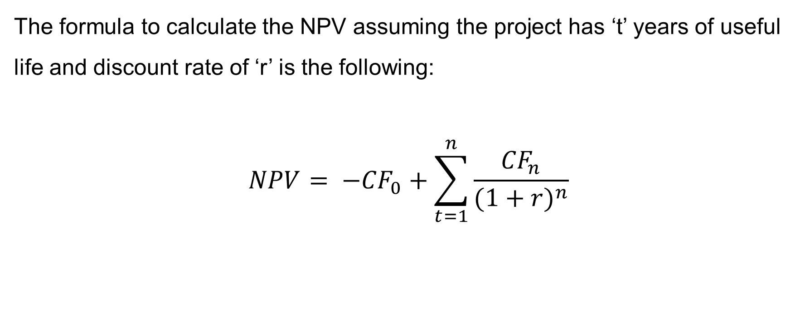
The formula to calculate the NPV assuming the project has ‘t’ years of useful life and discount rate of ‘r’ is the following:
$$NPV= −{CF}_{0}+\sum_{t=1}^{n}{\frac{{CF}_{n}}{{(1+r)}^{n}}}$$

Slide 25
Capital Budgeting Using Net Present Value (NPV) Method
Year | New Coffee Machine | New Beer Tap System
0 | $ (20,000.00) | $ (45,000.00)
1 | $ 3,500.00 | $ 17,500.00
2 | $ 5,000.00 | $ 13,000.00
3 | $ 9,800.00 | $ 10,000.00
4 | $ 6,500.00 | $ 10,000.00
5 | $ 5,500.00 | $ 9,000.00
NPV | $ 6,379.77 | $ 8,021.54
Cost of Capital | 4.5% | 4.50%

Slide 26
Financial Ratio Analysis
To gain the most benefit from financial statements, one must analyse them in assessing the business’s financial position, and trends in liquidity, profitability and solvency; they act as a starting point in planning for the future.
Financial ratios assist in evaluating a business entity’s financial and economic performance over a given accounting period.

Slide 27
There is no single ratio that judges how well a business is performing.
Ratios are calculated across a variety of dimensions to measure the business’s composite financial performance.
Ratios are compared against industry averages or with similar competitive businesses to evaluate how its operations are faring against set benchmarks.

Slide 28
Commonly used ratios for tourism organisations include:
Liquidity ratios: evaluate the business’s level of liquid assets held against short-term debt obligations
Activity ratios: measure how efficiently the different assets are utilized for business operations
Profitability ratios: demonstrate the business’s profitability in comparison to the financing and revenue earned
Long-term solvency ratios: evaluate the business’s ability to repay its long-term debt obligations

Slide 29
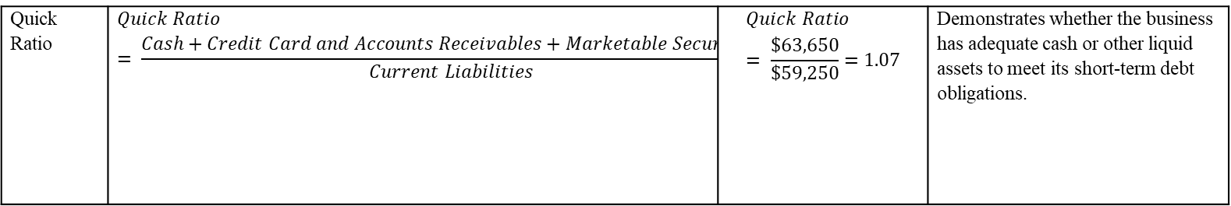
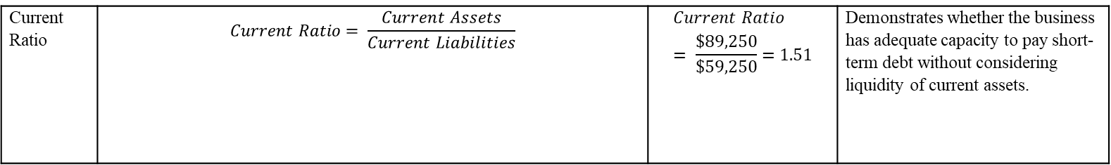
Liquidity Ratios
Current Ratio | $$Current Ratio= \frac{Current Assets}{Current Liabilities}$$ | $$Current Ratio= \frac{\$89,250}{\$59,250}=1.51$$ | Demonstrates whether the business has adequate capacity to pay short-term debt without considering liquidity of current assets.
Quick Ratio | $$Quick Ratio= \frac{Cash+Credit Card and Accounts Receivables+Marketable Securities}{Current Liabilities}$$ | $$Quick Ratio= \frac{\$63,650}{\$59,250}=1.07$$ | Demonstrates whether the business has adequate cash or other liquid assets to meet its short-term debt obligations.

Slide 30
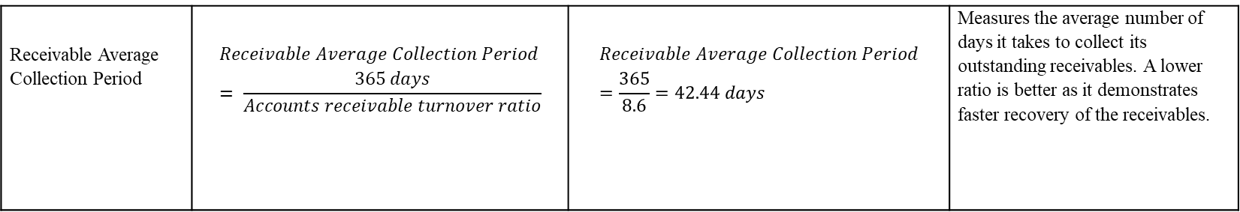
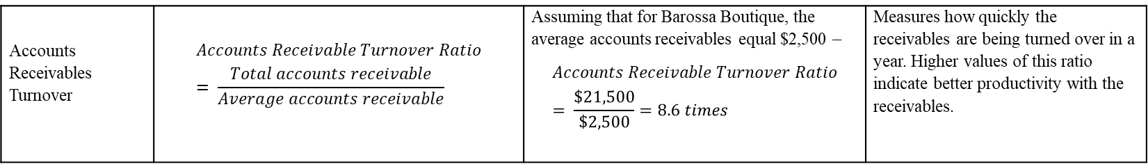
Accounts Receivables Turnover | $$Accounts Receivable Turnover Ratio= \frac{Total accounts receivable}{Average accounts receivable}$$ | Assuming that for Barossa Boutique, the average accounts receivables equal $2,500 – $$Accounts Receivable Turnover Ratio= \frac{\$21,500}{\$2,500}=8.6 times$$ | Measures how quickly the receivables are being turned over in a year. Higher values of this ratio indicate better productivity with the receivables.
Receivable Average Collection Period | $$Receivable Average Collection Period= \frac{365 days}{Accounts receivable turnover ratio}$$ | $$Receivable Average Collection Period=\frac{365}{8.6}=42.44 days$$ | Measures the average number of days it takes to collect its outstanding receivables. A lower ratio is better as it demonstrates faster recovery of the receivables.

Slide 31
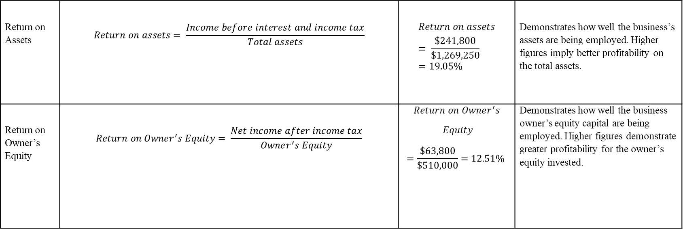
Profitability Ratios
Return on Assets | $$Return on assets= \frac{Income before interest and income tax}{Total assets}$$ | $$Return on assets= \frac{\$241,800}{\$1,269,250}=19.05\%$$ | Demonstrates how well the business’s assets are being employed. Higher figures imply better profitability on the total assets.
Return on Owner’s Equity | $$Return on Owner^{′}s Equity= \frac{Net income after income tax}{Owner^{′}s Equity}$$ | $$Return on Owner^{′}s$$ $$Equity$$ $$=\frac{\$63,800}{\$510,000}=12.51\%$$ | Demonstrates how well the business owner’s equity capital are being employed. Higher figures demonstrate greater profitability for the owner’s equity invested.

Slide 32
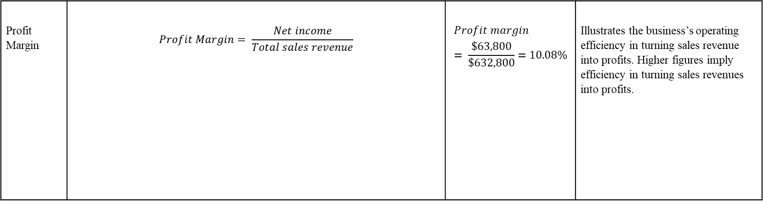
Profit Margin | $$Profit Margin= \frac{Net income}{Total sales revenue}$$ | $$Profit margin= \frac{\$63,800}{\$632,800}=10.08\%$$ | Illustrates the business’s operating efficiency in turning sales revenue into profits. Higher figures imply efficiency in turning sales revenues into profits.

Slide 33
Sustainability Performance Measures
Life Cycle Assessment (LCA): This measure evaluates the environmental, social, and economic negative impacts and benefits in the decision-making processes towards developing more sustainable products in its typical life cycle.
Triple Bottom Line (TBL) performance measures: This represents the spectrum of important organizational values – economic, environmental and social, and encourages expansion of traditional financial reporting frameworks with the inclusion of these values.
Social Impact Analysis: There are several social impact analysis methods used all around the world, but, commonly, they all seek to address the intended and unintended positive and negative social consequences derived from business interventions.

Slide 34
Exercise Questions
After attending a National Hospitality Industry Expo, Donald learned about key benchmarks of industry- average ratios for similar types of hotels. He is keen to examine how Barossa Boutique is performing in comparison to industry averages. Based on the information below, analyse and evaluate how Barossa Boutique is performing financially.
Ratio | Barossa Boutique | Industry Average
Current Ratio | 1.51 | 1.32
Receivable Average Collection Period | 42.44 days | 38.60 days
Profit Margin | 10.08% | 10.95%
Labor Cost Percentage | 36.67% | 32.45%

Slide 35
Solution
Ratio | Evaluation
Current Ratio | Barossa Boutique has higher than industry average current ratio, which means they have more than enough current assets to meet any current liabilities. However, having too high of current ratio is not necessarily a good thing, as Barossa Boutique might have too much productive current assets lying around.
Receivable Average Collection Period | Barossa Boutique’s average receivables collection period is longer than the industry average, which means they are slower than normal in collecting its receivables. It is not a good indicator, and Donald must ensure that efficient collection of receivables is in action to ensure quick cash recovery.
Profit Margin | There is not much difference in the profit margin figures, indicating that Barossa Boutique is in line with the industry with regards to its ability to convert sales revenues into profits.
Labour Cost Percentage | In the hospitality industry, labour cost is a crucial element that requires constant control. Barossa Boutique’s labour costs are higher than the industry, indicating that they require more control in keeping labour costs in check.

