Slide 1
Managing Tourism Enterprises
Chapter 7: Leadership for Tourism Enterprises

Slide 2
Chapter 7: Leadership for Tourism Enterprises
Learning Outcomes:
Recognize the critical role of high-performance leadership in tourism enterprises
Understand the different styles of leadership, including transformational leadership, servant leadership, authentic leadership, etc.
Evaluate how different leadership styles create different outcomes on performance
Understand the concept of ‘entrepreneurial leadership’ and how this can be applied in tourism enterprises

Slide 3
Leadership is ‘the process, not a person, of influencing others in a manner that enhances their contribution to the realisation of group goals’ (Platow et al., 2015, p. 20).
Leadership extends beyond control and direction; a successful leader delegates, stimulates, motivates, mobilises and influences others in order achieve specific objectives (Nanjundeswaraswamy and Swamy, 2014).

Slide 4
Employees in the tourism industry frequently experience emotional exhaustion, a lack of appreciation, low pay, stress, and uncertainty in their career progression (Huertas-Valdivia et al., 2019).
Leaders in tourism and hospitality need to understand and adapt their leadership styles to effectively motivate employees’ positive behaviours and improve their job performance (Fu et al., 2020).

Slide 5
Leadership vs. Management
Leadership:
The ability to influence, motivate and empower others to contribute toward the effectiveness and success of organizations.
Management:
Directing and controlling a group of people for the purpose of coordinating and harmonizing that group towards achieving organization goals.

Slide 6
High-performance leadership in tourism enterprises includes:
High energy and determination
Ability to learn from others
Willingness to learn from mistakes and past experience
Being open-minded and self-reflective
Strong communication skills and an ability to influence others
Competence in building relationships
Ability to learn from failures
Ability to recognize personal weaknesses
Developing and communicating a strategic vision for the enterprise
Having competencies in operations management

Slide 7
Outcomes of Effective Leadership
• Improve service quality and customer satisfaction
• Strengthen the competitiveness of the tourism SME
• Support the SME in innovation
• Increase employee engagement and loyalty
• Influence employee creative performance

Slide 8
Leadership Styles
• Authentic leadership
• Transformational leadership
• Servant leadership
• Empowerment leadership
• Wisdom leadership
• Entrepreneurial leadership

Slide 9
Authentic Leadership
Leadership that focuses on providing employees with a work environment that is realistic and genuine
Leadership involves understanding oneself, as well as adopting a ‘value-based mission’ toward those who follow.
Focus on building trust, helping to strengthen the psychological growth and self-development of the employees
Authentic leaders use positive modelling to establish the organizational culture.
Through building employee satisfaction, this extends to positive interactions between staff and customers in tourism organizations, supporting service quality.

Slide 10
Transformational Leadership
‘…style of leadership that transforms followers to rise above their self-interest by altering their morale, ideals, interests, and values, motivating them to perform better than initially expected’ (Pieterse et al., 2010, p. 610).
Transformation leadership practices for tourism enterprises:
• Establishing and reinforcing the vision, mission and goals of the tourism firm
• Acting as a role model for expected behaviours
• Being attentive to the needs of the employees
• Using active listening
• Mentoring employees to build their capabilities in creativity and problem solving
• Supporting employees in achieving their personal goals

Slide 11
Wisdom Leadership
Wisdom leadership is defined as the individual’s ‘awareness of one's workplace surroundings and the ability to anticipate consequences within the dynamic of the workplace … the ability to understand organisational dynamics and connect reasonable outcomes based upon the environmental cues that they read’ (McCann et al., 2014, p. 29).

Slide 12
Characteristics of Wise Leaders
• Ability to relate to people different from themselves
• Ability to inspire others
• Ability to be supportive and helpful to others
• Confidence in what they know (and are aware of what they don’t know)
• Prepared to deal with uncertainty and various situations

Slide 13
Servant Leadership
Focus on the psychological needs and wellbeing of the followers
Engage followers in multiple dimensions and emphasize humility, spirituality, ethics and justice
Build relationships – the leader aims to empower the employee, enabling them to grow and increase their potential and capabilities (Mayer et al., 2008; Eva et al., 2019).

Slide 14
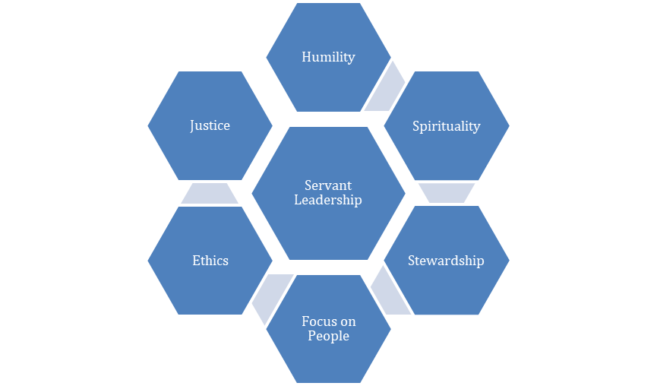
Servant Leadership
Employees in tourism and hospitality enterprises experience many challenges associated with emotional labour, therefore servant leadership increases their self-determination, self-efficacy, and conviction to grow and perform well (Huertas-Valdivia et al., 2019).

Slide 15
Empowerment Leadership
Emphasizes managers giving their employees more power, freedom and autonomy in decision making
Creates psychological empowerment of employees
Enables frontline staff to make decisions and take action in service delivery and service recovery
Staff are given authority to act in pursuit of achieving customer satisfaction and retention

Slide 16
Entrepreneurial Leadership
Interface between entrepreneurship and leadership
Entrepreneurship
Entrepreneurial Leadership
Leadership

Slide 17
Entrepreneurial Leadership
Energize staff to pursue an opportunity-focused vision
Focus on achieving entrepreneurial goals of recognizing and exploiting entrepreneurial opportunities
Creating an entrepreneurial culture that is focused on innovation

Slide 18
Questions/activities
1. Consider how leadership in tourism enterprises may different from leadership in other types of organizations, for example manufacturing.
2. How does leadership of employees in tourism enterprises affect service quality and enterprise performance?
3. Explain how entrepreneurial leadership is distinct from other types of leadership such as servant leadership, authentic leadership, etc.
4. Do some research and find examples of different leadership behaviours in tourism firms.
5. Imagine that you were in the process of launching your own tourism enterprise. Discuss what leadership approach you would adopt and provide reasons.

