Slide 1
Managing Tourism Enterprises
Chapter 6: Human Capital and Human Resources

Slide 2
Chapter 6: Human Capital and Human Resources
Learning Outcomes:
Define what Human Resource Management means
Understand the recruitment and selection process, involving the preparation of a job description, shortlisting suitable candidates, and conducting interviews
Identify the different ways employees can be trained
Engage in the process of performance appraisal
Identify the types and functions of rewarding employees
Understand how to enact disciplinary procedures

Slide 3
Chapter 6: Human Capital and Human Resources
Human Capital
Central to Human Capital Theory is the assumption that individuals deliberately invest in education and training in preparation to join the workforce (Nafukho et al., 2004).
This investment means individuals enter the workforce with a higher level of knowledge and skills, leading to economic pay-offs in the form of higher wages as compensation for their higher skillset (Kenworthy and McMullan, 2010).

Slide 4
Chapter 6: Human Capital and Human Resources
An entrepreneur’s human capital is represented by, among other things, his/her level of formal education, experiences, practical learning, and non-formal education (Davidsson and Honig, 2003).
Education in a similar field as the firm’s products and services, and experience in a similar line of business, provides entrepreneurs with substantial prior understanding of the prospective product their start-up will offer as well as the market environment they are entering (Jo and Lee, 1996).
Skills learnt through higher education such as how to successfully manage a firm, identify appropriate markets, and better prepare applications for external funding become more important to effectively grow the business (Goedhuys and Sleuwaegen, 2000; Ganotakis, 2012).

Slide 5
Chapter 6: Human Capital and Human Resources
Human Resources
Human Resource Management (HRM) has multiple definitions in academic literature. A good one to use in a business context is provided by Storey (1995):
HRM is a distinctive approach to employment management which seeks to achieve competitive advantage through the strategic deployment of a highly committed and capable workforce, using an integrated array of cultural, structural, and personnel techniques.

Slide 6
Chapter 6: Human Capital and Human Resources
HRM is a critical tool for tourism enterprises to:
use an array of techniques to develop highly committed and capable employees;
deploy employees in the most effective way;
increase their ability to provide better-quality products and services;
achieve a non-replicable competitive advantage.

Slide 7
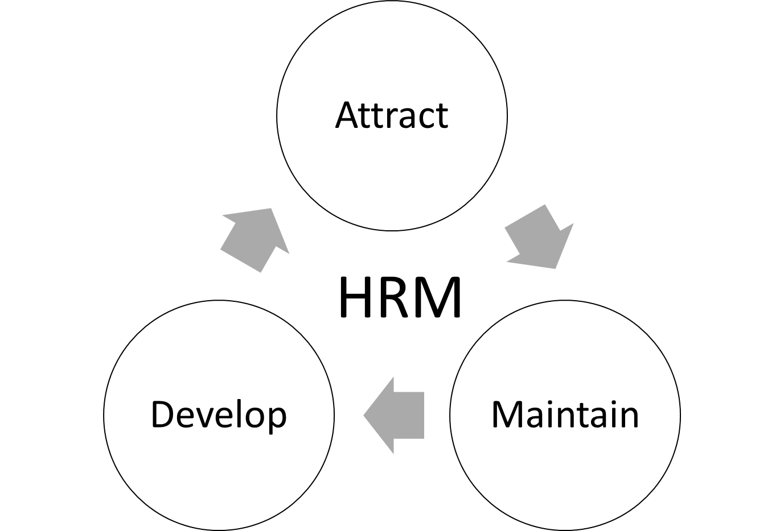
Chapter 6: Human Capital and Human Resources
The HRM Cycle

Slide 8
Chapter 6: Human Capital and Human Resources
Recruitment and Selection
Recruitment is the process of generating a pool of candidates from which to select the appropriate person for a vacancy.
It is important to also acknowledge that recruitment processes can vary in sophistication and complexity. For example, multinational hotel companies may employ a variety of sophisticated and time- and cost-intensive tools. Conversely, when tour operators interview for part-time or seasonal work, a company may take less time to assess candidates, and instead conduct a perfunctory interview and rely on word-of-mouth to assess a candidate’s credentials.
At the very least tourism enterprises should have mechanisms in place to enable a level of scrutiny for candidates for a vacant position.

Slide 9
Chapter 6: Human Capital and Human Resources
Job Description
Heery and Noon (2008) define a job description as:
A document that outlines the purposes of the job, the task involved, the duties and responsibilities, the performance of objectives, and the reporting relationships. It will give details of the terms and conditions, including the remuneration package and work hours.
Job descriptions should provide clear information to candidates about the organization and the job itself. Job descriptions should also act as a marketing document that seeks to make the job and the business look like an attractive place to work for potential applicants.

Slide 10
Chapter 6: Human Capital and Human Resources
A conventional job description should advertise the essential and desirable criteria that the organization is looking for in the person they are seeking to hire.
While there is no specific template that all job descriptions and advertisements should follow, the following information should be present:
• details about the employing firm
• role and duties of the job advertised
• essential and desirable criteria for the role
• training and development that will be provided
• instructions on how to apply

Slide 11
Chapter 6: Human Capital and Human Resources
Shortlisting
This is the process of systematically identifying the candidates you are interested in from your pool of applicants who best meet the essential and desirable criteria contained in the job description.
Shortlisting can be a useful way to quickly eliminate unsuitable candidates from the applicant pool so that more time can be devoted to carefully choosing the best applicant.

Slide 12
Chapter 6: Human Capital and Human Resources
A systematic process for shortlisting can involve:
drawing up the essential criteria to be shortlisted for the first round;
removing all applicants who do not meet the essential criteria;
setting the number of candidates that an initial shortlist should contain (e.g., 5 candidates, 8 candidates, etc.);
individual members on a selection panel producing their own individual list of candidates;
the selection panel combining and revealing their lists;
where there are differences in the candidates selected between lists, panel members discussing why certain candidates were preferred while others were not. The final goal is to reach a consensus, through mutual agreement, negotiation, compromise, or a vote;
the selection panel producing the final shortlist of candidates who will proceed to the next stage of the selection process.

Slide 13
Chapter 6: Human Capital and Human Resources
Interviewing
The employment interview is defined as:
A personally interactive process of one or more people asking questions of another person and evaluating the answers for the purpose of determining the qualifications of that person in order to make employment decisions (Levashina et al., 2014, p. 243).
Interviewing is the predominant method in assessing a candidate’s suitability for a vacant position for tourism enterprises.

Slide 14
Chapter 6: Human Capital and Human Resources
While there is no standard structure as to how an employment interview should run, managers should be aware of certain principles to ensure the process is effective, fair and equitable:
The interview process should focus on allowing the interviewee to speak. The interviewers should not be talking extensively.
Questions should function to elicit information from the candidate, such as open-ended questions starting with “what”, “why”, “when”, “which”, and “how”.
Interviewers need to be mindful and reflect on their personal biases to ensure that the effects of these are mitigated as much as possible.
If conducting multiple interviews sequentially, interviewers need to be mindful of the contrast effect. This refers to allowing the experience of interviewing a previous candidate to influence the interview of the next candidate. As much as possible, each interview format should be similar and treated as separate cases.
Both interviewers and interviewees are affected by physical cues. Interviewers need to avoid non-verbal cues associated with negative emotions, and instead adopt neutral expressions and body language.

Slide 15
Chapter 6: Human Capital and Human Resources
Training
Training can be broadly categorized according to the desired outcomes of the training.
Induction and socialization – training programmes designed to induct new employees into the organization (often referred to as on-boarding). It also functions to socialize new employees with current employees.
Development – training programmes designed to develop and improve individuals within the organization. For example, preparing employees for promotion, upskilling, introduction of new processes and procedures, etc.
Disciplinary/remedial – training programmes designed to improve the performance of employees who have fallen below the standards set by the firm.

Slide 16
Chapter 6: Human Capital and Human Resources
Training can occur internally or external to the organization. These are broadly categorized as:
Internal, on-the-job training – involves junior employees observing or shadowing senior employees when work takes place during working hours.
Internal, off-the-job training – takes place within the organization, either outside the normal place of work (e.g., in dedicated training room in the back-of-house section instead of on the work site) or outside of work hours. There may also be a dedicated or specialized training department within the firm to facilitate this type of training.
External, off-the-job training – takes place outside of the organization and is usually associated with sending employees to be trained by external training providers.

Slide 17
Chapter 6: Human Capital and Human Resources
Performance Appraisal
Performance appraisal refers to the process of evaluating the performance of employees to:
ensure that expected standards of performance for an employee’s role are being met
assess future training and development needs of the firm’s workforce

Slide 18
Chapter 6: Human Capital and Human Resources
Managing performance can assist a tourism enterprise to:
clarify minimum and/or expected performance standards required of employees;
set future performance goals for employees or the enterprise;
improve performance of employees by providing feedback (e.g., Are they doing things the right or wrong way? How could they do things better?);
identify future training and development needs;
set and award pay and rewards;
identify employees with high potential for career development and succession planning;
increase employee motivation (e.g., from being able to set goals, provide rewards, etc.);
solve job problems;
evaluate the effectiveness of the recruitment and selection process.

Slide 19
Chapter 6: Human Capital and Human Resources
What to Appraise
Task-based performance includes an employee’s:
skill, ability and knowledge of the job;
quality of work. This quality also needs to be assessed if it is consistent over time;
volume of output.
Personality-based performance includes an employee’s:
attitude during work hours, such as commitment, motivation, professionalism and enthusiasm;
quality of interaction, encompassing:
communication and ability to get along with teammates, colleagues and other employees;
communication and professionalism during customer interactions.

Slide 20
Chapter 6: Human Capital and Human Resources
Who Should Appraise?
Several approaches can be used in tandem to measure the ‘true’ performance of employees using:
Self-evaluation – employees self-assess their performance according to a specific set of criteria.
Peer-evaluation – team members or colleagues (usually within the same department or work unit) asses all other individuals that they work with (except themselves).
Upward evaluation – the manager’s performance is evaluated by the staff.
Customer evaluation – the firm’s customers may evaluate the performance of their staff through customer surveys, comments, observations, mystery shoppers, etc.

Slide 21
Chapter 6: Human Capital and Human Resources
Rewards
Rewards for employees’ work largely involves monetary compensation (i.e. pay). Pay plays a role for both employees and the employers.
Employees want and expect to:
Earn sufficient to achieve a level of purchasing power to maintain or attain their desired standard of living;
perceive that they are being fairly treated (i.e. equal pay for equal work);
perceive that they are being recognized for their work;
obtain their rights as an employee. Since employees create wealth for the firm through their work, the expectation is that this wealth is in turn shared with them.

Slide 22
Chapter 6: Human Capital and Human Resources
Employers pay employees for their work to:
attract good candidates to work for the firm;
retain high-performing employees within the firm;
motivate employees to perform well in service to the firm’s objectives;
create change in the organization. For example, if employees are required to perform new tasks or different tasks, they may need to be compensated more for the increase in workload;
maintain or enhance a firm’s corporate reputation as a good place to work;
determine the affordability of producing the firm’s products and services, as labour costs factor into the prices a firm will charge to obtain a desired return on investment.

Slide 23
Chapter 6: Human Capital and Human Resources
Other than pay, rewards offered to employees can also be non-monetary in nature, such as:
promoting employees (while usually associated with higher levels of pay, this can also demonstrate recognition and value towards an employee);
giving employees extra days off;
offering recognition of excellence (e.g., Employee of the Month rewards, certificates of achievement, etc.);
taking employees on activities or incentive trips;
offering company healthcare and retirement plans.

Slide 24
Chapter 6: Human Capital and Human Resources
Disciplinary Procedures
Conflict inevitably occurs within any firm. Sources of conflict can be broadly categorized into:
Environmental conflict – conflict arising due to adverse working conditions or the unacceptable nature of the work an employee performs. This encompasses the economic conditions of the job, the physical conditions of the job, and whether employees feel their workload is too much or too little.
Social substantive conflict – conflict arising due to perceived disagreements of how decisions are made in the organization. This can be caused by actions from management or company policy that make employees perceive that decisions made or actions taken are inequitable.
Social relational conflict – arising from relationships between individuals and groups within the firm. For example, conflicts due to racism, sexism, differing personalities, etc.

Slide 25
Chapter 6: Human Capital and Human Resources
Levels of Conflict
The magnitude of the perceived conflict can be expressed according to different levels:
Dissatisfaction – anything that disturbs an employee’s contentment with their job, whether this disturbance is expressed in words or internally.
Complaint – dissatisfaction which is brought to the attention of the manager or person responsible in words or in writing.
Grievance – a complaint that has been formally presented to a higher management representative, such as the Human Resources department or union official.

Slide 26
Chapter 6: Human Capital and Human Resources
Reporting and Dealing with a Grievance
A tourism enterprise should have steps for employees to lodge a formal grievance. These can include:
employees presenting the nature of the grievance formally in writing;
the employer holding a meeting to discuss the employee’s grievance as soon as possible;
the employee being allowed to bring a support person to the meeting. This can be a co-worker, union representative, etc;
following the meeting, the employer following up by:
deciding on an appropriate action;
communicating in writing the decision to the employee, along with how the employer came to the decision;
if action is intended to be taken, explaining what the action involves;
detailing the timeframe for action to be taken.

Slide 27
Chapter 6: Human Capital and Human Resources
Questions/activities
Draw up a job application for a hypothetical position in a tourism enterprise.
Come up with practical ways internal, on-the-job training can be conducted within a tourism enterprise.
What kind of training could be implemented to encourage teamwork within a tourism enterprise?
What types on non-monetary rewards can be used to reward teamwork within a tourism enterprise?

