Slide 1
Managing Tourism Enterprises
Chapter 5: Business Strategy and Growth

Slide 2
Chapter 5: Business Strategy and Growth
Learning Outcomes:
Utilize a PESTEL analysis to analyse the macro-environment.
Utilize a Porter’s 5 Forces framework to analyse the industry environment.
Utilize a SWOT analysis to analyse the firm’s capabilities.
Understand the different types of business strategies available to tourism enterprises.
Identify the types of strategies a tourism enterprise can use for business growth.

Slide 3
Chapter 5: Business Strategy and Growth
PESTEL Analysis
The macro-environment can be analysed using a PESTEL analysis (Aguilar, 1967). PESTEL stands for:
• Political
• Economic
• Social
• Technological
• Ecological
• Legal

Slide 4
Chapter 5: Business Strategy and Growth
Political
Represents the role of governments and other political factors that can influence the tourism enterprise.
Managers can analyse political risks associated with whole countries (e.g., politics in Australia) or specific industries or sectors within a country (e.g., hotel industry in the Middle East).

Slide 5
Chapter 5: Business Strategy and Growth
Political Issues to Consider
• National or regional policies of governing parties
• Changes in government
• International trade policies
• Immigration and border policies
• Wars
• Political stability/instability
• Terrorism

Slide 6
Chapter 5: Business Strategy and Growth
Economic
Represents the forces that can influence a tourism enterprise based on the state of the economy and business prospects within a particular region/country/industry.
An awareness of economic cycles is important as economic growth rates tend to increase and decrease at regular intervals.
The tourism industry is highly susceptible to economic cycles because it is a discretionary-spend and high-fixed-cost industry.

Slide 7
Chapter 5: Business Strategy and Growth
Economic Issues to Consider
• Gross domestic product (GDP) growth rates
• Inflation rates
• Interest rates
• Mortgage rates
• Currency exchange rates
• Consumer Price Index (CPI)
• Stock market movements
• Taxation
• Unemployment rates
• Prices of commodities

Slide 8
Chapter 5: Business Strategy and Growth
Social
Represents the demographic, psychographic and geographic characteristics of a population that can influence the tourism enterprise’s market. These factors will determine the nature of supply and demand within the tourism industry.
Social issues to consider:
Demographic characteristics related to: age, gender, education, ethnicity, religion, population growth, income
Psychographic characteristics related to: lifestyles of generational cohorts (e.g., Gen X and Y, Baby Boomers), wellbeing, political leaning
Geographic characteristics related to: weather and climate, elevation, bodies of water

Slide 9
Chapter 5: Business Strategy and Growth
Technology
Represents the extent to which technology plays a role in the way products and services in tourism are produced, marketed, distributed and consumed. Technology is utilized on both the demand and supply sides.
Demand side: customers increasingly search, book or purchase tourism products over the internet (e.g., through OTAs such as Expedia, TripAdvisor, etc.).
Supply side: tourism enterprises have benefitted from technology through enhanced efficiency and productivity. For example, the relatively low cost and wide distribution of internet marketing has enabled tourism enterprises to reach customers across the globe to promote their products and services.

Slide 10
Chapter 5: Business Strategy and Growth
Technology Issues to Consider
Extent of spending on research and development by firms, industries or countries
Extent of patenting activity on national patent registers
New hardware technology developed and introduced to market
New software technology developed and introduced to market
Development and/or introduction of new products and services within a particular industry

Slide 11
Chapter 5: Business Strategy and Growth
Ecological
Represents the extent to which ‘green’ issues, such as pollution, waste, energy saving and climate change is a major issue in the markets the tourism enterprise operates in.
Can be seen as an opportunity to establish a competitive advantage (e.g., creating a positive brand image resulting in customer loyalty and satisfaction), especially as customers are becoming more eco-friendly in their lifestyles and purchase decisions.
Can be seen as an additional cost to doing business (e.g., having to invest in greener technology, sourcing more environmentally friendly products).

Slide 12
Chapter 5: Business Strategy and Growth
Ecological Issues to Consider
• Climate change
• Greenhouse gas emissions
• Global warming
• Sea level rises
• Rate of deforestation
• Waste disposal
• Recycling policies
• Availability of ‘green’ technologies
• Customer demand for ‘green’ products and services
• Availability of suppliers of ‘green’ products and services

Slide 13
Chapter 5: Business Strategy and Growth
Legal
Represents the extent that laws, regulations and informal norms within a society influence the ability of tourism enterprises to conduct business.
Legal aspects related to laws and regulations can cover labour and taxation laws and corporate governance.
Informal norms, representing patterns of expected behaviour within a society, are also covered under this aspect.

Slide 14
Chapter 5: Business Strategy and Growth
Legal Issues to Consider
Labour and employment law (e.g., minimum wage policies, leave policies)
Taxation law
Rules on business ownership
Competition law
Consumer protections
Corporate governance laws

Slide 15
Chapter 5: Business Strategy and Growth
Porter’s 5 Forces
The Porter’s 5 Forces Framework (Porter, 1980) helps to analyse an industry and identify attractiveness in terms of five competitive forces:
• extent of rivalry between competitors
• threat of entry
• threat of substitutes
• power of buyers
• power of suppliers

Slide 16
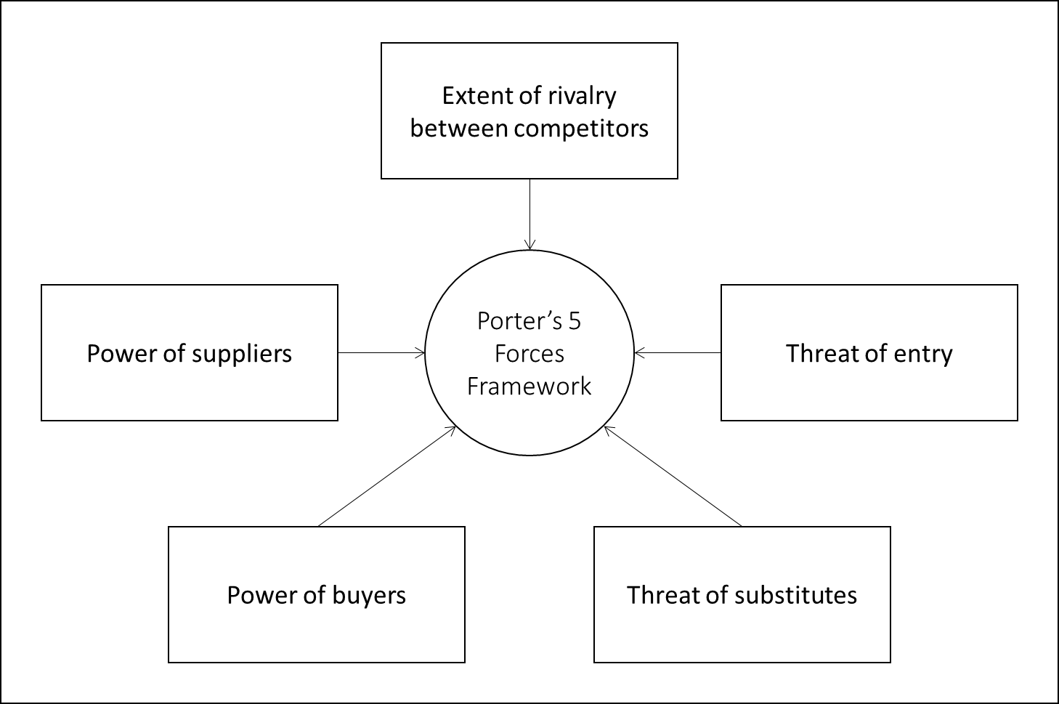
Chapter 5: Business Strategy and Growth

Slide 17
Chapter 5: Business Strategy and Growth
Through this analysis, the five forces are then determined by managers to be high/strong, medium, or low/weak.
When the five forces are deemed high and strong, an industry is said to be unattractive for entry.
This is because excessive rivalry between competitors, powerful buyers and suppliers; the ease with which consumers can switch to substitutes; and the threat of new entrants into the industry will combine to significantly reduce profitability.

Slide 18
Chapter 5: Business Strategy and Growth
When the five forces are deemed low and weak, an industry is said to be attractive for entry.
This is because little or no rivalry, with customers and suppliers with relatively low bargaining power, the lack of substitutes for a firm’s products and services, and high barriers to entry, result in first-mover advantages and the potential to establish a monopoly.

Slide 19
Chapter 5: Business Strategy and Growth
SWOT Analysis
SWOT analysis is a method for analysing an organization’s resources and environment according to its Strengths, Weaknesses, Opportunities and Threats (Phadermrod et al., 2019).
Strengths and weaknesses are the internal factors that enhance or obstruct an enterprise achieving its goals and can be controlled.
Opportunities and threats are the external factors that enable or disable an enterprise achieving its goals and are uncontrollable.

Slide 20
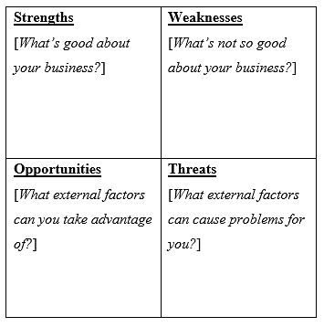
Chapter 5: Business Strategy and Growth
Listing favourable and unfavourable internal and external factors can allow tourism enterprises to better understand how strengths can be leveraged to capture new opportunities and understand how weaknesses can hinder efforts to achieve organizational goals (Helms and Nixon, 2010).

Slide 21
Chapter 5: Business Strategy and Growth
Business Strategies
There are four general strategies that tourism enterprises can pursue. These are cost leadership, differentiation, focus and hybrid strategies.
Cost leadership: refers to firms deriving a competitive advantage primarily by maintaining a low-cost position. This means having lower costs of production compared to competing firms in the same market, allowing the firm to charge lower prices.

Slide 22
Chapter 5: Business Strategy and Growth
Differentiation: refers to firms providing unique products and services to customers compared to their competitors. Competitive advantage is achieved when the firm can charge premium prices for its products and services, or if the firm can sell more of a product at a higher price compared to the competition.
Focus strategy: refers to firms focusing their efforts on a particular market segment, with the sole objective of only catering to this specific market. An enterprise will develop its products and services to the specific needs of its target market to the exclusion of all others.

Slide 23
Chapter 5: Business Strategy and Growth
Hybrid strategy: it may be possible for firms to pursue a hybrid strategy, combining cost, differentiation, and focus strategies. However, firms are generally discouraged from doing so as attempting to pursue multiple strategies tends to lead to a loss of focus, efficiency, and product and service quality by being ‘stretched too thin’.

Slide 24
Chapter 5: Business Strategy and Growth
Business Growth
Not only do enterprises need to survive in the marketplace, but they should also seek to grow and thrive. Growth can relate to increasing sales, profitability, opening new outlets/locations, etc.
To grow a business, there are four general strategies that can be implemented according to whether a business seeks to grow its current customer base or seek new markets and whether they will do so by using existing or new products and services.

Slide 25
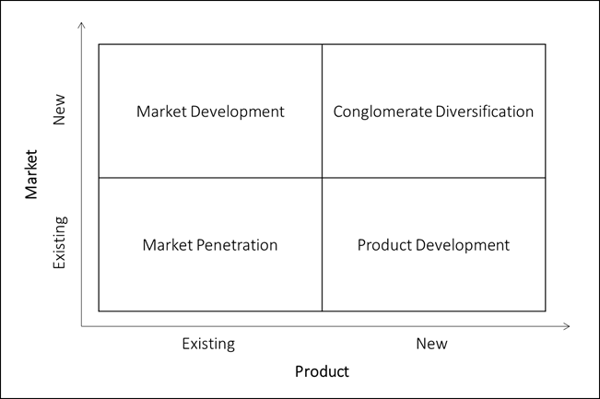
Chapter 5: Business Strategy and Growth
Business Growth Strategies Matrix
Market penetration: increasing the penetration of a firm’s existing products and services within an existing market.
Product development: deliver modified/improved/ updated or new products and services to existing markets.
Market development: offering a firm’s existing products and services to new markets.
Conglomerate diversification: grow by going beyond existing markets, products and services. This strategy is generally enacted in practice through mergers and acquisitions.

Slide 26
Chapter 5: Business Strategy and Growth
Questions/activities
Conduct a PESTEL analysis for an industry within tourism at the national level (e.g., hotel industry in China, cruise industry in the Bahamas, etc.).
Conduct a Porter’s 5 Forces analysis for an industry within tourism at the local level (e.g., boutique hotel market in Cape Town, South Africa, fine-dining restaurant market in Tokyo, Japan, etc.).
Conduct a SWOT analysis for a tourism business in your area.
Conduct an internet search to find examples of tourism enterprises that have adopted a cost leadership, differentiation and focus strategy.
Do some research and find out what tourism enterprises have engaged in, or are part of, a conglomerate diversification business growth strategy.

