Slide 1
Managing Tourism Enterprises
Chapter 4: Marketing, Service Quality and Distribution

Slide 2
Chapter 4: Marketing, Service Quality and Distribution
Learning Outcomes:
Describe the 7Ps of the marketing mix
Explain the marketing challenges of small-business operators
Distinguish between entrepreneurial marketing and traditional marketing
Understand the entrepreneurial marketing dimensions
Define the concept of service quality
Understand distribution systems in tourism

Slide 3
Chapter 4: Marketing, Service Quality and Distribution
Marketing Mix
The marketing mix is a combination of elements that a business can use to implement its marketing strategies to achieve its marketing objectives.
The 7Ps marketing mix is an extension to Kotler’s traditional 4Ps (price, product, promotion and place) commonly used for products to include services-focused elements (people, process and physical evidence) (Pholphirul et al., 2021).

Slide 4
Chapter 4: Marketing, Service Quality and Distribution
The 7Ps of the Marketing Mix
Product: what is being sold. This may include tangible, intangible or an experience.
Price: charges paid for products or services. When setting prices, it is vital to understand how much customers are prepared to pay for your product, the profit margins target, and costs associated with selling the product. This may include credit payment and instalment payments.
People: includes everyone directly or indirectly involved in selling the product or service and providing customer service.

Slide 5
Chapter 4: Marketing, Service Quality and Distribution
Place (or distribution): channels or means used to make the products available to customers. This could refer to a shopfront, an online store, a warehouse, or a cloud-based platform.
Promotion: actions taken to inform the market about what is being sold including advertising and public relations.
Physical evidence: everything that customers see when interacting with your business. This includes the physical or online facilities where product or service are provided, the design of the facilities, company logo and branding, product packaging, social media presence and more.
Process: functions involved in delivering your product or service to customers. This includes aspects like your sales funnel, payment systems, distribution approach and the way you manage customer relationships.

Slide 6
Chapter 4: Marketing, Service Quality and Distribution
Marketing Challenges for Small Business
Lack of marketing budget – lack of financial resources to carry out marketing research and feasibility analysis before product introduction to the market.
Limited access to communication techniques – choosing the right market strategies for the product. Most small-business owners are not sure of how to gather and evaluate available marketing information.
Limited resources to implement marketing activities – marketing is a dynamic process in an evolving environment. Small businesses may struggle with acquiring the resources (including skills and finance) to develop and implement continuous marketing activities.

Slide 7
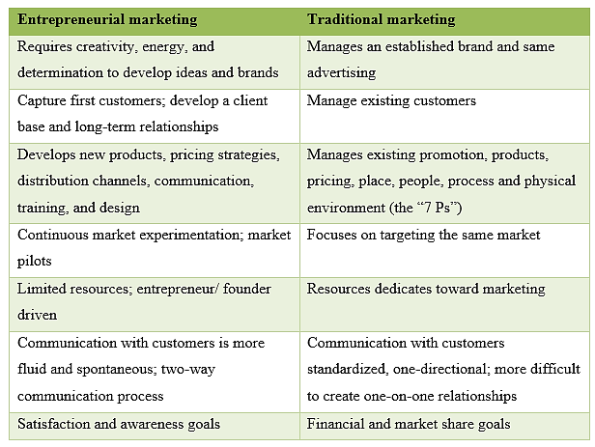
Chapter 4: Marketing, Service Quality and Distribution
Entrepreneurial Marketing vs. Traditional Marketing

Slide 8
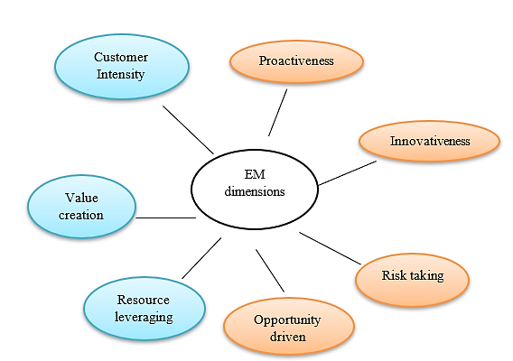
Chapter 4: Marketing, Service Quality and Distribution
Dimensions of Entrepreneurial Marketing

Slide 9
Chapter 4: Marketing, Service Quality and Distribution
Implementing Entrepreneurial Marketing
Networking/relationship marketing – one-on-one, person-to -person techniques of promoting and creating a new product.
Guerilla marketing – using novel and unconventional tactics that businesses (mostly small) use to introduce and attract buyers for a new product. The tactics are designed to evoke surprise, wonder, or shock.
Expeditionary marketing – enables businesses to identify and expand into new markets. It helps to discover information and opportunities about new markets.

Slide 10
Chapter 4: Marketing, Service Quality and Distribution
Service Quality
Products or services in tourism have unique characteristics that differentiate it from manufacturing and other service-oriented organizations.
Intangible products and services make them harder for testing and evaluation. Heterogeneous services dependent on human performance make it difficult to apply standard specifications of quality and eliminate deviations from the norm.
Mistakes in the service process cannot be identified and corrected before it reaches the consumer because of simultaneity. Many mistakes are accidental or unexpected and are a part of business.
Because of these characteristics, managing service quality is essential for any tourism enterprise.

Slide 11
Chapter 4: Marketing, Service Quality and Distribution
Customer service has a direct impact on customer satisfaction. In turn, this increases repeat purchase and positive word-of-mouth, ultimately increasing the company’s bottom line. Delivering good customer service functions to:
• improve guest convenience
• enhance a tourism provider's image
• ensure customer security
• generate repeat visitation or purchase
• establish a competitive edge
• generate customer demand

Slide 12
Chapter 4: Marketing, Service Quality and Distribution
Service quality is subjective and judged by the guests. Guests' expectations are conceptualized at three levels:
Essential services – services that are the core of the service business. These meet the fundamental requirements to continue operations. For example, hotels should maintain reasonable opening hours and check in guests with reservations.
Expected services – services that guests assume the provider should offer. While not mandatory, these services need to be offered to stay competitive because of guest expectations; e.g., multiple payment options, full information on the services, facilities and surrounding location.
Optional/desired services – services that are an added bonus that enhance the value of a guest’s visit. This expresses the uniqueness of the service provider and creates a competitive advantage.

Slide 13
Chapter 4: Marketing, Service Quality and Distribution
SERVQUAL
Measuring the service quality expectations and perceptions of the service recipient is important as it helps organizations to identify problems in current systems and manage them effectively.
The SERVQUAL model consists of five factors that contribute to service quality:
Tangibles – appearance of physical facilities, equipment, personnel, and communication materials
Reliability – ability to perform the promised service dependably and accurately

Slide 14
Chapter 4: Marketing, Service Quality and Distribution
Responsiveness – willingness to help customers and provide prompt service
Assurance – knowledge and courtesy of employees and their ability to convey trust and confidence
Empathy – caring, individualized attention the firm provides its customers

Slide 15
Chapter 4: Marketing, Service Quality and Distribution
Service Performance
Service quality reflects the difference between guests’ expectations and the actual services received.
Service is perceived as exceptional when expected services have been surpassed in quality and quantity.
Service is perceived as adequate when expectations are sufficiently met.
Services are unsatisfactory when service performed does not match expectations.

Slide 16
Chapter 4: Marketing, Service Quality and Distribution
Distribution Channels
Distribution channels in tourism refers to a system of intermediaries that facilitate the sale and delivery of tourism services from suppiers to consumers (Buhalis and Laws, 2001).
Distribution channels are important to consider because they serve as part of the marketing mix that makes tourism products and services available to customers. They are the link between the suppliers of tourism products and services to their end users, and are the bridge between supply and demand (Gartner and Bachri, 1994).

Slide 17
Chapter 4: Marketing, Service Quality and Distribution
Intermediaries
Intermediaries refer to actors that bundle together two or more elements of supply (e.g., a tour, airline seat, accommodation) and sell it to the customer (i.e. middlemen) (Cooper, 2016).
Intermediaries are important in tourism distribution channels because in many cases it is not feasible for tourism enterprises to be able to sell their products and services directly to tourists across every market.

Slide 18
Chapter 4: Marketing, Service Quality and Distribution
According to Song (2012), intermediaries function to:
Match supply with demand: tourists demand a wide range of products and services when engaging in tourism. However, suppliers can only provide a specific range of products and services to meet tourist needs. Tourism intermediaries can package several tourism products and services to meet tourism demand.
Improve efficiency: intermediaries reduce the number of transactions and associated costs that tourists need to make. For example, instead of making individual purchases for airline tickets, accommodation and tours, intermediaries can bundle these services together and sell them in one transaction at one price.

Slide 19
Chapter 4: Marketing, Service Quality and Distribution
Facilitate information exchange: tourism enterprises may sell their products and services to markets far beyond their location. Intermediaries assist in transferring information to customers that can be costly or too complex for smaller tourism enterprises to manage.
Provide extra services: intermediaries can provide service beyond just facilitating buying and selling. For example, tourism enterprises can extend credit to allow delayed payments to intermediaries. Intermediaries can also offer members in the channel finance, credit, insurance and consultancy services.

Slide 20
Chapter 4: Marketing, Service Quality and Distribution
Distribution Channel Structure
The structure of a distribution channel refers to the way in which tourism supplies reach the consumer. This can be categorized into direct and indirect channels.
Direct channel: a tourism enterprise sells their products and services directly to the customer without involving intermediaries.
Indirect channel: a tourism enterprise works with their intermediaries to sell their products and services to customers.

Slide 21
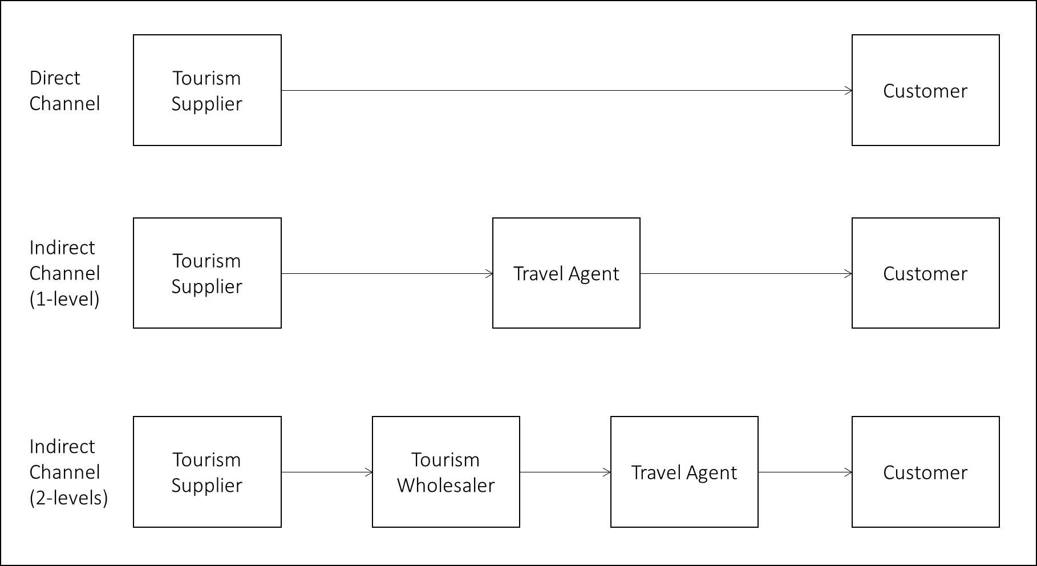
Chapter 4: Marketing, Service Quality and Distribution
Distribution Channel Structure

Slide 22
Chapter 4: Marketing, Service Quality and Distribution
Developing Distribution Channels
There are several strategies tourism enterprises can use to set their distribution channels as illustrated by Cooper (2016):
Intensive distribution strategy – the tourism enterprise’s products and services are sold through every available channel.
Exclusive distribution strategy – the tourism enterprise’s products and services are sold through a limited number of highly appropriate/specialized channels which meet the tourism enterprise’s desired image or type of clientele.
Selective distribution strategy – a hybrid of the previous two approaches. The tourism enterprise’s products and services are sold through multiple channels, but each channel closely meets the tourism enterprise’s desired marketing image and objectives.

Slide 23
Chapter 4: Marketing, Service Quality and Distribution
Questions/activities
What is entrepreneurial marketing? How is it different from traditional marketing? Discuss using examples.
Using examples, discuss the entrepreneurial marketing dimensions.
With your classmates, discuss the 7Ps of the marketing mix.
In your class groups, come up with a hypothetical example of a tourism business and develop its distribution channel.

