Slide 1
Managing Tourism Enterprises
Chapter 3: Creativity and Innovation

Slide 2
Chapter 3: Creativity and Innovation
Learning Outcomes:
Distinguish between the concepts of creativity and innovation
Identify the sources of information for new business ideas
Understand the different types of innovations that can be developed by tourism enterprises
Identify the barriers to creativity and the innovation process

Slide 3
Chapter 3: Creativity and Innovation
Creativity
Creativity is defined as the act of generating or recognizing ideas, alternatives or possibilities that may be useful in solving problems, communicating with others, and entertaining ourselves and others (Franken, 1982, p. 396).
The concept of creativity involves creative thinking, creativity processes, and creativity outcomes (Edwards-Schachter et al., 2015).
Creative ideas are a ‘multiplicative product of originality, utility and surprise’, whereas uncreative ideas are routine or habitual, serendipitous responses (Simonton, 2016, p. 87).

Slide 4
Chapter 3: Creativity and Innovation
At the enterprise level, creativity is defined as ‘the generation of new and useful/valuable ideas for products, services, processes, and procedures by individuals or groups in specific organisational contexts’ (Martins and Treblanche, 2003, p. 67).
Actors from outside the enterprise that have input into the creative process include customers, clients, professional bodies, and cross-boundary networks (Anderson et al., 2014).
Creative ideas can be generated from monitoring and imitating competitors, gathering customer feedback, consulting with suppliers, or accessing University and Government research (Von Hippel, 1988; Chesbrough et al., 2006).

Slide 5
Chapter 3: Creativity and Innovation
Innovation
Innovation is defined as the introduction of new products or production methods, the opening of a new market or source of new materials, and the creation of new organisational structures in industry (Schumpeter, 1952).

Slide 6
Chapter 3: Creativity and Innovation
The key element to define an innovation is that it must be a ‘new’ idea. Being ‘new’ encompasses an idea that is perceived as new to an individual regardless of when it was first used or discovered (Rogers, 2003).
For an idea to be considered an innovation it must also be successfully implemented and utilised for an economic benefit (Kanter, 1983; Damanpour, 1987).

Slide 7
Chapter 3: Creativity and Innovation
Sources of Information for Innovation
New ideas can come from ‘internal sources’, generally referring to actors within an enterprise, and from ‘external sources’, referring to actors outside the enterprise (Bommer and Jalajas, 2004).
Internal sources: investments in internal R&D, employees
External sources: suppliers, customers, competitors, universities, governments, private laboratories, other countries

Slide 8
Chapter 3: Creativity and Innovation
Types of Innovation
The Organization for Economic Cooperation and Development (OECD) (OECD & Eurostat, 2005) classifies innovations according to five types: product, service, process, management, and marketing innovations (Schumpeter, 1934; Hjalager, 2010).

Slide 9
Chapter 3: Creativity and Innovation
Product/service innovation:
New or significantly improved products and services (Hall, 2009). These can be the development or introduction of new materials, intermediate products, or new components or product features (Camisón and Monfort-Mir, 2012).
Process innovation:
New processes which take place ‘behind the scenes’ with the goal of increasing efficiency and productivity (Hjalager, 2010). This can include the introduction of new equipment or increased automation, new and more efficient methods of production, or the use of new energy sources (Camisón and Monfort-Mir, 2012).

Slide 10
Chapter 3: Creativity and Innovation
Organizational/managerial innovation:
New or improved methods in an enterprise’s organizational structure or system, configuration of work, or developing new external relations (Hall, 2009). This can include developing new ways of coordinating internal collaborations, training and empowering staff, career progression, and rewarding workers with appropriate pay and benefits (Ottenbacher and Gnoth, 2005; Hjalager, 2010).
Process innovation:
New marketing methods, which include changes in product design, promotional strategies, and price (Camisón and Monfort-Mir, 2012). Marketing innovations can also involve developing novel types of marketing or behaviour in the market which include relationships between other parties such as state and other regulatory systems, societal organizations, or specific customer segments (Sundbo, 1998).

Slide 11
Chapter 3: Creativity and Innovation
Benefits of Innovation
New product/service, process, and marketing innovations strongly associated with firm growth in entrepreneurial SMEs (Varis and Littunen, 2010).
Process innovations can increase profits for an enterprise through improved efficiencies and reducing costs (Johne and Davies, 2000).
Management innovations can create new organizational structures that can make building an entrepreneurial culture more effective, facilitating the development of innovation in other areas, playing a key role in enhancing an enterprise’s innovative capabilities (Gunday et al., 2011).

Slide 12
Chapter 3: Creativity and Innovation
Barriers to Creativity and Innovation
An enterprise’s strategy, structures, support mechanisms, and behaviour that encourages innovation will either support or hinder creativity and the innovation process (Martins and Treblanche, 2003).
Factors such as the firm’s age, types of innovation being developed, and the cultural context play significant roles in influencing the success of developing innovations (Rosenbusch et al., 2011).
Innovation requires significant investment in time and resources, as well as creating risk for the enterprise.

Slide 13
Chapter 3: Creativity and Innovation
Tourism enterprises may operate with a limited resource base both in funding and knowledge and may not have the competencies to establish formal research and development departments (Whittaker et al., 2016).
The innovation development process can also be restricted due to high development costs, lack of government support, and difficulties in protecting intellectual property (Oke, 2004; Madrid-Guijarro et al., 2009).

Slide 14
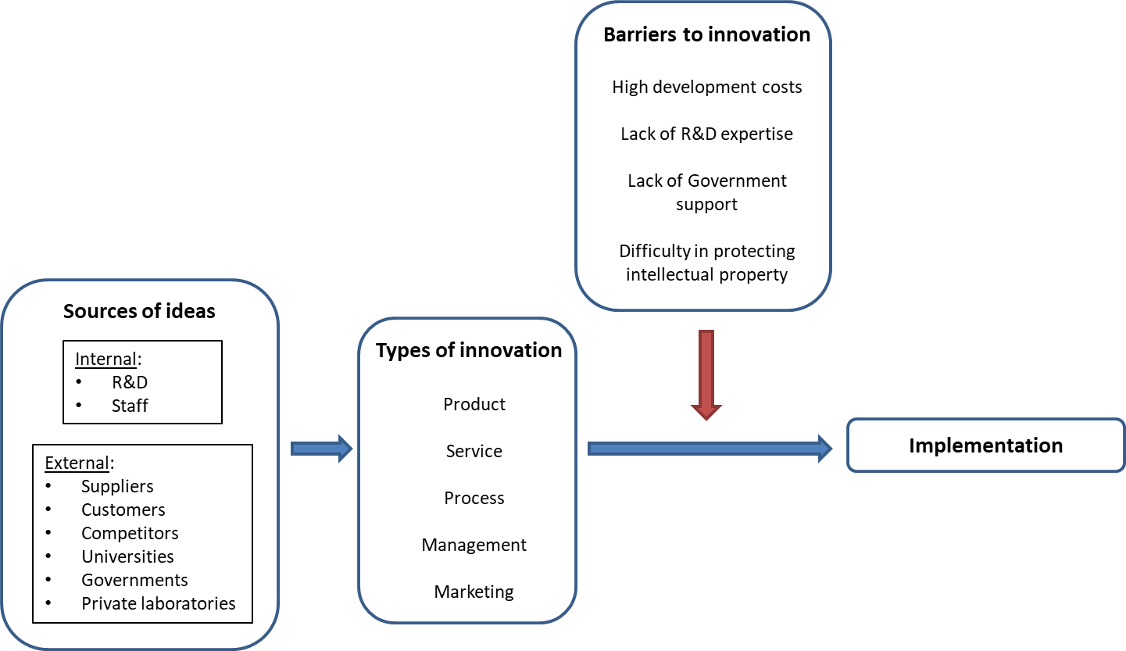
Chapter 3: Creativity and Innovation
The Innovation Development Process

Slide 15
Chapter 3: Creativity and Innovation
Questions/activities
How can tourism enterprises build a culture of creativity within the organization?
What external sources of information may be useful for tourism enterprises to develop ideas for information?
Do some research and find out what are the current innovations in products, services, processes, management, and marketing in the tourism industry.
How might tourism entrepreneurs overcome some of the barriers associated with the innovation development process?

