Slide 1
Managing Tourism Enterprises
Chapter 2: Entrepreneurship and New Ventures

Slide 2
Chapter 2: Entrepreneurship and New Ventures
Learning Outcomes:
Understand the definitions of entrepreneurship and the attributes of high-impact entrepreneurs
Recognize the criteria that investors look for in supporting entrepreneurs
Differentiate between ‘entrepreneurial’ organizations and ‘solid-state’ businesses, understanding the key differences
Understand the different paths to entry in tourism entrepreneurship

Slide 3
Chapter 2: Entrepreneurship and New Ventures
Why focus on entrepreneurship?
Entrepreneurship is a driving force for economic growth, development, job creation and productivity.
Entrepreneurship is described as a ‘dynamic process of creating value to society, business and environment’ (Frederick et al., 2019, p. 10).
The pursuit of opportunities to create value is manifested through business creation and market disruption through new or improved technologies, products, services, processes and business models.

Slide 4
Entrepreneurship is a way of thinking, reasoning, and acting that is opportunity obsessed, holistic in approach, and leadership balanced for the purpose of value creation and capture...at the heart of the process is the creation and/or recognition of opportunities, followed by the will and initiative to seize these opportunities. It requires a willingness to take risks – both personal and financial – but in a very calculated fashion in order to constantly shift the odds of success, balancing the risk with the personal reward.
(Timmons and Spinelli, 2009, p. 101)

Slide 5
Entrepreneurship is a ‘high-impact’ activity that generates:
Innovation
Job creation
Wealth creation
Societal impact.
(World Economic Forum, 2014)

Slide 6
Entrepreneurs come in all shapes and sizes, from different cultures, religions, backgrounds, etc.
High-impact entrepreneurs are a product of multiple internal and external factors.

Slide 7
Internal factors that influence entrepreneurship
• Individual personality:
certain personality traits are associated with high-impact entrepreneurship
• Practical entrepreneurial skills:
entrepreneurship competencies, resilience and the drive to pursue opportunities can be acquired through education and experience

Slide 8
External factors
• Local cultural attitudes towards entrepreneurship:
countries that celebrate entrepreneurs and their successful enterprises tend to have higher rates of entrepreneurship
• Role models:
successful entrepreneurs act as role models and can influence career choices by providing individuals with tangible evidence that they too can succeed as entrepreneurs
• Exposure at school, university and in the family:
familiarity with the concept of start-ups and entrepreneurship helps avoid misconceptions about being an entrepreneur
• Supportiveness of local start-up ecosystem:
before deciding whether to launch a start-up, individuals would assess if the ecosystem around them or in their targeted area is supportive of entrepreneurship

Slide 9
Entrepreneurs share a distinct range of attributes which can be classified into three categories:
• Innate attributes:
these are psychological and behavioural characteristics that may be genetic
• Acquired/learned attributes:
these can be developed through experience, education, training and exposure to entrepreneurial environments
• Undesirable attributes:
these attributes have negative effects on successful entrepreneurship and are less present in successful entrepreneurs

Slide 10
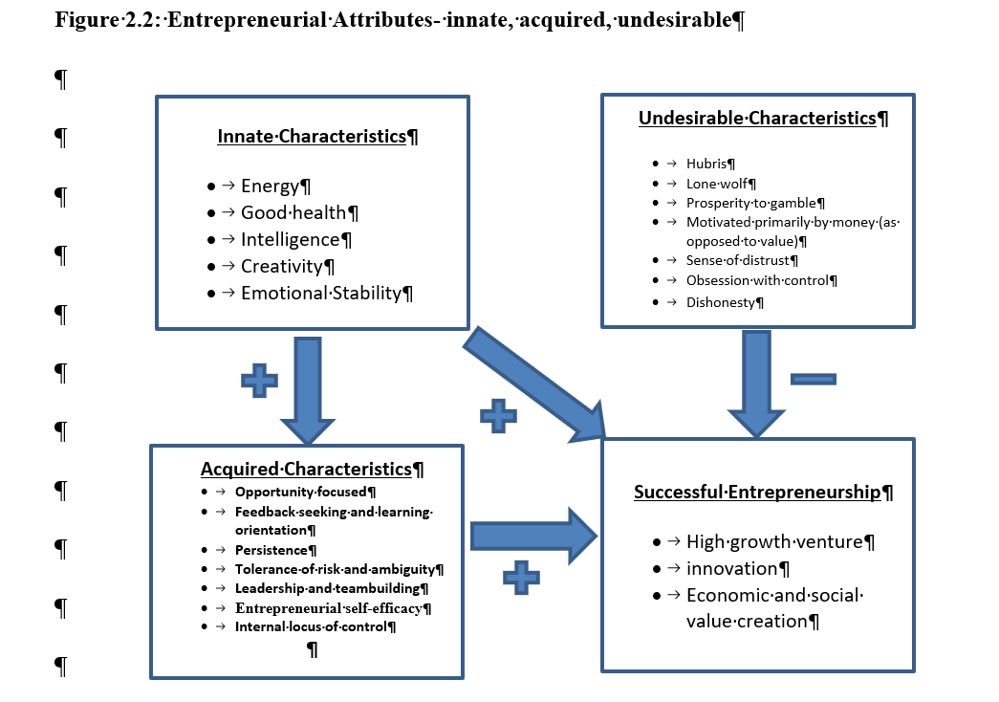

Slide 11
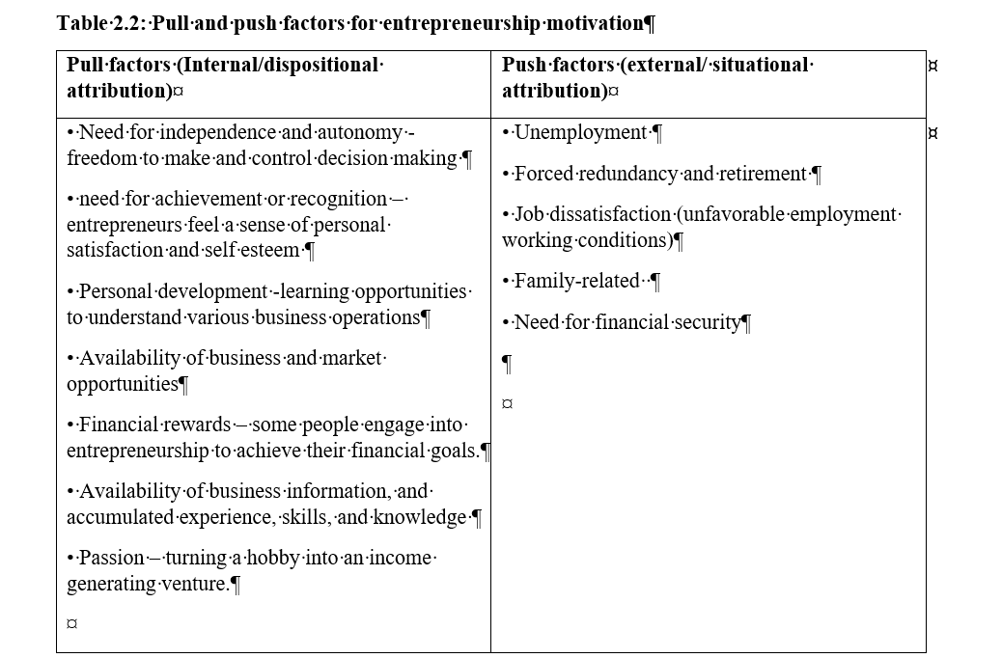

Slide 12
Entrepreneurial Organizations
Not all business owners are entrepreneurs and not all organizations are entrepreneurial. For organizations, there are certain characteristics that differentiate between ‘entrepreneurial’ and ‘solid-state’ enterprises.
The distinguishing characteristics include:
• Innovation
• Opportunity seeking
• Tolerance of risk
• Proactivity
• Networking and stakeholder engagement
• Entrepreneurial culture
• Vision and strategy

Slide 13
Pathways to Entrepreneurship
• New venture creation (business start-up)
• Purchasing an existing business
• Investing in (buying-into) an existing business
• Inheriting (or taking over) an existing business
• Buying a franchise

Slide 14
New Venture Creation
Disadvantages | Advantages
A new business starts without a customer base | A start-up begins with a clean slate and does not carry any of the baggage of an existing business
Businesses may have new or inexperienced staff | Provides opportunities for the entrepreneurs to structure the business model, hire new staff, appointment managers, etc.
It takes time (and money) to build up brand recognition | Opportunity to build a new brand
It is difficult to establish trade credit with suppliers | Adopt the latest technologies
Accessing debt financing is less accessible, and expensive | Opportunity to start with ‘innovation’, rather than carryovers from the past
The business needs time to build up its cashflow, while covering its ongoing purchases and expenses. | Allows crafting of a business that can best exploit the identified opportunity in the market

Slide 15
Purchasing an Existing Business
Advantages | Disadvantages
Established ready-to-use plans and procedures Instant cashflow Ability to assess the financial viability of the business Established customer base, brand image, suppliers, staff, assets Existing mature market for the product Availability of experienced employees Requires less cash outlay as the owner will not need to purchase new equipment, machinery, etc. | Might require business model adjustment and assets improvement Mostly requires a large financial budget to cover the acquisition costs The business could be attractive but poorly managed with unskilled employees External factors, rising competition or a declining industry can impede future growth Poor performing businesses require a lot of initial investment to make them profitable Business may also come with baggage, poor reputation or disgruntled customers

Slide 16
Advantages
Franchisor | Franchisee
Market expansion (uses the franchisee expertise for marketing and growing the brand) | Perceived to be low risk (established reputation and brand name)
Source of extra income from franchising fees, royalties | Easy set-up - little experience is required since the franchisor usually provides training
Increased brand awareness through franchisee distribution and marketing strategies | Shared marketing costs
Reduced risk as part of the marketing risk is assumed by the franchisee | Established target market
 | Potentially lower start-up costs
Disadvantages
Reduction of market share to franchisee | High start-up costs in terms of franchise fees, licence fees, human resources training costs, a percentage of advertising revenue
Loss of brand control | Restrictions on daily business operations dictated by franchisor
 | No guaranteed agreement renewal
 | Profit sharing with franchisor
 | Reputation damage can spread to entire franchising network

Slide 17
Bootstrapping examples
Running a business from home instead of leasing expensive premises
Paying employees with company shares or non-cash benefits
Doing what you can yourself
Using your own funds, or borrowing from family and friends as opposed to debt from banks
Buying on consignment
Minimizing accounts receivables
Delaying accounts payable payments
Using government grants
Working with universities in collaborative market/product research
Leasing, as opposed to buying, equipment

Slide 18
Questions/activities
Are individuals born to be entrepreneurs or can they be trained?
What are some of undesirable attributes of entrepreneurs and what impact do they have on business success?
Describe characteristics of entrepreneurial organizations in contrast to solid-state businesses?
What are advantages of business start-ups (new ventures) in contrast to buying and existing business or a franchise?
Find three examples of businesses in tourism that began through bootstrapping.

