Slide 1

Managing Tourism Enterprises
Chapter 1: Conceptual Foundations of Tourism Enterprises

Slide 2
Chapter 1: Conceptual Foundations of Tourism Enterprises
Learning Outcomes:
Understand the importance of tourism firms in the success of tourism destinations
Recognize the role of the entrepreneur in driving the performance of tourism enterprises
Learn the definition and unique characteristics of tourism enterprises
Understand the challenges experienced by tourism enterprises
Recognize the opportunities for business success by building key capabilities in organizational operations and strategies

Slide 3
Chapter 1: Conceptual Foundations of Tourism Enterprises
Globally, the number of international tourist arrivals (overnight stays) had reached a record 1.5 billion in 2019 (UNWTO, 2020).
Prior to COVID-19, the UNWTO had forecasted an increase to 1.8 billion by 2030.
Between 2014 and 2019, almost 25% of all global new jobs were created by travel and tourism, with 54% of these jobs being occupied by women.
Entrepreneurship was also flourishing with small and medium enterprises (SMEs) representing 80% of all businesses in the tourism industry (WTTC, 2021).

Slide 4
Chapter 1: Conceptual Foundations of Tourism Enterprises
COVID-19 devasted the tourism industry.
Border closures, travel restrictions, event cancellations, lockdowns, social distancing measures, venue capacity limits, etc., had had an unprecedented impact on the tourism sector.
Small and medium tourism enterprises (SMTEs) were among the hardest hit.

Slide 5
Chapter 1: Conceptual Foundations of Tourism Enterprises
In 2020, over 62 million tourism-related jobs were lost, although this number would have been much higher if it were not for government relief packages keeping businesses on life support.
The World Travel & Tourism Council (WTTC, 2021) has stated that the recovery of global tourism is dependent on both public and private sector initiatives.
Government policies aimed at supporting the return of travel also require the creation (and re-creation) of tourism enterprises (WTTC, 2021).

Slide 6
Chapter 1: Conceptual Foundations of Tourism Enterprises
Tourism enterprises act as ‘economic engines’ in tourism destinations by boosting growth and prosperity in declining and impoverished communities (Getz et al., 2004).
They provide the essential services of tourism including accommodation, transport, attractions, experiences, and food and beverage.

Slide 7
Chapter 1: Conceptual Foundations of Tourism Enterprises
Small and medium-sized enterprises (SMEs) are non-subsidiary, independent firms which employ fewer than a given number of employees. This number varies across countries. The most frequent upper limit designating an SME is 250 employees, as in the European Union. However, some countries set the limit at 200 employees, while the United States considers SMEs to include firms with fewer than 500 employees….Small firms are generally those with fewer than 50 employees, while micro-enterprises have, at most, 10 or, in some cases, 5 workers. (OECD, 2019)

Slide 8
Chapter 1: Conceptual Foundations of Tourism Enterprises
Definition of Small and Medium Tourism Enterprises
Independently owned and operated businesses operating within sectors of the tourism and hospitality industry – these include restaurants/cafés, pubs, accommodations (hotel/motel/b&b), tour operators, visitor attractions, travel agencies, souvenir shops. (Hallak, 2010)

Slide 9
Chapter 1: Conceptual Foundations of Tourism Enterprises
Characteristics of Tourism Enterprises
Tourism enterprises operate in an industry that is dominated by small firms, including micro- enterprises.
Businesses are normally independently owned and financed by the owner(s).
Tourism enterprises operate in an industry with high competition and relatively low barriers to entry – i.e. low skill requirements and start-up costs.
Tourism businesses are often created by individuals with lifestyle objectives, rather than profit- oriented objectives.
Tourism offers diverse opportunities for starting up various types of businesses, which appeals to both sole proprietors and families.
Tourism enterprises, being small in size, are more nimble and agile and can adapt quickly, especially in niche tourism markets.
Tourism enterprises may be exposed to a range of uncertainties originating in other parts of the supply chain or in other countries, which negatively affect demand and revenue.
Tourism enterprises operate simultaneously in local and international markets and therefore face a highly competitive and dynamic environment.

Slide 10
Chapter 1: Conceptual Foundations of Tourism Enterprises
Differences between Tourism Entrepreneurs and Entrepreneurs from other Industries
Tourism entrepreneurs create ‘touristic’ enterprises.
Tourism products are mostly ‘intangible’, which creates greater complexity in testing of products. This also affects the ability to attract investors and/or lenders.
Tourism enterprises deliver service-based experiences, therefore business operators need to employ service-oriented management/marketing practices.
Tourism entrepreneurs must deal with seasonality and frequent sales (and profitability) fluctuations.
In the tourism industry, the buyers/visitors are required to come to the destination as opposed to product manufacturers that can deliver products to the customer. This means that tourism business owners are susceptible to external disruptions affecting buyers.
Many major tourism attractions are government-owned (e.g., national parks) and this restricts the ability of tourism businesses to operate in a relatively free market system.

Slide 11
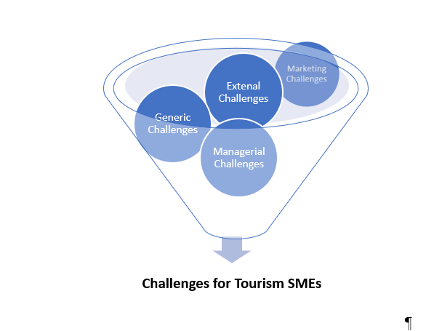
Chapter 1: Conceptual Foundations of Tourism Enterprises
Challenges Facing Tourism Enterprises

Slide 12
Chapter 1: Conceptual Foundations of Tourism Enterprises
Managerial Challenges
Short-run decision making and planning
Challenges in establishing organizational structures
Shortfalls in human capital
Less experienced in ‘managerial’ decision making
Slow to adopt innovations and technology
Staff resistant to implementation of new innovations
Owner/managers not expert in HRM practices

Slide 13
Chapter 1: Conceptual Foundations of Tourism Enterprises
Marketing Challenges
Shortfalls in marketing expertise
Smaller customer base and fewer repeat purchases
Limited knowledge of the external market environment and trends
Smaller marketing budgets and resources
Capabilities in digital marketing and social media

Slide 14
Chapter 1: Conceptual Foundations of Tourism Enterprises
External Challenges
High business failure rate
Seasonality and revenue fluctuations
High competition due to low barriers to entry
Susceptible to external shocks
Destination management and government policy
Remoteness of regional destinations
Digital disruptions and technology

Slide 15
Chapter 1: Conceptual Foundations of Tourism Enterprises
Financial Challenges
Inability to influence price
Limited investment in R&D
Ability to access finance
Limited cashflow

Slide 16
Chapter 1: Conceptual Foundations of Tourism Enterprises
Opportunities for Success
Tourism SMEs have several advantages:
Diverse range of business opportunities
Fewer restrictions
Fewer organizational layers
Greater flexibility
This enables businesses to be entrepreneurial, creative and adaptable. Tourism SMEs are on the front line in customer engagement and can use this to their advantage in regard to product and service development.

Slide 17
Chapter 1: Conceptual Foundations of Tourism Enterprises
Questions/activities
Describe the characterises of tourism enterprises and how they are different from organizations in other industries.
Identify and provide examples of three key managerial challenges facing tourism SMEs.
The tourism industry is synonymous with low barriers to entry. Explain how this can be both a challenge to and an opportunity for business success.
Out of the four categories of challenges facing tourism SMEs (managerial, financial, external, marketing), which do you think presents the greatest challenge to the success, and why?

