Slide 1
Managing Tourism Enterprises
Chapter 11: Crisis Management and Entrepreneurial Resilience

Slide 2
Chapter 11: Crisis Management and Entrepreneurial Resilience
Learning Outcomes:
Understand the concept of crisis management in tourism
Learn how tourism businesses can build resilience
Understand the concept of entrepreneurial resilience
Identify the factors that can drive resilience

Slide 3
Crisis Management in Tourism
A crisis can be defined as ‘an unpredictable event that threatens important expectancies of stakeholders related to health, safety, environmental, and economic issues which can seriously impact an organisation’s performance and generate negative comments’ (Coombs, 2019, p. 3).

Slide 4
Crises types include:
• Political events (e.g., Occupy Central)
• Terrorism (9/11; Bali bombings)
• Health issues and disease outbreaks (Ebola, SARS, COVID)
• Financial crises (2008 global financial crisis)
• Natural disasters (tsunamis, typhoons, wildfires)
• Political events (conflicts, wars, refugee exodus)
• Human error (plane crash)

Slide 5
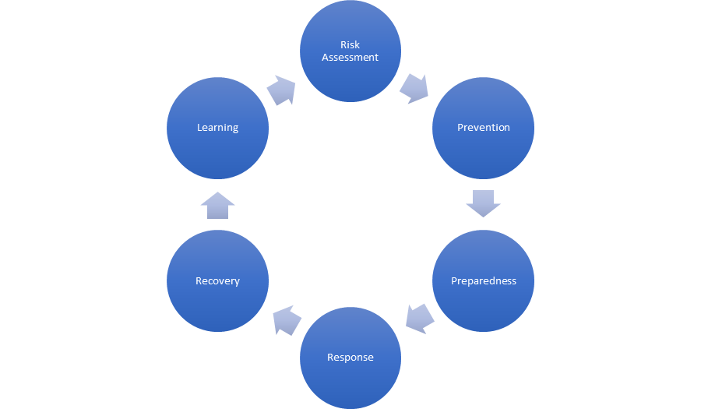
Crisis management is conceptualized as a cyclical process that includes:

Slide 6
Risk assessment provides the framework for identifying and mitigating crisis events, determining their likelihood and possible impacts on the tourism organization.
Risk assessment identifies the known risks, but should also point toward risks that are yet unknown, where information is lacking and that require further understanding.

Slide 7
Risk identification – the screening exercise that lists all possible risks, including risks that the business owner can control or mitigate, and those that are outside the control of the organization.
Risk analysis – the second stage of risk assessment; evaluates the risks identified from the first stage to rate and rank these risks in terms of their likelihood, and impact on the tourism organization.

Slide 8
Risk evaluation considers the risks identified and their assessment (impact x likelihood) to determine whether the risks are tolerable.
Risk Item | Likelihood | Impact Type | Impact Scale | Risk Response

Slide 9
Prevention
Following the assessment and analysis of risks, tourism business operators need to implement measures and strategies that mitigate, minimize or even eliminate potential risks.
Tourism business operators, as part of their crisis management plans, should outline ‘risk treatment’, which can include:
risk avoidance
risk removal
diminishing the likelihood of the risk
preventing or mitigating the risk consequences
risk sharing

Slide 10
Response to Crises
Situational Crisis Communication Theory (Coombs, 2007) emphasizes that, in times of crisis, an organization needs a strategic and appropriate response to protect its ‘reputational assets’.
SCCT identifies three components to a crisis communication response:
Instructing Information – this provides a factual explanation of the crisis to stakeholders
Adjusting Information – Information that is designed to help stakeholders deal with the crisis
Reputation management – the actual response and remedial actions undertaken by the organization to protect its reputation

Slide 11
Recovery from Crises
Post-crisis recovery is particularly complex for businesses in the tourism and hospitality industry as the crisis may have caused:
loss of infrastructure and the inability of tourists to visit the destination where the business operates;
travel restrictions and government travel warnings;
booking cancellations;
inability of the business to restart operations caused by external factors such as rescue activities or damage repairs;
negative media reports about tourism or a destination that affect a business’s ability to attract visitors.

Slide 12
Learning
The final stage of the crisis management process is organizational ‘learning’.
To effectively ‘learn’ from crisis events, tourism enterprises should follow six main steps:
Knowledge acquisition
Knowledge diffusion
Knowledge utilization
Reflection
Organizational memory
Crisis and organizational change (Ghaderi et al., 2014)

Slide 13
Entrepreneurial Resilience
The resilience of the tourism enterprise, as well as the resilience of the entrepreneur driving the tourism business, is an important predictor of the business’s ability to withstand the shocks of a crisis and its ability to recover and ‘bounce back’.
‘Entrepreneurial resilience’ can be broadly defined as the ability of an entrepreneur to overcome challenges or withstand adversity while persisting in the entrepreneurial process (Awotoye and Singh, 2017).

Slide 14
Outcomes of Resilience for Business Operators
There exists a positive association between individual resilience and entrepreneurial success.
Experience as an entrepreneur may also nurture resilience at an individual level.
Internal locus of control is a fundamental element of resilience with regards to business success.
Resilience and self-efficacy are mutually reinforcing factors that affect entrepreneurial behaviour.

Slide 15
How Can Tourism Entrepreneurs Build Their Resilience?
For tourism enterprises, the psychological resilience of business owners has a positive effect on building employee resilience, which, in turn, contributes to strengthening overall resilience of the enterprise.
Resilience is driven by psychological traits, as well as processes and resources.
Human capital, which includes education, training and experience, builds capabilities to manage and respond to crisis events.
Professional development in areas such as ICT, customer service skills, digital marketing, negotiating and continuity planning are also vital to building resilience.

Slide 16
The tourism entrepreneur’s social networks, and professional and personal connections foster social capital, which, in turn, strengthens resilience.
The interaction between the entrepreneur and their environment provides fertile ground for the development of resilience (Fisher et al., 2016).
Resilient entrepreneurs are known to draw on social capital in order to access information, support and resources in the aftermath of crisis events (Grube and Storr, 2018).

Slide 17
Questions/Activities
1. Identify three recent (past 5 years) events that had a major impact on the tourism industry.
2. What was the impact on the tourism organizations as a result of these events?
3. How did tourism organizations respond to the crisis and what was their recovery?
4. What are the ways in which entrepreneurs in tourism can build their entrepreneurial resilience?

