Slide 1
Managing Tourism Enterprises
Chapter 10: Social Capital and Business Networks

Slide 2
Chapter 10: Social Capital and Business Networks
Learning Outcomes:
Define what social capital is and identify different types of social capital
Identify four different types of business networks and the types of resources that can be obtained from these networks
Understand how online social networks can be used to build social capital

Slide 3
Chapter 10: Social Capital and Business Networks
Social Capital
Social capital is defined as the actual and potential resources available through an individual’s network of relationships with others (Stam et al., 2014). These ‘others’ refer to people an individual knows or who are known by the people that an individual knows (Greve and Salaff, 2003). These connections can serve as resources/assets to help achieve certain objectives (Burt, 1992, 2000).
Social capital is an important resource for tourism enterprises as it provides access to financial resources, labour, skills and information (Greve and Salaff, 2003).

Slide 4
Chapter 10: Social Capital and Business Networks
Social capital has been classified in several ways.
Bonding social capital refers to the relationships between individuals that know each other well (e.g., family and friends), allowing exchanges of resources based on trust and reciprocity (Davidsson and Honig, 2003).
Bridging social capital refers to relationships between individuals from diverse groups or backgrounds (e.g., between a firm and trade organizations), which facilitates the attainment of information otherwise unavailable within an individual’s familiar group (i.e. bonding social capital) (Davidsson and Honig, 2003).

Slide 5
Chapter 10: Social Capital and Business Networks
Another framework to distinguish types of social capital is provided by Granovetter (1973) through the concept of ‘strong’ and ‘weak’ ties.
Strong ties refers to ties derived from strong relationships such as family bonds which provide consistent access to resources.
Weak ties represents loose relationships between individuals to obtain resources that are otherwise unavailable.

Slide 6
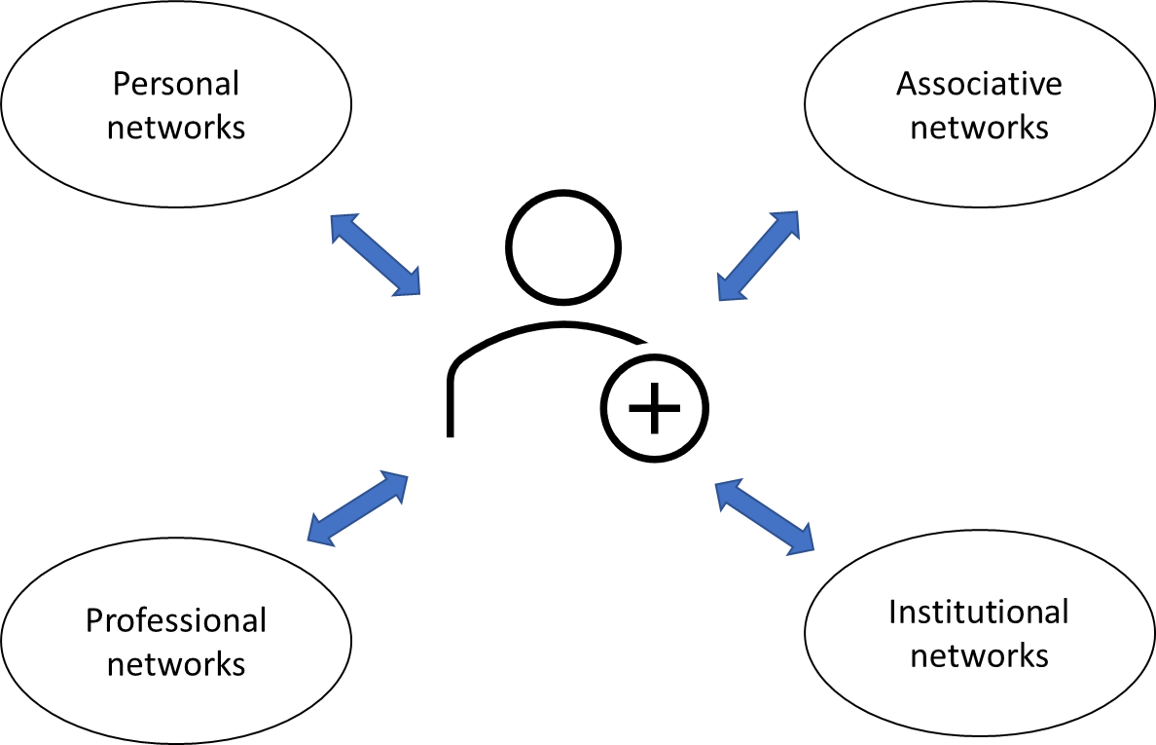
Chapter 10: Social Capital and Business Networks
Business Networks
In a tourism enterprise context, social relationships that are leveraged to extract resources for the enterprise are known as business networks. Business networks can be classified into four categories: personal, professional, associative, and institutional (Hernández-Carrión et al., 2017):

Slide 7
Chapter 10: Social Capital and Business Networks
Personal networks are relationships with people in an individual’s private circle, such as family, relatives and friends that share common characteristics and interests.
Professional networks are relationships with partners, workers, suppliers, customers and colleagues.
Associative networks are relationships with associations an individual belongs to (e.g., business, trade, professional, political, sports, or volunteer associations).
Institutional networks are relationships with people within public or private institutions (such as local, regional or national governments, large firms, and banks).

Slide 8
Chapter 10: Social Capital and Business Networks
Benefits of Business Networks
Financial resources: Funds obtained to finance the enterprise. These can include loans (whether personal or from a bank) as well as credit or subsidies and public aid.
Technology and innovation: Technologies the enterprise uses (e.g., IT tools, machinery, exploitation of patents, etc.) and/or knowledge for new business ideas and to develop innovations.
Market information: Information about the enterprise’s customers, suppliers and competitors that can be used to satisfy current customers and attract new customers.

Slide 9
Chapter 10: Social Capital and Business Networks
Quality management capabilities: The enterprises’ ability to design products and services, to access suppliers providing high-quality raw materials, to train employees, or to introduce quality management systems (e.g., ISO norms, etc.).
Human resources: The employees’ professional quality and qualifications as well as the enterprises’ ability to manage these human resources (i.e. attract, retain and motivate workers).
Management capabilities: The owner’s/manager’s ability to coordinate all the previous resources (e.g., human, quality, sales, technological and financial resources) so the enterprise is successful and generates value. This includes information to enhance the owner’s/manager’s management skills, help the enterprise adapt to change, and manage information and communication systems whether they are managed directly or externally (e.g., consultancy, advice).

Slide 10
Chapter 10: Social Capital and Business Networks
Online Social Networks
In the contemporary business environment, the growing use of technology in everyday work has created a platform for enterprise managers to build online networks through social media platforms such as LinkedIn, Facebook and Twitter.
The utilization of online networking platforms to build and maintain relationships is significantly different than in-person interactions (Baym, 2010). In online settings, time and space is compressed, the speed of communication is rapid, and accessibility to individuals is increased (Baym, 2010). This can allow a wide-reaching social network to be built quickly but can also lead to several drawbacks.

Slide 11
Chapter 10: Social Capital and Business Networks
Social networking sites may enable entrepreneurs to find others with similar interests, assess the content of networks they may wish to join, and make social judgements about potential connections.
With the vast availability of information through social networking sites, entrepreneurs could use this opportunity to make calculative connections that may not be possible in real-world settings (Smith et al., 2017).
However, while sites such as LinkedIn facilitate sharing industry insights, this goes against competitive strategy.
Also, if one invests too heavily in social media interaction, they may continuously loop between gaining new information about resources and reassessing their set of means and potential goals, without using their means to pursue a goal.

Slide 12
Chapter 10: Social Capital and Business Networks
Questions/activities
Consider whether different types of business networks (i.e. personal, professional, associative, institutional) may provide access to different types of resources.
What kind of online platforms may be useful for tourism enterprises to build online social networks?

