Slide 1
Events as a Strategic Marketing Tool
2nd Edition
Dorothé Gerritsen and Ronald van Olderen

Slide 2
Part I Plan – Chapter 5
Events and Marketing Communication

Slide 3
Phase: plan
Introductory chapters
  Chapters 1 and 2
Event Marketing
  Chapter 3
Four types of marketing
  Chapters 4-7

Slide 4
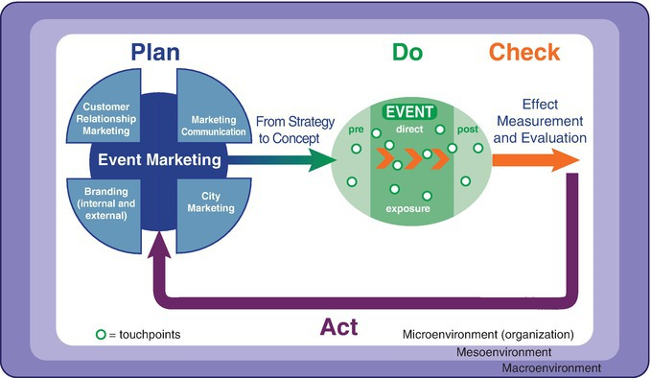
The EVENTS model

Slide 5
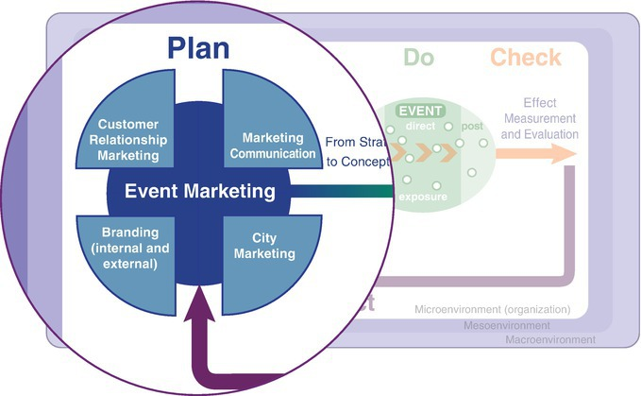
The EVENTS model, plan phase

Slide 6
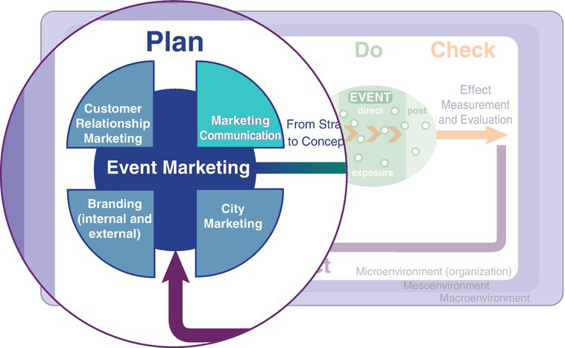
Chapter 5

Slide 7
Events and marketing communication
A golden couple

Slide 8
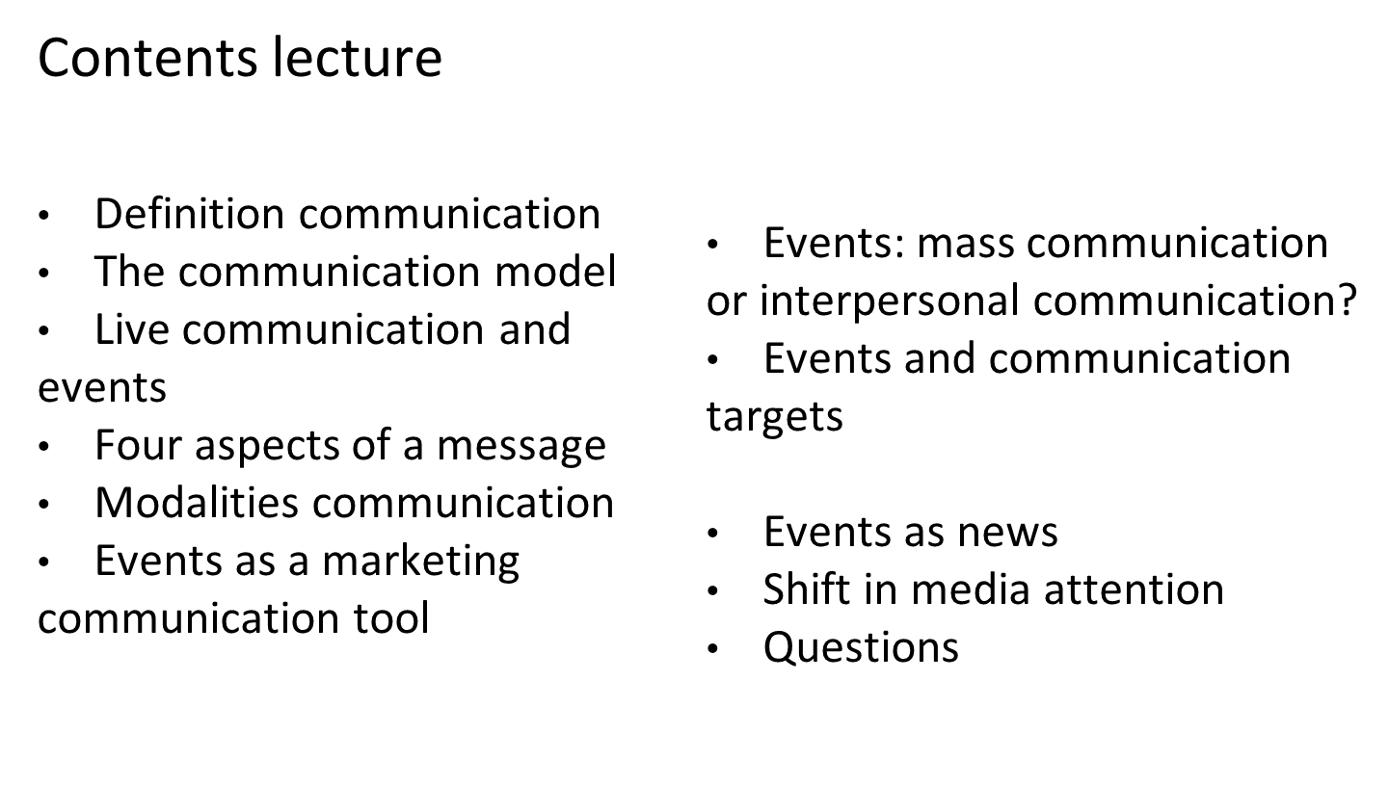

Slide 9
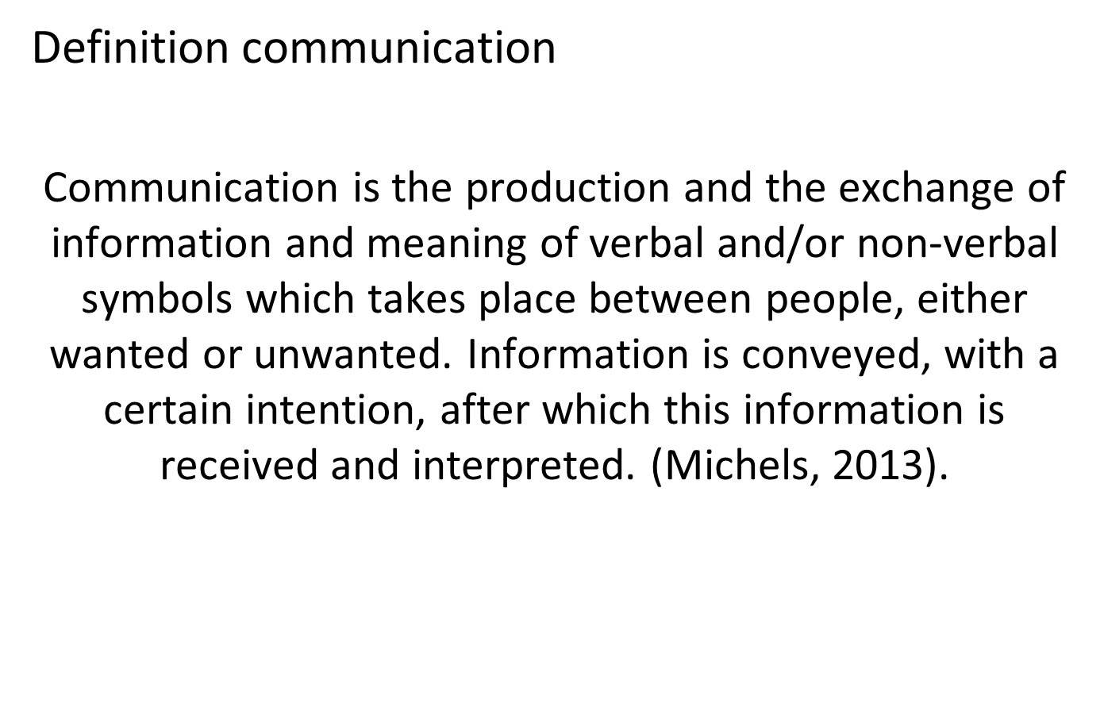

Slide 10
The communication model
      S ↔ M ↔ R

Slide 11
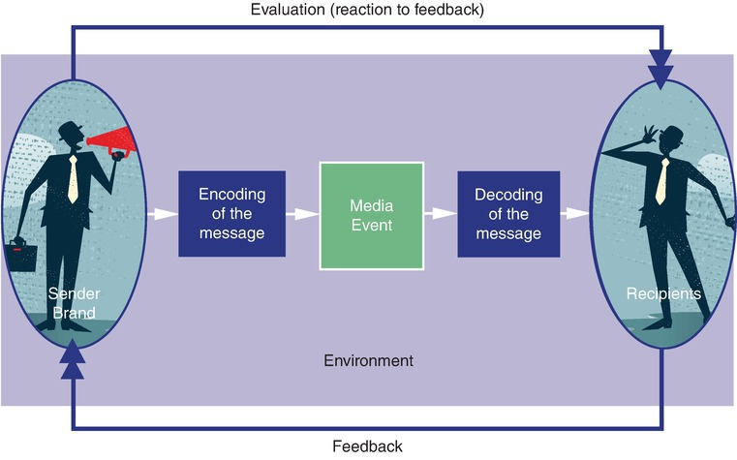
Expanded communication model

Slide 12
Live communication and events
Creating experience moments
Building outstanding PR
Promoting a product or service in a unique way
Generating attention for one’s message
Establishing loyalty with the product, service or company

Slide 13
Four aspects of a message
Business: objective information
Expressive: senders show something of themselves
Relational: senders show how they see the recipient
Appealing: senders want to get the recipient to do something

Slide 14
Modalities communication
Information
Education
Public relations
Advertising
Propaganda

Slide 15
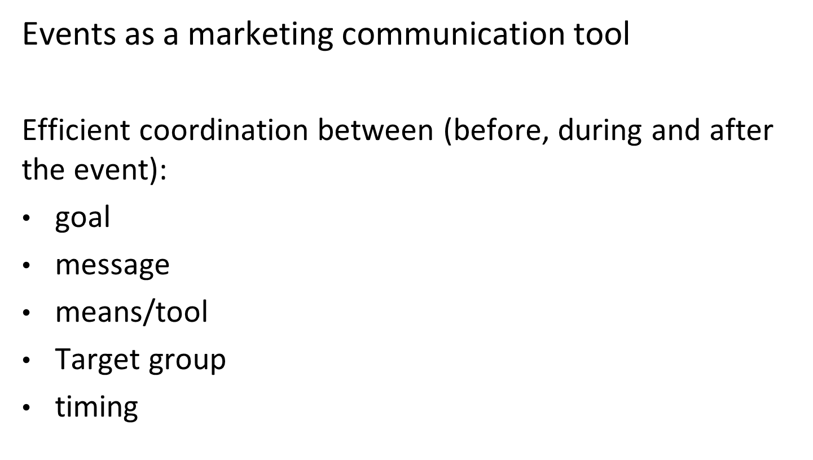

Slide 16
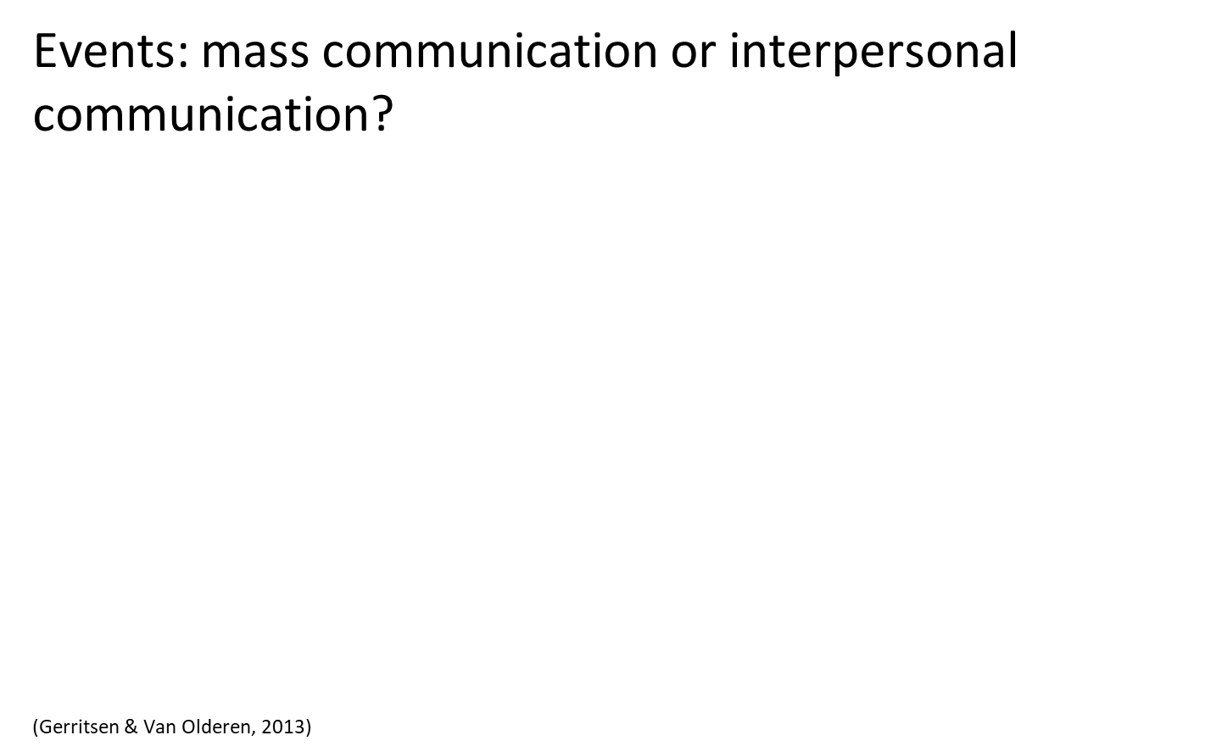
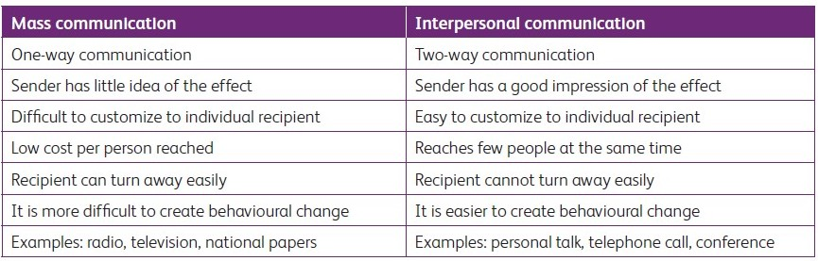

Slide 17
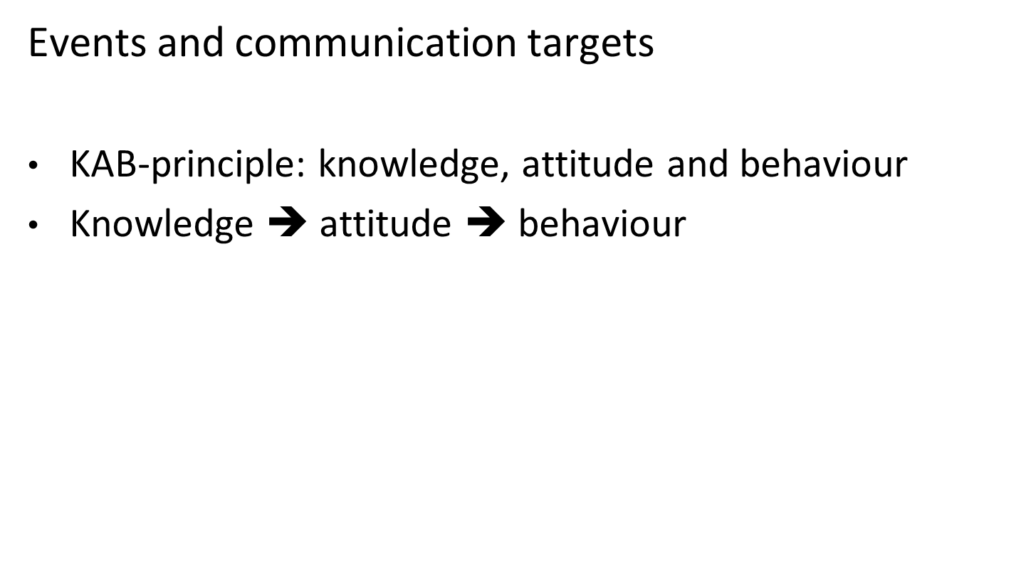

Slide 18
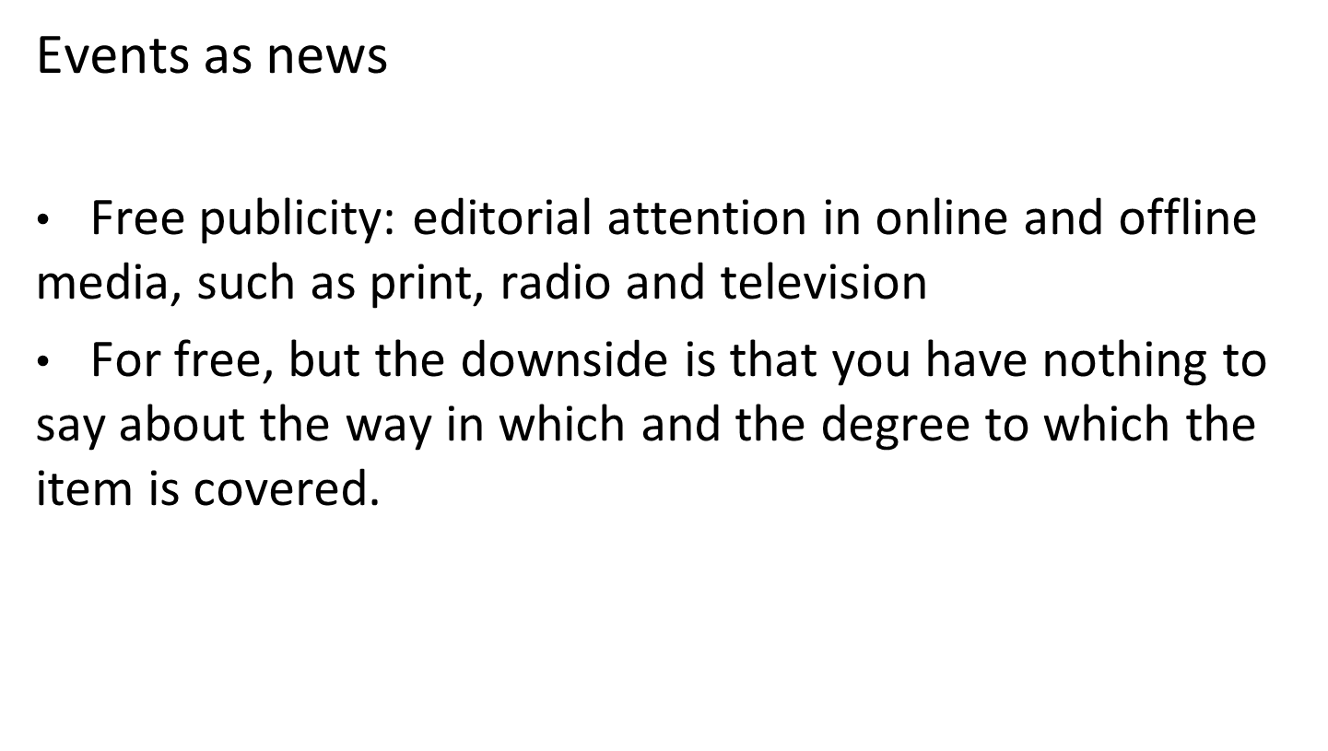

Slide 19
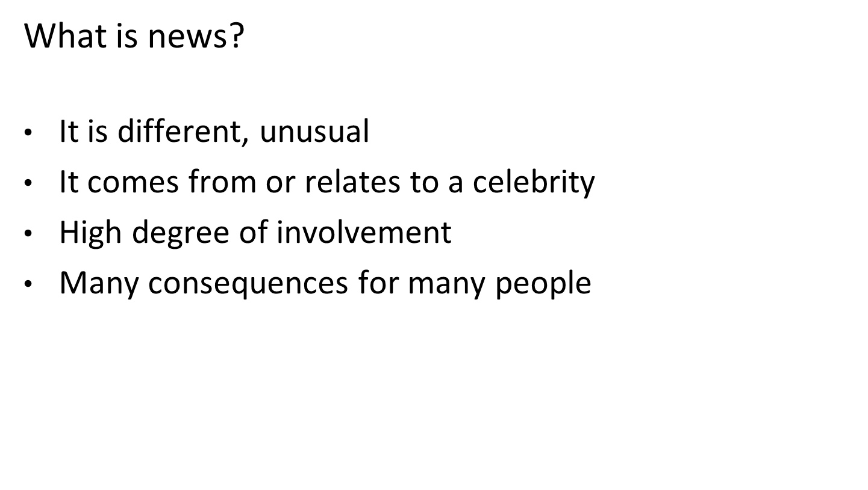

Slide 20
What makes that an event has newsworthiness?
Events are unique and therefore different from the daily routines.
Events come from a brand or organization or relate to a celebrity (authority).
The programme or content is in line with target group(s), so: involvement.
Events mobilize a lot of people and therefore have major consequences.

Slide 21
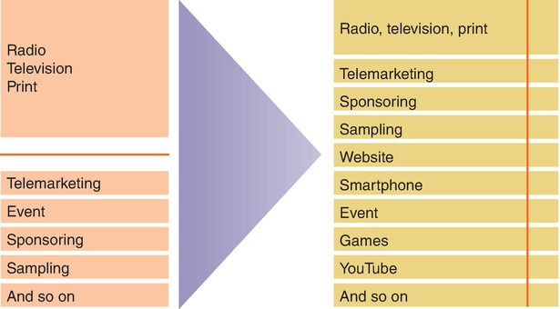
Shift in media attention

Slide 22
Questions?

Slide 23
Thank You

