Slide 1
Events as a Strategic Marketing Tool 2nd Edition
Dorothé Gerritsen and Ronald van Olderen

Slide 2
Part II Do – Chapter 9
Touchpoints

Slide 3
Phase: do
Chapter 8
Chapter 9

Slide 4
The EVENTS model

Slide 5
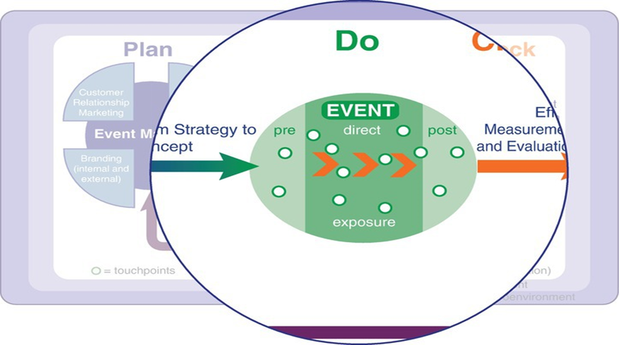
The EVENTS model, do phase

Slide 6
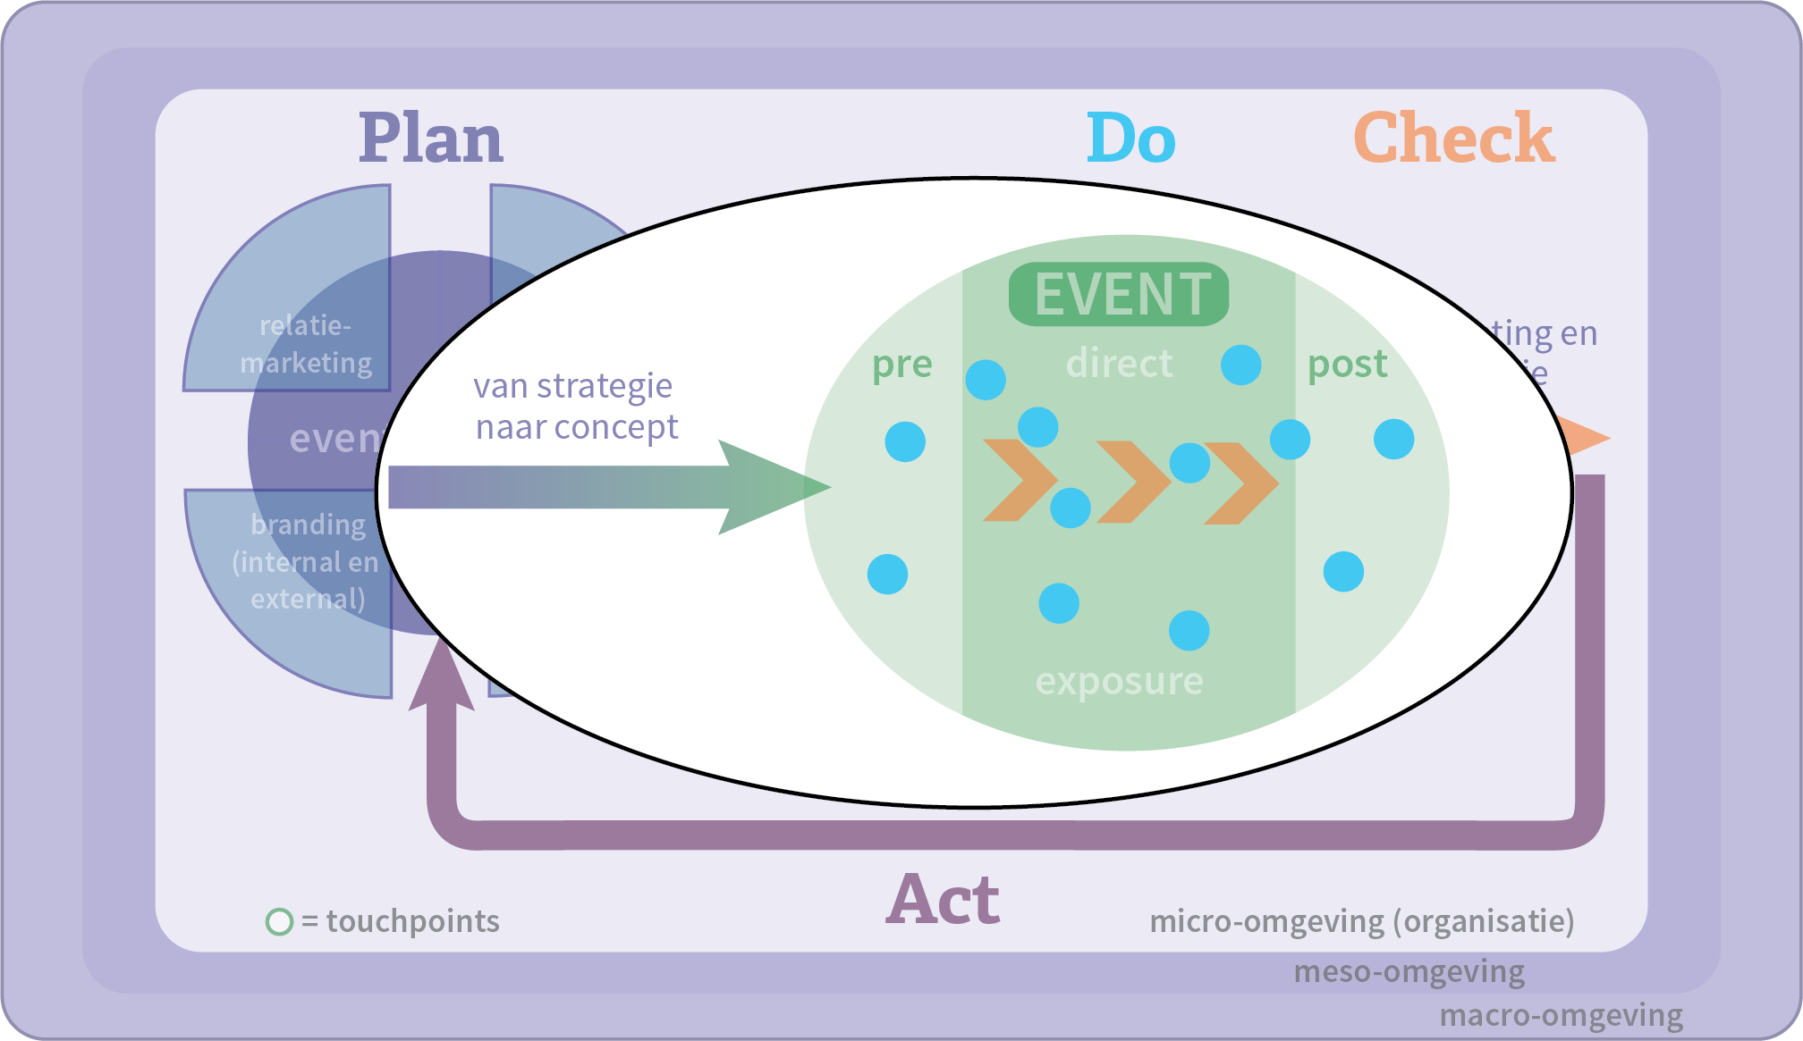
Chapter 9

Slide 7
Touchpoints
‘Touch’ the visitor

Slide 8
Contents lecture
What are touchpoints?
From staged to customer experience
The value fit
The touchpoint model
From event to experience, requirements for touchpoints
Satisfiers en dissatisfiers
Magical moments
Peak-end rule
Pleasure-pain gap
The customer journey
Orchestrating experiences
Guest Experience Model
Example touchpoint model Trade Fairs
Example touchpoint model corporate event
Questions

Slide 9
What are touchpoints?
Interaction points
Contact between visitor and organization/brand/city
In three phases: pre-experience, direct experience and post experience
Every contact has the potential to cause either a positive or negative reaction.
Not all contact moments can be influenced by the organizer.

Slide 10
From staged to customer experience
Staged experience
The experience is completely orchestrated by the organization of the event.
All experience instruments and touchpoints thought through and deployed by the organizer.
Example: Libelle Zomerweek, a live event that is entirely based on the values ​​of Libelle readers.

Slide 11
From staged to customer experience
Customer experience
Meaning the individual customer attaches to product or service determines the value.
Does the product or service adequately reflect the customer’s values or respond to the customer’s needs.?
Ecustomer’s expereinces are extremely important.
Example: ING as facilitator of an event for the major shareholders who are planning to sell their businesses.

Slide 12
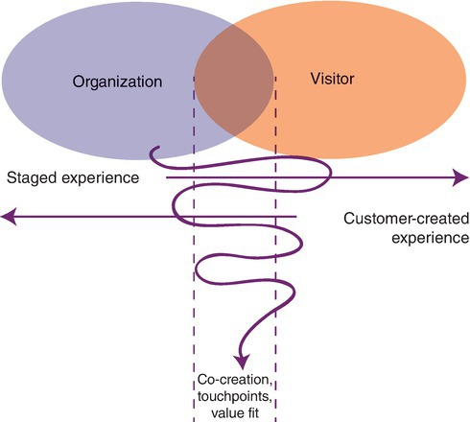
From staged to customer experience
Continuum of value addition

Slide 13
The value fit
The organization and their customers share similar values and needs.
Visitors must be given a more active role in the organization of the event (co-creation).
What is happening in the lives of our visitors at the moment?
The pre- and post-event stage are becoming increasingly important!
Example value fit: ABN AMRO World Tennis Tournament

Slide 14
The touchpoint model

Slide 15
The touchpoint model (organization’s perspective)

Slide 16
The touchpoint model (visitor’s perspective)

Slide 17
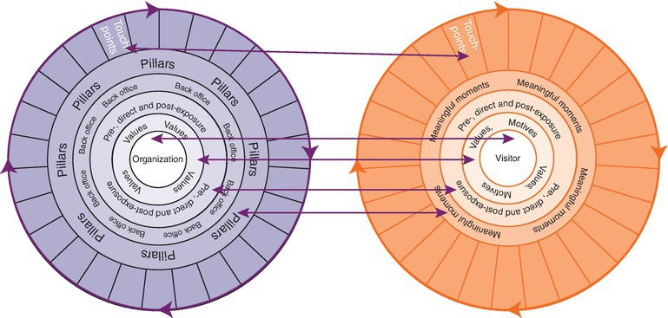
The touchpoint model
Value fit organization and visitor

Slide 18
From event to experience, requirements for touchpoints
Divers
Create a memorable experience
Focus on values
Engage several senses
Inspire emotions
Mutually consistent
Chosen purposefully

Slide 19
Satisfiers and dissatisfiers
Satisfiers: good touchpoints, surprising the visitor, or even exceeding the visitor’s expectation.
Examples: surprising act, current information via sms about parking problems
Dissatisfiers: good touchpoints, they will not generate any greater appreciation for your organization (has to be good)
Examples: price quality ratio catering, lead times, quality of light and sound

Slide 20
Magic moments
The moments when customers experience a product or service that they never had imagined, that truly surprises them and that shows the organization’s commitment
Appreciation for the customer
is expressed.
Peaks and valleys, routine and
moments of excitement and relaxation.

Slide 21
Peak-end rule
Storytelling
Event will be more memorable if the event has the certain structure of a story.
Introduction, trigger moment, tension moves towards a climax and is brought to an end.
The end has to be always POSITIVE!

Slide 22
Pleasure-pain gap

Slide 23
Pleasure-pain gap
Plays an important role in the consumer experience process
Register peaks
Experience has to be heterogeneous
The distance between positive pleasure touchpoints and a negative touchpoint should be as great as possible
Due to negative experiences, the positive ones are rated even more positive

Slide 24
Pleasure-pain gap example Geneva Motor Show

Slide 25
The individual journey
The customer journey
Sensory perceptions
Emotion
Prior, during and after the event
Mystery guest

Slide 26
Orchestrating experiences
Empathize with the visitor
Seeing what the visitor sees, feeling what the customer feels
The Guest Experience Model

Slide 27
Guest Experience Model

Slide 28
Guest Experience Model
Three pillars: people, setting, process
Foundation: vision, mission, values, experience concept
Leadership
Touchpoints

Slide 29
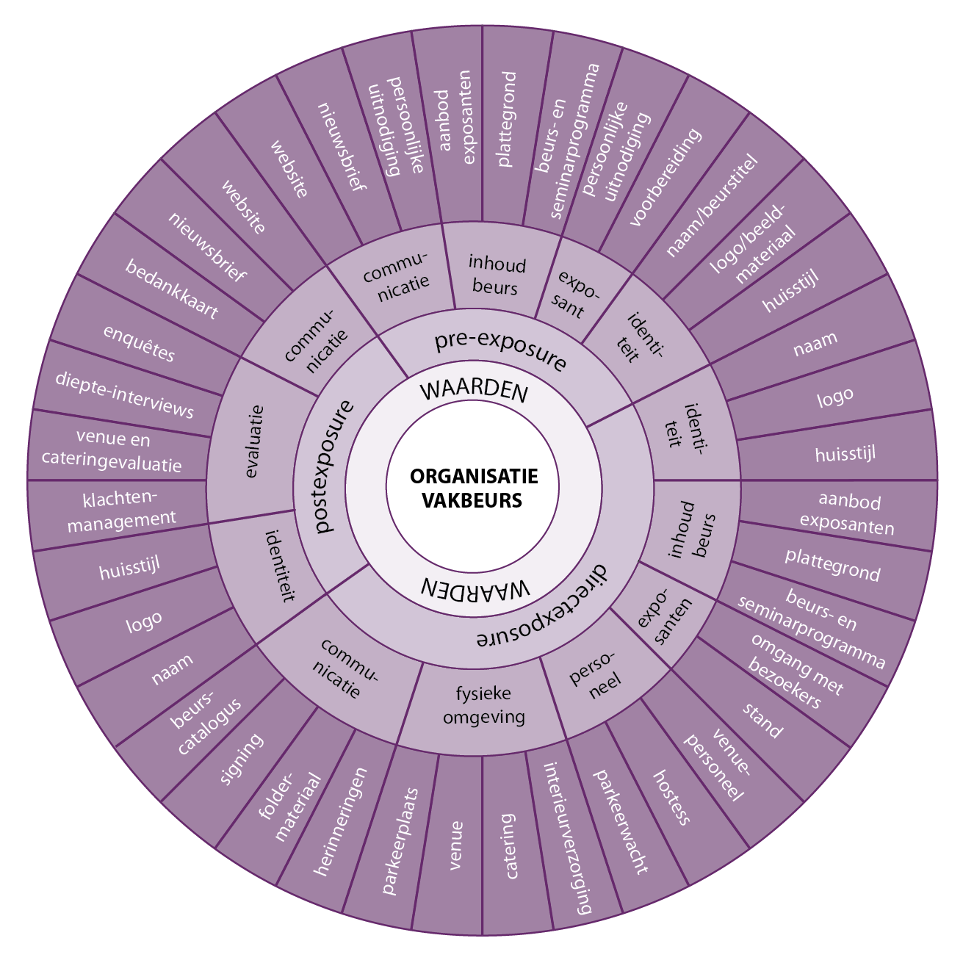
Example touchpoint model trade fair

Slide 30
Example touchpoint model corporate event

Slide 31
Questions ?

Slide 32
SECTION 2

Slide 33
Text here, block or bullets. text here, block or bullets. text here, block or bullets. text here, block or bullets. text here, block or bullets. text here, block or bullets. text here, block or bullets.
Text here, block or bullets. text here, block or bullets. text here, block or bullets.

Slide 34
Title

Slide 35
Text here, block or bullets. text here, block or bullets. text here, block or bullets. text here, block or bullets. text here, block or bullets. text here, block or bullets. text here, block or bullets.
Text here, block or bullets. text here, block or bullets. text here, block or bullets.

Slide 38
Title
Text here, block or bullets. text here, block or bullets. text here, block or bullets. text here, block or bullets. text here, block or bullets. text here, block or bullets. text here, block or bullets.
Text here, block or bullets. text here, block or bullets. text here, block or bullets.

Slide 39
Thank You
Name: First Surname
Email: email@email.com

