Slide 1
Events as a Strategic Marketing Tool 2nd Edition
Dorothé Gerritsen and Ronald van Olderen

Slide 2
Part II Do – Chapter 8
The Translation of Strategy into Concept

Slide 3
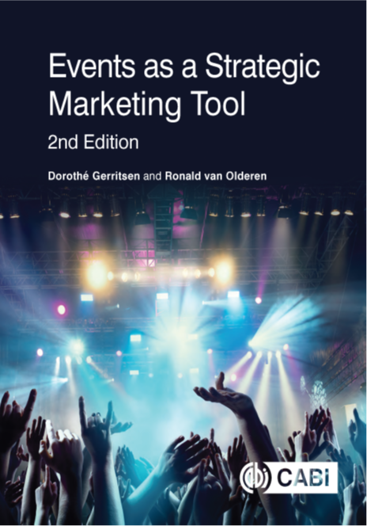
Phase: (plan and) do
Chapter 8
Chapter 9

Slide 4
The EVENTS model

Slide 5
The EVENTS model, do phase

Slide 6
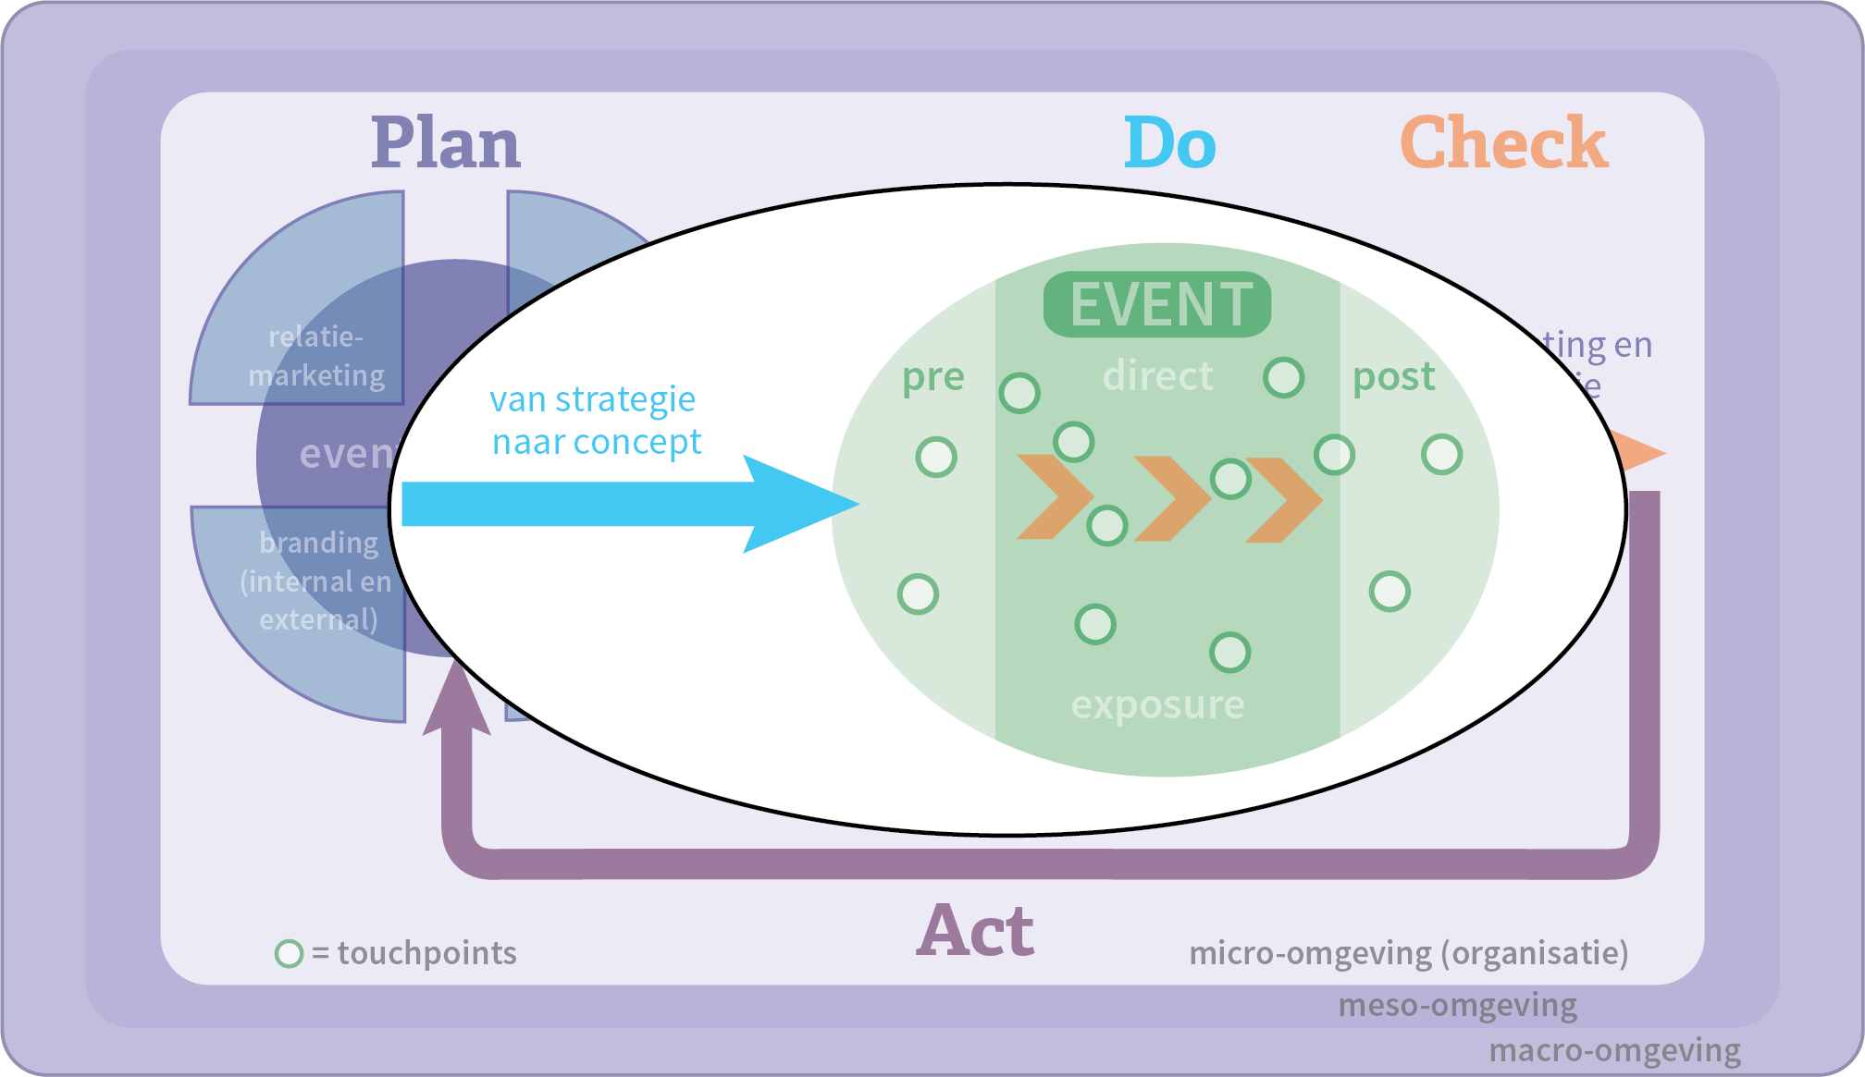
Chapter 8

Slide 7
The translation of strategy into concept
From party to meaningful experience

Slide 8
Contents lecture
Analysis of supply and demand
Staged experience and true experience
The psychosocial framework
Storytelling
What’s in a concept?
The experience concept
Creativity and development experience concept
The experience tool

Slide 9
Analysis of the demand
Values are a essential component of our cognitive system and they determine our expectations of people and things.
Values affect how people think and act and handle information.
Values are criteria that people use to test information.

Slide 10
Analysis of the supply
The initiator of an event also has values.
What does the city or brand want to transfer?
To what extend do those values correspond to those of the visitors?

Slide 11
Building a bridge between objectives and an event

Slide 12
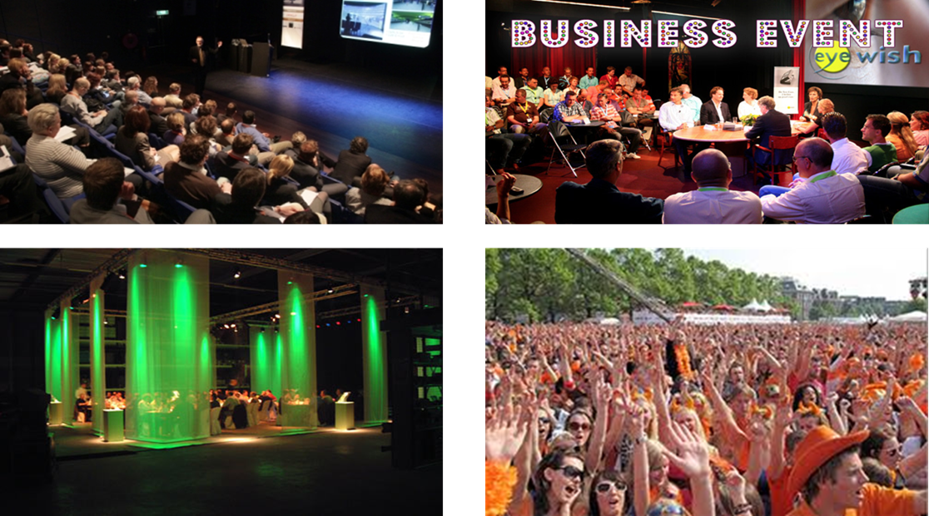
Staged and true experience Staged experience: staged event

Slide 13
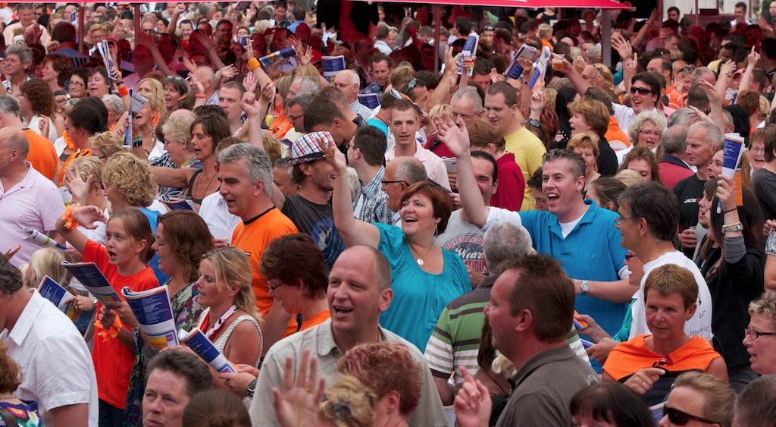
Stage and true experience
True experience: determined per person individually

Slide 14
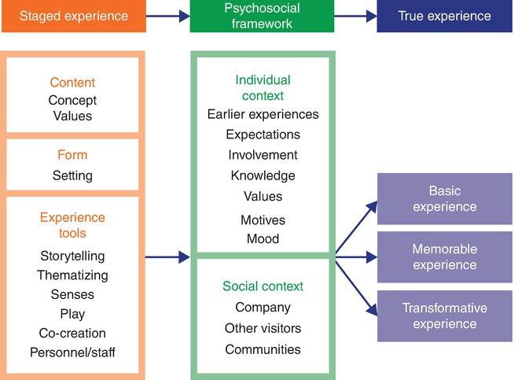
Staged and true experience
Levels of true experience

Slide 15
Staged and true experience

Slide 16
The psychosocial framework
Knowledge
Expectations and past experiences
Motives
Moods
Involvement
Social context
Personality and competencies
Values

Slide 17
Storytelling
Every true experience is a personal story about an actual staged experience.

Slide 18
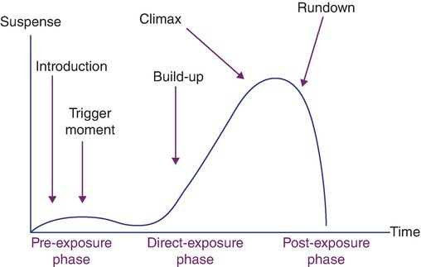
Storytelling
The storyline and the phases of an event

Slide 19
What’s in a concept?
The active principle that creates coherence and gives direction to the realization of one or several goals.
What makes it tick?
The active principle is conciously exploited for the realization of a goal.

Slide 20
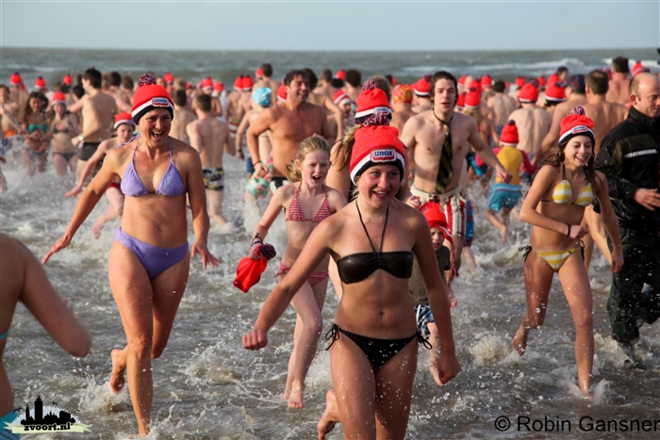
What’s in a concept?
Unox New Year’s Day Dip
3FM Serious Request
Burning Man
Tomorrowland
André Rieu
Jamie Oliver

Slide 21
The experience concept: five criteria
Meaningful, basing on values relevant to the target group, its authenticity can be felt
Distinctive and unique, a surprising combination of existing elements
Endurance, over a long period of time
Several layers
Well timed (trends and developments but also intuitively)

Slide 22
Creativity and developing an experience concept (concept ontwikkelen)

Slide 23
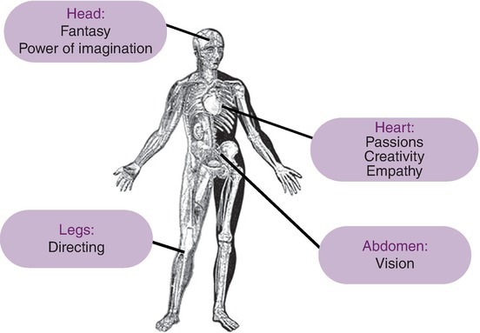
Creativity and developing an experience concept
The creative process

Slide 24
The experience tools
Required for staging an event.
Six tools:
Thematizing
Storytelling
Senses
Play
Co-creation
Personnel

Slide 25
The experience tools
1. Thematizing
Themes can be based on:
history or epochs, example thematic festivals
culture or (sub)cultures, example Sail Amsterdam
fiction, example Harry Potter
nature, example beachparty
technology, example railway museum

Slide 26
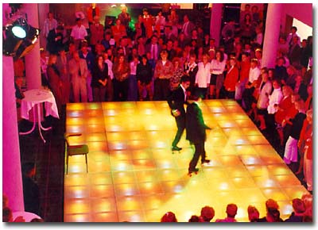
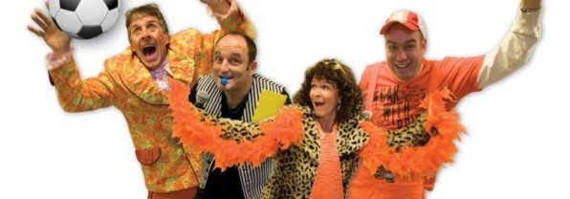
1. Thematizing
Holland Heineken House

Slide 27
The experience tools
2. Storytelling
Explicit storytelling: a story is literally narrated by someone, whether or not by interaction.
Example: A lantern tour through a dark Arnhem Open Air Museum with a narrator in a black robe. The aim is that the visitor experiences the 19th century’ life in the dark at night.
Implicit storytelling: visual representationor object triggers a story in the visiter. He fills it with his own powers of imagination.

Slide 28
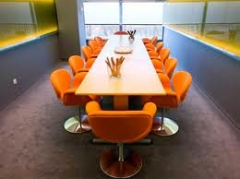
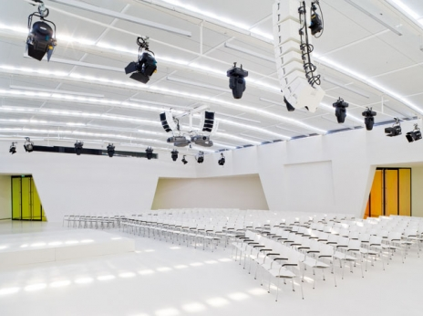
The experience tools
3. Senses
Senses cause emotions
Emotions are the crucial factor for an experience
The more intense the experience
Example: MeetUp of congress and exhibition centre Jaarbeurs Utrecht

Slide 29
The experience tools
4. Play
Closely linked to sport
Online games and physical
Full of surprises
Provides scope for creativity
Enables player to develop his cognitive and motor skills, and his emotional skills

Slide 30
The experience tools
5. Co-creation
Involving the customer in designing the experience that is most in accordance with the meaning that he personally wants to give his life.
Freedom of choice experienced
Intrinsic motivation
Interaction
Creativity
Self-development
There is no pre-determined result

Slide 31
The experience tools
6. Personnel
Customer friedliness
Commitment of actors
Empathic ability!
Often temporary staff at events
Storytelling is a suitable tool to motivate personnel

Slide 32
Questions?

Slide 33
Thank You

