Slide 1
Events as a Strategic Marketing Tool
2nd Edition
Dorothé Gerritsen and Ronald van Olderen

Slide 2
Part I Plan – Chapter 7
Events and City Marketing: The Role of Events in Cities

Slide 3
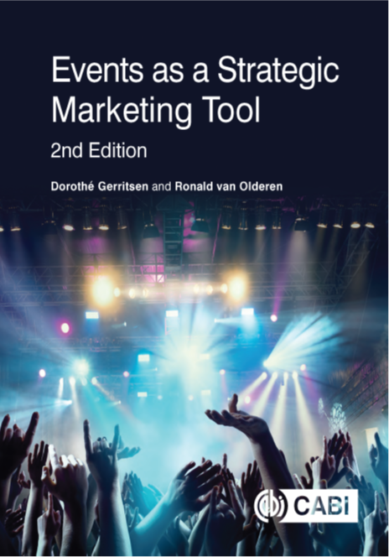
Phase: plan
Introductory chapters
  Chapters 1 and 2
Event Marketing
  Chapter 3
Four types of marketing
  Chapters 4-7

Slide 4
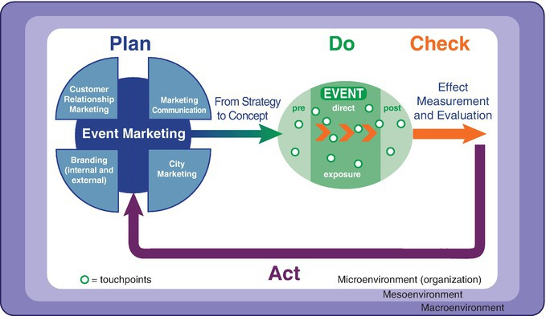
The EVENTS model

Slide 5
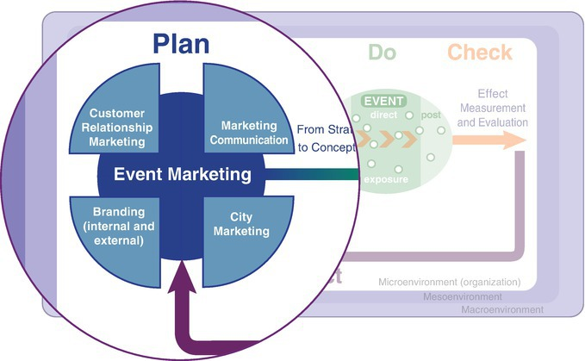
The EVENTS model, plan phase

Slide 6
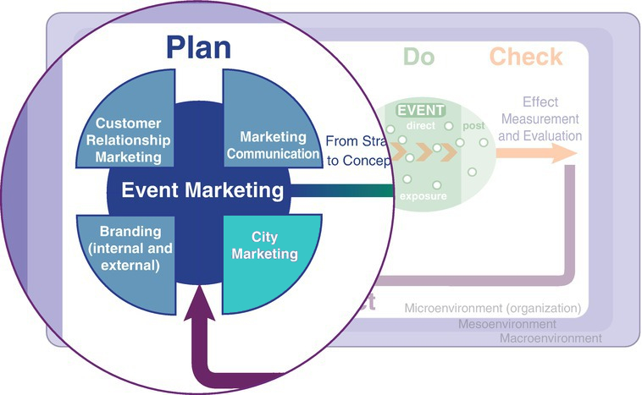
Chapter 7

Slide 7
Contents lecture
City marketing
History and the emergence of city promotion
Seven Ps city marketing
City branding and definition city marketing
Four elements of making a city attractive
Events policy
Eventful city
Sustainability and events policy
Questions

Slide 8
City marketing
Cities try to distinguish themselves from their competitors.
Cities try to position themselves in an attractive way.
Recent development: explained historically.

Slide 9
History and the emergence of city promotion
Originally a city was a compact settlement usually closed by walls and canals.
City as trade and craft centre.
City was autonomous.
Industrialization: factories were set up, workers settled near those factories.
Proximity of raw materials or a favourable site close to transport routes or good location.

Slide 10
History and the emergence of city promotion
Second half of the 20th century: emergence of the service sector.
Employees live outside the city.
Rise to the building of dormitory towns outside the historical and industrial cities.
Depopulation of the inner cities.

Slide 11
City promotion
Start in the 1940s. In those days mainly focused on promoting cities over the countryside.
Nowadays mainly focused on competing with other cities.
Aim of promotion was not only to attract residents, but also tourists.
Cities had to contend with a bad image, well-to-do residents moved to the quieter and greener adjoining towns.

Slide 12
City marketing
Focussed on attracting inhabitants, firms and visitors.
This provides tax revenue, employment and income for the middle class.
This leads to more diverse cultural activities, including events.

Slide 13
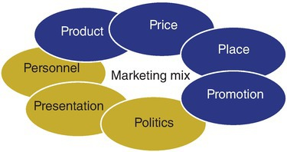
The seven Ps of city marketing

Slide 14
City branding
City branding can be used to build a clear city identity on the basis of well-defined core values.
Self expression as a marketing tool: based on its culture and its character and the chemistry between its inhabitants.
People make a city.

Slide 15
Definition city marketing
City marketing is acquiring a distinctive relevant position to be able to attract the right enterprises, visitors and residents, and retain them, by establishing core values for the creation of a clear city identity from the inside out, and based on the culture and character of a city, utilizing the commitment of the parties involved and aligned to city policy, which leads to involvement with and a willingness to do something for a city in such a way that reality matches the image created.

Slide 16
Four elements of making a city attractives
Urban design
Infrastructural improvement
Basic services
Attractions: with events as an important component!

Slide 17
Events policy
What is meant by an event?
Vision on the development of events in the municipality
Aligned with the integrated city policy
Desirability of events and the criteria of events
Quality assurance with respect to events
The conditions that an application should fulfil

Slide 18
Events policy
What to do if an event crosses the city limits?
Process of applying for a license and subsidy
Co-operation with an events organizer or an events coordinator or committee
How events are facilitated
Financial resources available for events
Evaluation procedures

Slide 19
Role of events in the city
Early days: events were a vital diversion from the harshness of existence and were used by rulers to strengthen their position
Nowadays: arts and culture festivals’ (fringe festivals) were organized as a kind of marginal phenomenon in an ordered society, made money and are an attractive promotional tool
Cultural events were assigned a new function, that of generators of meaning

Slide 20
Eventful city
Refer to cities where cultural festivals are used in a harmonious way to achieve the following:
Objectives are:
  improvement of the quality of life in the city
  New forms of cooperation
  improvement of image
  Increase of public groups

Slide 21
Eventful city
City marketing focused on:
residents
visitors
companies

Slide 22
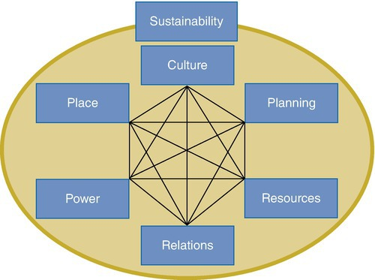
Success factors eventful city

Slide 23
Sustainability and events policy
People, planet, profit
Sustainable growth
Equal working conditions
Taking responsibility for nature and the environment
Social well-being

Slide 24
Sustainability events
Linking to the six critical success factors eventful city (Getz, 2009)
Examples: striving for cultural diversity, involving the local population, minimizing negative effects

Slide 25
Questions?

Slide 26
Thank You

