Slide 1
Events as a Strategic Marketing Tool
2nd Edition
Dorothé Gerritsen and Ronald van Olderen

Slide 2
Part I Plan – Chapter 6
Events and Branding

Slide 3
Phase: plan
Introductory chapters
  Chapters 1 and 2
Event Marketing
  Chapter 3
Four types of marketing
  Chapters 4-7

Slide 4
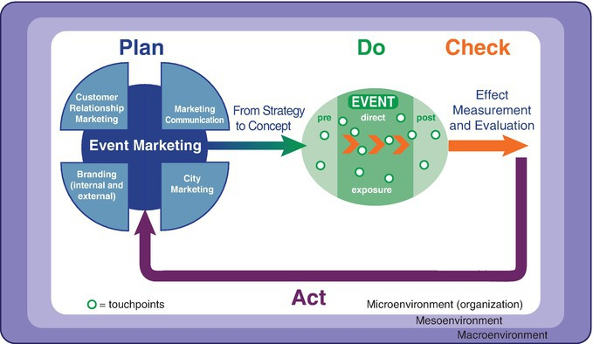
The EVENTS model

Slide 5
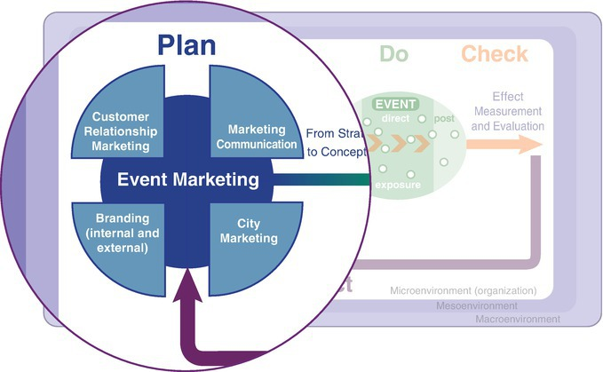
The EVENTS model, plan phase

Slide 6
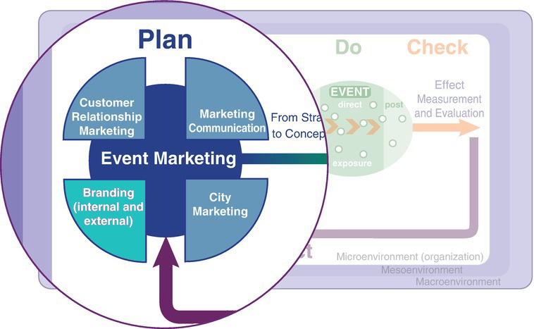
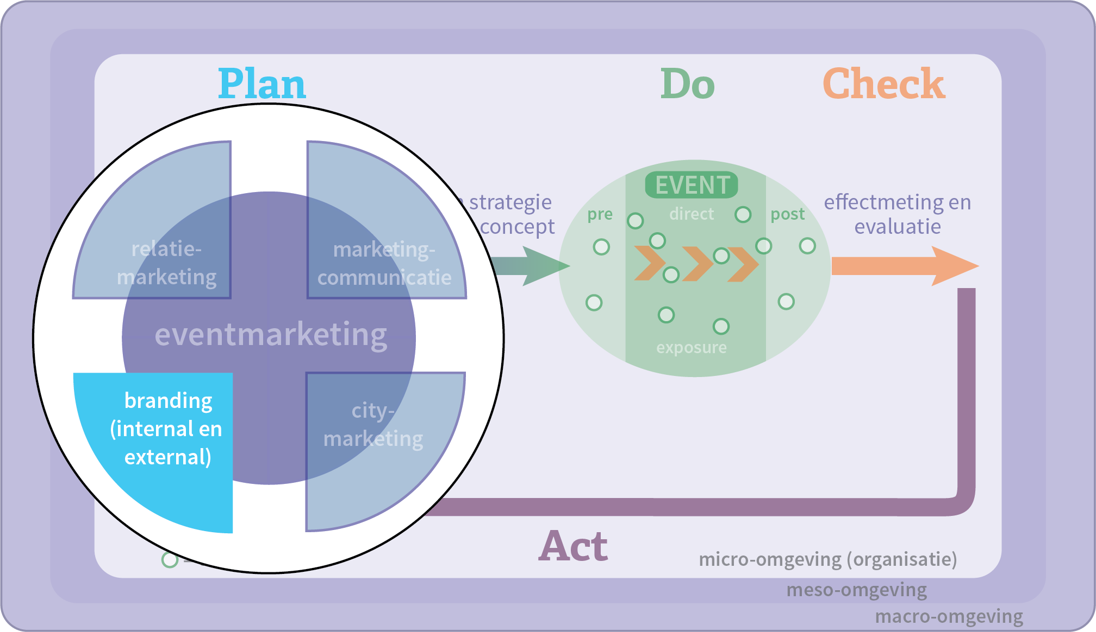
Chapter 6

Slide 7
Contents lecture
The magic of brands
What is a brand?
The significants of brands
Building a brand
Principles of brand building
Events based on image transfer
Questions

Slide 8
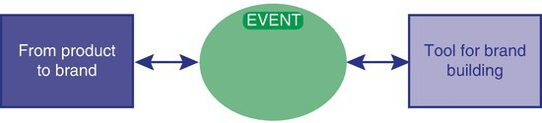
The magic of brands
Showing examples of brands. Why are these strong brands?
Events as a product brand or corporate brand
Events as a brand or imago transfer

Slide 9
Definition brand
A brand is a product, service, person or place to which, with the buyer or consumer in mind, relevant, unique, symbolic values have been added that are closely related to the needs of the consumer.

Slide 10
What is a brand?
A network of associations
Not tangible, a construct
Two principles
  Create brand-added value
  Provide a competitive advantage

Slide 11
The significance of brands
Demand side: brand-added value
  Identification function
  Assurance function
  Symbolic function
Supply side: brand equity

Slide 12
Building a brand
New or existing brand brand
Methods of getting to the bottom of what a brand is
(internal and external)
competitors
buyers

Slide 13
Building a brand
Brand associations
Identity prism

Slide 14
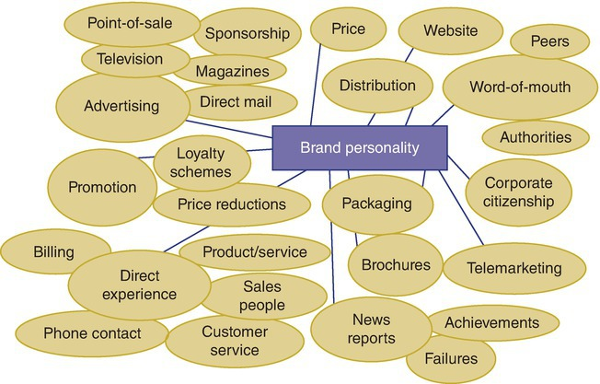
1. Brand associations
Brand associations depending on:
Positive associations
Intensity of the associations
Unicity of the associations

Slide 15
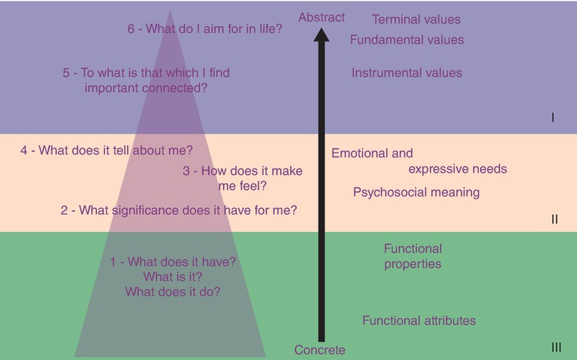
1. Brand associations
brand associative system
means-end analysis (applying hierarchy association network)

Slide 16
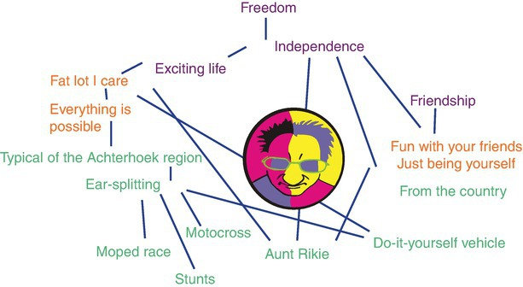
1. Brand associations

Slide 17
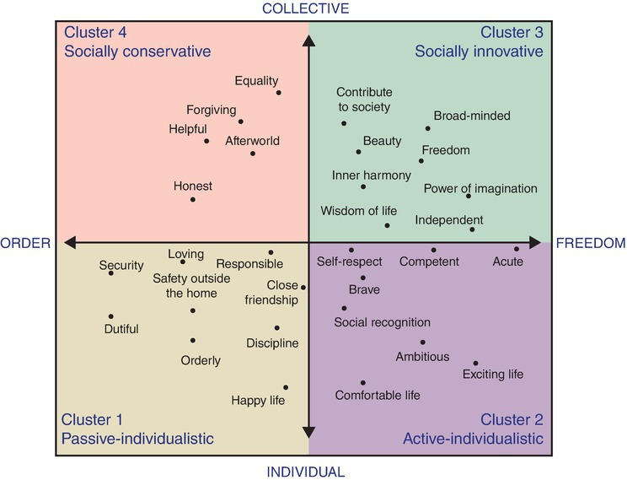
1. Brand associations
Value pattern of individuals
Relevance of features
  Brand association → higher rating
  Key concept → relevant for brain positioning
  Mental assets → relationship with buying behaviour

Slide 18
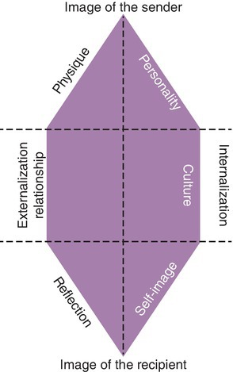
Brand-identity prism developed by Kapferer (1992)

Slide 19
Principles of brand building
Event as product
Event is a brand
Brand event (image transfer, source and target)

Slide 20
Principles of brand building
Brand event (image transfer, source and target)
  Ingredient branding
  Extension strategy
  Co-branding strategy
  Endorsement strategy

Slide 21
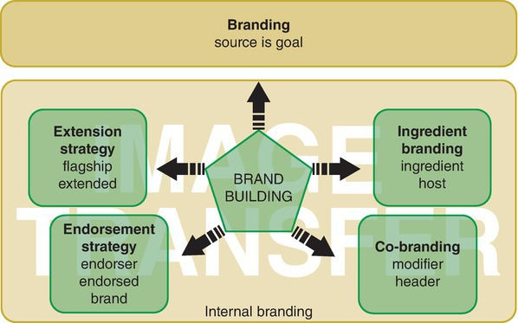
Principles of brand building

Slide 22
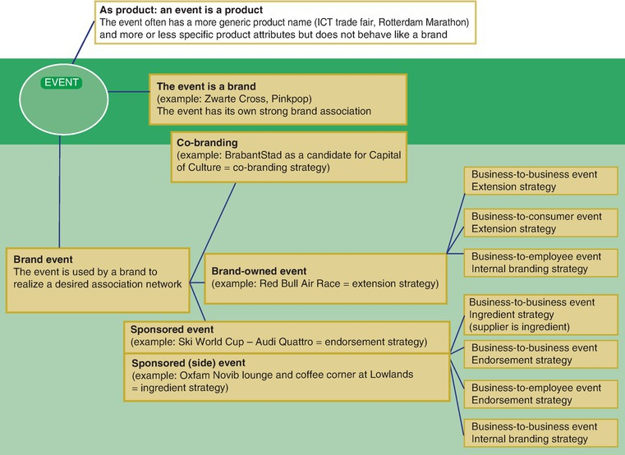
Events based on brand building

Slide 23
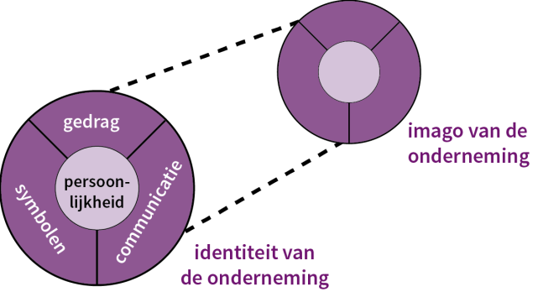
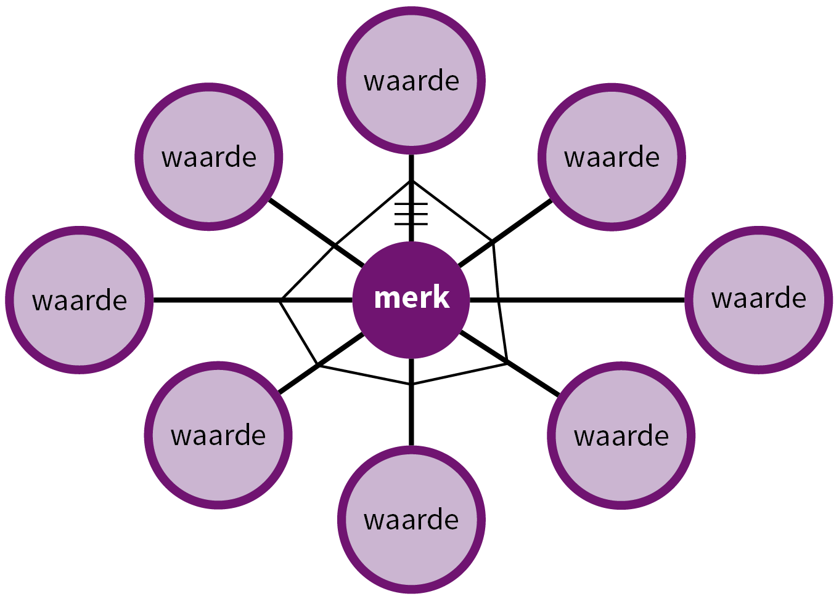
Internal branding events
Aim of internal branding
  Optimizing the consumer or visitor experience
  Creating greater commitment on the part of the employees
Corporate identity
Spider web method of Bernstein

Slide 24
Questions?

Slide 25
Thank You

