Slide 1
Events as a Strategic Marketing Tool
2nd Edition
Dorothé Gerritsen and Ronald van Olderen

Slide 2
Part I Plan – Chapter 3
Event Marketing

Slide 3
Plan phase
Introductory chapters
  Chapters 1 and 2
Event Marketing
  Chapter 3
Four types of marketing
  Chapters 4-7

Slide 4
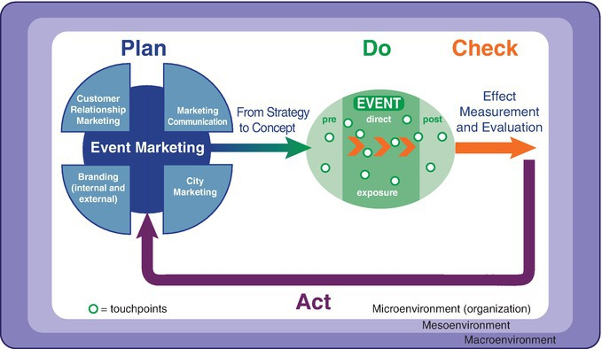
The EVENTS model

Slide 5
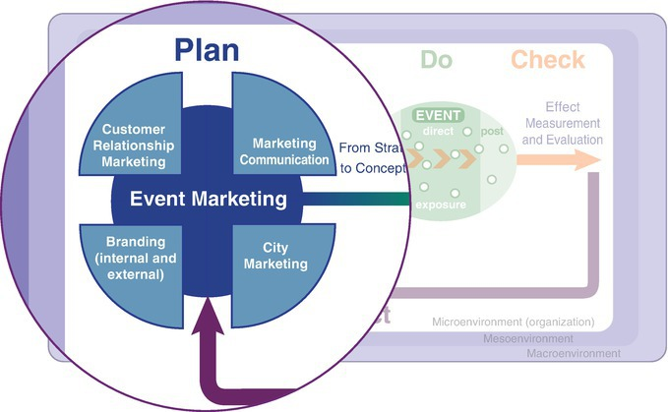
The EVENTS model, plan phase

Slide 6
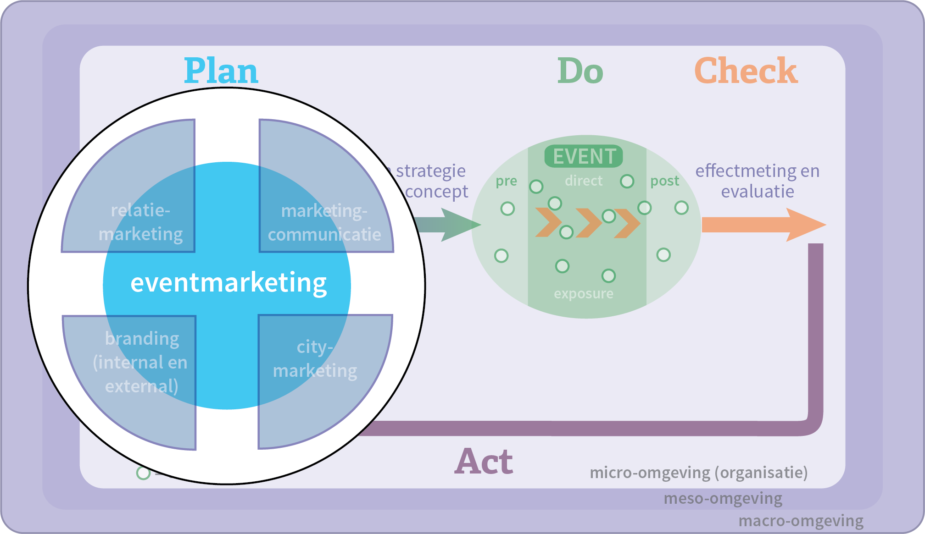
Chapter 3

Slide 7
Contents lecture
Emergence of Event Marketing
Perspectives
Reasons Event Marketing
Types of Event Marketing
Power of events and Event Marketing
Disadvantages of events and Event Marketing
Key questions
Choice for an event

Slide 8
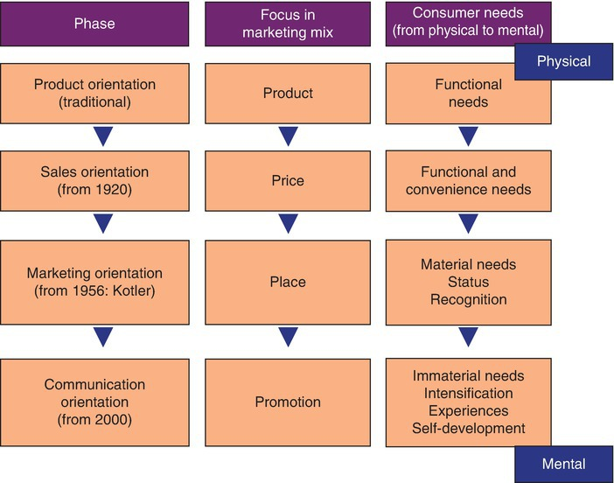
Emergence of Event Marketing
Marketing and the emergence of experiences
Developments in marketing communication

Slide 9
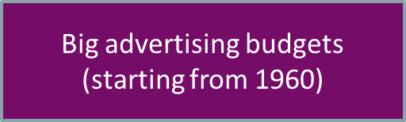
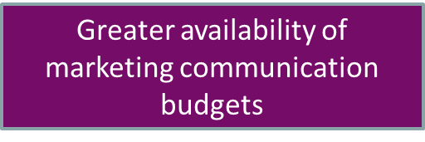


Emergence of Event Marketing
Developments in marketing communication

Slide 10
Perspectives
Marketing for events (marketing of an event)
Marketing through events (Event Marketing)

Slide 11
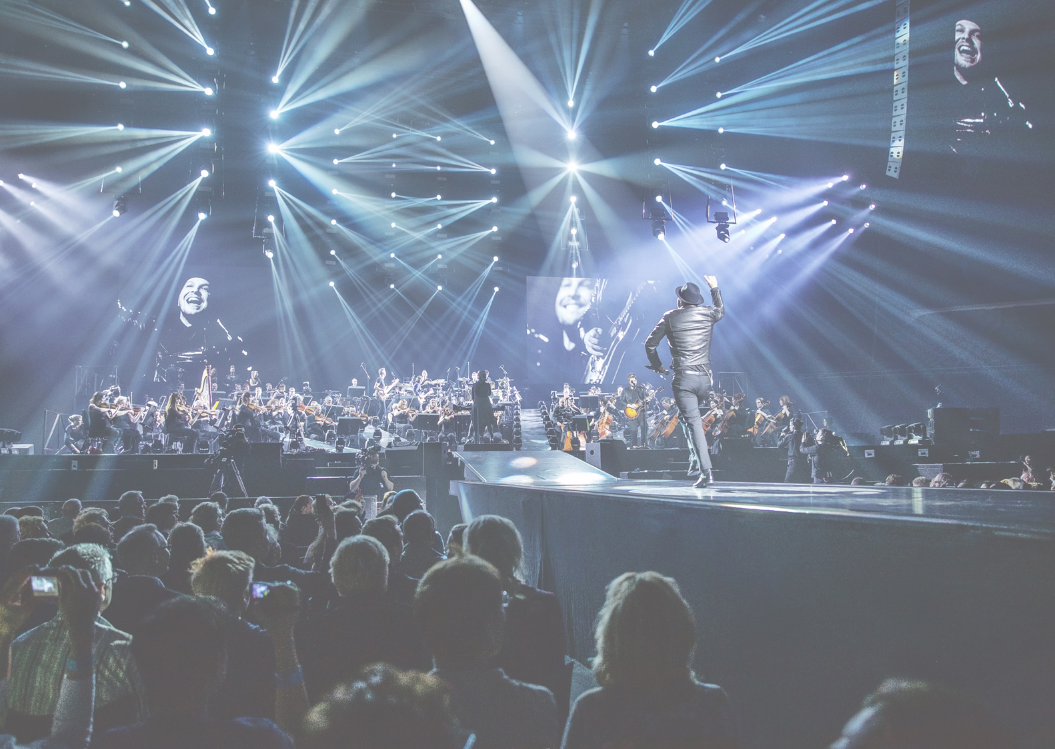
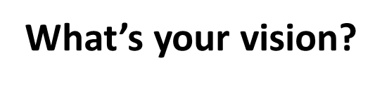
Event Marketing & communication approach
Marketing of
parties
or
Value creation through
Meaningful (live) encounters?

Slide 12
Definition Event Marketing
Event marketing focuses on developing, intensifying and expanding a relationship (or brand relationship) with one or more target groups, in which the event or the series of events is used as a marketing and communication tool and in which emotion and experience are brought together. A clearly defined objective, message and target group, consistent with the organizer’s policy, is a precondition in this respect.

Slide 13
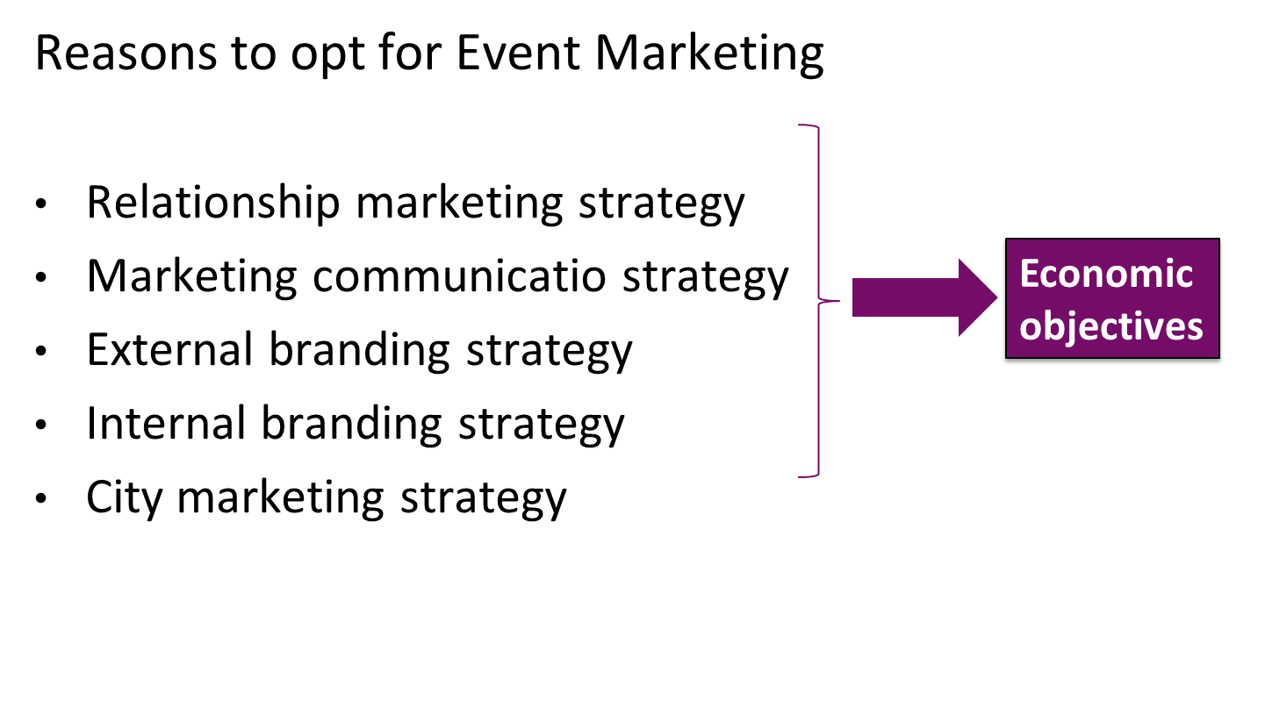

Slide 14
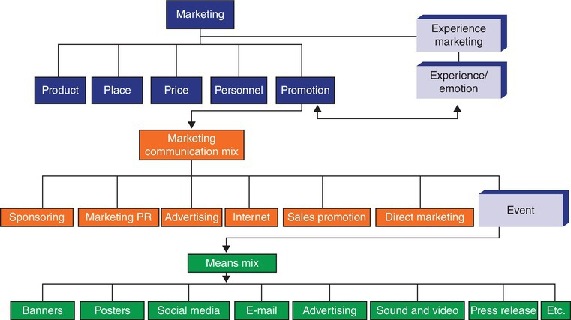

Slide 15
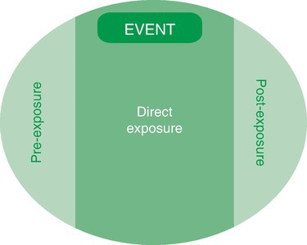

Slide 16
Types of Event Marketing
Conceive and organize
  Brand events
  Brand venues
  Relationship events
  Internal branding (internal brand events)
Teaming up with an existing event
  Sponsored events
  Side events
  Campaigns (edge of acceptability and legal)
  Relationship events
  Internal branding events
Hosting, facilitating and/or financing

Slide 17
Power of events and Event Marketing
Interaction
Encounters
Emotion and experience
Integrated communication
Being different
Networking opportunities
3D
Appealing to trade journalists

Slide 18
Disadvantages events and Event Marketing
One-off
Costs
Complexity

Slide 19
Key questions
Objective
Message
Target market
Tools, means and media
Customized
Follow-up

Slide 20
Choice for an event
Objective
Target group
Expected contribution to the objective
Available alternatives
Level of support
Feasibility
Risks
Time path
Costs

Slide 21
Questions?

Slide 22
Thank You

