Slide 1
Events as a Strategic Marketing Tool
2nd Edition
Dorothé Gerritsen and Ronald van Olderen

Slide 2
Part I Plan – Chapter 2
Trends and developments: the consumers’ pursuit of happiness

Slide 3
Phase: plan
Introduction
  Chapters 1 and 2
Event Marketing
  Chapter 3
Four types of marketing
  Chapters 4-7

Slide 4
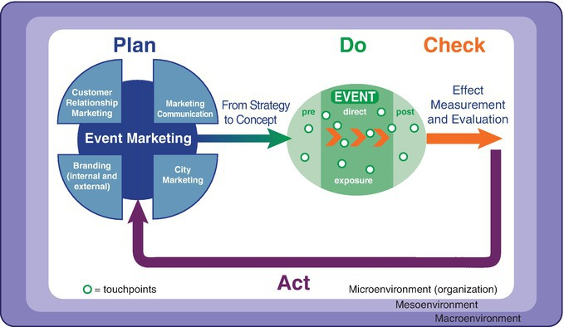
The EVENTS model

Slide 5
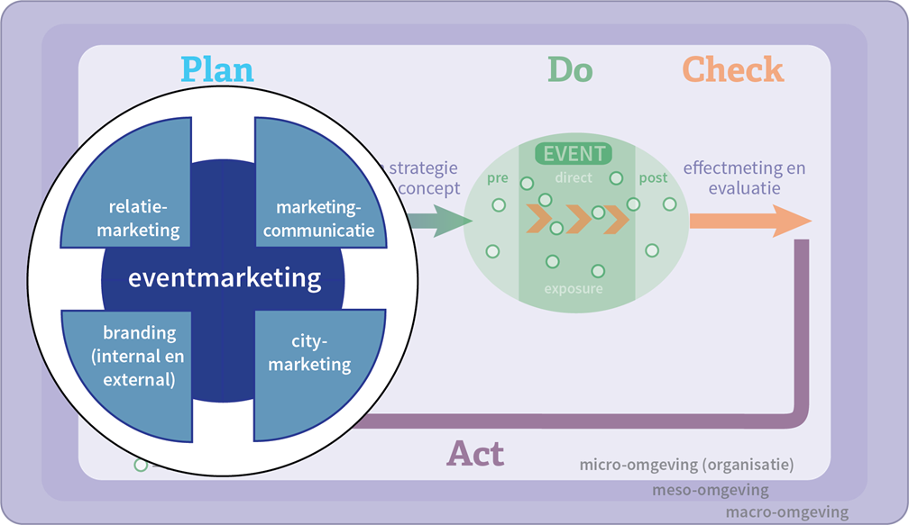
The EVENTS model, plan phase

Slide 6
Chapter 2

Slide 7
Contents lecture
Economic phases
Examples
Devaluation experience concept
Happiness economy
Innovations opportunities
Scenario research
Questions

Slide 8

Economic stage
Economic stage Supplier’s focus Consumer’s focus
Agrarian economy | Extracting commodities | Availability
Industrial economy | Manufacturing products | Price
Service economy | Delivering services | Quality
Experience economy | Staging experiences | Authenticity
Transformation economy (happiness economy)

Slide 9
The happiness economy
Characteristics of this new economic stage is that suppliers are taking on the challenge of bringing about permanent changes in the consumer and to help him give his life meaning.

Slide 10
Alternative terms
An economy of meaningfulness
Transformation economy

Slide 11
Happiness economy
1. Enabling happiness
2. Orchestrated happiness
3. Helping people to help themselves
4. Meaningful leisure products
5. Events with added value
6. Corporate social responsibility

Slide 12
1. Enabling happiness
Psychology and sociology
Seligman (2002): positive emotions, involvement and an economy of meaningfulness
Diener and Biswas-Diener (2008): family and friends, sense of direction and meaning and purpose in life
Veenhoven (2006): liveability of the external environment and the life skills of the individual

Slide 13
2. Orchestrated happiness
Manipulability of happiness
How can professional organizations stimulate happiness in the workplace?
Opportunities for leisure managers:
- individual makes own choices;
- sectors like labour and health care considerably lower
Evolution event manager from experience stagers to happiness managers (expertise in quality of life)

Slide 14
3. Helping people to help themselves
Ethics: risk of patronizing or manipulating emotions
Create possibilities to allow individuals to follow their own dreams
Meaning and purpose in the design and programming of events -> permanent changes!

Slide 15
4. Meaningful leisure products
Focus of suppliers to lasting optimization of the leisure user’s contentment with life.
Not only temporary flow experience
Search for examples!

Slide 16
5. Events with added value
Charity events
- Examples

Slide 17
6. Corporate social responsibility
HEMA “Helpende Handen event”
Siemens Caring Hands
Artishock Event in Den Bosch

Slide 18
Innovation opportunities
Focus from experiences to happiness and quality of life
Facilitating happiness
Individual level: achieve an increased sense of happiness
Social level: optimizing quality of life
- Quality of life in general
- Strengthen social cohesion within and between various groups and subgroups

Slide 19

Scenario study

Slide 20
Seven steps
1. Formulating a project plan
2. Carrying out a general trend analysis
3. Reducing to a limited number of key trends
4. Describing key trends
5. Alternative scenarios
6. Storyboards for each scenario
7. Recommendations

Slide 21
Two dominant trends
  Crowd versus cloud
  Large scale mass events versus intimate encounters
  Four alternative scenarios
  Large-scale physical encounters
  Large-scale online encounters
  Small-scale, physical encounters
  Small-scale online encounters

Slide 22
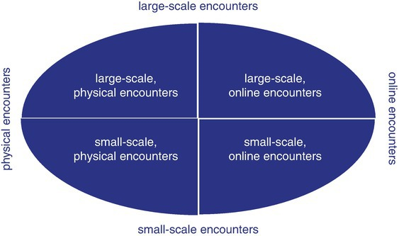
Four future scenarios

Slide 23
Scenario 1: large-scale encounters – crowd
The physical large-scale encounters remain and will be supported by online applications. This scenario describes a future which is very similar to the status quo.

Slide 24
Scenario 2: large-scale encounters – cloud
Large scale, online encounters are the majority of all events. Online contact has become more important than physical encounters which were in the central position before.

Slide 25
Scenario 3: small-scale encounters – crowd
Small-scale physical encounters have become more important. Physical encounters still exist but take place in small-scale events.

Slide 26
Scenario 4: small-scale encounters– cloud
Small-scale online encounters have become more important. Live communication has almost disappeared, because communication has become online via internet on a daily basis.

Slide 27
Questions?

Slide 28
Thank You

