Slide 1
Events as a Strategic Marketing Tool
2nd Edition
Dorothé Gerritsen and Ronald van Olderen

Slide 2
Part III Check – Chapter 10
Effect Measurement and Evaluation

Slide 3

Phase: check (and act)
Chapter 10

Slide 4
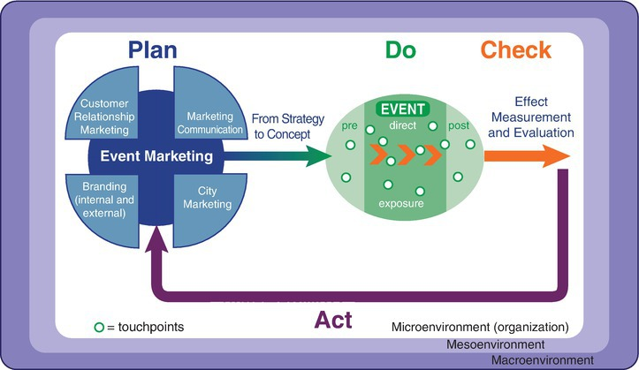
The EVENTS model

Slide 5
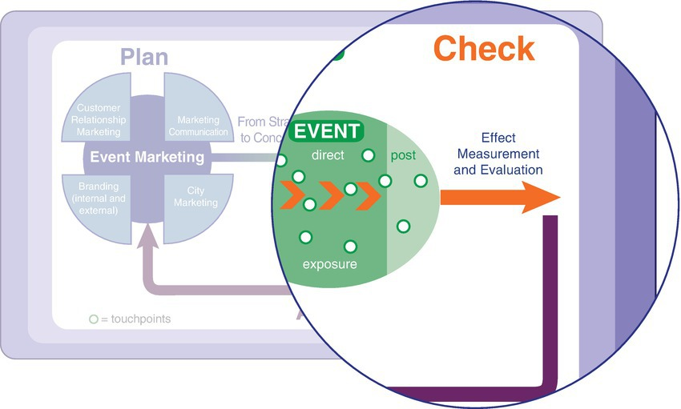
The EVENTS model, check phase (and act phase)

Slide 6
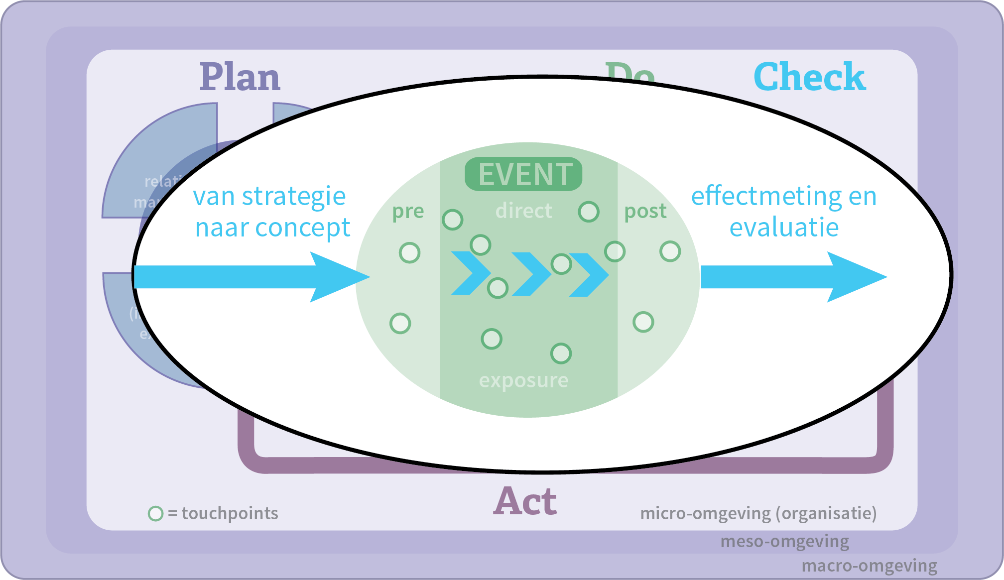
Chapter 10

Slide 7
Effect measurement and evaluation
Who wants to know what and why?

Slide 8
Contents lecture
PDCA cycle
Description and types of effects
What is effect measurement?
Reasons for effect measurement
Objectives
  Hierarchy of objectives
  SMART objectives
How question
Quantitative and qualitative research

Slide 9
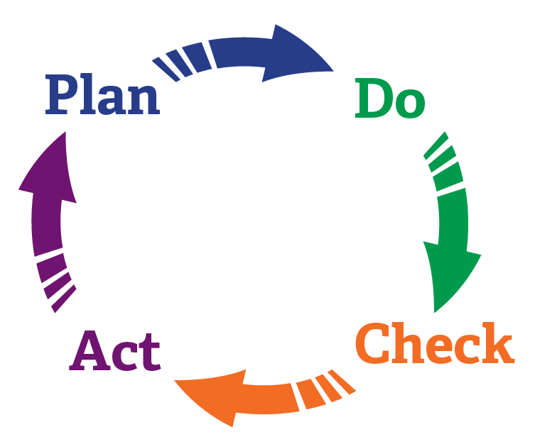
PDCA cycle
Feedback to EVENTS model

Slide 10
Effects are reactions to actions. There are intended and unintended effects. The intended effects of an event ensue from the predetermined objectives.
Unintended effects refer to consequences you could not have foreseen in advance.

Slide 11
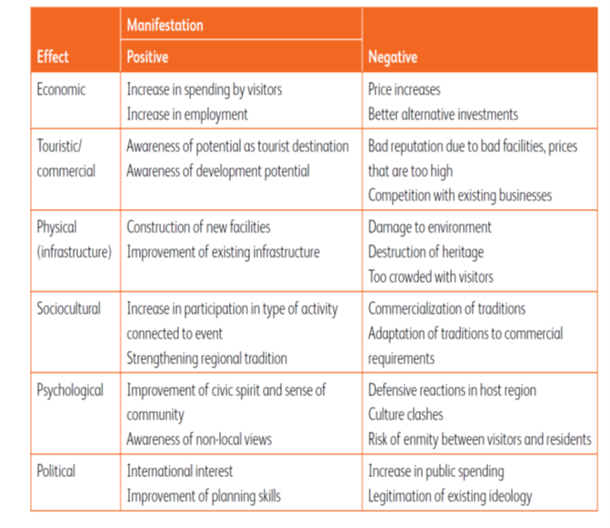
Types of effects of
public events
Effects matrix for public events. (source: Hall, 1992)

Slide 12
Different points of emphasis public and business events

Slide 13
What is effect measurement?
Effect measurement comprises the collection of data for the analysis of an event to be able to: make adjustments before, during and after an event; account for everything; improve processes; and formulate new objectives.
Who wants to know what and why?
The angle of the measurement is very important.

Slide 14
Reasons for effect measurement
Accountability
Return on investment (ROI)
Making adjustments
Looking back

Slide 15
Objectives
  What question
  Hierarchy of objectives
      Strategic effect objectives
      Operational effect objectives
      Attainment objectives
  SMART objectives

Slide 16
Hierarchy of objectives
Strategic effect objectives
    Corporate objectives are the basis
    Long-term
Operational effect objectives
    Degree of satisfaction and appreciation on event
Attainment objectives
    Quality and quantity of the target group to be reached at an event
    Potential and effective reach

Slide 17
Good (SMART) objectives
    are embedded in strategy of the organization
    have measurable performance indicators
    are logical, transparant and lucid
    are SMART (Specific, Measurable, Acceptable, Realistic, Time bound)

Slide 18
Relationship objective and effect measurement
  Beter position to work out a concept and design for an event
  Easier to demonstrate to what extent an event has contributed to attaining the objectives

Slide 19
PDCA cycle including SMART objective

Slide 20
Hierarchy of objectives and PDCA cycle

Slide 21
How question
Drawing up a plan for effect measurement and evaluation
  Knowing what you want to measure
  Selecting indicators
  Making measurement tools operational
  Collecting data
Baseline, first and second measurement

Slide 22
Quantitative and qualitative research
Quantitative research
  Measuring impact on large groups of visitors
  Monitoring
  Surveys
Qualitative research
  To find out underlying thoughts, values or motives
  Laddering
  Observation

Slide 23
Questions?

Slide 24
Thank You

