Slide 1
Events as a Strategic Marketing Tool
2nd Edition
Dorothé Gerritsen and Ronald van Olderen

Slide 2
Part I Plan – Chapter 1
Introduction: Using Events as a Strategic Marketing Tool

Slide 3
Phase: plan
Introductory chapters
Chapters 1 and 2
Event Marketing
Chapter 3
Four types of marketing
Chapters 4-7

Slide 4
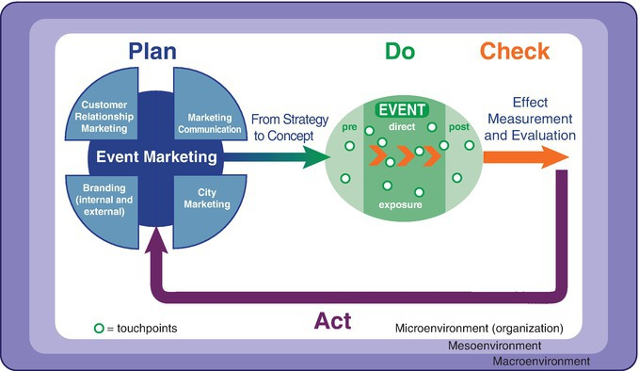
The EVENTS model

Slide 5
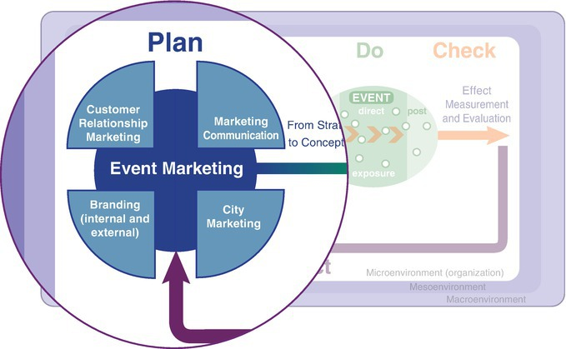
The EVENTS model, plan phase

Slide 6
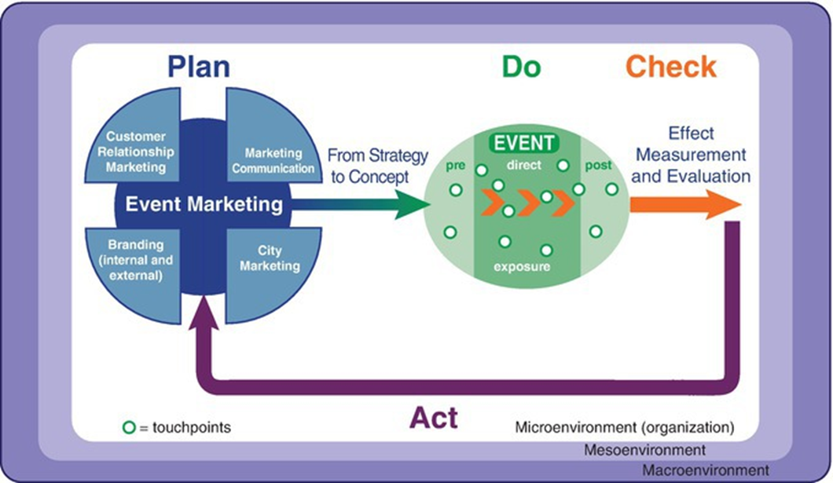
Chapter 1

Slide 7
Contents lecture
Increasing popularity in events
Event as live communication tool
Experience
Corporate and public events
Fading boundaries
EVENTS model
Questions

Slide 8
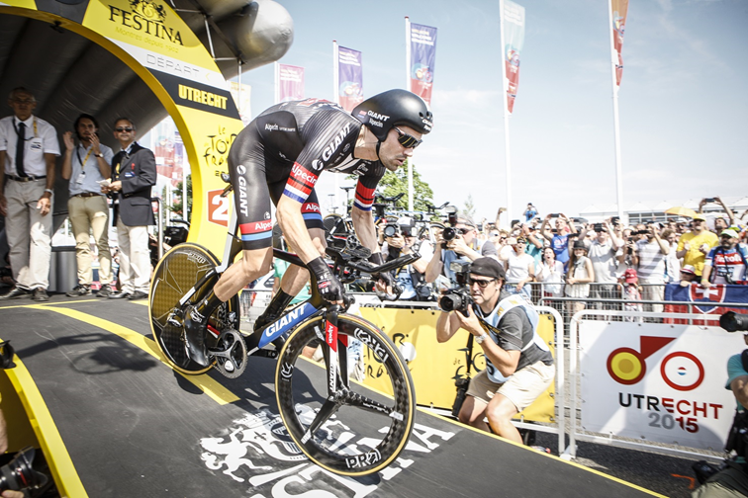
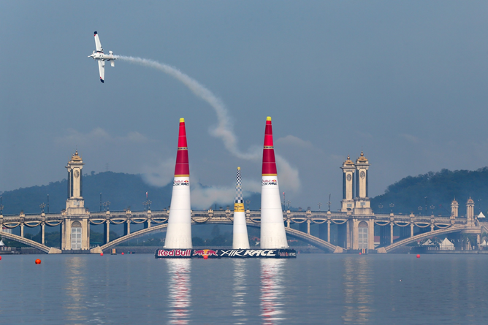
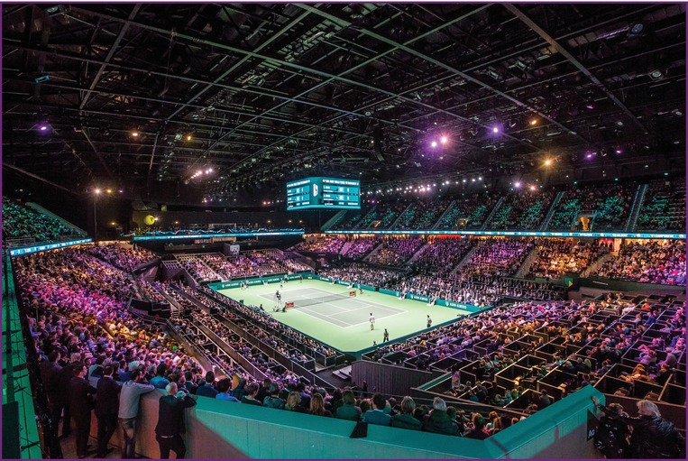
Fading boundaries

Slide 9
Increasing interest in events
Changing behaviour of target groups
Economic crisis
Distinctive and effective
Power of events as tool to bond

Slide 10
Increasing interest in events
People come together
Experience, emotion and value
Everyone has a memory/experience

Slide 11
‘We survived because of science. We lived because of events. Every month we celebrated birthdays, anniversaries, the births of new creatures and our personal and professional triumphs. Our looking forward to these celebrations, sustained our spirits.’

Slide 12
Event as live communication tool

Slide 13
Definition using events as a strategic marketing tool:
Planning a unique event or series of events for one or more target groups where people come together, either physically or virtually, at the invitation and initiation of a company/business, government body or non-profit organization. The client wishes to achieve an emotional added value by means of an experience, to support a predefined objective (communicative or otherwise) that has to be achieved among one or more of the target groups identified.

Slide 14
Definition using events as a strategic marketing tool
Unique event or series of events
Physical and/or virtual come together
At invitation
Initiated by the client, the government body or non-profit organization
Achieving objectives
Emotional added value by means of an experience

Slide 15
Experience
Event
Input
Output
Sensory
perception
Emotion
Staged
experience
Experience
Giving meaning

Slide 16
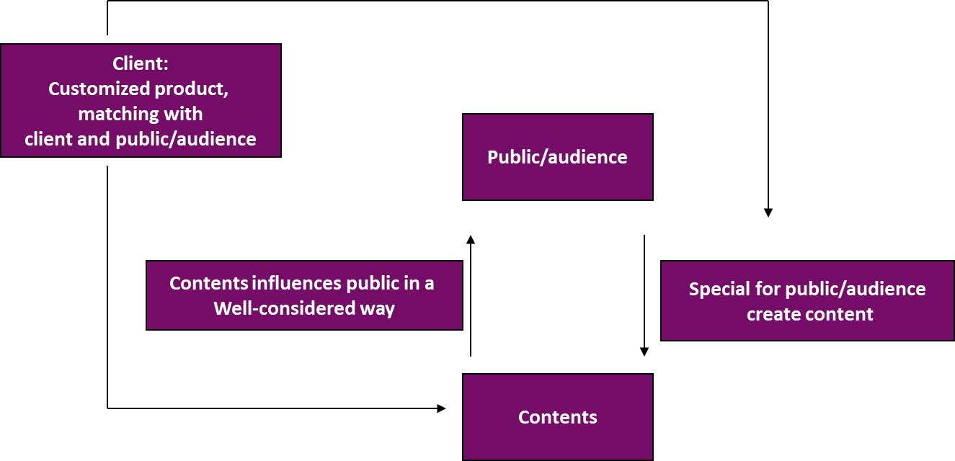
Corporate and public events

Slide 17
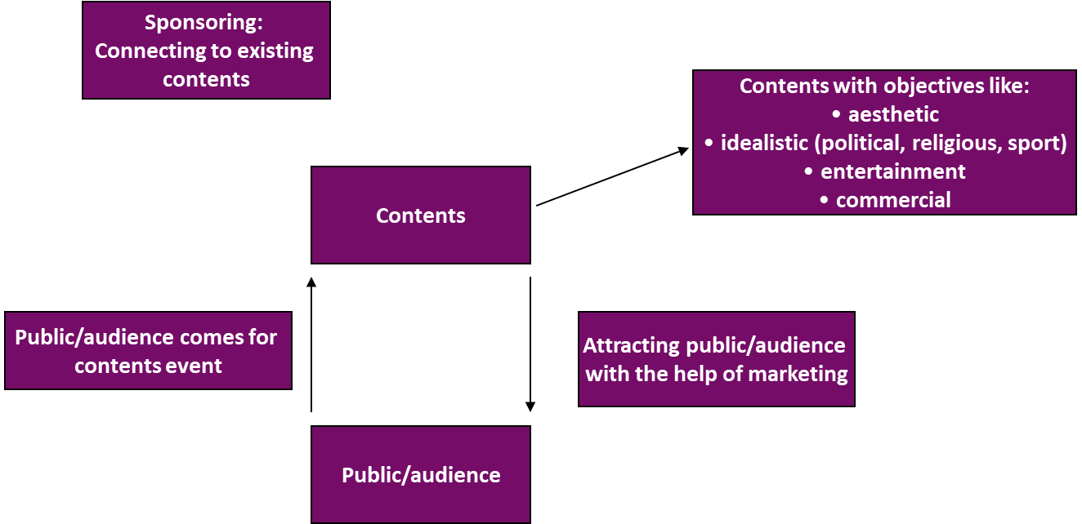
Corporate and public events

Slide 18
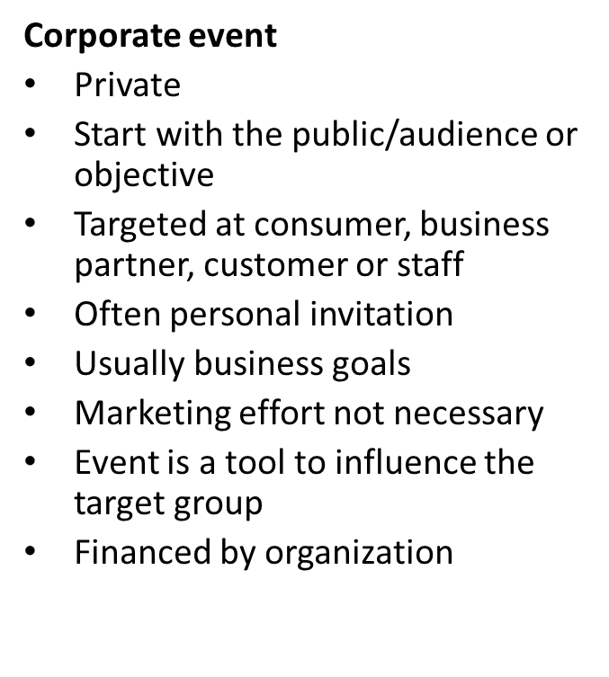
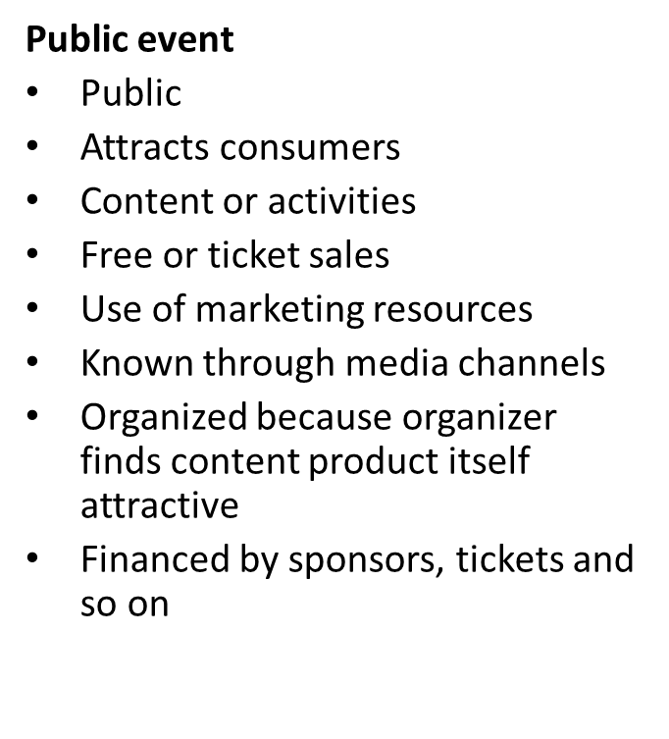
Differences corporate and public events

Slide 19
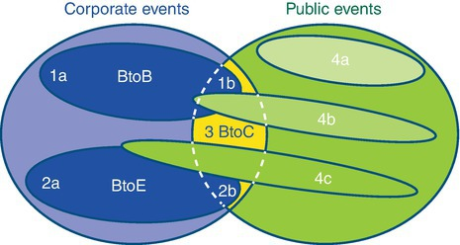
Fading bounderies

Slide 20
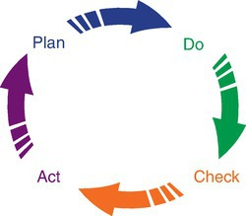
The importance of managing events

Slide 21
EVENTS model
E = environment
V = value
E = effect
N = new (concept and design)
T = touchpoints
S = strategy

Slide 22
Questions?

Slide 23
Thank You

