Slide 1
Events as a Strategic Marketing Tool
2nd Edition
Dorothé Gerritsen and Ronald van Olderen

Slide 2
Part I Plan – Chapter 4
Events and Customer Relationship Marketing

Slide 3
Phase: plan
Introductory chapters
Chapters 1 and 2
Event Marketing
Chapter 3
Four types of marketing
Chapters 4-7

Slide 4
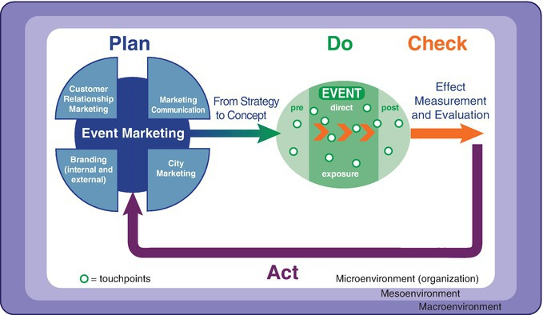
The EVENTS model

Slide 5
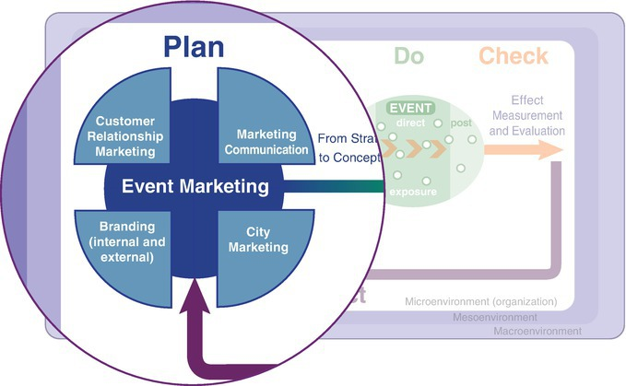
The EVENTS model, plan phase

Slide 6
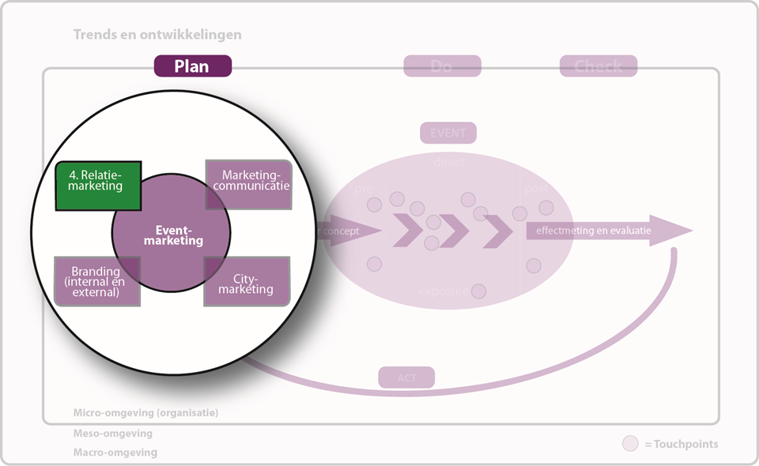
Chapter 4

Slide 7
Contents lecture
Emergence of customer relationship marketing
From 4 Ps to the 3 Rs
Events and customer relationship marketing
Pillars CRM
Reasons to use events
Limits to customer relationship marketing
Questions

Slide 8
Emergence of customer relationship marketing
Shift from transaction-oriented marketing towards customer relationship marketing
- Growing competition
- (Product)technological advancements
- Technological developments
- Individualization

Slide 9
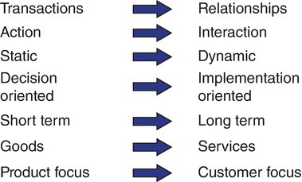
Emergence of customer relationship marketing

Slide 10
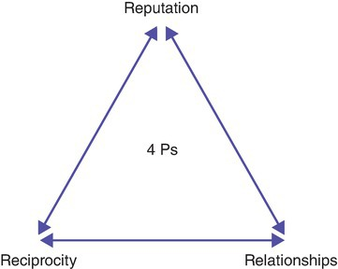
From 4Ps to the 3Rs

Slide 11
Definition relationship marketing
Relationship marketing is an integrated effort of the organization in order to identify, maintain and build a network with individual consumers, and continuously reinforce that network, to the advantage of both parties, by means of interactive, individualized and value-adding contacts that relate to several, successive transactions. (Schijns, 2000).

Slide 12
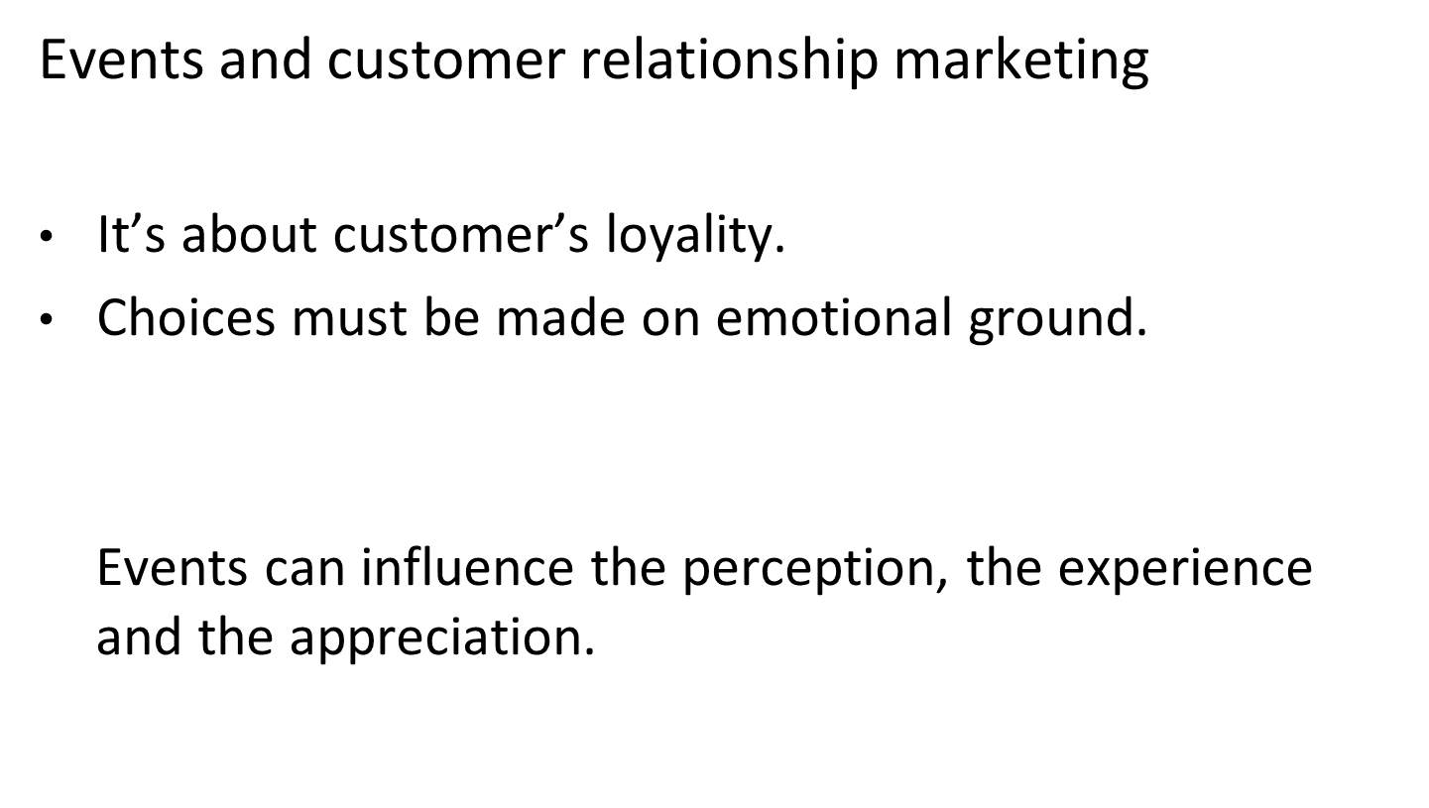


Slide 13
Pillars CRM
Customers knowledge
Customer relationship strategy
Communication
Individualized value proposition

Slide 14
1. Customer and customer knowledge
Prospects and customers
Suppliers
Competitors
Influencers
  Goverment
  Financial institions
  Press
Employees

Slide 15
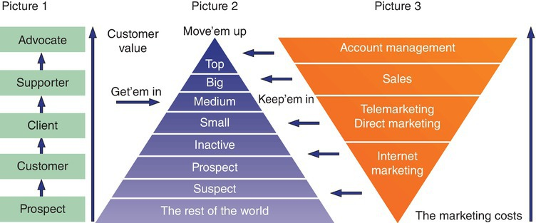
1. Customer and customer knowledge
Record data
Segmentation

Slide 16
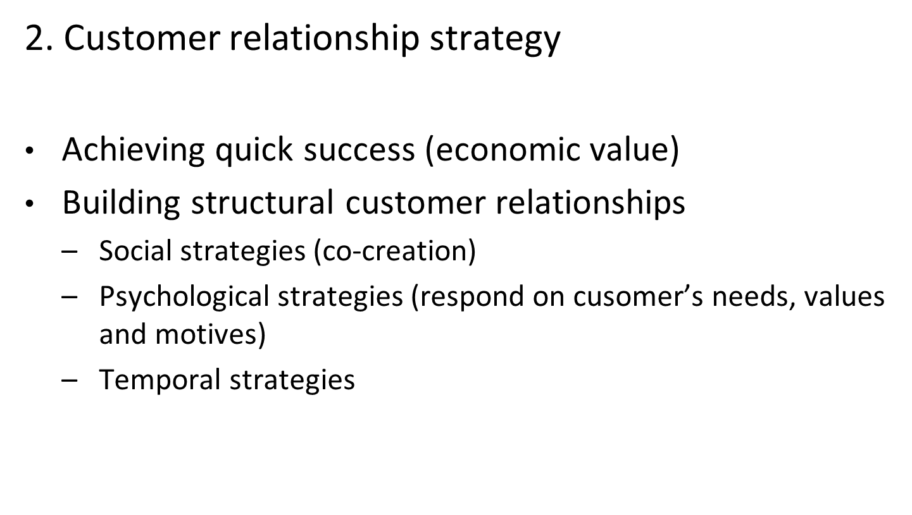

Slide 17
3. Communication
How do you reach the customer?
Touchpoints
4. Individualized value proposition
Organisation focuses on the individual customer
Finetuning processes

Slide 18
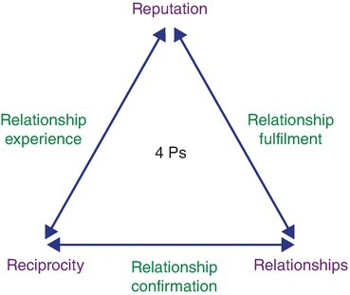
Reasons to use events
  Showing appreciation
  Informing
  Surprising
  Motivating
Relationship experience, relationship fulfilment
and relationship confirmation.
(Source: Storm, 1992.)

Slide 19

Surprising
Motivating
Informing
Appreciating

Slide 20
Limits customer relationship marketing
Companies determine for themselves what the limits are (code of conduct)
WKR

Slide 21
Questions?

Slide 22
Thank You

