Slide 1
Plant Pathology and Plant Diseases
© Anne Marte Tronsmo, David B. Collinge, Annika Djurle, Lisa Munk, Jonathan Yuen and Arne Tronsmo 2020

Slide 2
Fig. 9.1 A-B Examples of symptoms. (A) Rhytisma acerinum causing tar spot on acer. (B) Canker of apple tree caused by Neonectria ditissima. (A, B, © L. Munk.)
Plant Pathology and Plant Diseases © Anne Marte Tronsmo, David B. Collinge, Annika Djurle, Lisa Munk, Jonathan Yuen and Arne Tronsmo 2020

Slide 3
Fig. 9.1 C-D Examples of symptoms. (C) Colletotrichum gloeosporioides causing bitter rot on apple. (D) Aphanomyces cochlioides causing dry rot of sugar beet. (C: © L. Munk; D: © A. Djurle.)
Plant Pathology and Plant Diseases © Anne Marte Tronsmo, David B. Collinge, Annika Djurle, Lisa Munk, Jonathan Yuen and Arne Tronsmo 2020

Slide 4
Fig. 9.1 E-F Examples of visible signs of disease. (E) Smut spores (teliospores) of Ustilago maydis. (F) Mycelium and sclerotia of Sclerotinia sclerotiorum. (© L. Munk.)
Plant Pathology and Plant Diseases © Anne Marte Tronsmo, David B. Collinge, Annika Djurle, Lisa Munk, Jonathan Yuen and Arne Tronsmo 2020

Slide 5
Fig. 9.2 A-B Examples of visible signs of disease. (A) Conidia of Monilia fructigena causing brown rot on apple. (B) Conidia and chasmothecia of Erysiphe trifolii causing powdery mildew on lupin.. (© L. Munk).
Plant Pathology and Plant Diseases © Anne Marte Tronsmo, David B. Collinge, Annika Djurle, Lisa Munk, Jonathan Yuen and Arne Tronsmo 2020

Slide 6
Fig. 9.2 C-D Examples of visible signs of disease. (C) Aecia of Uromyces beticola causing beet rust. (D) Uredinia of Puccinia striiformis causing yellow rust on wheat. (© L. Munk).
Plant Pathology and Plant Diseases © Anne Marte Tronsmo, David B. Collinge, Annika Djurle, Lisa Munk, Jonathan Yuen and Arne Tronsmo 2020

Slide 7
Fig. 9.2 E-F Examples of visible signs of disease. (E) Smut spores (teliospores) of Ustilago maydis. (F) Mycelium and sclerotia of Sclerotinia sclerotiorum. (© L. Munk.)
Plant Pathology and Plant Diseases © Anne Marte Tronsmo, David B. Collinge, Annika Djurle, Lisa Munk, Jonathan Yuen and Arne Tronsmo 2020

Slide 8
Fig. 9.2 G-H Examples of visible signs of disease. (G) Sporangia of Albugo candida causing white rust on shepherd’s purse. (H) Sporangia of Peronospora viciae causing downy mildew on faba bean. (© L. Munk.)
Plant Pathology and Plant Diseases © Anne Marte Tronsmo, David B. Collinge, Annika Djurle, Lisa Munk, Jonathan Yuen and Arne Tronsmo 2020

Slide 9
Fig. 9.3 A-B Examples of abiotic disorders. (A) Hail damage on oilseed rape. (B) Frost damage on a shoot of grapevine. (A: © SLU; B: © L. Munk.)
Plant Pathology and Plant Diseases © Anne Marte Tronsmo, David B. Collinge, Annika Djurle, Lisa Munk, Jonathan Yuen and Arne Tronsmo 2020

Slide 10
Fig. 9.3 C-D Examples of abiotic disorders. (C) Ice damage on golf course. (D) Kale with leaf drop due to sudden change in temperature. (C: © A. Tronsmo. D: © L. Munk.)
Plant Pathology and Plant Diseases © Anne Marte Tronsmo, David B. Collinge, Annika Djurle, Lisa Munk, Jonathan Yuen and Arne Tronsmo 2020

Slide 11
Fig. 9.3 E-F Examples of abiotic disorders. (E) Iron deficiency. (F) Boron deficiency in celeriac. (E: T. Krogstad, © NMBU
F: I. Aasen, © NMBU.)
Plant Pathology and Plant Diseases © Anne Marte Tronsmo, David B. Collinge, Annika Djurle, Lisa Munk, Jonathan Yuen and Arne Tronsmo 2020

Slide 12
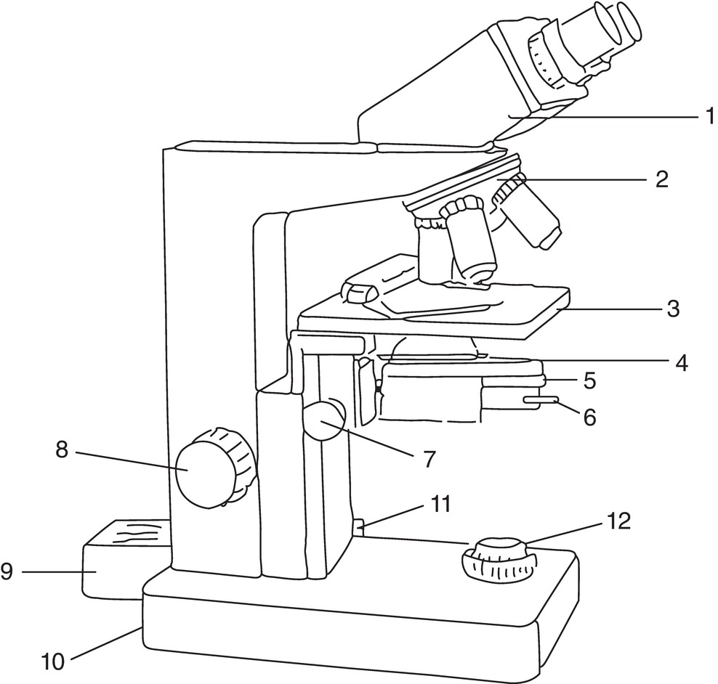
Fig. 9.4 A compound microscope with phase-contrast. 1, Eye pieces; 2, rotating revolver with 4 objectives; 3, stage; 4, condenser; 5, ring for shift between light field, phase-contrast and dark field; 6, adjustment knob for the aperture; 7, adjustment knob for condenser; 8, coarse and fine adjustment knob; 9, lamp; 10, power switch; 11, light control;12, brightness adjustment. (© A. Tronsmo)
Plant Pathology and Plant Diseases © Anne Marte Tronsmo, David B. Collinge, Annika Djurle, Lisa Munk, Jonathan Yuen and Arne Tronsmo 2020

Slide 13
Fig. 9.5 A-B Examples of fungal and fungal-like structures. (A) Spores of Fusarium sp. (B) A conidiophore and conidia of Botrytis cinerea. (E) Mature and immature teliospores of Phragmidium sp. (F) Sporangiophores and a sporangium of Peronospora viciae on pea. (© L. Munk).
Plant Pathology and Plant Diseases © Anne Marte Tronsmo, David B. Collinge, Annika Djurle, Lisa Munk, Jonathan Yuen and Arne Tronsmo 2020

Slide 14
Fig. 9.5 C-D Examples of fungal and fungal-like structures. (C) Ascospores of Venturia inaequalis. (D) Chasmothecium –ascocarp of the fungus causing powdery mildew on oak, Erysiphe alphitoides. (© L. Munk.)
Plant Pathology and Plant Diseases © Anne Marte Tronsmo, David B. Collinge, Annika Djurle, Lisa Munk, Jonathan Yuen and Arne Tronsmo 2020

Slide 15
Fig. 9.5 E-F Examples of fungal and fungal-like structures. (E) Mature and immature teliospores of Phragmidium sp. (F) Sporangiophores and a sporangium of Peronospora viciae on pea. . (© L. Munk).
Plant Pathology and Plant Diseases © Anne Marte Tronsmo, David B. Collinge, Annika Djurle, Lisa Munk, Jonathan Yuen and Arne Tronsmo 2020

Slide 16
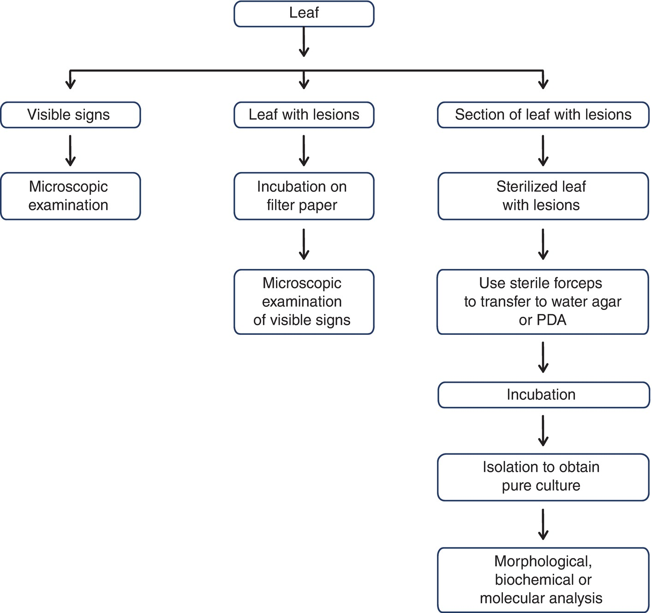
Fig. 9.6 A scheme for diagnosis following isolation of the pathogen. (© L. Munk.)
Plant Pathology and Plant Diseases © Anne Marte Tronsmo, David B. Collinge, Annika Djurle, Lisa Munk, Jonathan Yuen and Arne Tronsmo 2020

Slide 17
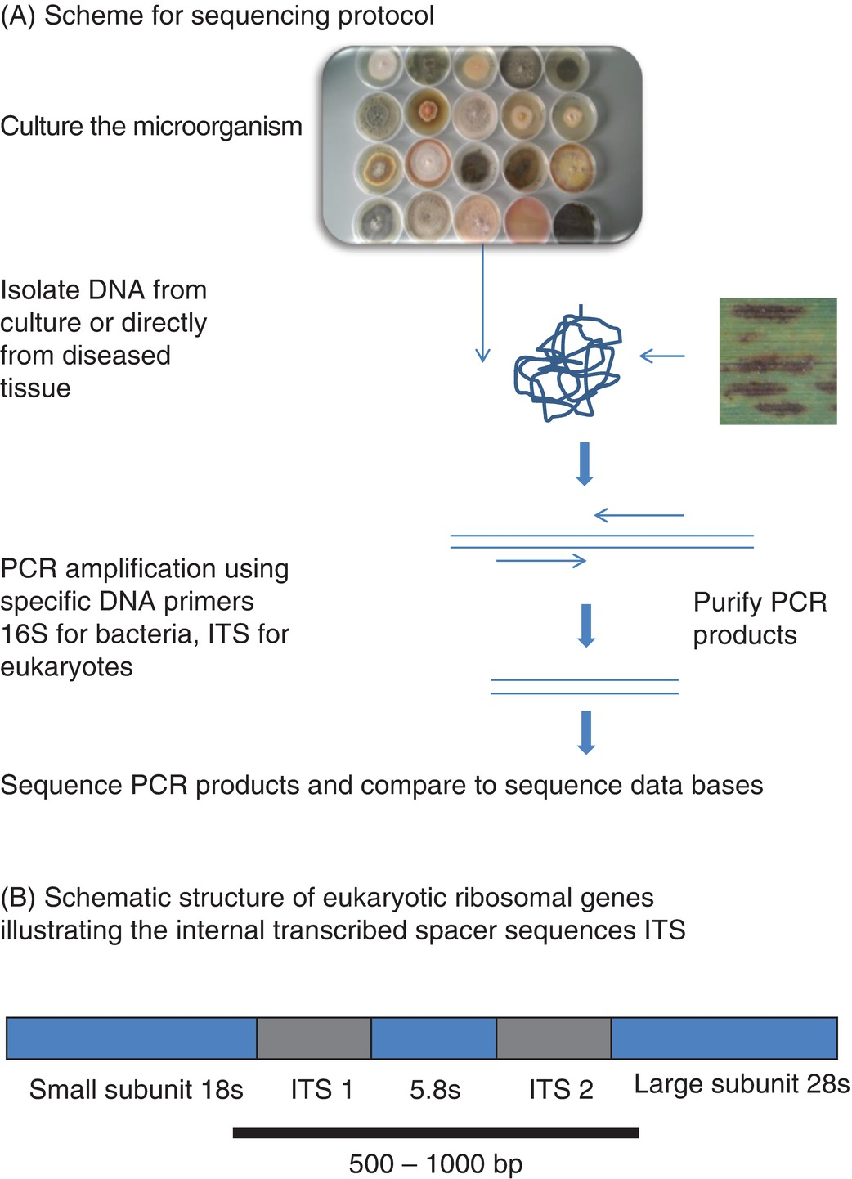
Fig. 9.7 DNA sequencing for identification of microorganisms: (A) Scheme for isolating DNA and PCR amplification of specific DNA sequences from infected plant tissue. (B) Schematic structure of eukaryotic ribosomal genes illustrating the internal transcribed spacer (ITS) sequences. (© D.B. Collinge).
Plant Pathology and Plant Diseases © Anne Marte Tronsmo, David B. Collinge, Annika Djurle, Lisa Munk, Jonathan Yuen and Arne Tronsmo 2020

Slide 18
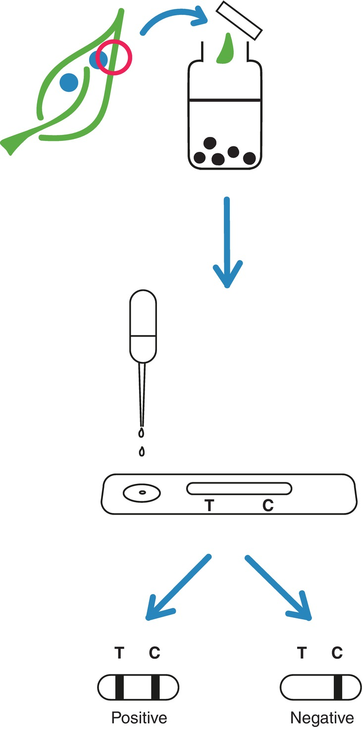
Fig. 9.8 Lateral flow device – field kit. (© L. Munk.)
Plant Pathology and Plant Diseases © Anne Marte Tronsmo, David B. Collinge, Annika Djurle, Lisa Munk, Jonathan Yuen and Arne Tronsmo 2020

