Slide 1
Plant Pathology and Plant Diseases
© Anne Marte Tronsmo, David B. Collinge, Annika Djurle, Lisa Munk, Jonathan Yuen and Arne Tronsmo 2020

Slide 2
Fig. 8.1 The body plan of a nematode is like ‘a-tube-in-a-tube’. A, stoma; b, pharynx; c, corpus; d, isthmus; e, basal bulb; f, valves; g, intestine; h, rectum; I, anus; j, gonad; k, vulva; l, vagina; m, egg; n, nerve ring; o, secretory/excretory pore. (© C. Magnusson.)
Plant Pathology and Plant Diseases © Anne Marte Tronsmo, David B. Collinge, Annika Djurle, Lisa Munk, Jonathan Yuen and Arne Tronsmo 2020

Slide 3
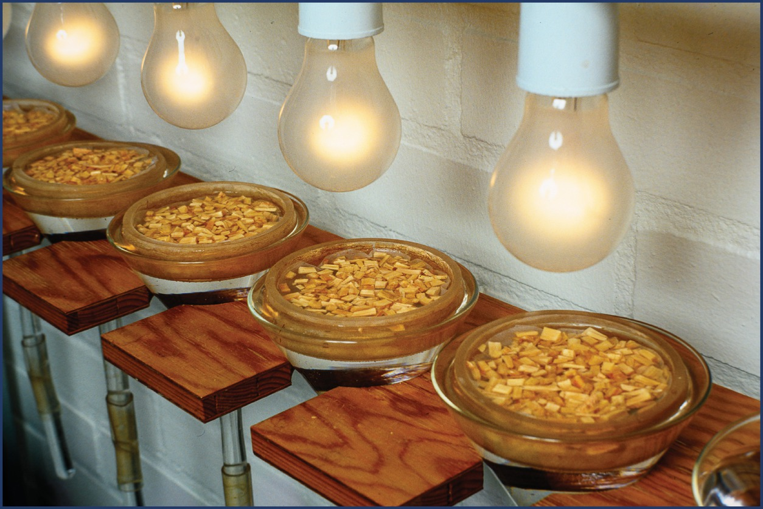
Fig. 8.2 The Baermann funnel fitted with light bulbs. Extraction of wood chips. (© C. Magnusson.)
Plant Pathology and Plant Diseases © Anne Marte Tronsmo, David B. Collinge, Annika Djurle, Lisa Munk, Jonathan Yuen and Arne Tronsmo 2020

Slide 4
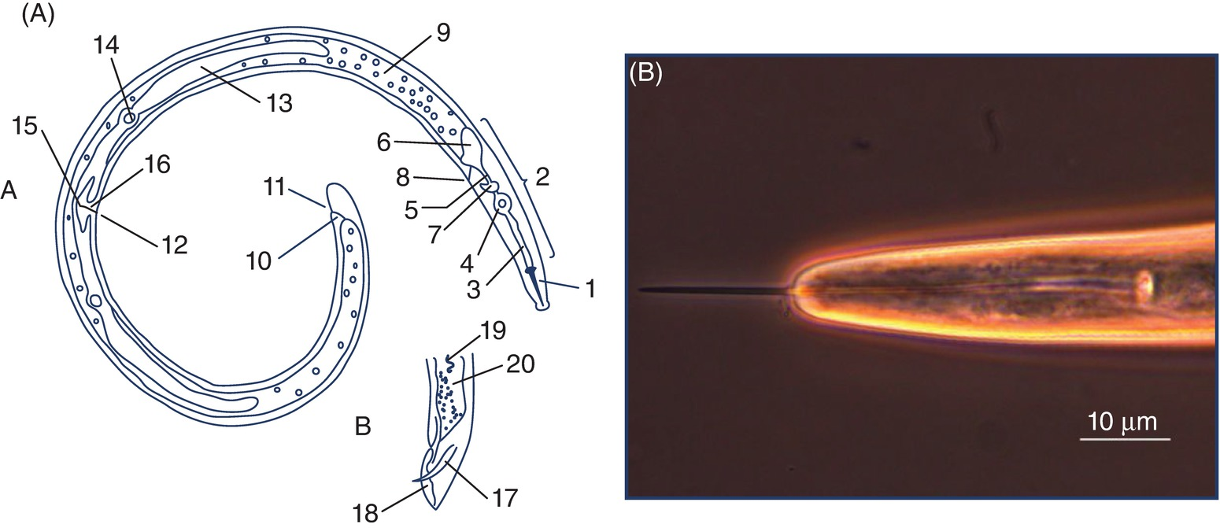
Fig. 8.3 (A) Morphology of a plant-parasitic nematode (Rotylenchus). (A), female; B, tail of male. 1, Mouth spear (stylet); 2, pharynx; 3, procorpus; 4, median bulb (metacorpus); 5, isthmus; 6, basal bulb; 7, nerve ring; 8, excretory pore; 9, intestine; 10, rectum; 11, anus; 12, vulva; 13, gonad; 14, spermatheca; 15, uterus; 16, vagina; 17, spicule; 18, bursa; 19, sperm; 20, seminal duct (vas deferens). (B) The long protruded stylet of the pin-nematode Gracilacus stræleni.
(© C. Magnusson.)
Plant Pathology and Plant Diseases © Anne Marte Tronsmo, David B. Collinge, Annika Djurle, Lisa Munk, Jonathan Yuen and Arne Tronsmo 2020

Slide 5
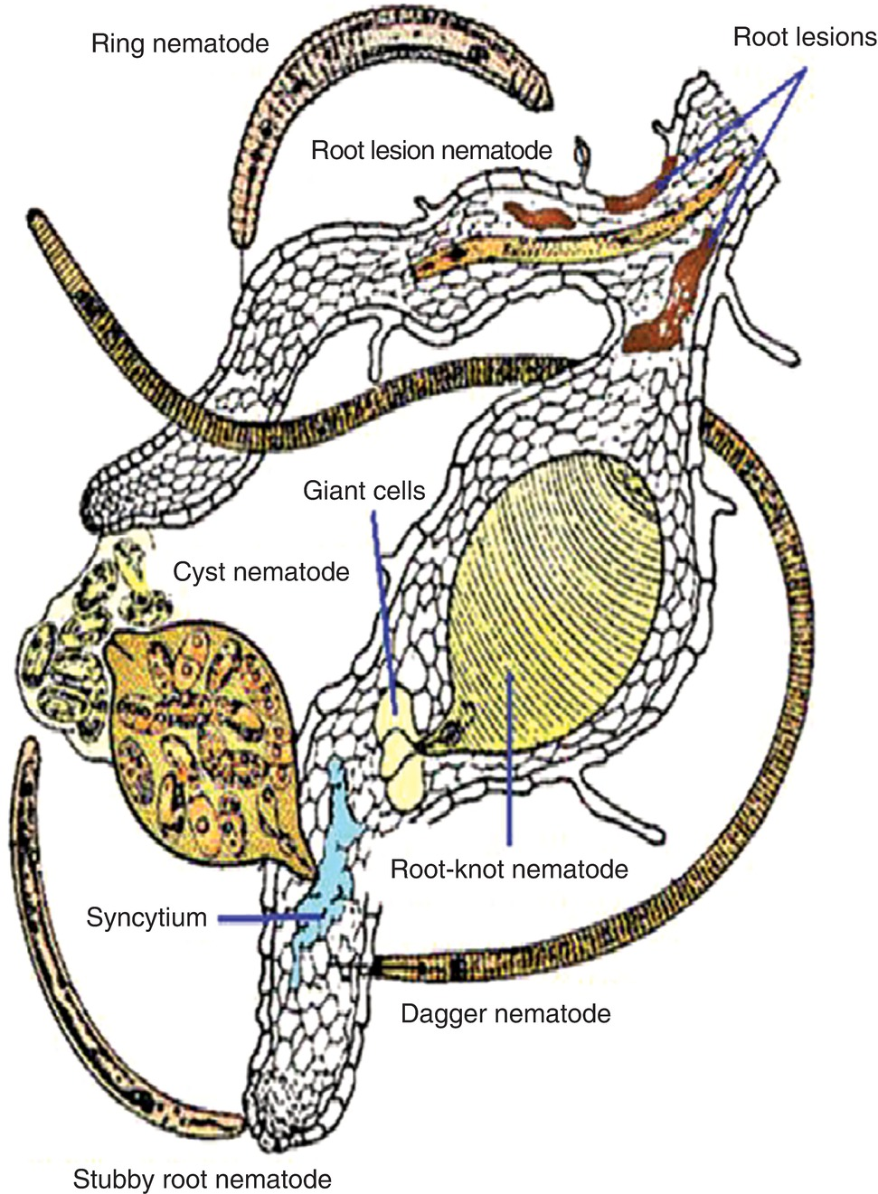
Fig. 8.4 Feeding habits of root parasitic nematodes. (© C. Magnusson.)
Plant Pathology and Plant Diseases © Anne Marte Tronsmo, David B. Collinge, Annika Djurle, Lisa Munk, Jonathan Yuen and Arne Tronsmo 2020

Slide 6
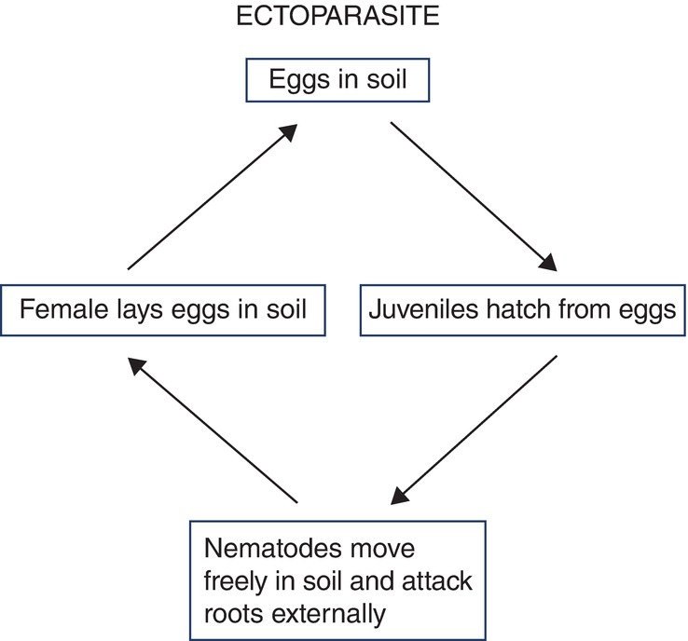
Fig. 8.5 Principal life cycle of an ectoparasitic nematode. (© C. Magnusson.)
Plant Pathology and Plant Diseases © Anne Marte Tronsmo, David B. Collinge, Annika Djurle, Lisa Munk, Jonathan Yuen and Arne Tronsmo 2020

Slide 7
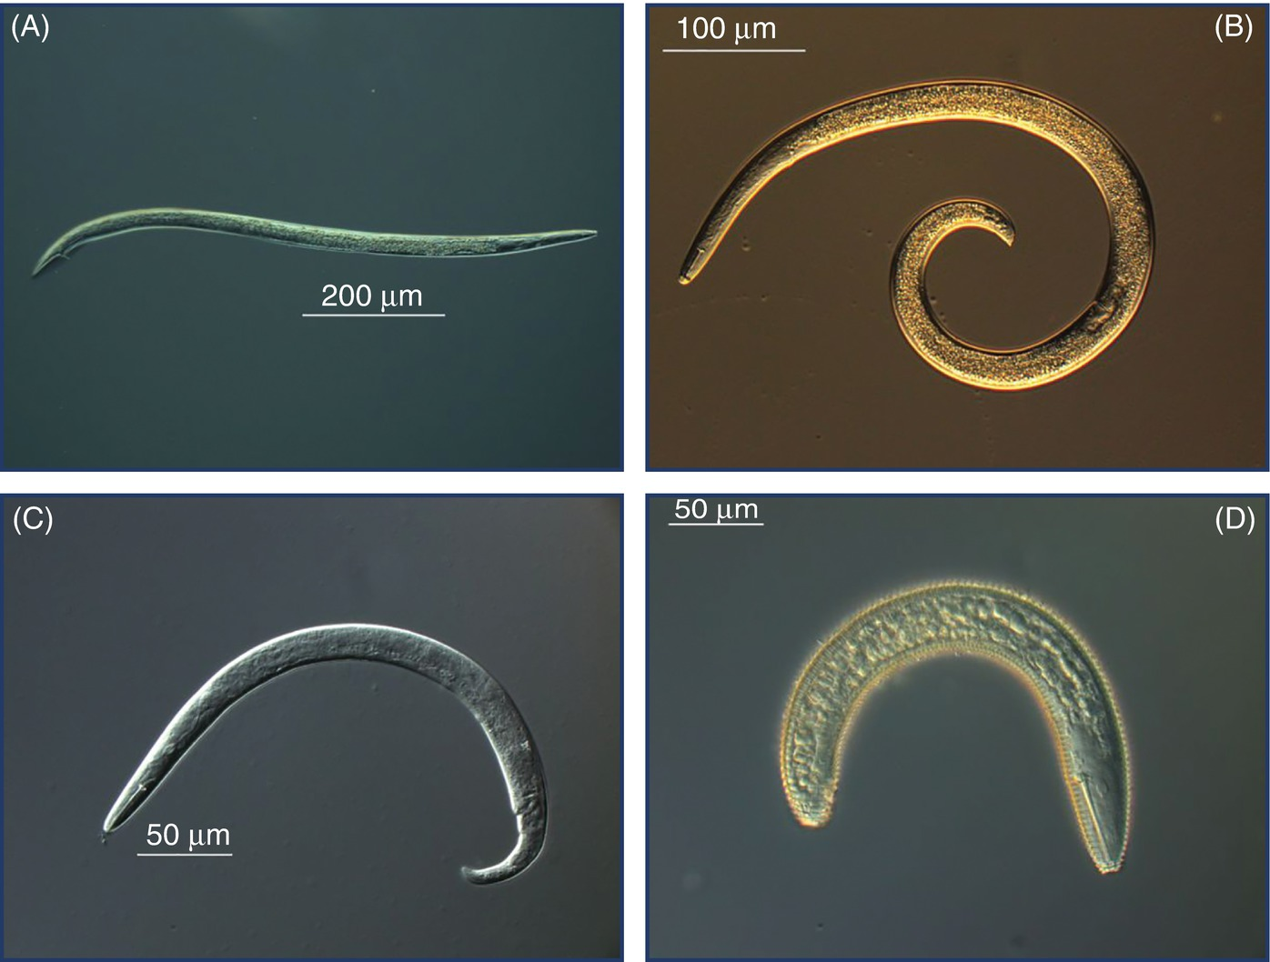
Fig. 8.6 (A) Stunt nematode Tylenchorhynchus dubius (male). (B) Spiral nematode Helicotylenchus pseudorobustus. (C) Pin nematode Paratylenchus projectus. (D) Ring nematode Macroposthonia sp. (© C. Magnusson.)
Plant Pathology and Plant Diseases © Anne Marte Tronsmo, David B. Collinge, Annika Djurle, Lisa Munk, Jonathan Yuen and Arne Tronsmo 2020

Slide 8
Fig. 8.7 A-B (A) Stubby-root nematode Paratrichodorus minor on a blueberry root. (B) Needle nematode Longidorus elongates under the stereo microscope. (A: © Phytopathology; B: B. Hammeraas © NIBIO.)
Plant Pathology and Plant Diseases © Anne Marte Tronsmo, David B. Collinge, Annika Djurle, Lisa Munk, Jonathan Yuen and Arne Tronsmo 2020

Slide 9
Fig. 8.7 C (C) Dagger nematode Xiphinema diversicaudatum juvenile. Note the dagger- like stylet. (M. P. Tangvik © NIBIO.)
Plant Pathology and Plant Diseases © Anne Marte Tronsmo, David B. Collinge, Annika Djurle, Lisa Munk, Jonathan Yuen and Arne Tronsmo 2020

Slide 10
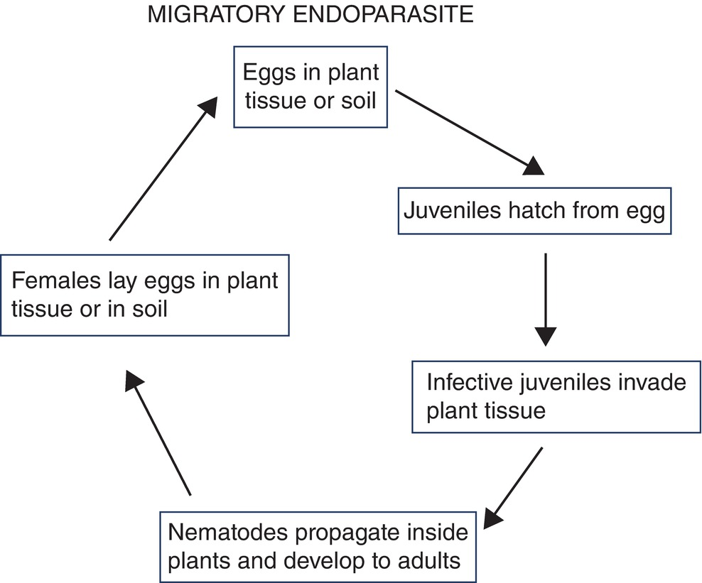
Fig. 8.8 Principal life cycle of a migratory endoparasitic nematode. (© C. Magnusson.)
Plant Pathology and Plant Diseases © Anne Marte Tronsmo, David B. Collinge, Annika Djurle, Lisa Munk, Jonathan Yuen and Arne Tronsmo 2020

Slide 11
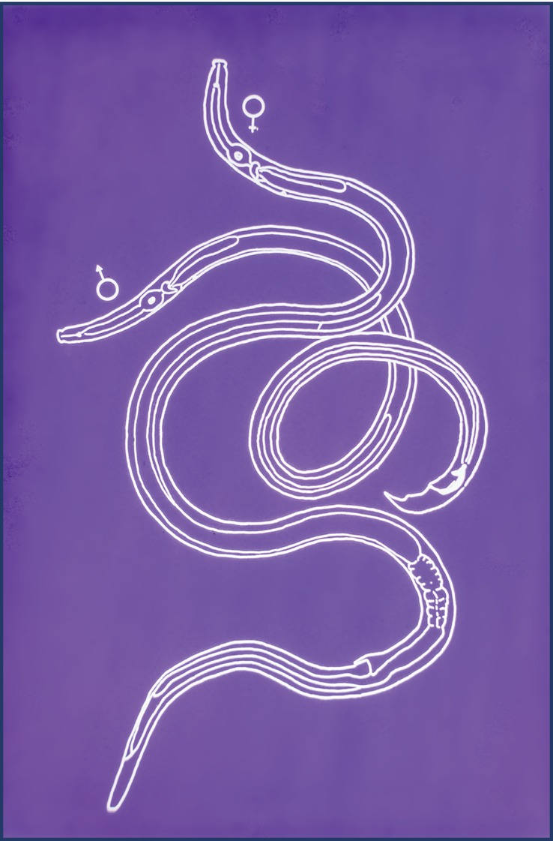
Fig. 8.9 Pine wood nematode Bursaphelenchus xylophilus. Adult stages (Length 0.8 mm). (© C. Magnusson.)
Plant Pathology and Plant Diseases © Anne Marte Tronsmo, David B. Collinge, Annika Djurle, Lisa Munk, Jonathan Yuen and Arne Tronsmo 2020

Slide 12
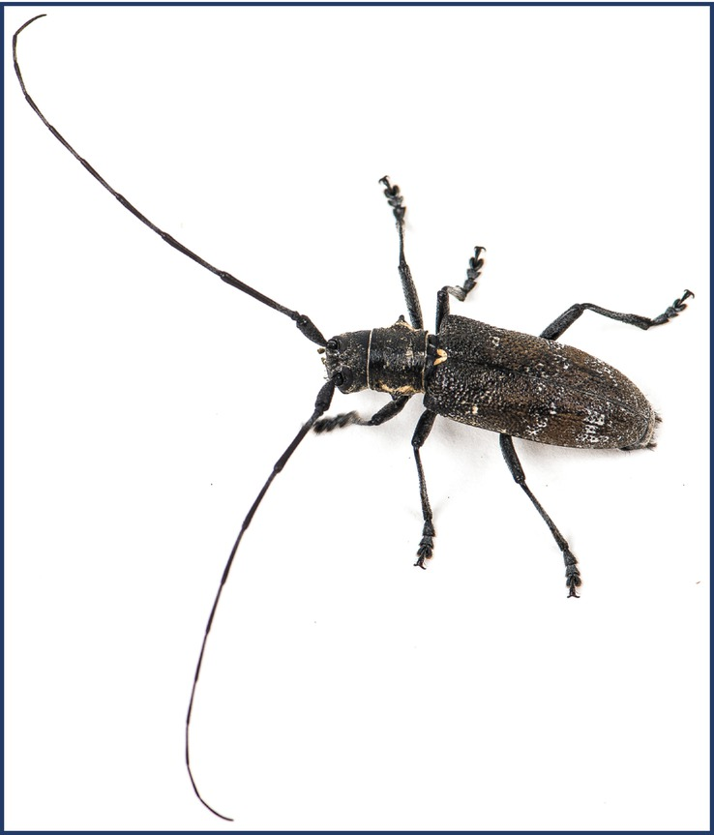
Fig. 8.10 The pine sawyer beetle Monochamus galloprovincialis, a vector of Bursaphelenchus xylophilus. (E. Fløistad © NIBIO.)
Plant Pathology and Plant Diseases © Anne Marte Tronsmo, David B. Collinge, Annika Djurle, Lisa Munk, Jonathan Yuen and Arne Tronsmo 2020

Slide 13
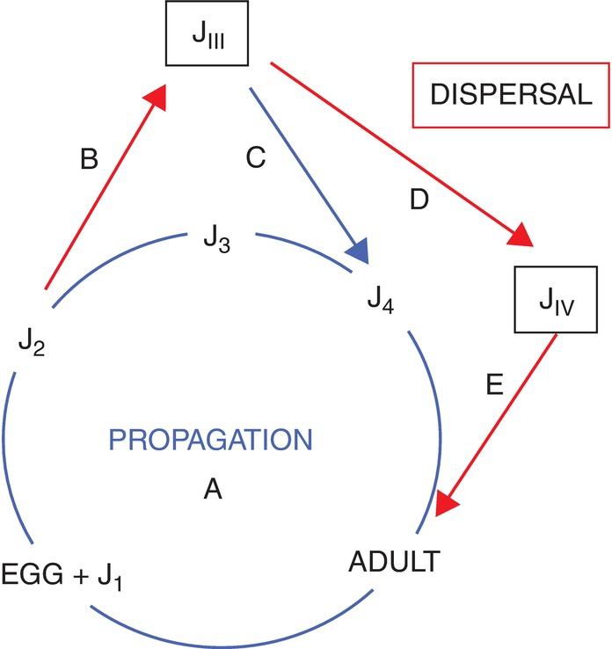
Fig. 8.11 Life cycle strategies of the pine wood nematode Bursaphelenchus xylophilus. (© C. Magnusson.)
Plant Pathology and Plant Diseases © Anne Marte Tronsmo, David B. Collinge, Annika Djurle, Lisa Munk, Jonathan Yuen and Arne Tronsmo 2020

Slide 14
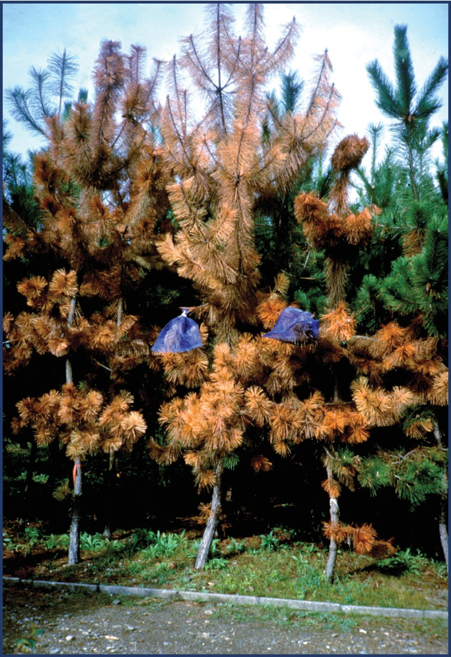
Fig. 8.12 Pine trees killed by pine wood nematode (PWN) Bursaphelenchus xylophilus transmitted by Monochamus alternatus (blue net bags). (© C. Magnusson.)
Plant Pathology and Plant Diseases © Anne Marte Tronsmo, David B. Collinge, Annika Djurle, Lisa Munk, Jonathan Yuen and Arne Tronsmo 2020

Slide 15
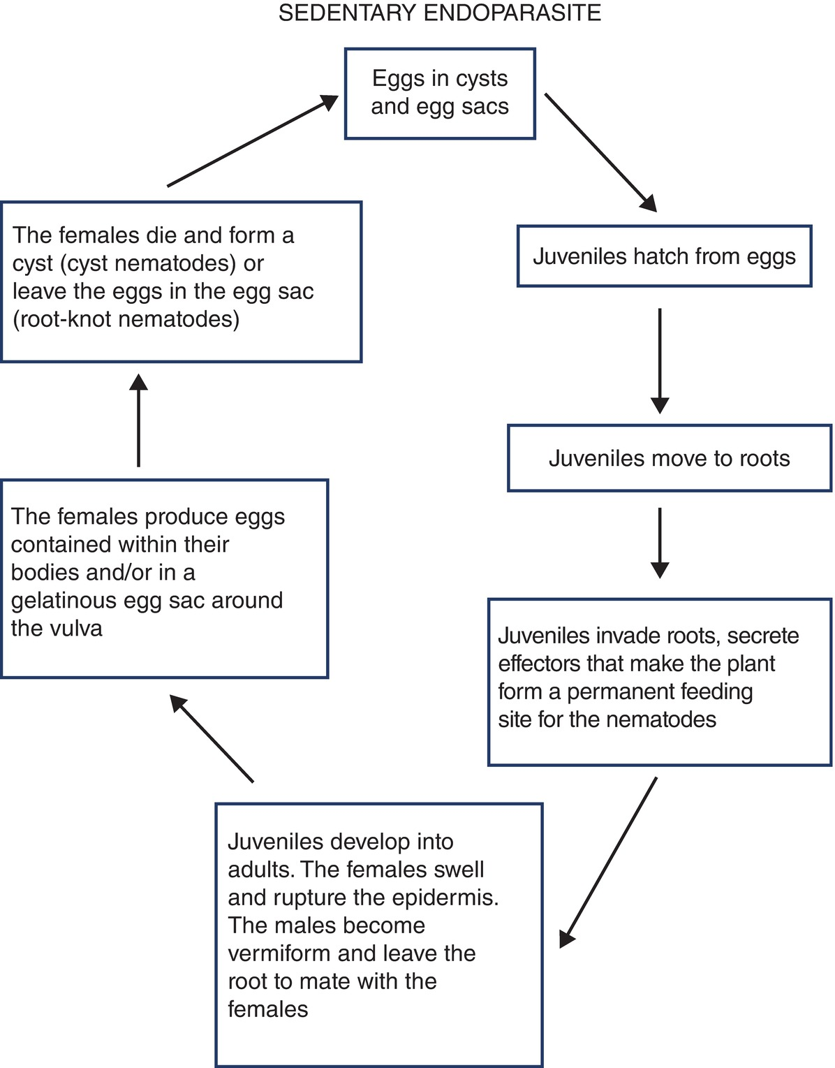
Fig. 8.13 Principal life cycle of sedentary endoparasitic nematode. (© C. Magnusson.)
Plant Pathology and Plant Diseases © Anne Marte Tronsmo, David B. Collinge, Annika Djurle, Lisa Munk, Jonathan Yuen and Arne Tronsmo 2020

Slide 16
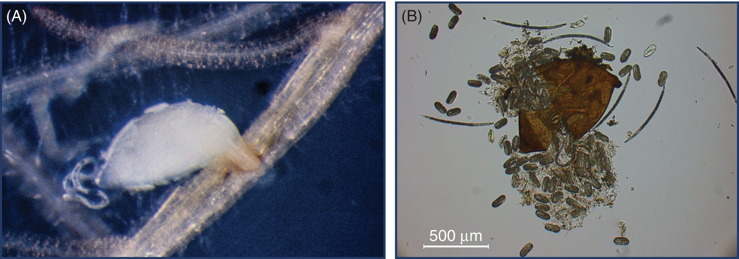
Fig. 8.14 (A) Mating in beet cyst nematode Heterodera schachtii. (B) Cyst of Heterodera trifolii crushed to show eggs and juveniles. (© C. Magnusson.)
Plant Pathology and Plant Diseases © Anne Marte Tronsmo, David B. Collinge, Annika Djurle, Lisa Munk, Jonathan Yuen and Arne Tronsmo 2020

Slide 17
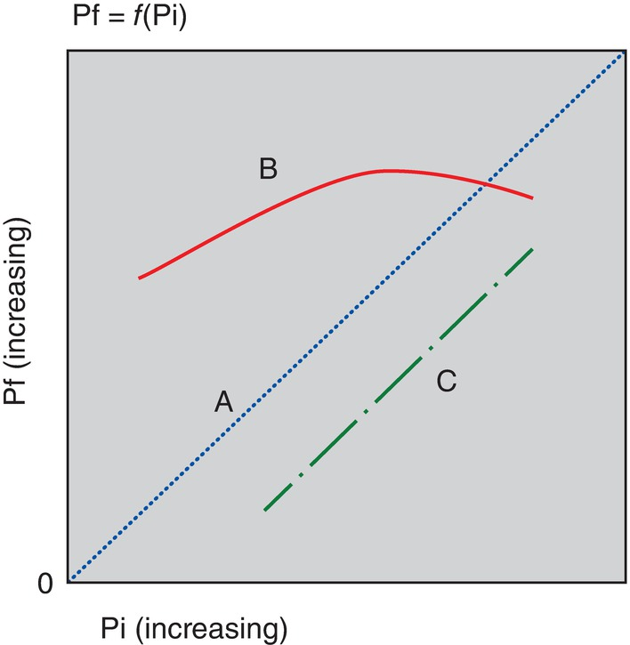
Fig. 8.15 The relationship between the final nematode population (Pf) and the initial nematode population (Pi). (L.O. Brandsaeter. © NIBIO.)
Plant Pathology and Plant Diseases © Anne Marte Tronsmo, David B. Collinge, Annika Djurle, Lisa Munk, Jonathan Yuen and Arne Tronsmo 2020

Slide 18
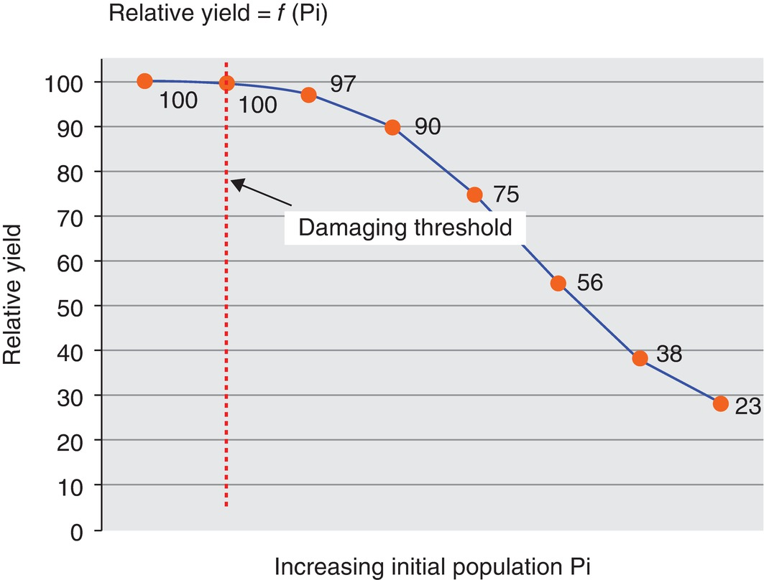
Fig. 8.16 Damage threshold. The relationship between the relative yield of a crop and the initial nematode population density (Pi). (L.O. Brandsaeter. © NIBIO.)
Plant Pathology and Plant Diseases © Anne Marte Tronsmo, David B. Collinge, Annika Djurle, Lisa Munk, Jonathan Yuen and Arne Tronsmo 2020

Slide 19
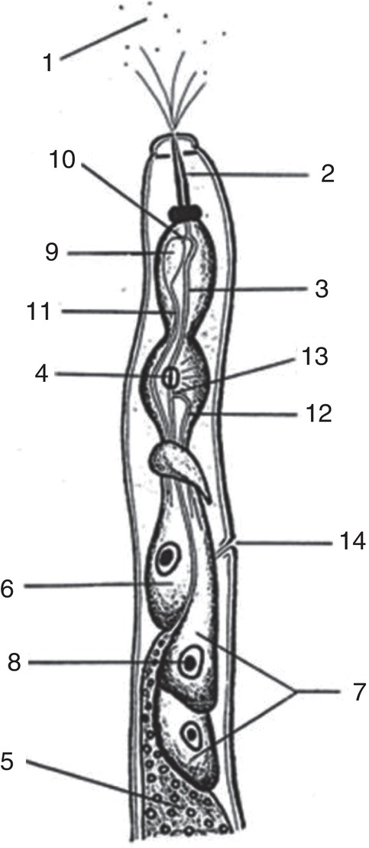
Fig. 8.17 The anterior part (pharyngeal region) of a plant-parasitic nematode. 1, Effector peptids; 2, stylet; 3, pharyngeal lumen; 4, valves of median bulb; 5, intestine; 6, dorsal pharyngeal gland; 7, subventral pharyngeal glands; 8, nucleus; 9, ampulla for effector peptides; 10, dorsal pharyngeal gland outlet; 11, duct of dorsal pharyngeal gland; 12, duct of subventral pharyngeal glands; 13, subventral pharyngeal gland outlet; 14, secretory/excretory pore. (© C. Magnusson.)
Plant Pathology and Plant Diseases © Anne Marte Tronsmo, David B. Collinge, Annika Djurle, Lisa Munk, Jonathan Yuen and Arne Tronsmo 2020

Slide 20
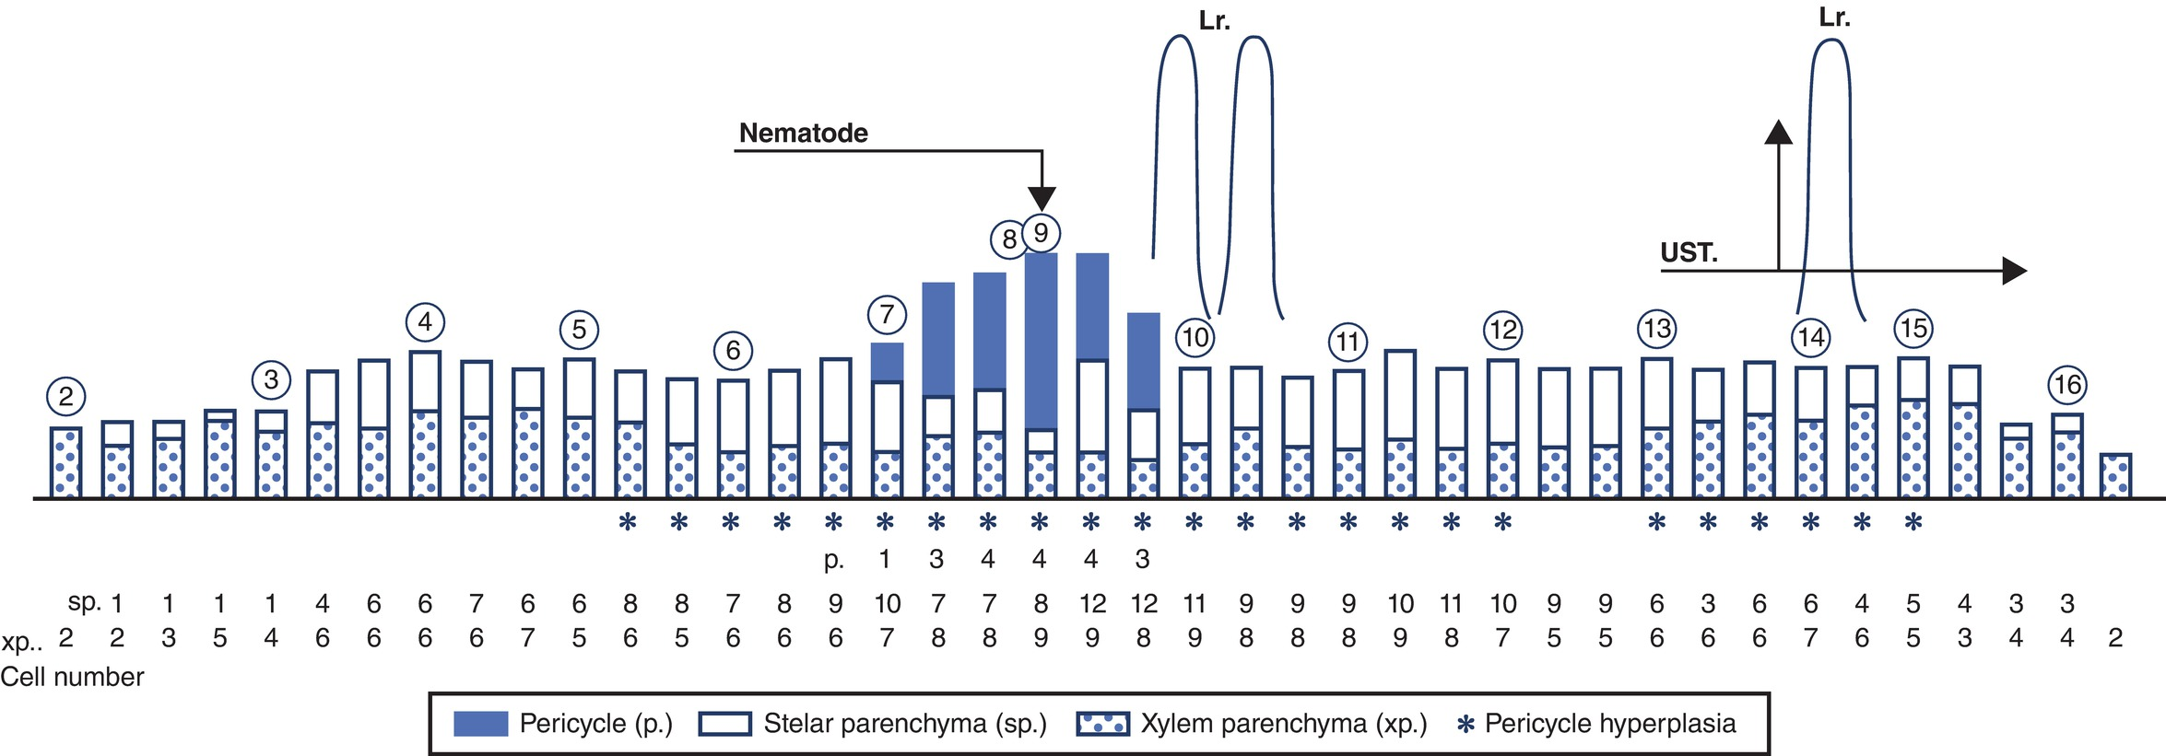
Fig. 8.18 Profile of a 5-day-old syncytium induced by beet cyst nematode Heterodera schachtii in a root of rape. (© C. Magnusson.)
Plant Pathology and Plant Diseases © Anne Marte Tronsmo, David B. Collinge, Annika Djurle, Lisa Munk, Jonathan Yuen and Arne Tronsmo 2020

Slide 21
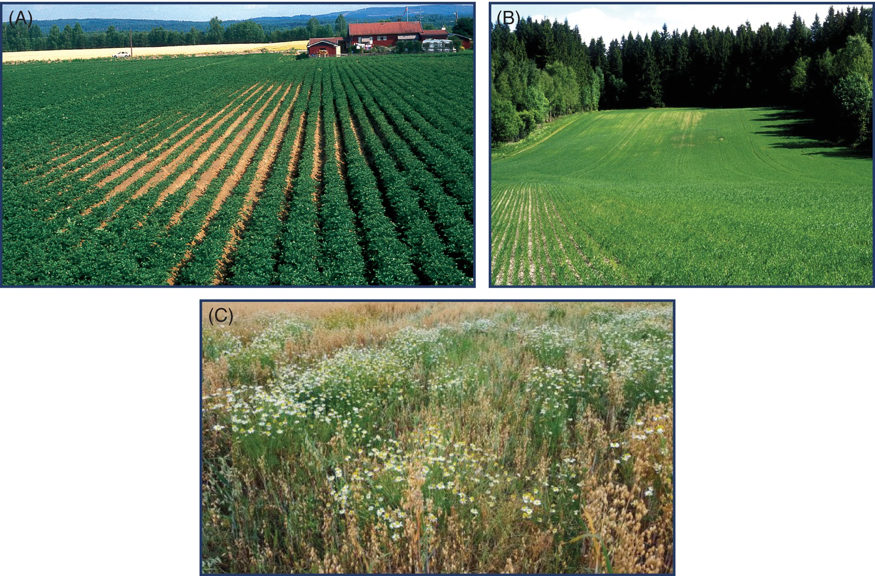
Fig. 8.19 (A) Patch caused by root-lesion nematode Pratylenchus penetrans in potato. (B) Cereals attacked by cereal cyst nematode (Heterodera avenae). (C) An oat crop infested by the cereal cyst nematode (Heterodera avenae) causing an outburst of weeds. (A, B: B. Hammeraas © NIBIO; C: C. Magnusson,© NIBIO.)
Plant Pathology and Plant Diseases © Anne Marte Tronsmo, David B. Collinge, Annika Djurle, Lisa Munk, Jonathan Yuen and Arne Tronsmo 2020

Slide 22
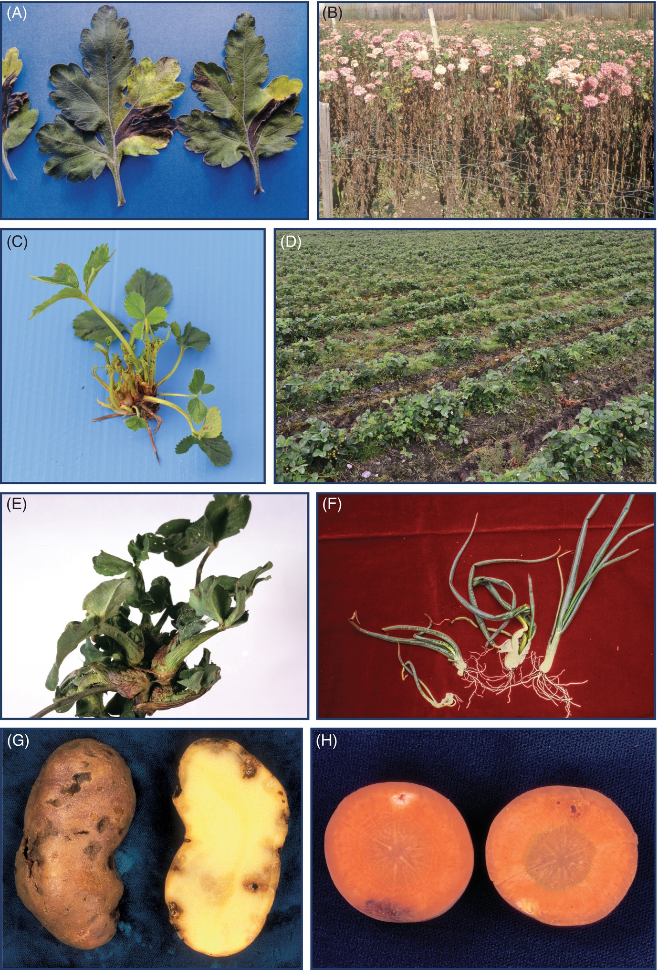
Fig. 8.20 A-D (A) Chrysanthemum leaf nematode Aphelenchoides rhizemabosi damage on leaves. (B) A. rhizemabosi damage to field grown plants. (C) A. fragariae damage on strawberry plants. (D) A. fragariae field damage in strawberry. (A: © CABI; B: B. Hammeraas © NIBIO; C-D: A. Døving © NIBIO.)
Plant Pathology and Plant Diseases © Anne Marte Tronsmo, David B. Collinge, Annika Djurle, Lisa Munk, Jonathan Yuen and Arne Tronsmo 2020

Slide 23
Fig. 8.20 E-H (E) Stem nematode Ditylenchus dipsaci on red clover. (F) Stem nematode Ditylenchus dipsaci on onion. (G) Potato rot nematode Ditylenchus destructor on potato. (H) Potato rot nematode D. destructor on carrot. (E: G. Taksdal © NIBIO; F, G, H: B. Hammeraas © NIBIO.)
Plant Pathology and Plant Diseases © Anne Marte Tronsmo, David B. Collinge, Annika Djurle, Lisa Munk, Jonathan Yuen and Arne Tronsmo 2020

Slide 24
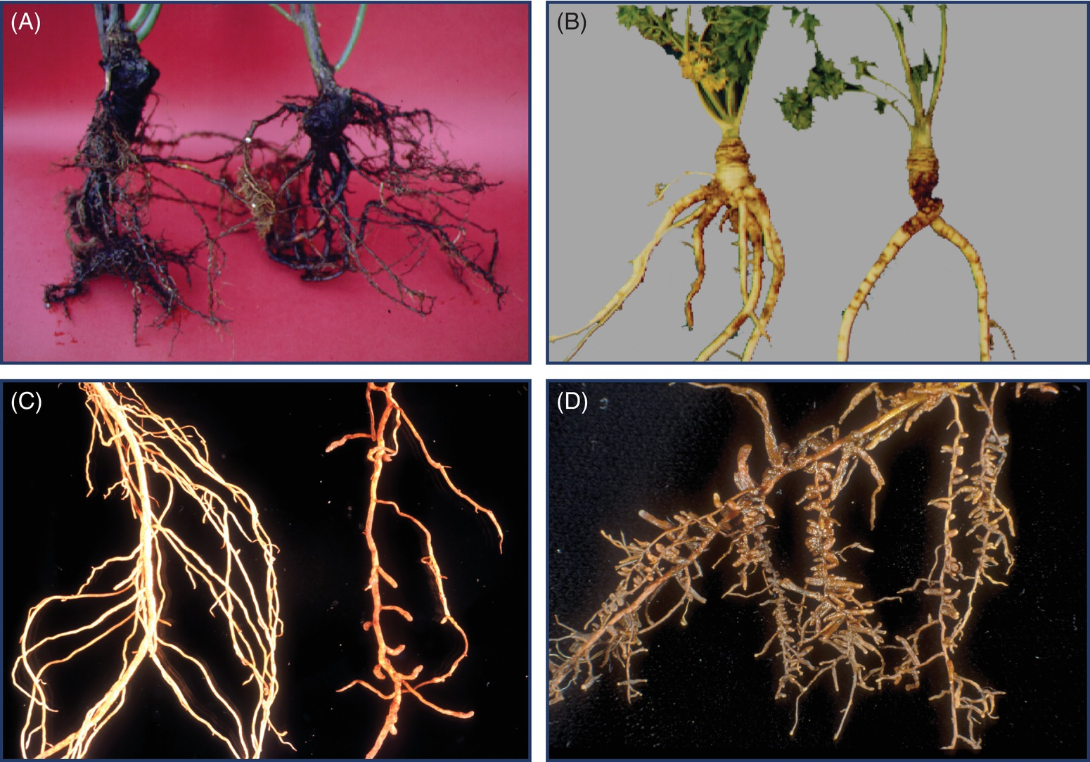
Fig. 8.21 (A) Damage from the ‘peat nematode’ Cephalenchus hexalineatus on roses. (B) The pin nematode Paratylenchus bukowinensis on celeriac. (C) Strawberry attacked by the needle nematode Longidorus elongates. Left, healthy root; right, damaged root showing root clubs. (D) Dagger nematode (Xiphinema diversicaudatum) on apple. (A-D: B. Hammeraas © NIBIO.)
Plant Pathology and Plant Diseases © Anne Marte Tronsmo, David B. Collinge, Annika Djurle, Lisa Munk, Jonathan Yuen and Arne Tronsmo 2020

Slide 25
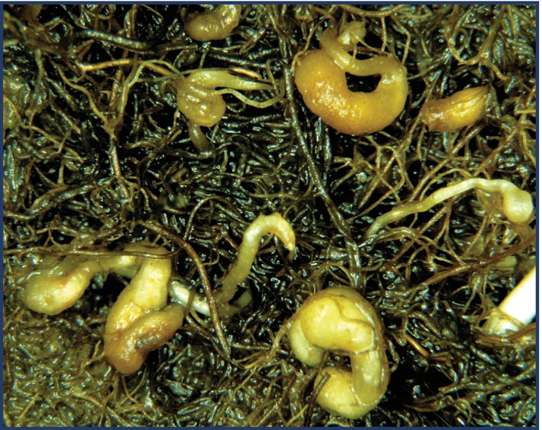
Fig. 8.22 Root galls of Subanguina radicicola on Poa pratensis.
(B. Hammeraas © NIBIO.)
Plant Pathology and Plant Diseases © Anne Marte Tronsmo, David B. Collinge, Annika Djurle, Lisa Munk, Jonathan Yuen and Arne Tronsmo 2020

Slide 26
Fig. 8.23 A-B (A) Pratylenchus sp. on chrysanthemum. (B) Root lesions caused by Pratylenchus penetrans on stolon of potato. (B. Hammeraas © NIBIO.)
Plant Pathology and Plant Diseases © Anne Marte Tronsmo, David B. Collinge, Annika Djurle, Lisa Munk, Jonathan Yuen and Arne Tronsmo 2020

Slide 27
Fig. 8.23 C (C) Skin lesions caused by P. penetrans on potato tuber. (B. Hammeraas © NIBIO.)
Plant Pathology and Plant Diseases © Anne Marte Tronsmo, David B. Collinge, Annika Djurle, Lisa Munk, Jonathan Yuen and Arne Tronsmo 2020

Slide 28
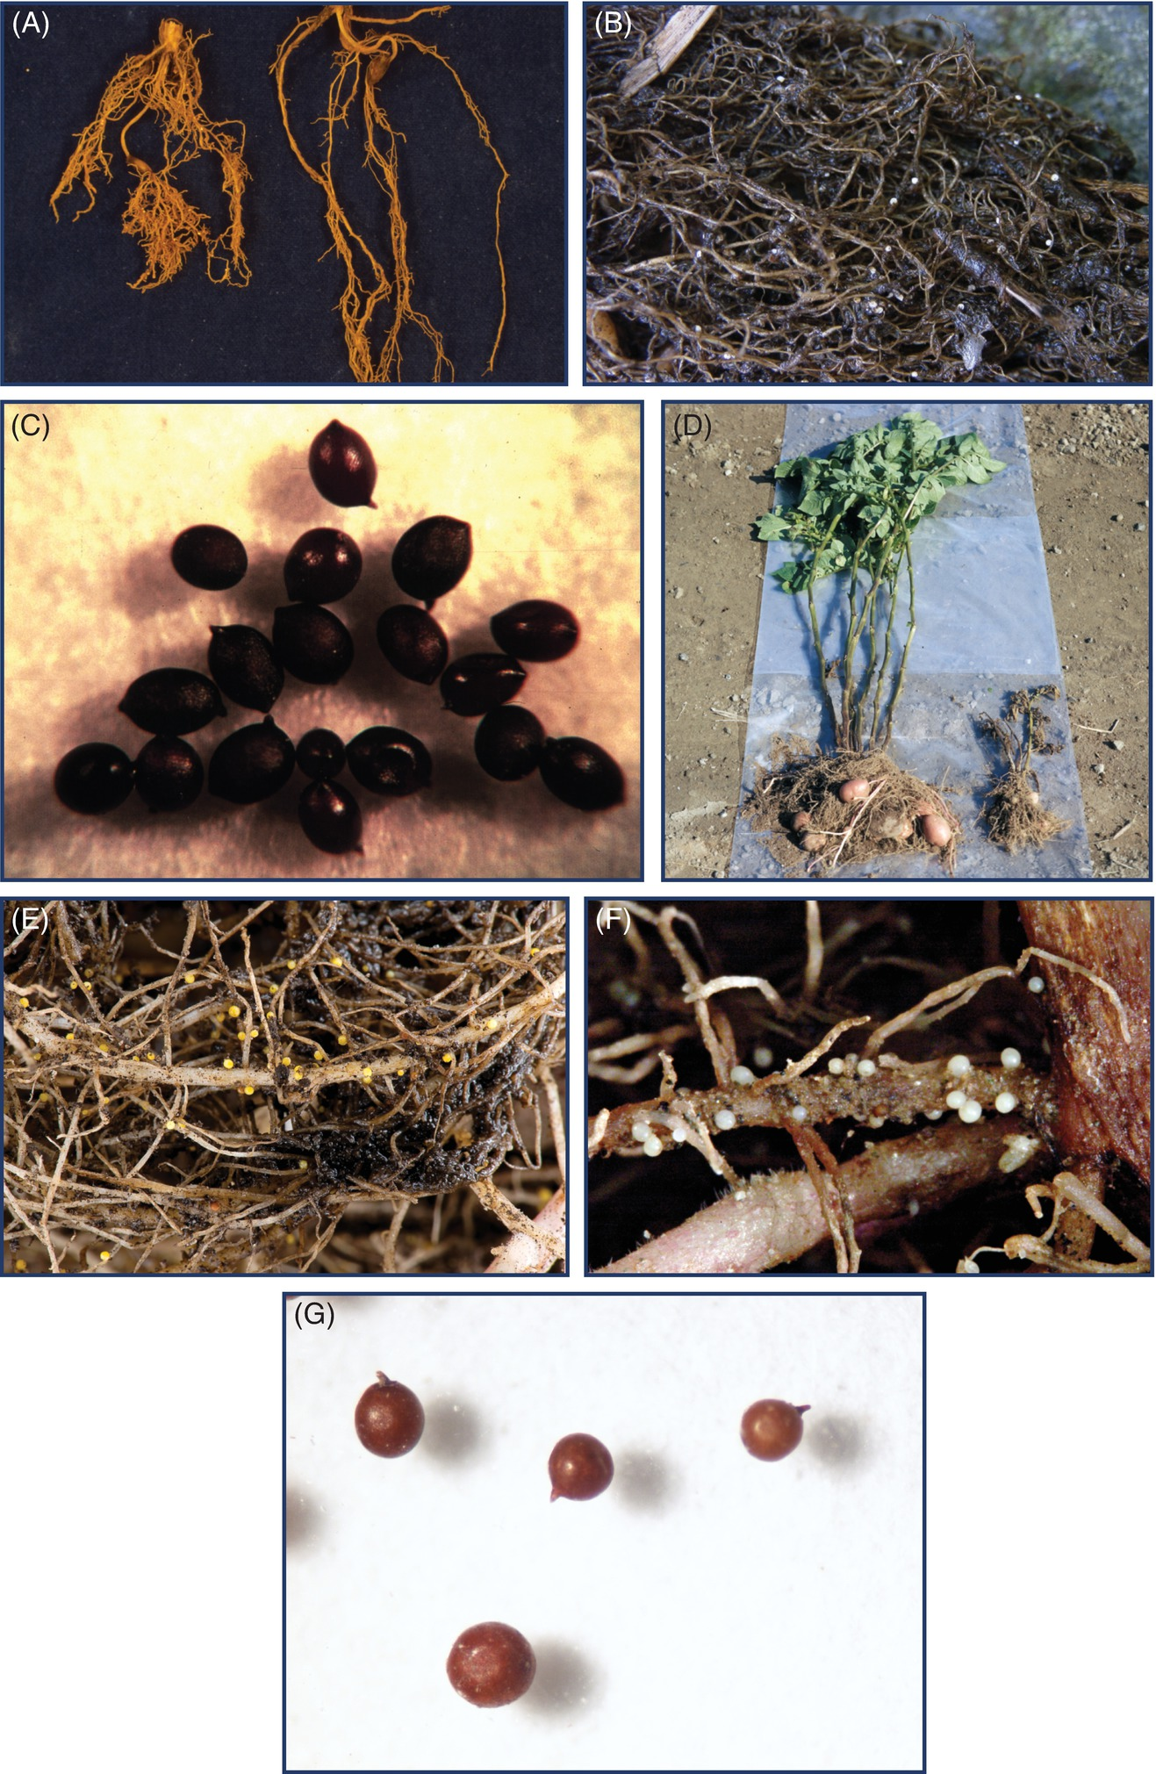
Fig. 8.24 A-D (A) Roots of oat infected by the cereal cyst nematode Heterodera avenae. (B) White females of cereal cyst nematode H. avenae on roots of oat. (C) Cysts of cereal cyst nematode (H. avenae). (D) Potato cyst nematode Globodera rostochiensis on potato.
(A, D: B. Hammeraas © NIBIO; B: ©J.I. Øverland. N.L.R. Viken; C: © J. Rowe Rothamstead Experimental Station UK.)
Plant Pathology and Plant Diseases © Anne Marte Tronsmo, David B. Collinge, Annika Djurle, Lisa Munk, Jonathan Yuen and Arne Tronsmo 2020

Slide 29
Fig. 8.24 E-G (E) The yellow potato cyst nematode G. rostochienis on potato roots. (F) White potato cyst nematode Globodera pallida on potato roots. (G) Brown cysts of potato cyst nematode. (E, F: B. Hammeraas © NIBIO; G: J. Luimes © EPPO Bulletin.)
Plant Pathology and Plant Diseases © Anne Marte Tronsmo, David B. Collinge, Annika Djurle, Lisa Munk, Jonathan Yuen and Arne Tronsmo 2020

Slide 30
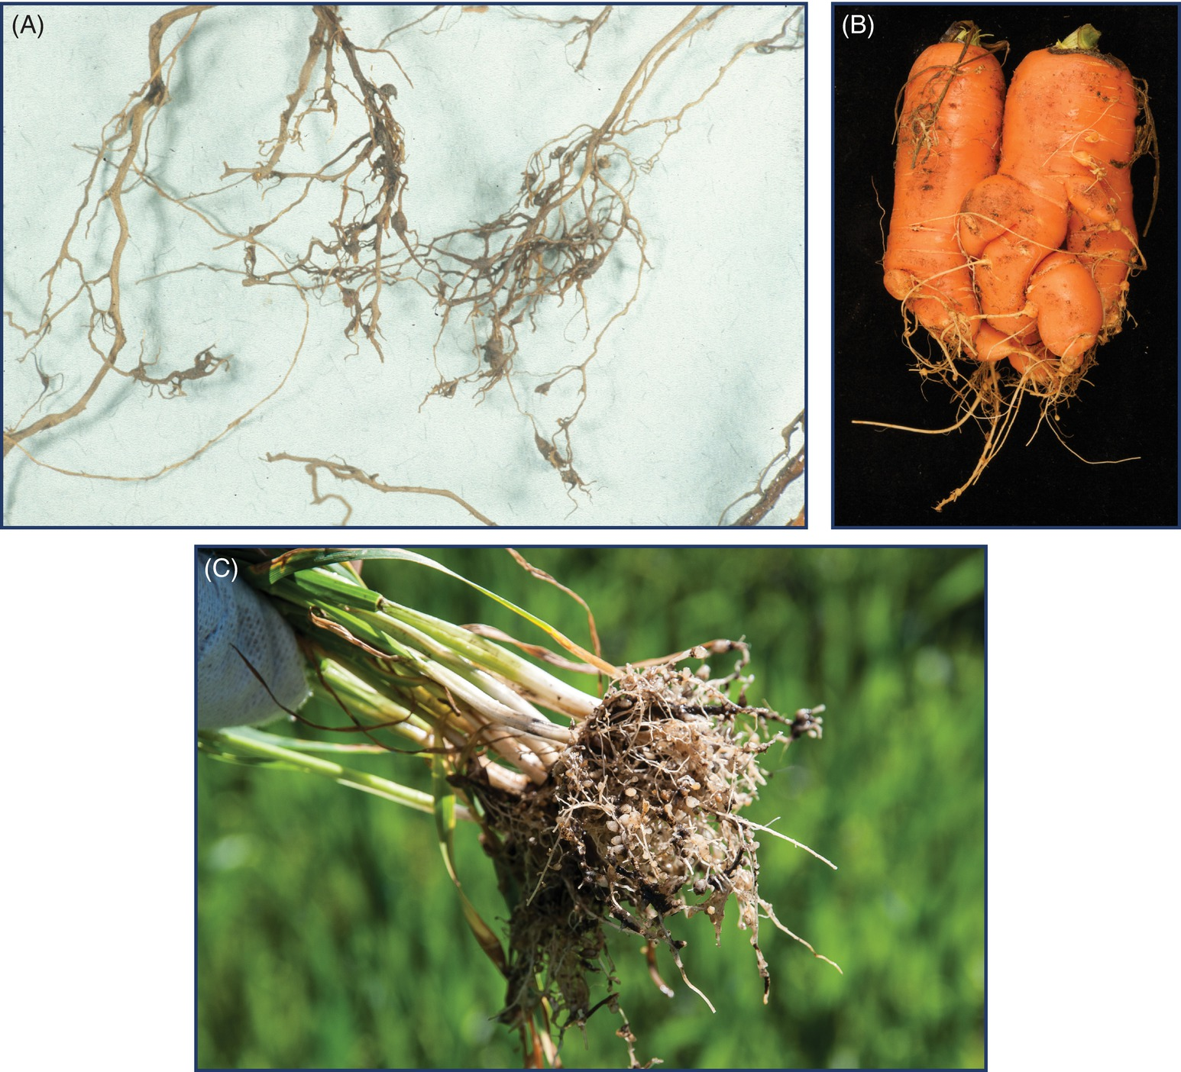
Fig. 8.25 A-B (A) Root-knot nematode Meloidogyne hapla root galls on roses. (B) M. hapla on carrot causing deformation and galling. (A: B. Hammeraas © NIBIO B: M.P.Tangvik © NIBIO.)
Plant Pathology and Plant Diseases © Anne Marte Tronsmo, David B. Collinge, Annika Djurle, Lisa Munk, Jonathan Yuen and Arne Tronsmo 2020

Slide 31
Fig. 8.25C Meloidogyne naasi on summer wheat. (E. Fløistad © NIBIO.)
Plant Pathology and Plant Diseases © Anne Marte Tronsmo, David B. Collinge, Annika Djurle, Lisa Munk, Jonathan Yuen and Arne Tronsmo 2020

Slide 32
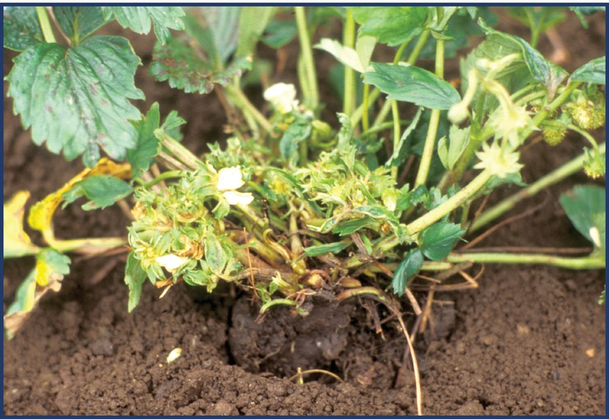
Fig. 8.26 Cauliflower disease of strawberry caused by the interaction between Aphelenchoides fragariae and the bacterium Rhodococcus fascians. (B. Hammeraas © NIBIO.)
Plant Pathology and Plant Diseases © Anne Marte Tronsmo, David B. Collinge, Annika Djurle, Lisa Munk, Jonathan Yuen and Arne Tronsmo 2020

