Slide 1
Plant Pathology and Plant Diseases
© Anne Marte Tronsmo, David B. Collinge, Annika Djurle, Lisa Munk, Jonathan Yuen and Arne Tronsmo 2020

Slide 2
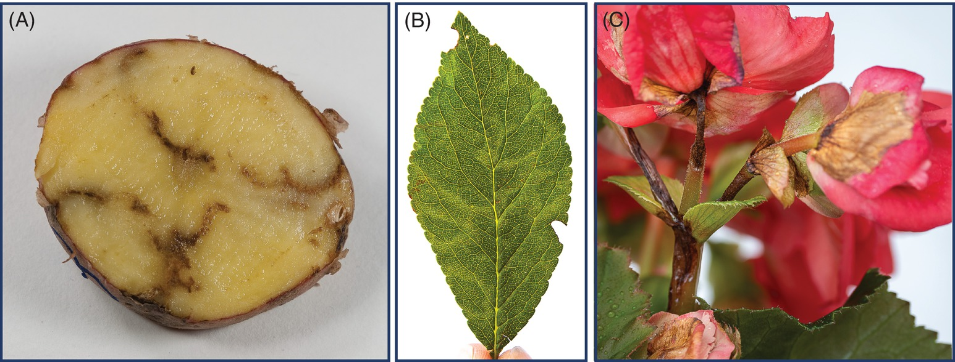
Fig. 7.1 Examples of virus-induced symptoms. (A) Tobacco rattle virus. (B) Plum pox virus in plum. (C) Necrosis and mosaic in begonia flowers caused by Impatience necrotic spot virus. (© D-R. Blystad.)
Plant Pathology and Plant Diseases © Anne Marte Tronsmo, David B. Collinge, Annika Djurle, Lisa Munk, Jonathan Yuen and Arne Tronsmo 2020

Slide 3
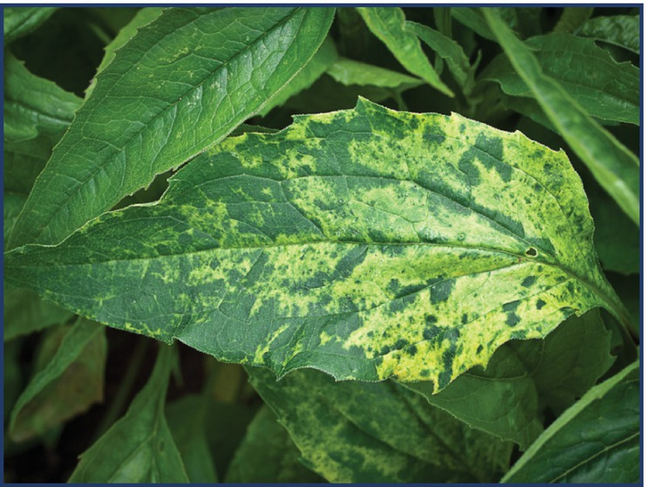
Fig. 7.2 Cucumber mosaic virus causing yellow mosaic in Echinacea purpurea. (© D-R. Blystad.)
Plant Pathology and Plant Diseases © Anne Marte Tronsmo, David B. Collinge, Annika Djurle, Lisa Munk, Jonathan Yuen and Arne Tronsmo 2020

Slide 4
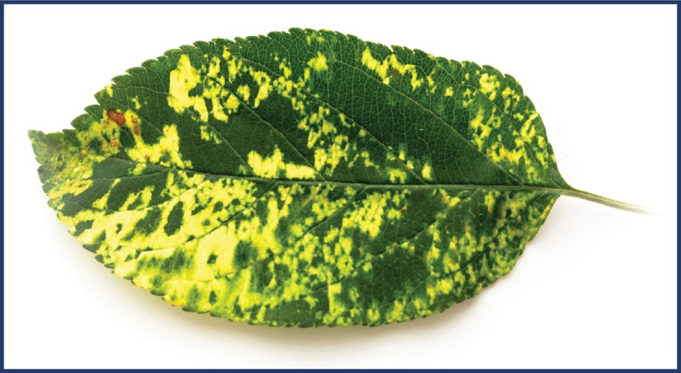
Fig. 7.3 Apple mosaic virus giving typical symptoms in apple leaves. (© D-R. Blystad.)
Plant Pathology and Plant Diseases © Anne Marte Tronsmo, David B. Collinge, Annika Djurle, Lisa Munk, Jonathan Yuen and Arne Tronsmo 2020

Slide 5
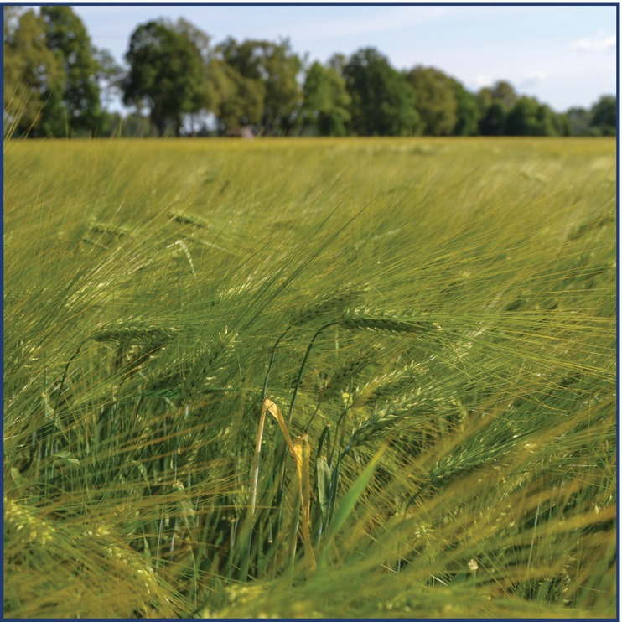
Fig. 7.4 Yellow leaves on barley caused by the luteovirus barley yellow dwarf virus. (© A. Kvarnheden.)
Plant Pathology and Plant Diseases © Anne Marte Tronsmo, David B. Collinge, Annika Djurle, Lisa Munk, Jonathan Yuen and Arne Tronsmo 2020

Slide 6
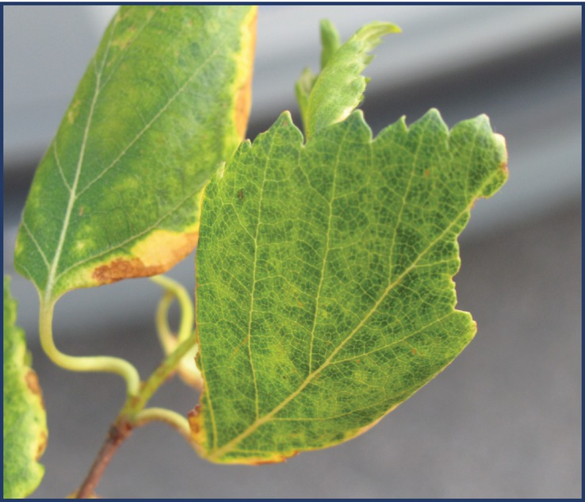
Fig. 7.5 A nepovirus – cherry leafroll virus – is associated with mosaic in birch. (© J. Valkonen.)
Plant Pathology and Plant Diseases © Anne Marte Tronsmo, David B. Collinge, Annika Djurle, Lisa Munk, Jonathan Yuen and Arne Tronsmo 2020

Slide 7
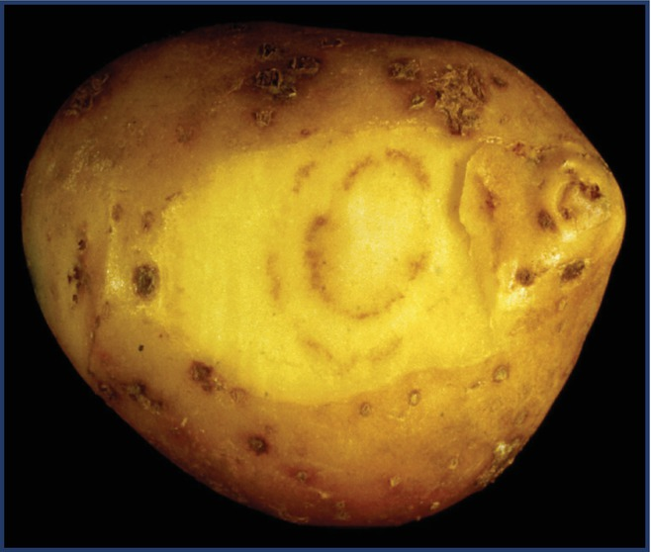
Fig. 7.6 Brown arches and spots (spraing) in potato tubers caused by potato mop-top virus.
(T. Munthe © NIBIO.)
Plant Pathology and Plant Diseases © Anne Marte Tronsmo, David B. Collinge, Annika Djurle, Lisa Munk, Jonathan Yuen and Arne Tronsmo 2020

Slide 8
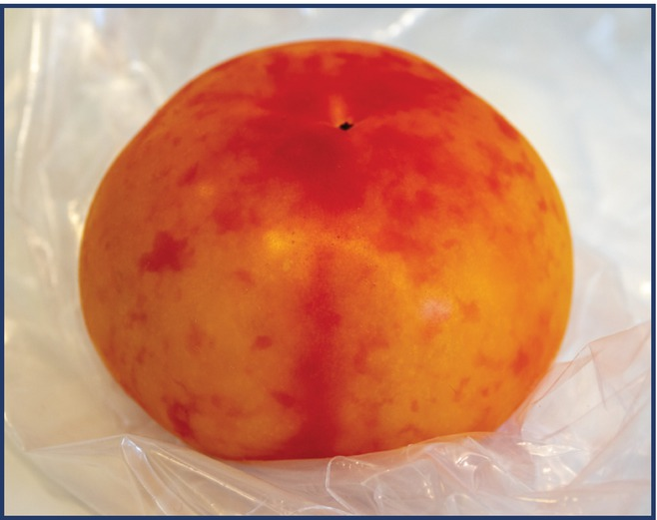
Fig. 7.7 Pepino mosaic virus giving yellow spots and mosaic in tomato. (© D-R. Blystad.)
Plant Pathology and Plant Diseases © Anne Marte Tronsmo, David B. Collinge, Annika Djurle, Lisa Munk, Jonathan Yuen and Arne Tronsmo 2020

Slide 9
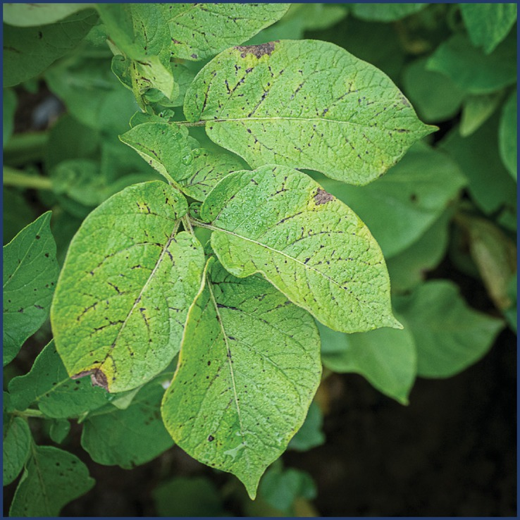
Fig. 7.8 Potato virus Y in potato giving necrosis on the veins. (© D-R. Blystad.)
Plant Pathology and Plant Diseases © Anne Marte Tronsmo, David B. Collinge, Annika Djurle, Lisa Munk, Jonathan Yuen and Arne Tronsmo 2020

Slide 10
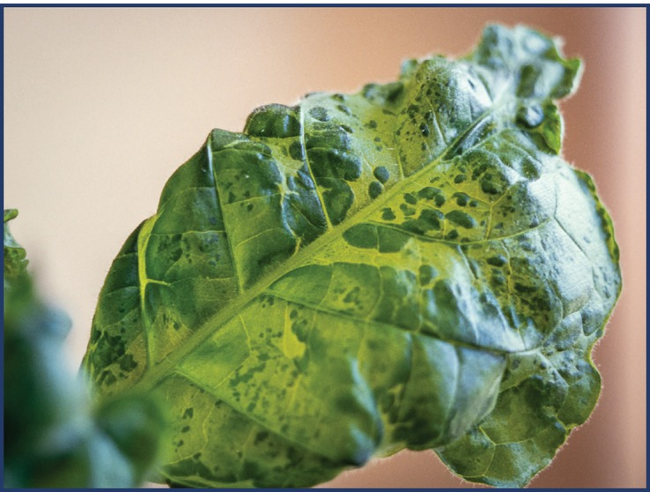
Fig. 7.9 Tobacco mosaic virus in tobacco – Nicotiana tabacum. (© D-R. Blystad.)
Plant Pathology and Plant Diseases © Anne Marte Tronsmo, David B. Collinge, Annika Djurle, Lisa Munk, Jonathan Yuen and Arne Tronsmo 2020

Slide 11
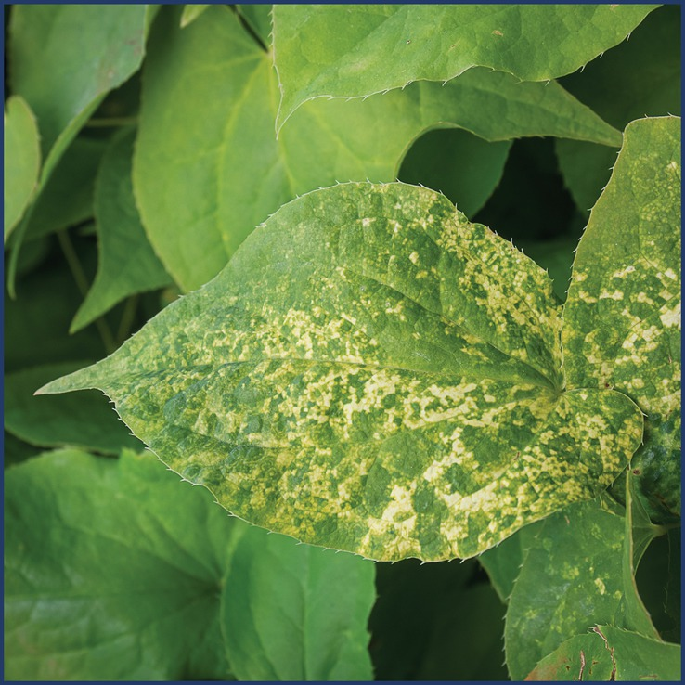
Fig. 7.10 Tobacco rattle virus causing mosaic in the ornamental perennial Epimedium sp. (© D-R. Blystad.)
Plant Pathology and Plant Diseases © Anne Marte Tronsmo, David B. Collinge, Annika Djurle, Lisa Munk, Jonathan Yuen and Arne Tronsmo 2020

Slide 12
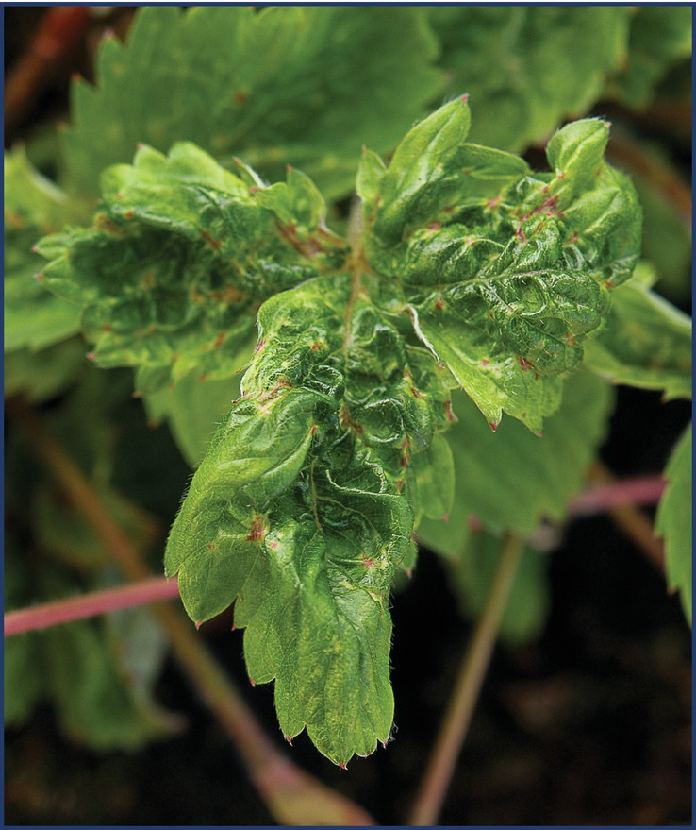
Fig. 7.11 Strawberry crinkle virus giving clear symptoms in a sensitive indicator of Fragaria. (© D-R. Blystad.)
Plant Pathology and Plant Diseases © Anne Marte Tronsmo, David B. Collinge, Annika Djurle, Lisa Munk, Jonathan Yuen and Arne Tronsmo 2020

Slide 13
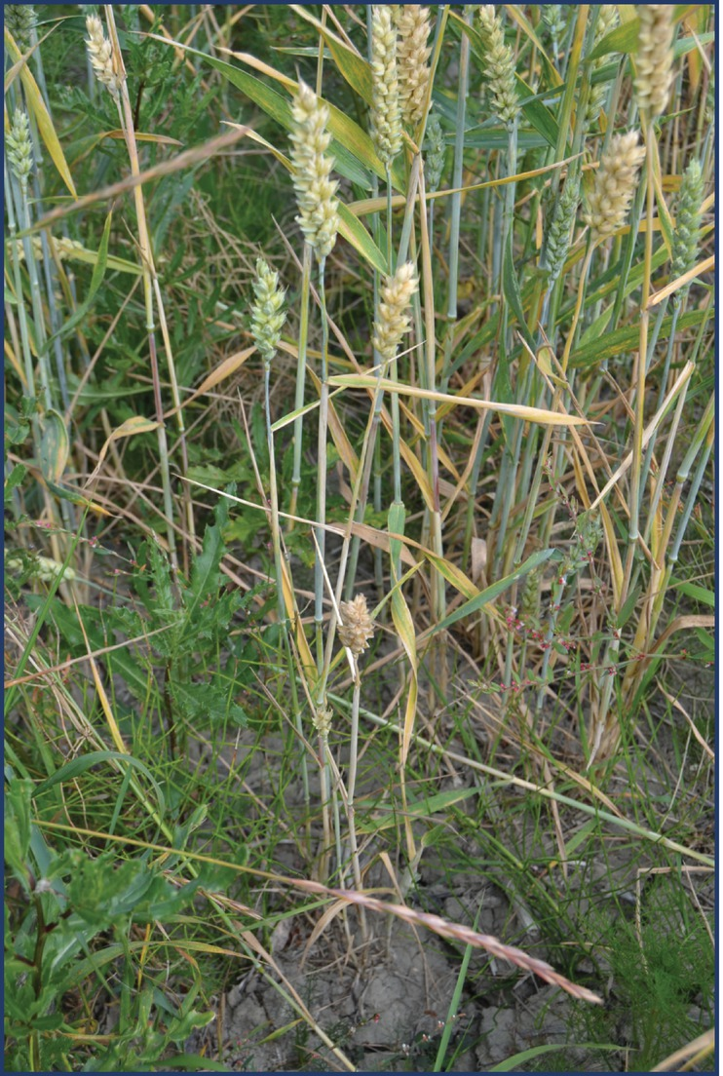
Fig. 7.12 Yellow stripes and necrosis caused by wheat dwarf virus in wheat. (© A. Kvarnheden.)
Plant Pathology and Plant Diseases © Anne Marte Tronsmo, David B. Collinge, Annika Djurle, Lisa Munk, Jonathan Yuen and Arne Tronsmo 2020

Slide 14
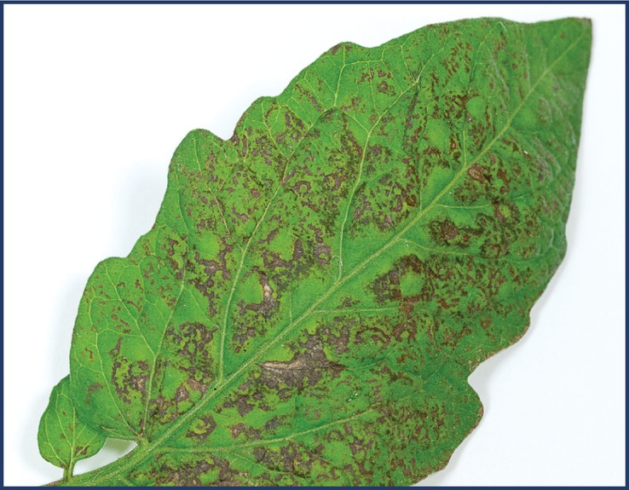
Fig. 7.13 Tomato spotted wilt virus in tomato – necrotic bronze coloured ringspots and bands. (© D-R. Blystad.)
Plant Pathology and Plant Diseases © Anne Marte Tronsmo, David B. Collinge, Annika Djurle, Lisa Munk, Jonathan Yuen and Arne Tronsmo 2020

Slide 15
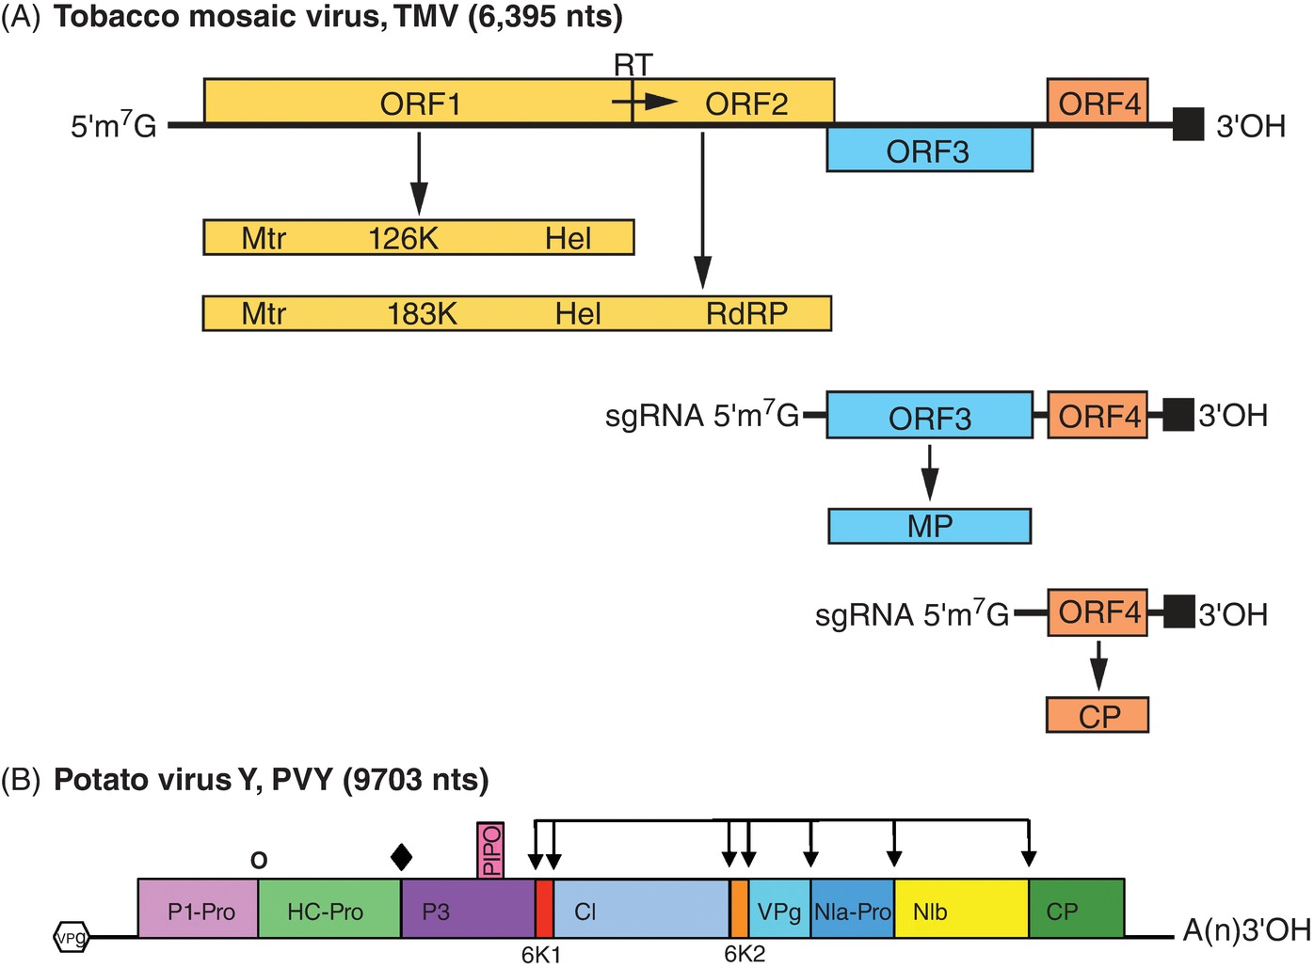
Fig. 7.14 Strategies for plant virus translation. (A) The strategy with sub-genomic RNAs is used by tobacco mosaic virus. (B) Polyprotein strategy: the genome of potato virus Y. (A: Adams et al., 2017; B Wylie et al., 2019.)
Plant Pathology and Plant Diseases © Anne Marte Tronsmo, David B. Collinge, Annika Djurle, Lisa Munk, Jonathan Yuen and Arne Tronsmo 2020

Slide 16
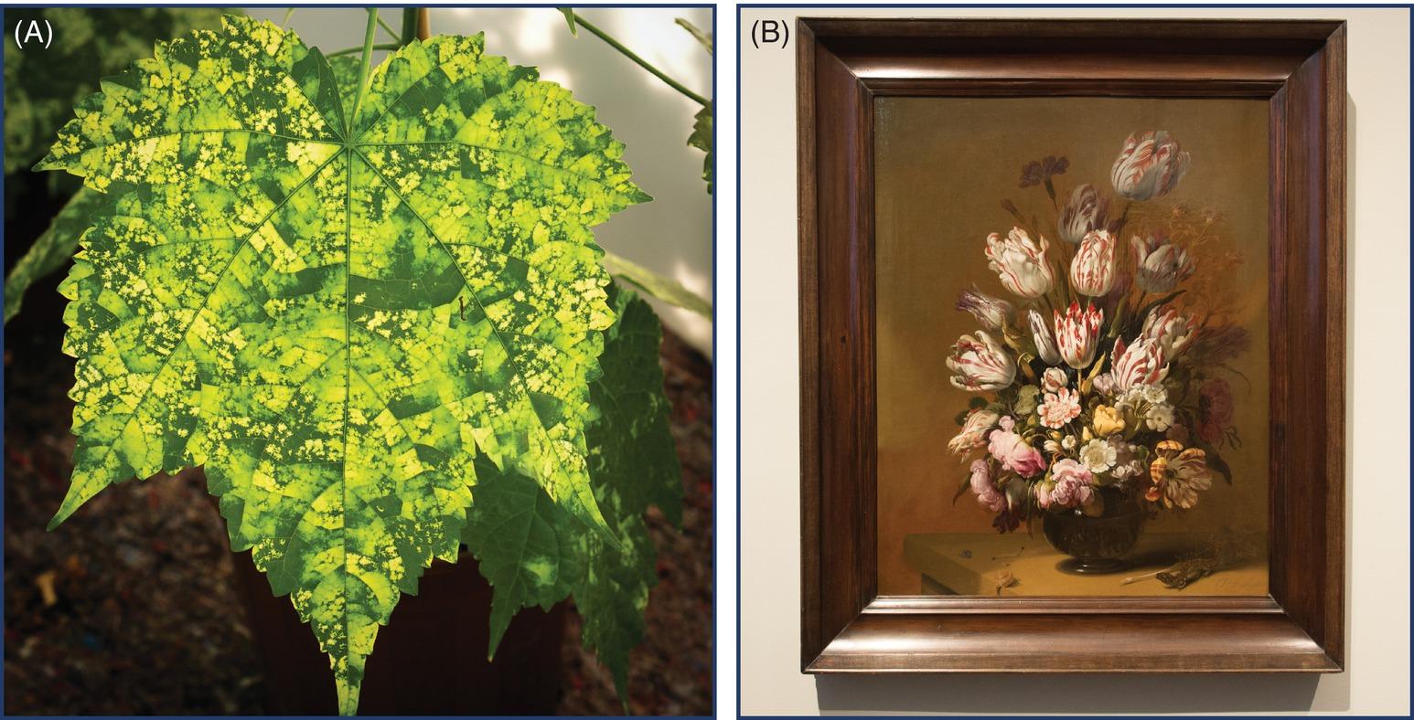
Fig. 7.15 Mosaic caused by viruses in some instances been regarded as giving ornamental value. (A) Mosaic in Abutilon caused by abutilon mosaic virus. (B) Tulip with petal stripes. (© D-R. Blystad.)
Plant Pathology and Plant Diseases © Anne Marte Tronsmo, David B. Collinge, Annika Djurle, Lisa Munk, Jonathan Yuen and Arne Tronsmo 2020

Slide 17
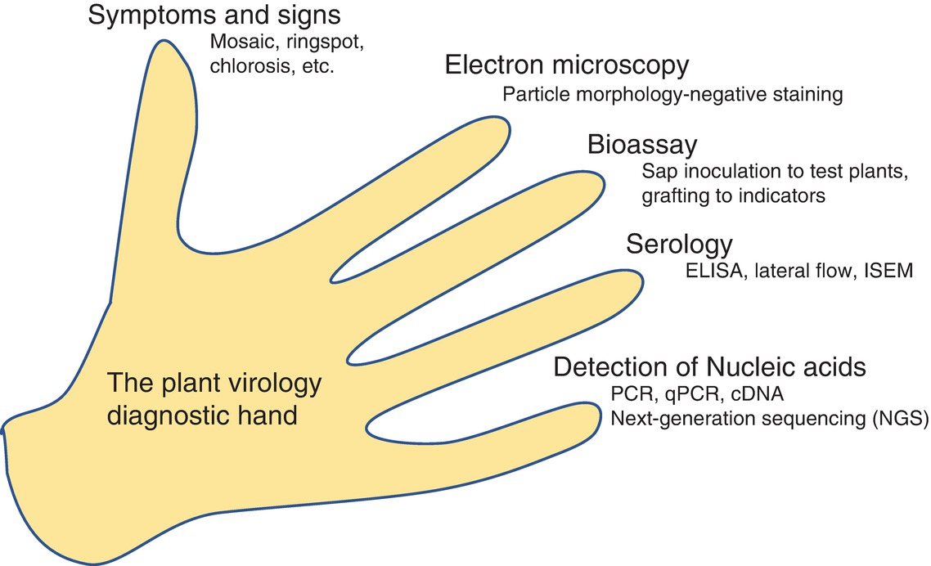
Fig. 7.16 Diagnosis and detection of plant viruses are dependent on different aspects related to the virus. (© D-R. Blystad.)
Plant Pathology and Plant Diseases © Anne Marte Tronsmo, David B. Collinge, Annika Djurle, Lisa Munk, Jonathan Yuen and Arne Tronsmo 2020

Slide 18
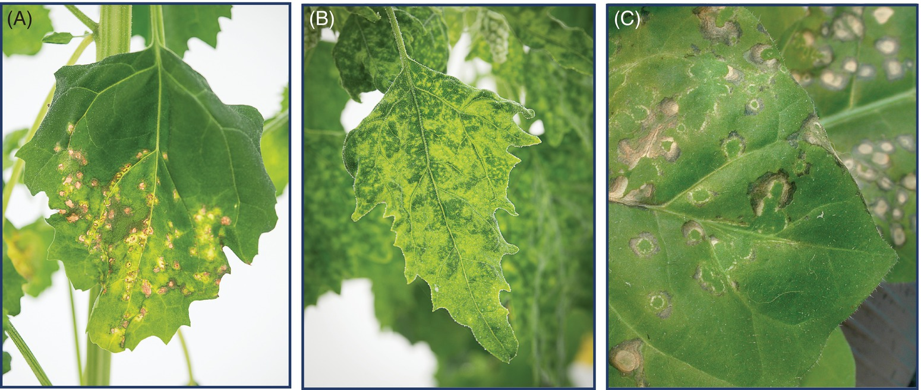
Fig. 7.17 Symptoms caused by viruses on test plants mechanically inoculated with virus. (A) Lettuce mosaic virus giving local lesions in Chenopodium quinoa. (B) Lettuce mosaic virus giving systemic mosaic in C. quinoa some days later. (C) Tobacco rattle virus giving local lesions in Nicotiana tabacum. (© D-R. Blystad.)
Plant Pathology and Plant Diseases © Anne Marte Tronsmo, David B. Collinge, Annika Djurle, Lisa Munk, Jonathan Yuen and Arne Tronsmo 2020

Slide 19
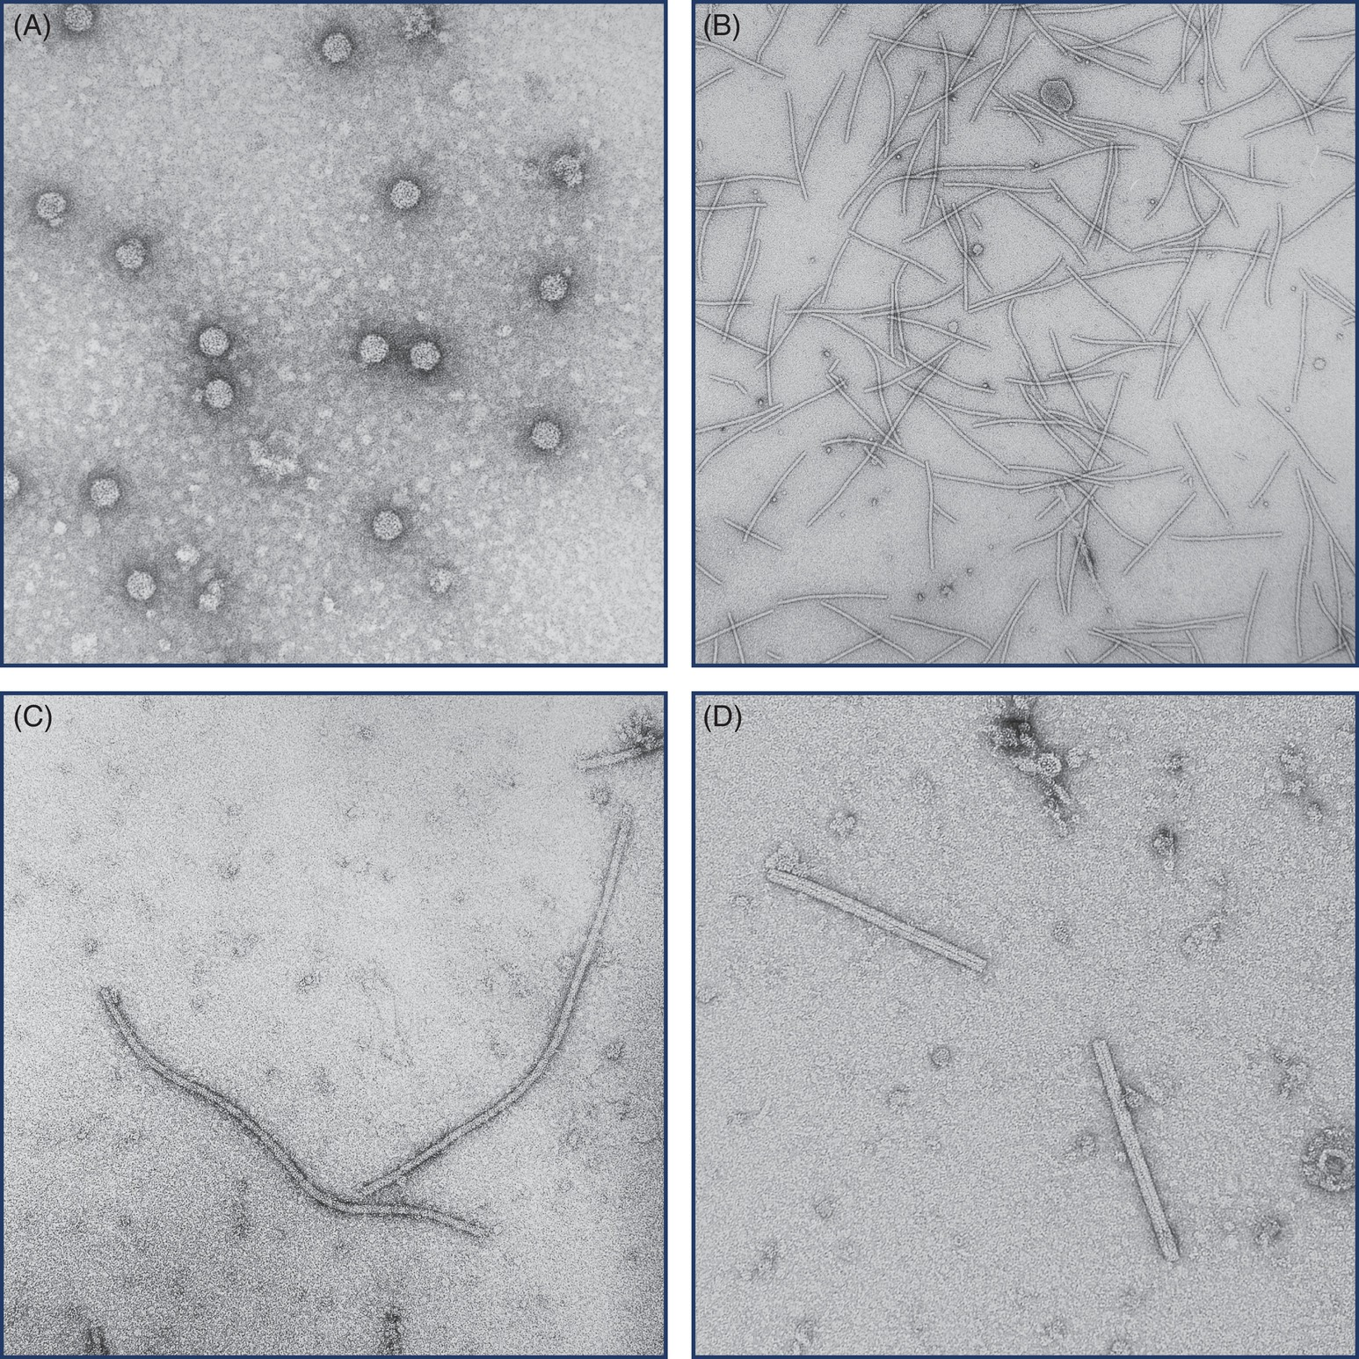
Fig. 7.18 Virus particles. (A) Pelargonium flower break virus (B) Potato virus X. (C) Lettuce mosaic virus (D) Cucumber green mottle mosaic virus. (A: © S. Haugslien; B-C: © D-R Blystad; D: © L.C. Hermansen)
Plant Pathology and Plant Diseases © Anne Marte Tronsmo, David B. Collinge, Annika Djurle, Lisa Munk, Jonathan Yuen and Arne Tronsmo 2020

Slide 20
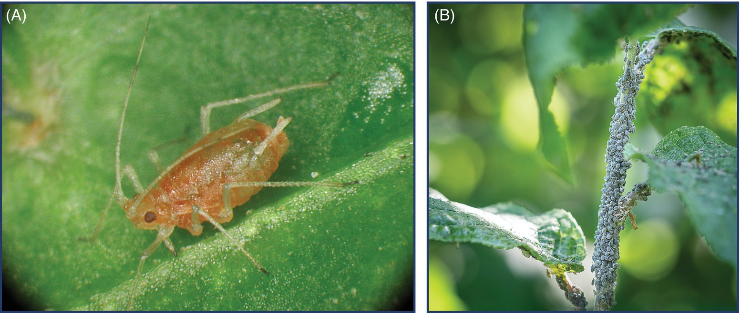
Fig. 7.19 Important aphid vectors. (A) The green peach aphid (Myzus persicae) is the aphid species known to vector most different virus species. (B) Bird cherry-oat aphid (Rhopalosiphum padi) occurs in high numbers in springtime and is an important virus vector. (A: E. Fløistad © NIBIO. B: D-R Blystad.)
Plant Pathology and Plant Diseases © Anne Marte Tronsmo, David B. Collinge, Annika Djurle, Lisa Munk, Jonathan Yuen and Arne Tronsmo 2020

Slide 21
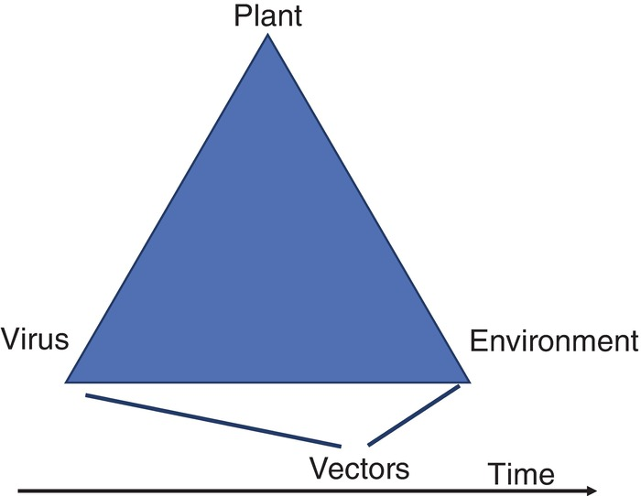
Fig. 7.20 Plant virus epidemiology often involves vectors. This makes an additional and complicating factor in the understanding of plant virus epidemics. (© D-R. Blystad.)
Plant Pathology and Plant Diseases © Anne Marte Tronsmo, David B. Collinge, Annika Djurle, Lisa Munk, Jonathan Yuen and Arne Tronsmo 2020

Slide 22
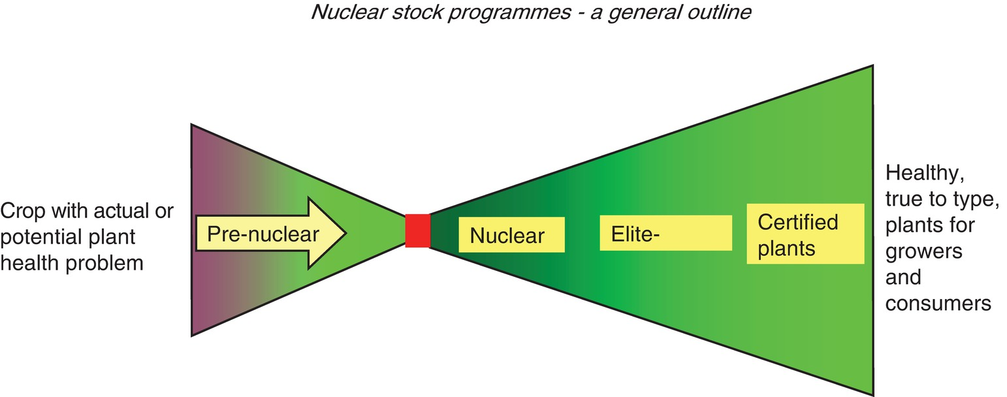
Fig. 7.21 A nuclear stock programme has to establish a few virus-free nuclear stock plants as a foundation for the further propagation stocks. . (© D-R. Blystad.)
Plant Pathology and Plant Diseases © Anne Marte Tronsmo, David B. Collinge, Annika Djurle, Lisa Munk, Jonathan Yuen and Arne Tronsmo 2020

