Slide 1
Plant Pathology and Plant Diseases
© Anne Marte Tronsmo, David B. Collinge, Annika Djurle, Lisa Munk, Jonathan Yuen and Arne Tronsmo 2020

Slide 2
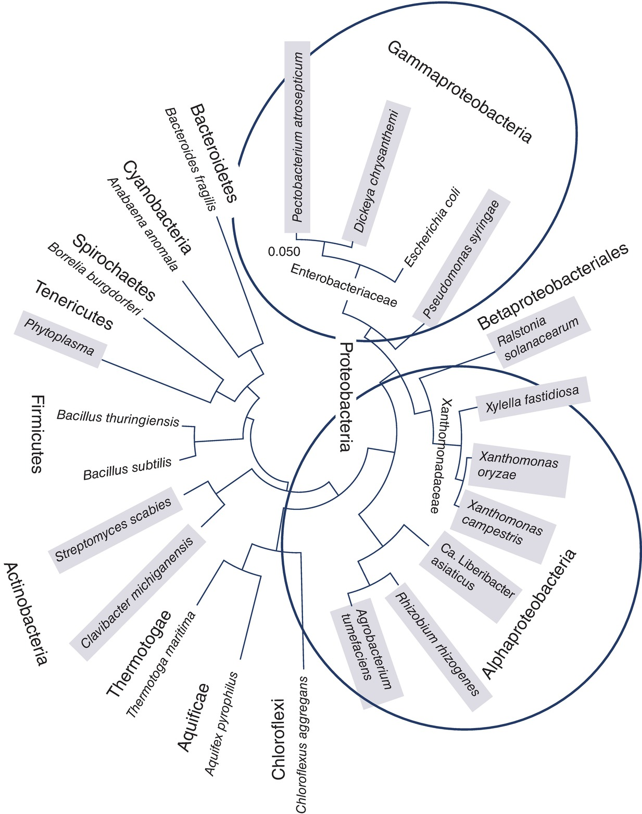
Fig. 6.1 A phylogenetic tree illustrating the diversity of Eubacteria causing diseases on plants.
Plant Pathology and Plant Diseases © Anne Marte Tronsmo, David B. Collinge, Annika Djurle, Lisa Munk, Jonathan Yuen and Arne Tronsmo 2020

Slide 3
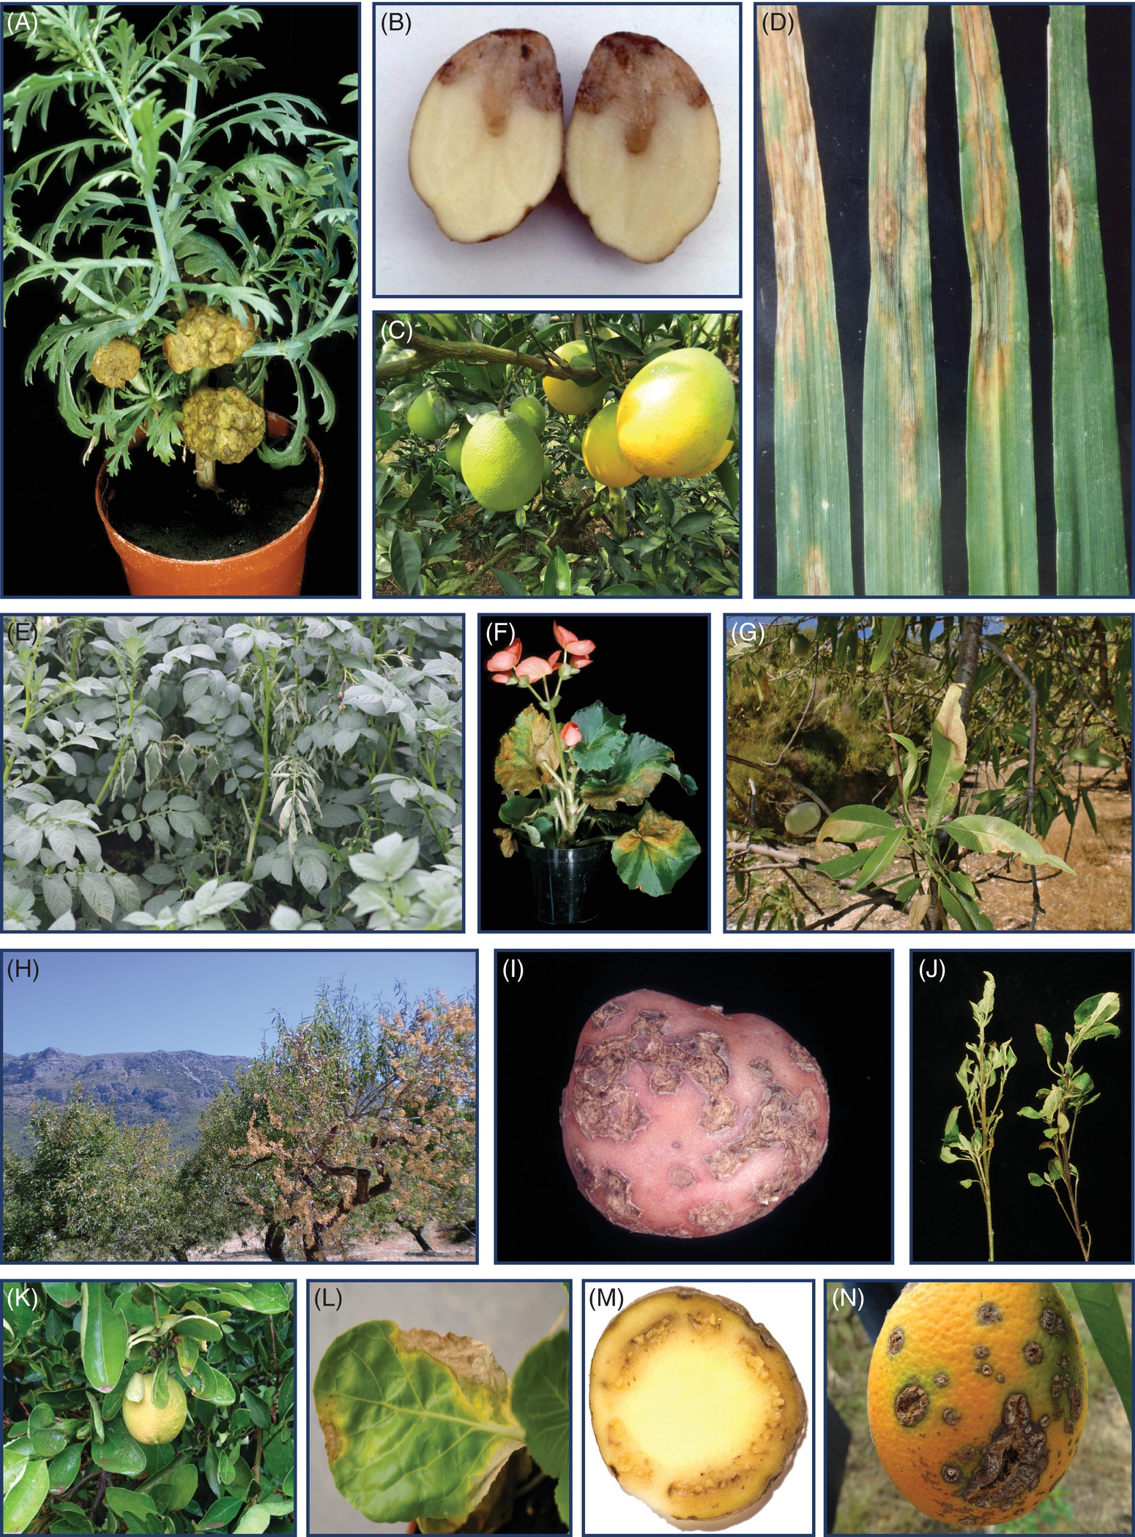
Fig. 6.2 A-G The diversity of diseases caused by bacteria. (A) Agrobacterium tumefaciens on marguerite. (B) Pectobacterium spp. on potato. (C) Candidatus Liberibacter asiaticus. (D) Pseudomonas coronofaciens on oat. (E) Ralstonia solanacearum on potato. (F) Xanthomonas axonopodis pv. egonia on begonia. (G) Xylella fastidiosa on almond. (A, F,: © NIBIO. B, D: ©P. Persson. C,: © D. Jiang. E: © J. Yuen. G: © A. Vicent.)
Plant Pathology and Plant Diseases © Anne Marte Tronsmo, David B. Collinge, Annika Djurle, Lisa Munk, Jonathan Yuen and Arne Tronsmo 2020

Slide 4
Fig. 6.2 H-N The diversity of diseases caused by bacteria. (H) Xylella fastidiosa on almond. (I) Streptomyces spp. on potato. (J) Candidatus Phytoplasma on basil. (K) Candidatus Spiroplasma on lemon (Citrus limon). (L) Xanthomonas campestris pv. Campestris on cabbage. (M) Clavibacter sepedonicus on potato. (N) Xanthomonas campestris pv. Citri on orange. (H: © A. Vicent, I,M: © NIBIO. J: © M. Dickinson. K: © M. C. Vives, L: © D.B. Collinge. N: © D. Jiang.)
Plant Pathology and Plant Diseases © Anne Marte Tronsmo, David B. Collinge, Annika Djurle, Lisa Munk, Jonathan Yuen and Arne Tronsmo 2020

Slide 5
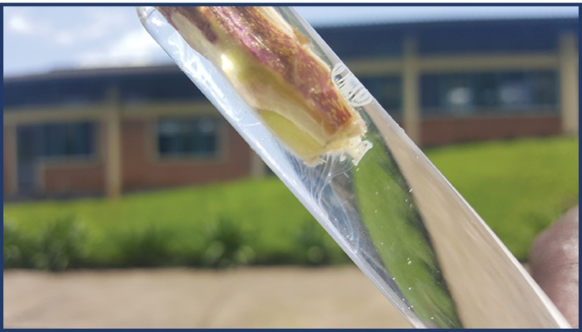
Fig. 6.3 The streaks below the cut surface are bacterial extracellular polysaccharide from Ralstonia oozing out of a potato stem. (© F. Uwamahoro.)
Plant Pathology and Plant Diseases © Anne Marte Tronsmo, David B. Collinge, Annika Djurle, Lisa Munk, Jonathan Yuen and Arne Tronsmo 2020

Slide 6
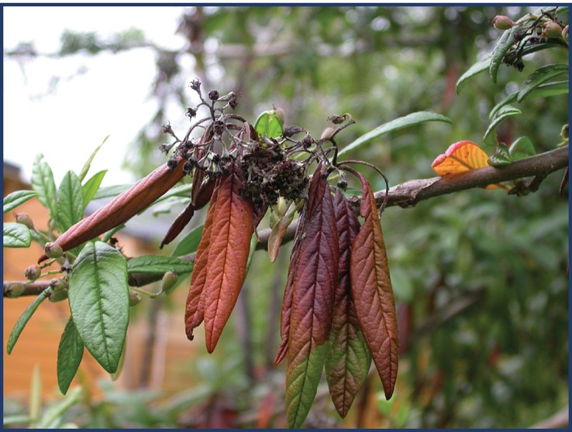
Fig. 6.4 Fireblight (Erwina amylovora) on Cotoneaster bullatus. (© NIBIO.)
Plant Pathology and Plant Diseases © Anne Marte Tronsmo, David B. Collinge, Annika Djurle, Lisa Munk, Jonathan Yuen and Arne Tronsmo 2020

