Slide 1
Plant Pathology and Plant Diseases
© Anne Marte Tronsmo, David B. Collinge, Annika Djurle, Lisa Munk, Jonathan Yuen and Arne Tronsmo 2020

Slide 2
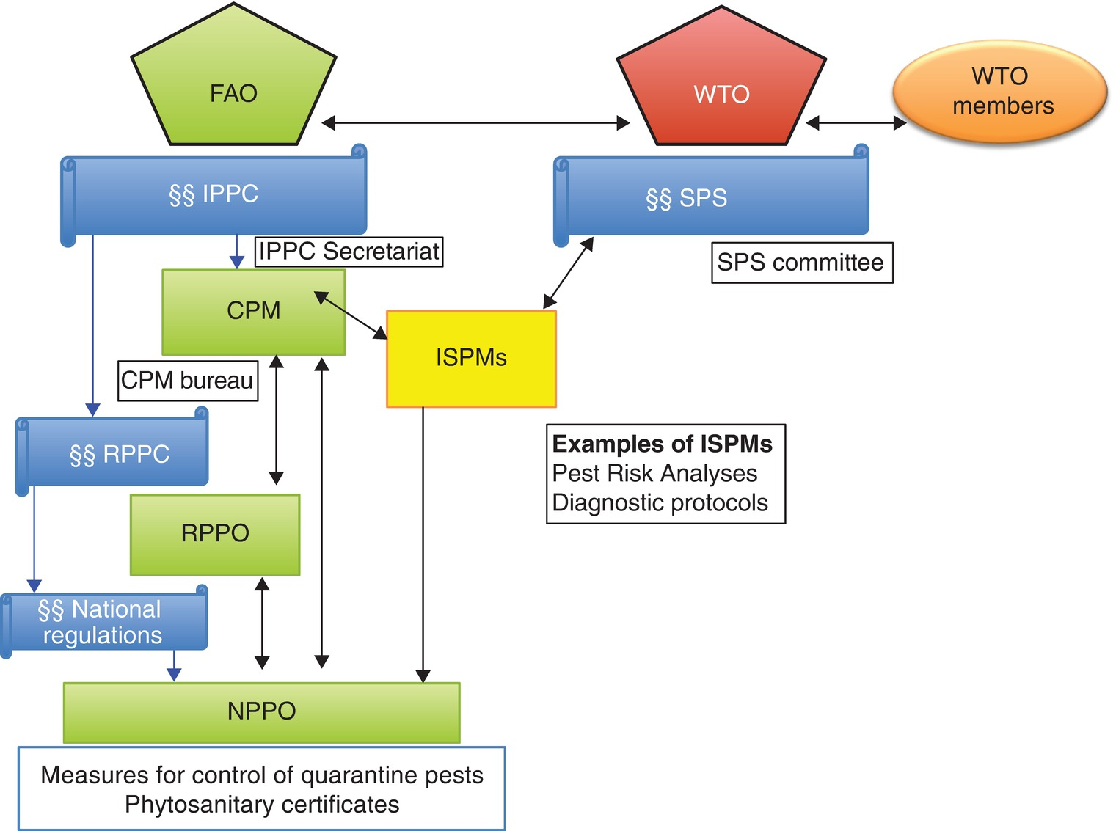
Fig. 22.1 The relationships between organizations regulating plant pathogens and global trade.
The colours indicate the following: Blue – conventions, laws and regulations; Green – organizations, commissions and committees related to food and agriculture; Red – trade; Yellow – standards for phytosanitary measures. FAO, Food and Agriculture Organization of the United Nations; CPM, Commission on Phytosanitary Measures; IPPC, International Plant Protection Convention; ISPM, International Standards for Phytosanitary Measures; NPPO, national plant protection organizations; RPPC, regional plant protection conventions; RPPO, regional plant protection organizations; SPS, The agreement on application of Sanitary and Phytosanitary Measures; WTO, World Trade Organization.§§ indicates international and regional binding agreements and national regulations (laws), that if broken can result in legal action. (©A.M. Tronsmo.)
Plant Pathology and Plant Diseases © Anne Marte Tronsmo, David B. Collinge, Annika Djurle, Lisa Munk, Jonathan Yuen and Arne Tronsmo 2020

Slide 3
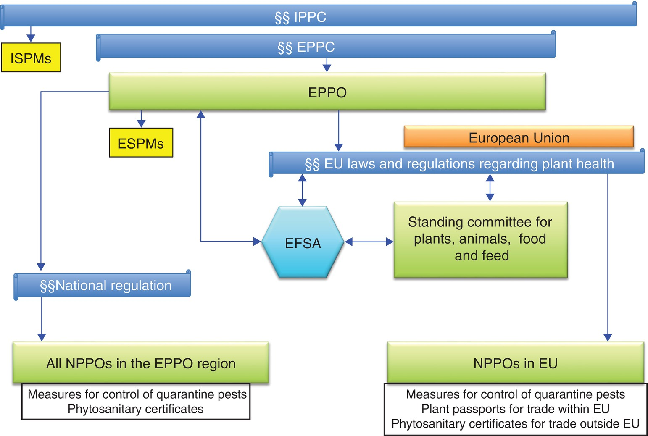
Fig. 22.3 Relationships between organizations in Europe regulating plant pathogens.
The colours indicate the following: Blue – conventions, laws and regulations; Green – organizations, commissions and committees related to food and agriculture; Yellow – standards for phytosanitary measures. EFSA, European Food Safety Authority; EPPC, The European and Mediterranean Plant Protection Convention; EPPO, The European and Mediterranean Plant Protection Organization; ESPMs, EPPO Standards for Phytosanitary Measures; ISPMs, International Standards for Phytosanitary Measures; NPPO, national plant protection organizations; IPPC, International Plant Protection Convention. §§ indicates international and regional binding agreements and national regulations (laws), that if broken can result in legal action. (©A.M. Tronsmo.)
Plant Pathology and Plant Diseases © Anne Marte Tronsmo, David B. Collinge, Annika Djurle, Lisa Munk, Jonathan Yuen and Arne Tronsmo 2020

Slide 4
Fig. 22.4 (A) An olive grove with dead olive trees (Olea europaea). (B) Typical symptoms of infection by Xylella fastidiosa on an olive twig. (© P. Milonas)
Plant Pathology and Plant Diseases © Anne Marte Tronsmo, David B. Collinge, Annika Djurle, Lisa Munk, Jonathan Yuen and Arne Tronsmo 2020

Slide 5
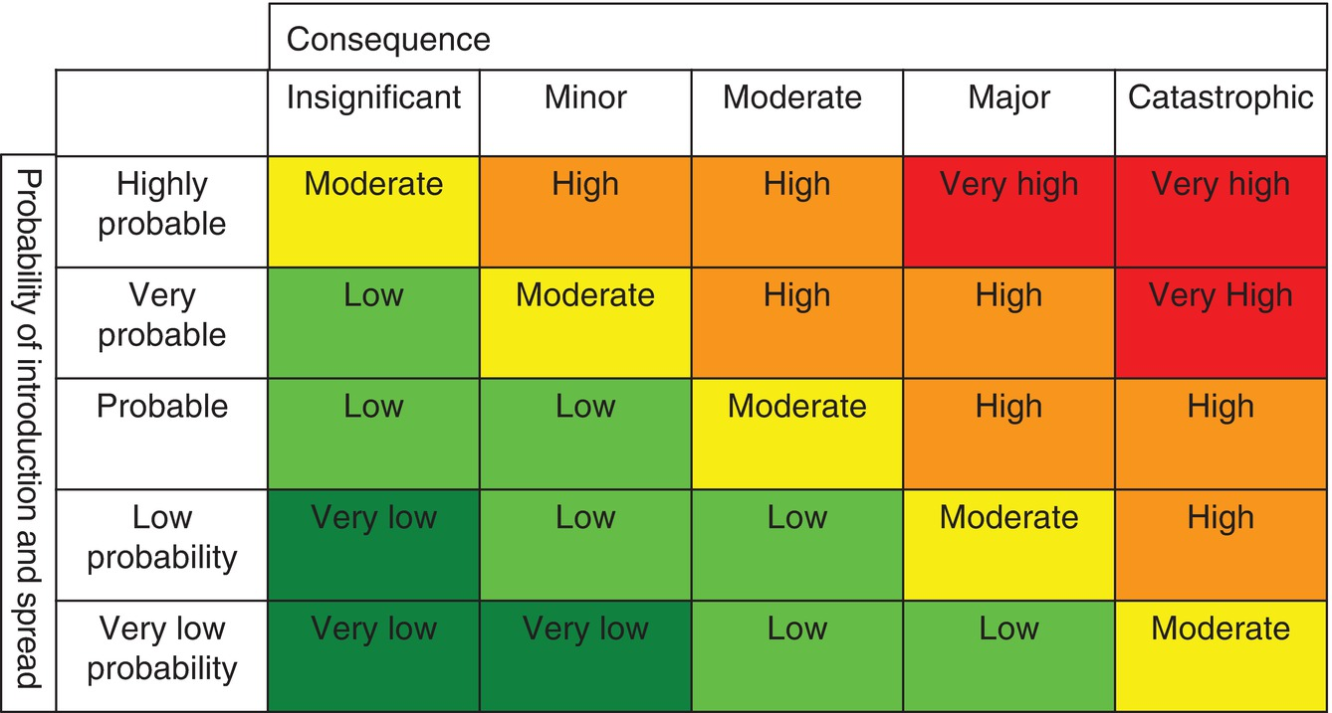
Fig. 22.5 Risk matrix that can be used to describe the magnitude of the risk. Red – very high risk; Orange – high risk; Yellow – moderate risk; Light green – low risk; Dark green – very low risk. (Risk = probability x consequence.).
Plant Pathology and Plant Diseases © Anne Marte Tronsmo, David B. Collinge, Annika Djurle, Lisa Munk, Jonathan Yuen and Arne Tronsmo 2020

