Slide 1
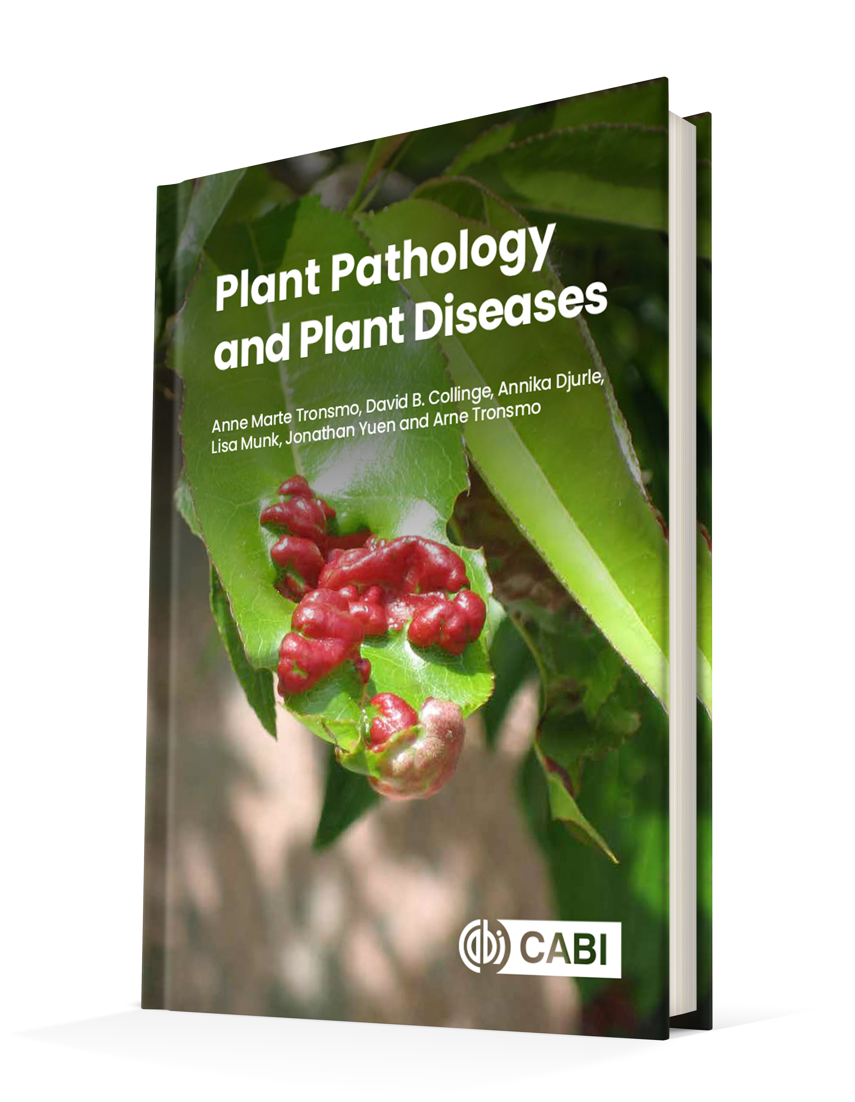
Plant Pathology and Plant Diseases
© Anne Marte Tronsmo, David B. Collinge, Annika Djurle, Lisa Munk, Jonathan Yuen and Arne Tronsmo 2020

Slide 2
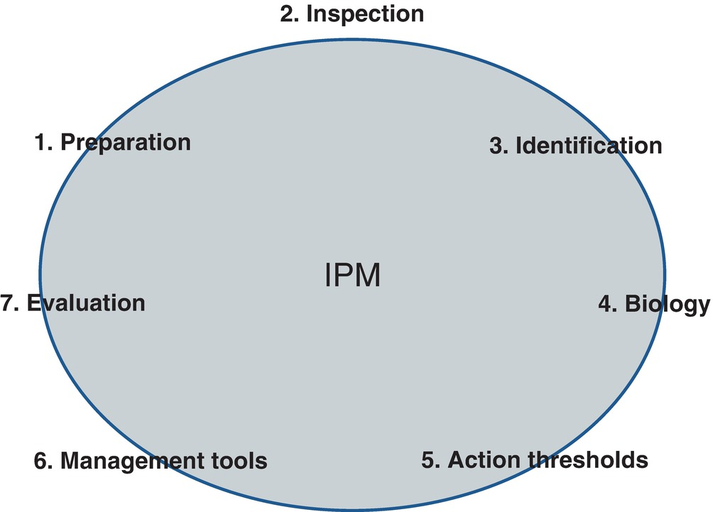
Fig. 21.1 The seven steps of integrated pest management (IPM). (L. Munk.)
Plant Pathology and Plant Diseases
© Anne Marte Tronsmo, David B. Collinge, Annika Djurle, Lisa Munk, Jonathan Yuen and Arne Tronsmo 2020

Slide 3
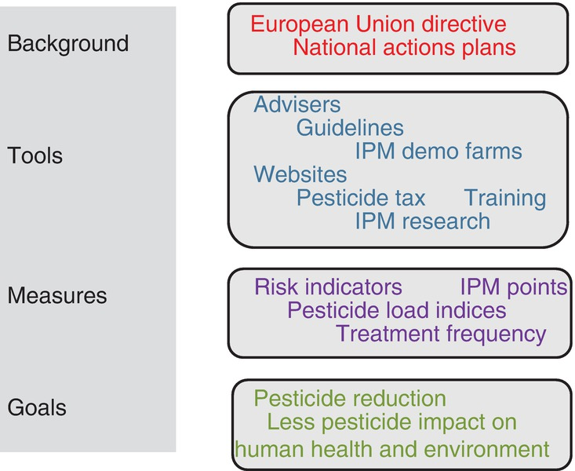
Fig. 21.2 Background, tools and measures used in the implementation of integrated pest management (IPM)
principles. (L. Munk.)
Plant Pathology and Plant Diseases
© Anne Marte Tronsmo, David B. Collinge, Annika Djurle, Lisa Munk, Jonathan Yuen and Arne Tronsmo 2020

Slide 4
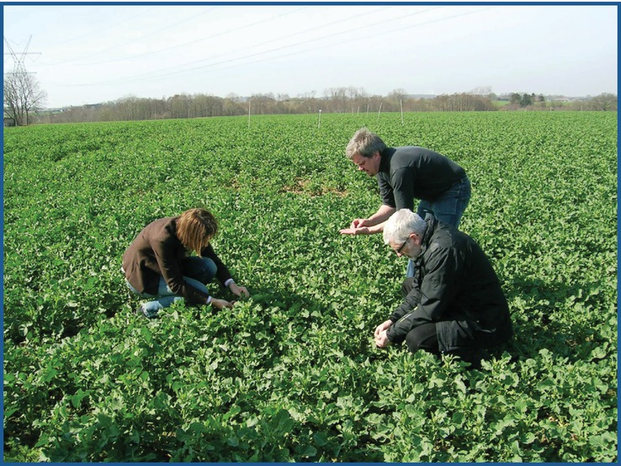
Fig. 21.3 Field inspection at an IPM demonstration farm, Denmark, March 2012. (© L. Munk.)
Plant Pathology and Plant Diseases
© Anne Marte Tronsmo, David B. Collinge, Annika Djurle, Lisa Munk, Jonathan Yuen and Arne Tronsmo 2020

