Slide 1
Plant Pathology and Plant Diseases
© Anne Marte Tronsmo, David B. Collinge, Annika Djurle, Lisa Munk, Jonathan Yuen and Arne Tronsmo 2020

Slide 2
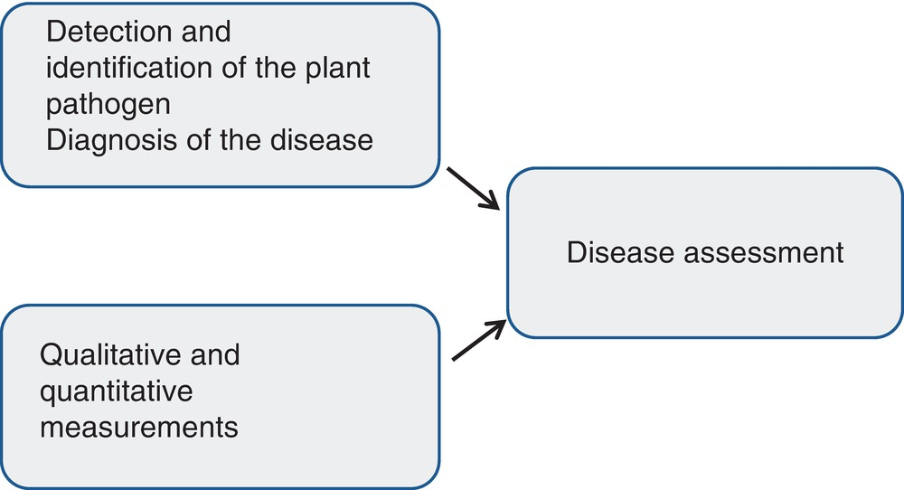
Fig. 20.1 Disease diagnosis and qualitative and quantitative measurements are relevant elements in plant disease assessment. (L. Munk.)
Plant Pathology and Plant Diseases © Anne Marte Tronsmo, David B. Collinge, Annika Djurle, Lisa Munk, Jonathan Yuen and Arne Tronsmo 2020

Slide 3
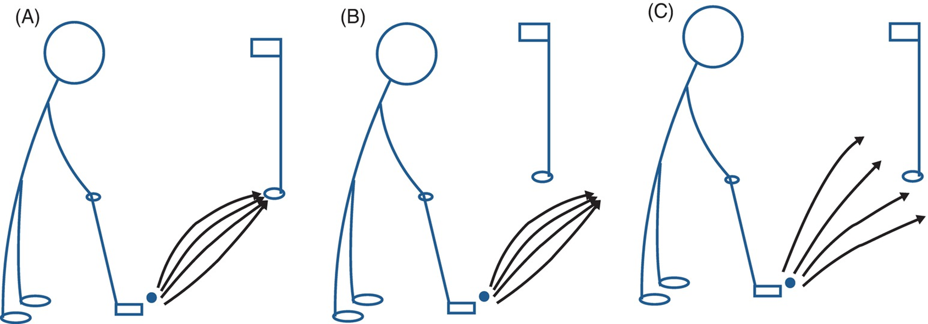
Fig. 20.2 Golfers can be (A) accurate and precise, (B) precise but not accurate and (C) neither accurate nor precise. (© J. Yuen.)
Plant Pathology and Plant Diseases © Anne Marte Tronsmo, David B. Collinge, Annika Djurle, Lisa Munk, Jonathan Yuen and Arne Tronsmo 2020

Slide 4
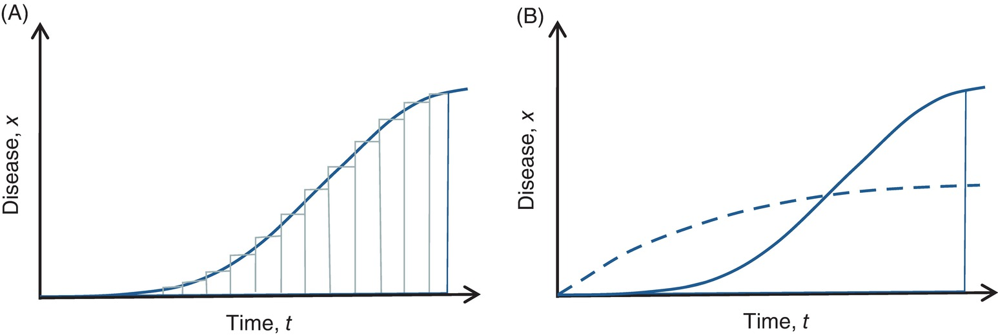
Fig. 20.3 (A) AUDPC is calculated from the added surfaces of rectangles. (B) Two shapes resulting in the same area but not the same epidemic. (A: © Djurle; B: © B. Andersson.)
Plant Pathology and Plant Diseases © Anne Marte Tronsmo, David B. Collinge, Annika Djurle, Lisa Munk, Jonathan Yuen and Arne Tronsmo 2020

Slide 5
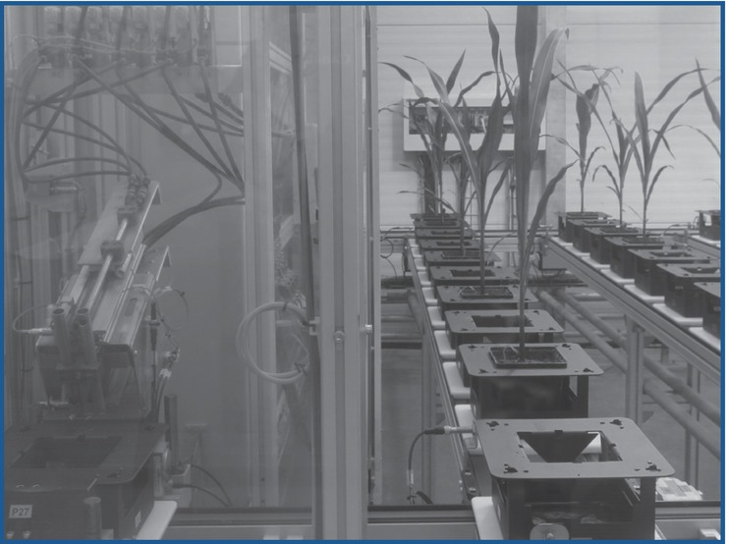
Fig. 20.4 Phenotyping platform. (© L. Munk.)
Plant Pathology and Plant Diseases © Anne Marte Tronsmo, David B. Collinge, Annika Djurle, Lisa Munk, Jonathan Yuen and Arne Tronsmo 2020

Slide 6
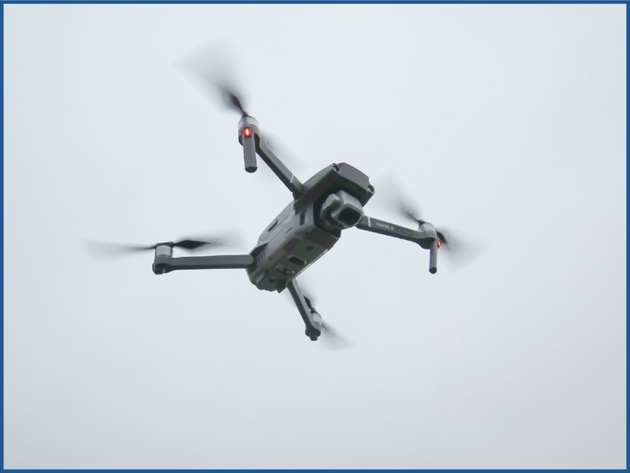
Fig. 20.5 Drone (Mavic 2 pro) mounted with a camera. (© L. Munk.)
Plant Pathology and Plant Diseases © Anne Marte Tronsmo, David B. Collinge, Annika Djurle, Lisa Munk, Jonathan Yuen and Arne Tronsmo 2020

Slide 7
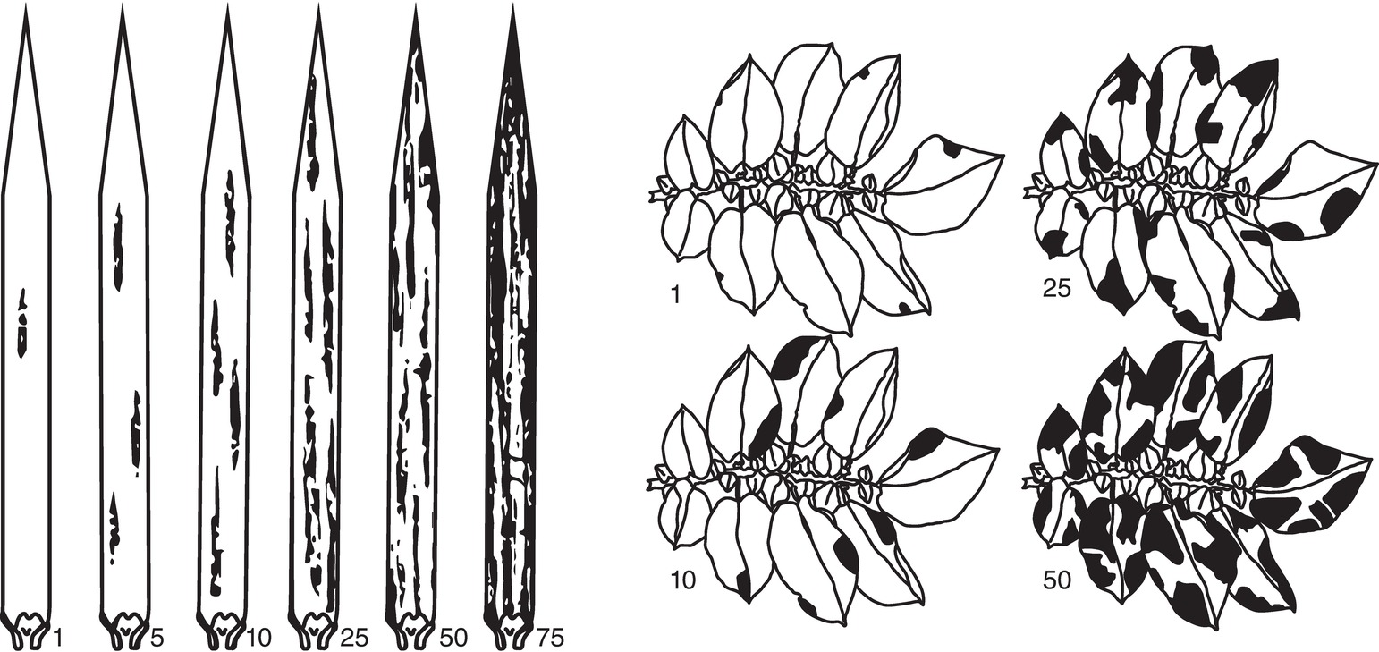
Fig. 20.6 Standard assessment keys for estimating the severity of leaf spots of cereals and late blight of potato. (James, 1971.)
Plant Pathology and Plant Diseases © Anne Marte Tronsmo, David B. Collinge, Annika Djurle, Lisa Munk, Jonathan Yuen and Arne Tronsmo 2020

Slide 8
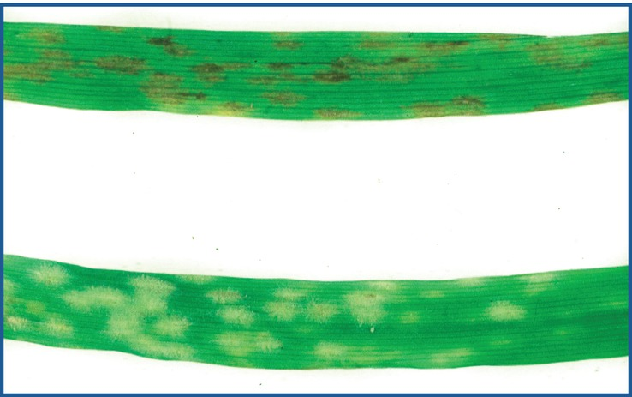
Fig. 20.7 Barley leaves with powdery mildew: (A) type 2 (moderately resistant) and (B) type 4 (susceptible). (© L. Munk.)
Plant Pathology and Plant Diseases © Anne Marte Tronsmo, David B. Collinge, Annika Djurle, Lisa Munk, Jonathan Yuen and Arne Tronsmo 2020

Slide 9
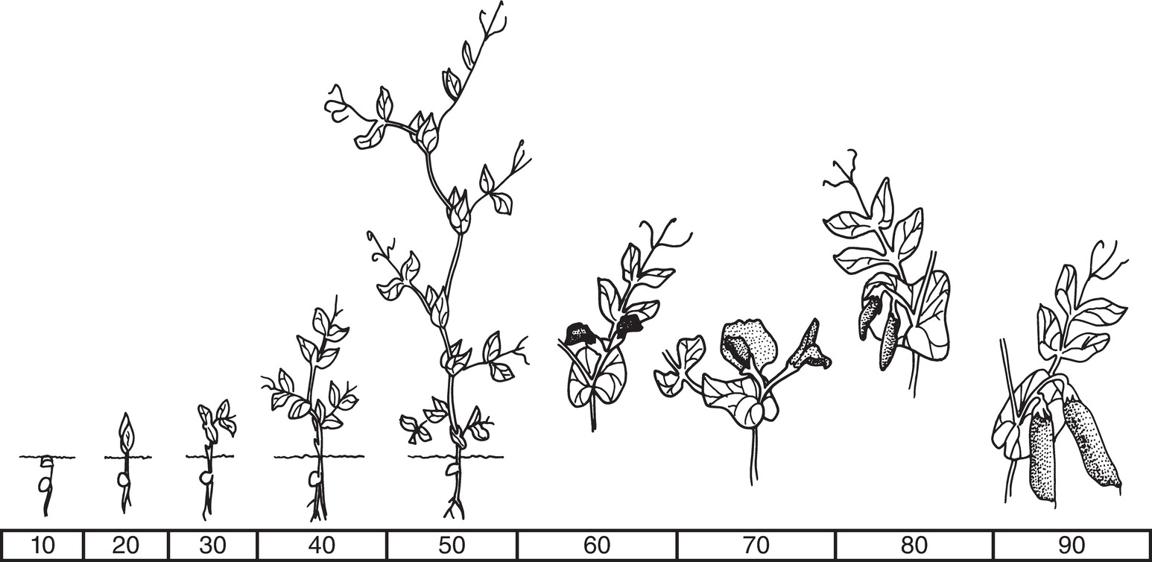
Fig. 20.8 Growth stages of pea. (© K. Göransson,courtesy of SLU.)
Plant Pathology and Plant Diseases © Anne Marte Tronsmo, David B. Collinge, Annika Djurle, Lisa Munk, Jonathan Yuen and Arne Tronsmo 2020

Slide 10
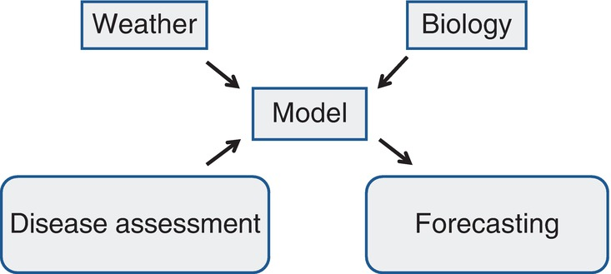
Fig. 20.9 Key elements in disease forecasting. (© L. Munk.)
Plant Pathology and Plant Diseases © Anne Marte Tronsmo, David B. Collinge, Annika Djurle, Lisa Munk, Jonathan Yuen and Arne Tronsmo 2020

Slide 11
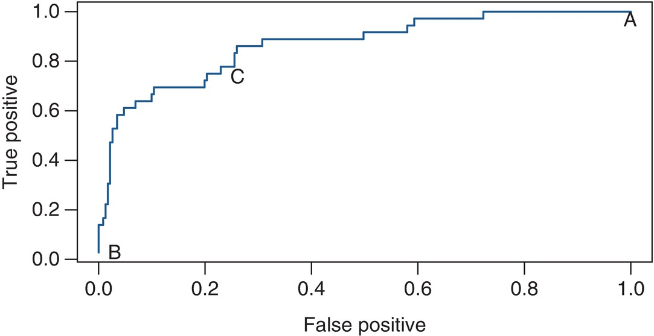
Fig. 20.10 A receiver operating characteristic (ROC) curve. (© J. Yuen.)
Plant Pathology and Plant Diseases © Anne Marte Tronsmo, David B. Collinge, Annika Djurle, Lisa Munk, Jonathan Yuen and Arne Tronsmo 2020

Slide 12
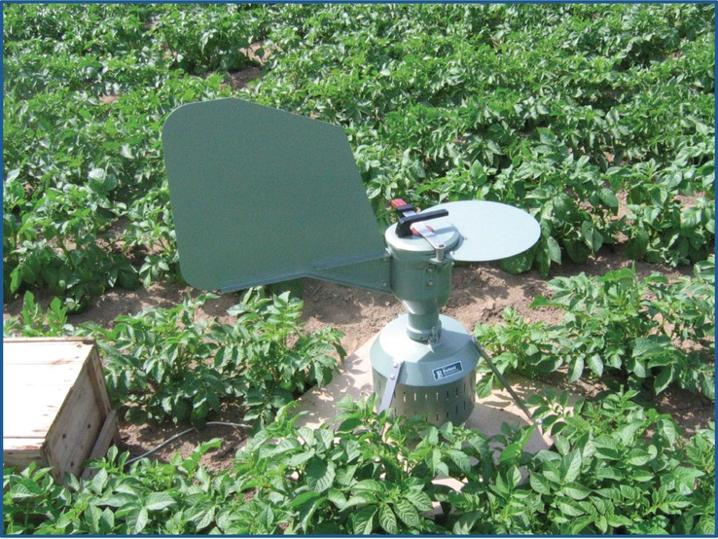
Fig. 20.11 A Burkhard spore trap collecting spores of an airborne pathogen. (© L. Munk.)
Plant Pathology and Plant Diseases © Anne Marte Tronsmo, David B. Collinge, Annika Djurle, Lisa Munk, Jonathan Yuen and Arne Tronsmo 2020

Slide 13
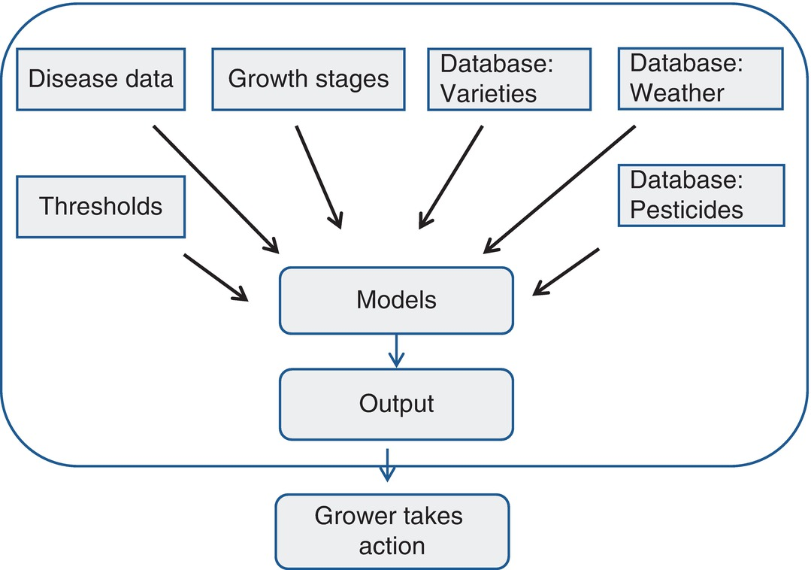
Fig. 20.12 Elements in decision support systems leading to grower’s action. (© L. Munk.)
Plant Pathology and Plant Diseases © Anne Marte Tronsmo, David B. Collinge, Annika Djurle, Lisa Munk, Jonathan Yuen and Arne Tronsmo 2020

Slide 14
Fig. 20.13A Blight Management – Infection pressure data for Dronninglund, 2017. (Courtesy of J. Grønbech Hansen and P. Lassen.)
Plant Pathology and Plant Diseases © Anne Marte Tronsmo, David B. Collinge, Annika Djurle, Lisa Munk, Jonathan Yuen and Arne Tronsmo 2020

Slide 15
Fig. 20.13B Blight Management – Daily risk value for Dronninglund, 2017. (Courtesy of J. Grønbech Hansen and P. Lassen).
Plant Pathology and Plant Diseases © Anne Marte Tronsmo, David B. Collinge, Annika Djurle, Lisa Munk, Jonathan Yuen and Arne Tronsmo 2020

Slide 16
Fig. 20.13C Blight Management – Weather data for Dronninglund, 2017. (Courtesy of J. Grønbech Hansen and P. Lassen.)
Plant Pathology and Plant Diseases © Anne Marte Tronsmo, David B. Collinge, Annika Djurle, Lisa Munk, Jonathan Yuen and Arne Tronsmo 2020

Slide 17
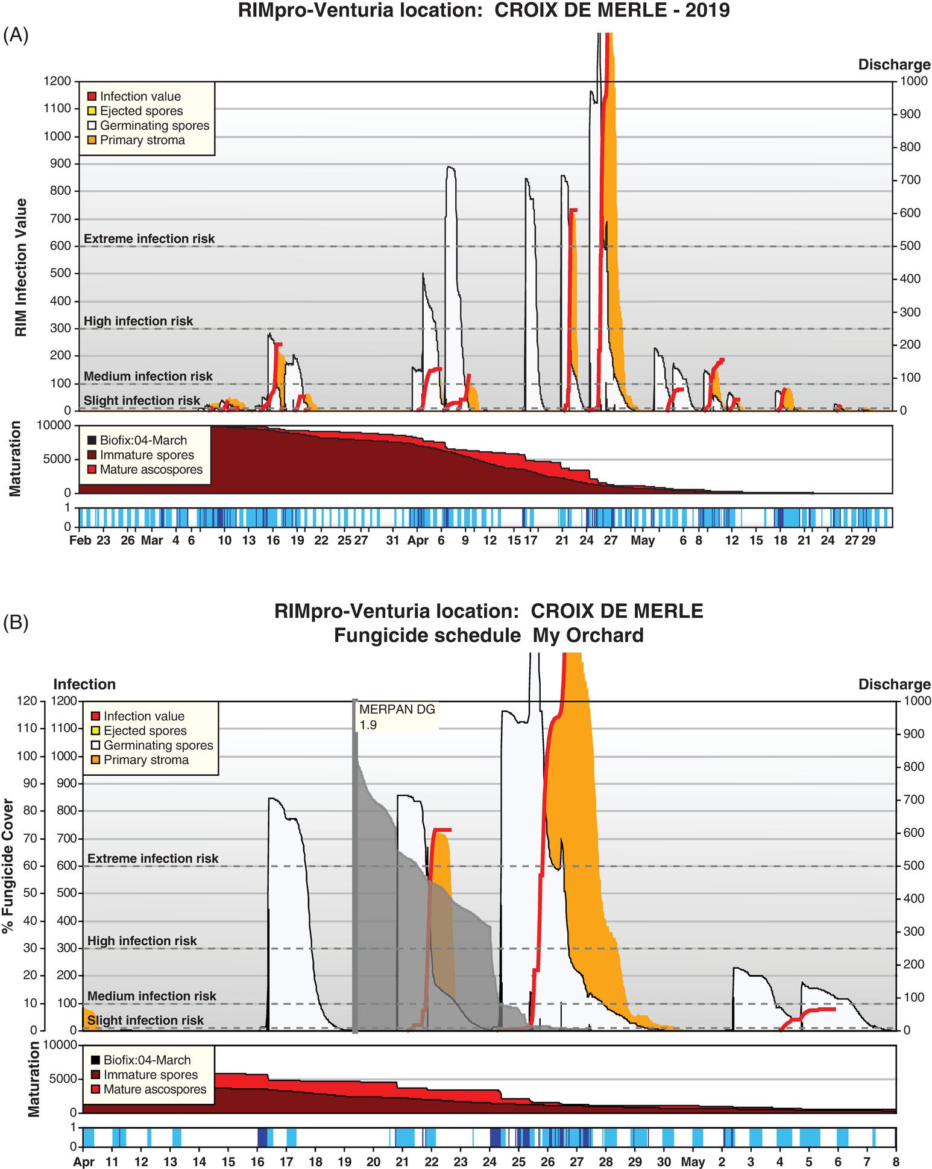
Fig. 20.14A (A) A typical example of RIMpro simulations. (Courtesy of M Trapman.)
Plant Pathology and Plant Diseases © Anne Marte Tronsmo, David B. Collinge, Annika Djurle, Lisa Munk, Jonathan Yuen and Arne Tronsmo 2020

Slide 18
Fig. 20.14B (B) RIMpro output after fungicide application. (Courtesy of M. Trapman.)
Plant Pathology and Plant Diseases © Anne Marte Tronsmo, David B. Collinge, Annika Djurle, Lisa Munk, Jonathan Yuen and Arne Tronsmo 2020

Slide 19
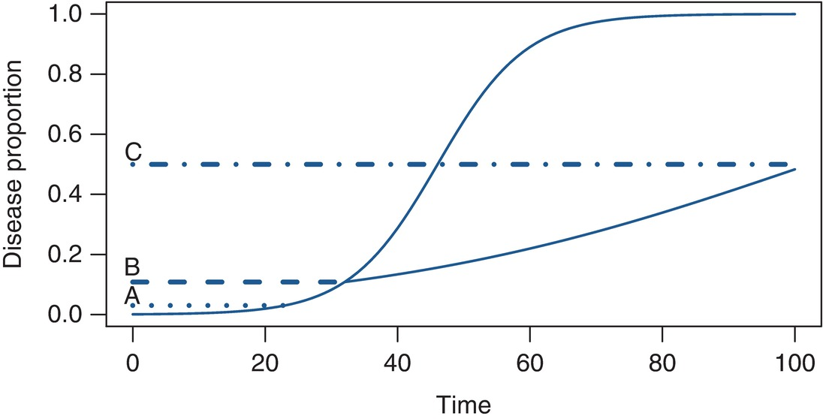
Fig. 20.15 Graphic presentation of disease progress over time with different thresholds. (….) Warning threshold; (----), action threshold; (.-.-.-), damage threshold. (© J. Yuen.)
Plant Pathology and Plant Diseases © Anne Marte Tronsmo, David B. Collinge, Annika Djurle, Lisa Munk, Jonathan Yuen and Arne Tronsmo 2020

Slide 20
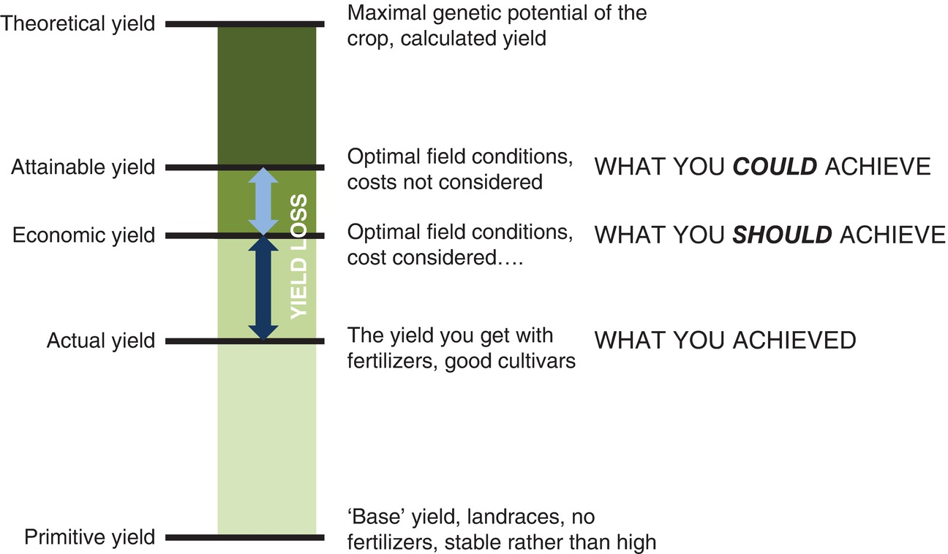
Fig. 20.16 Yield levels and yield loss. (© B. Andersson.)
Plant Pathology and Plant Diseases © Anne Marte Tronsmo, David B. Collinge, Annika Djurle, Lisa Munk, Jonathan Yuen and Arne Tronsmo 2020

Slide 21
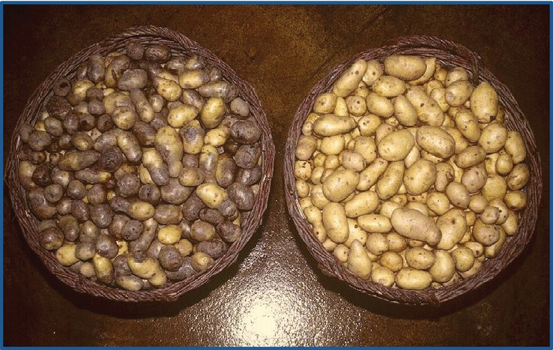
Fig. 20.17 Potatoes with and without tuber rot after sorting in storage. (© B. Andersson.)
Plant Pathology and Plant Diseases © Anne Marte Tronsmo, David B. Collinge, Annika Djurle, Lisa Munk, Jonathan Yuen and Arne Tronsmo 2020

Slide 22
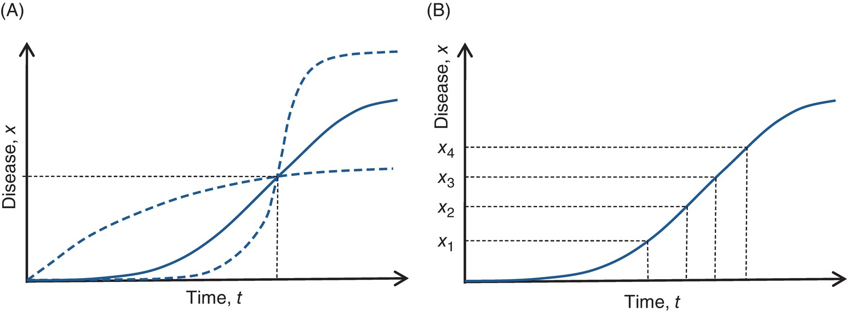
Fig. 20.18 (A) A single point model. The dotted lines show alternatives for disease progress that would give the same loss estimate. (B) A multiple point model. The loss equations in the text are obtained based on the solid lines after linear transformation. (© B. Andersson.)
Plant Pathology and Plant Diseases © Anne Marte Tronsmo, David B. Collinge, Annika Djurle, Lisa Munk, Jonathan Yuen and Arne Tronsmo 2020

