Slide 1
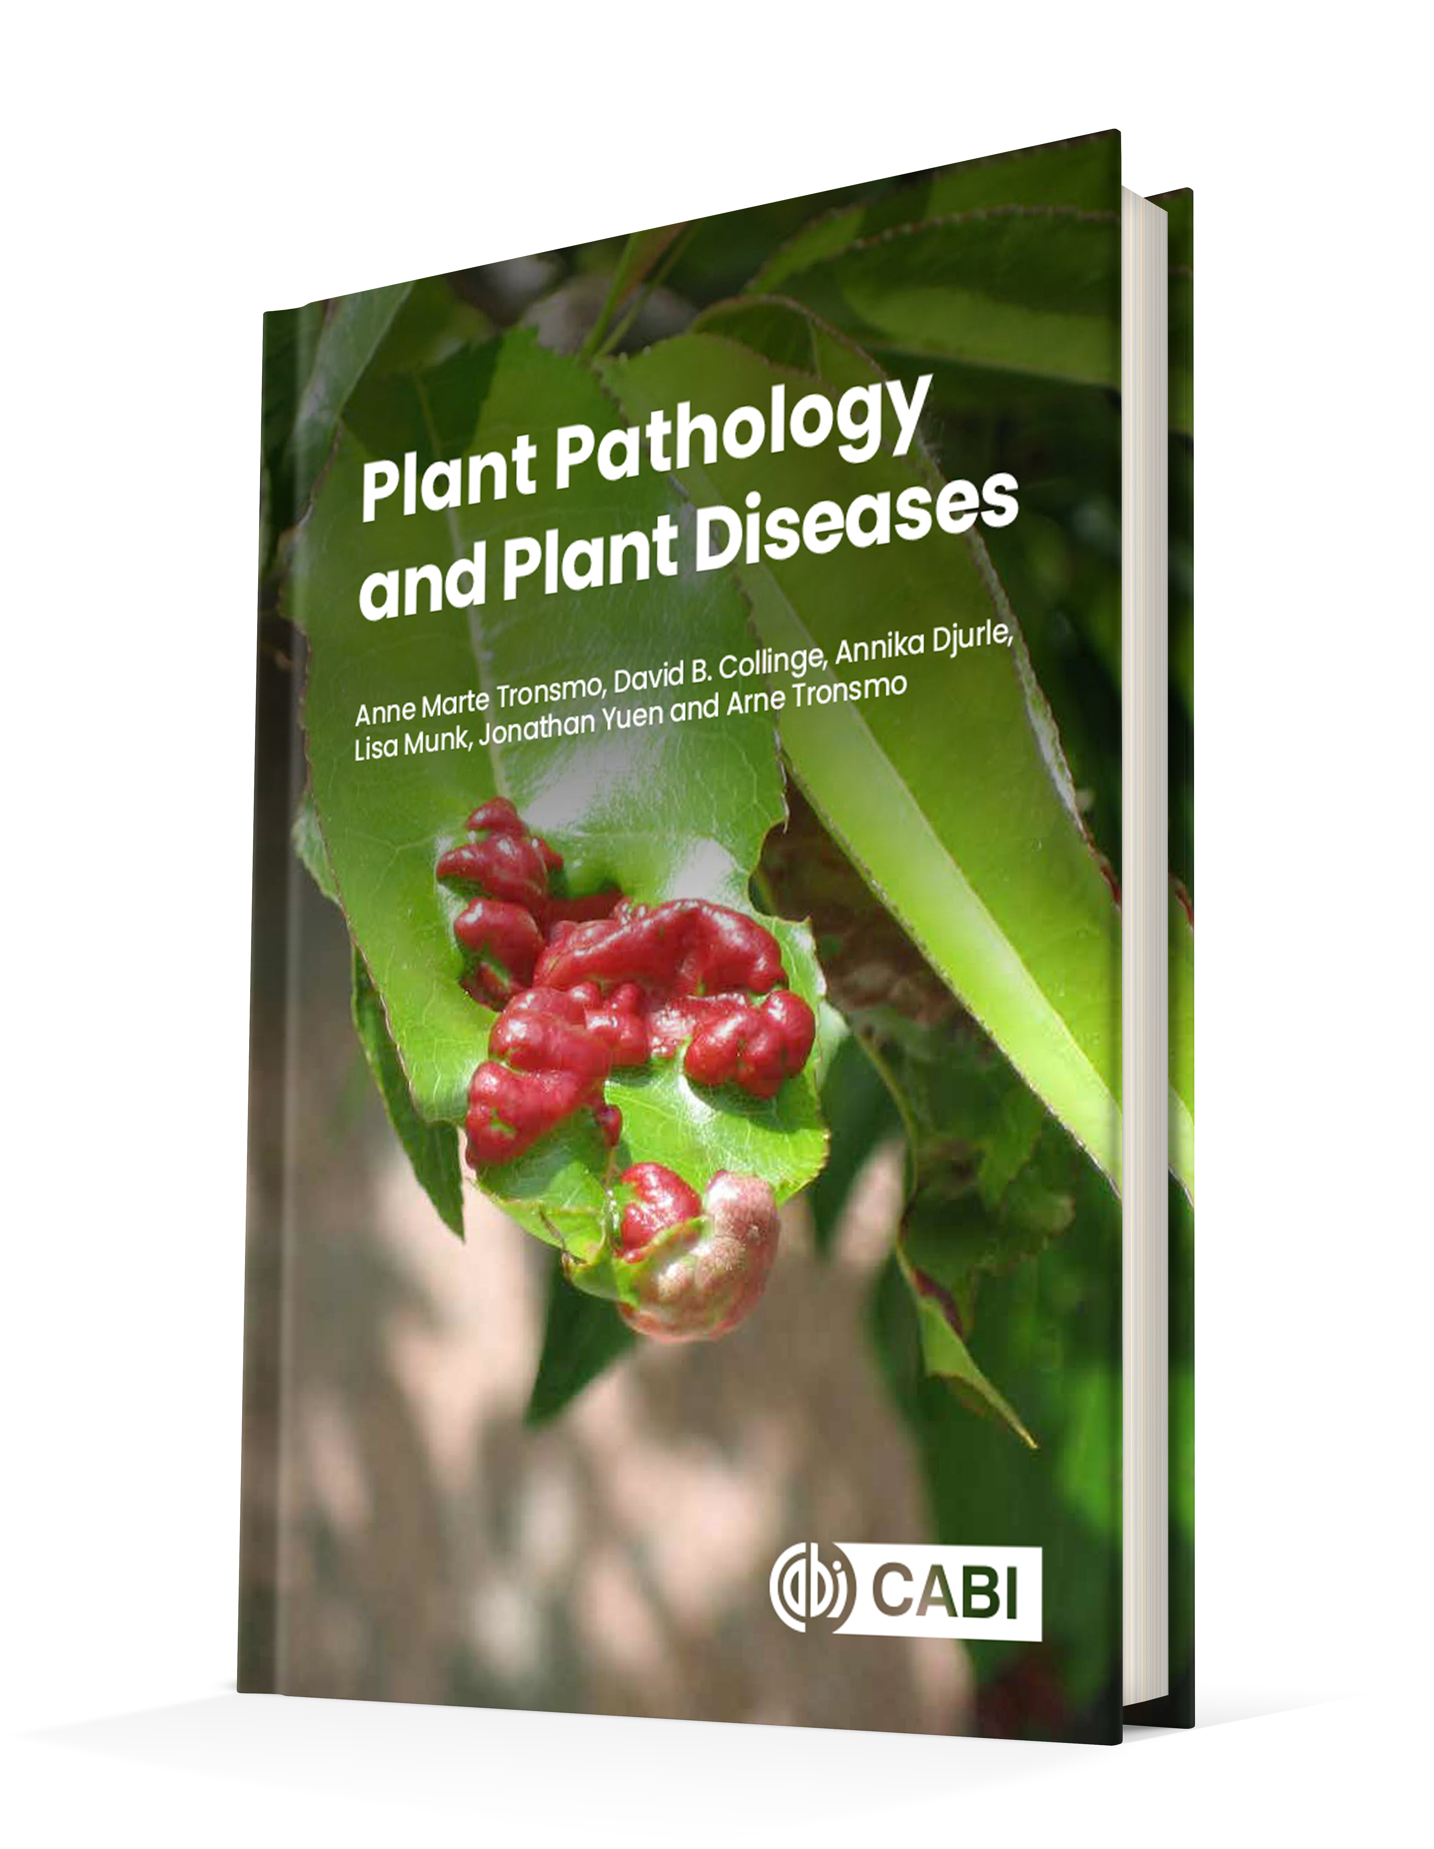
Plant Pathology and Plant Diseases
© Anne Marte Tronsmo, David B. Collinge, Annika Djurle, Lisa Munk, Jonathan Yuen and Arne Tronsmo 2020

Slide 2
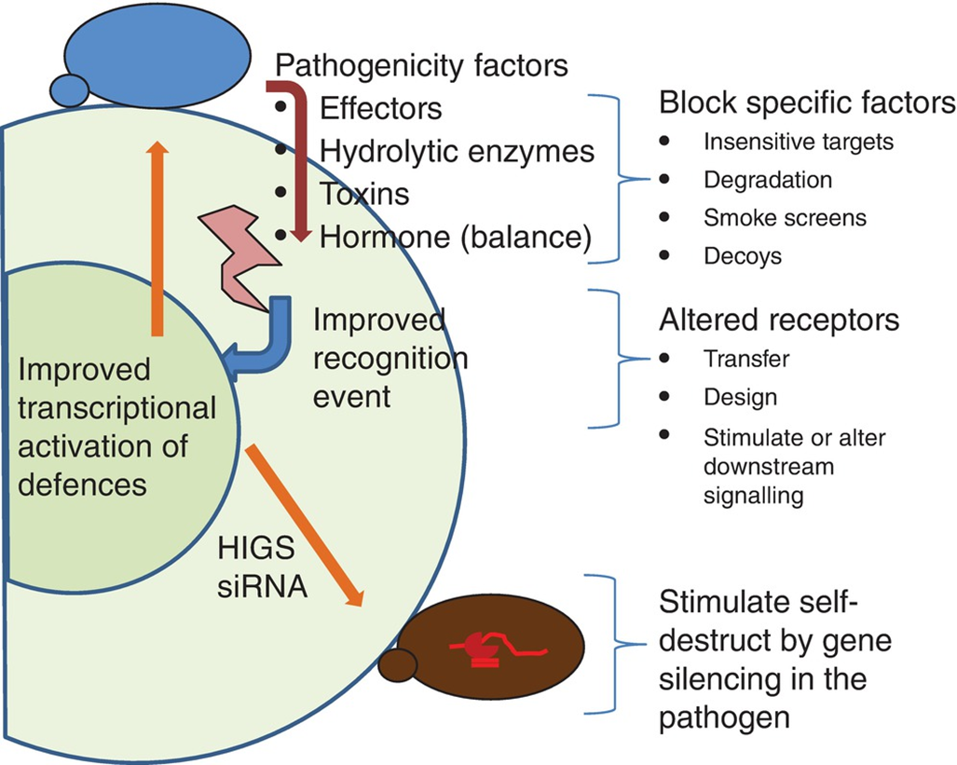
Fig. 19.1 Strategies for transgenic disease resistance. HIGS: host-induced gene silencing. (© D.B. Collinge.)
Plant Pathology and Plant Diseases
© Anne Marte Tronsmo, David B. Collinge, Annika Djurle, Lisa Munk, Jonathan Yuen and Arne Tronsmo 2020

Slide 3
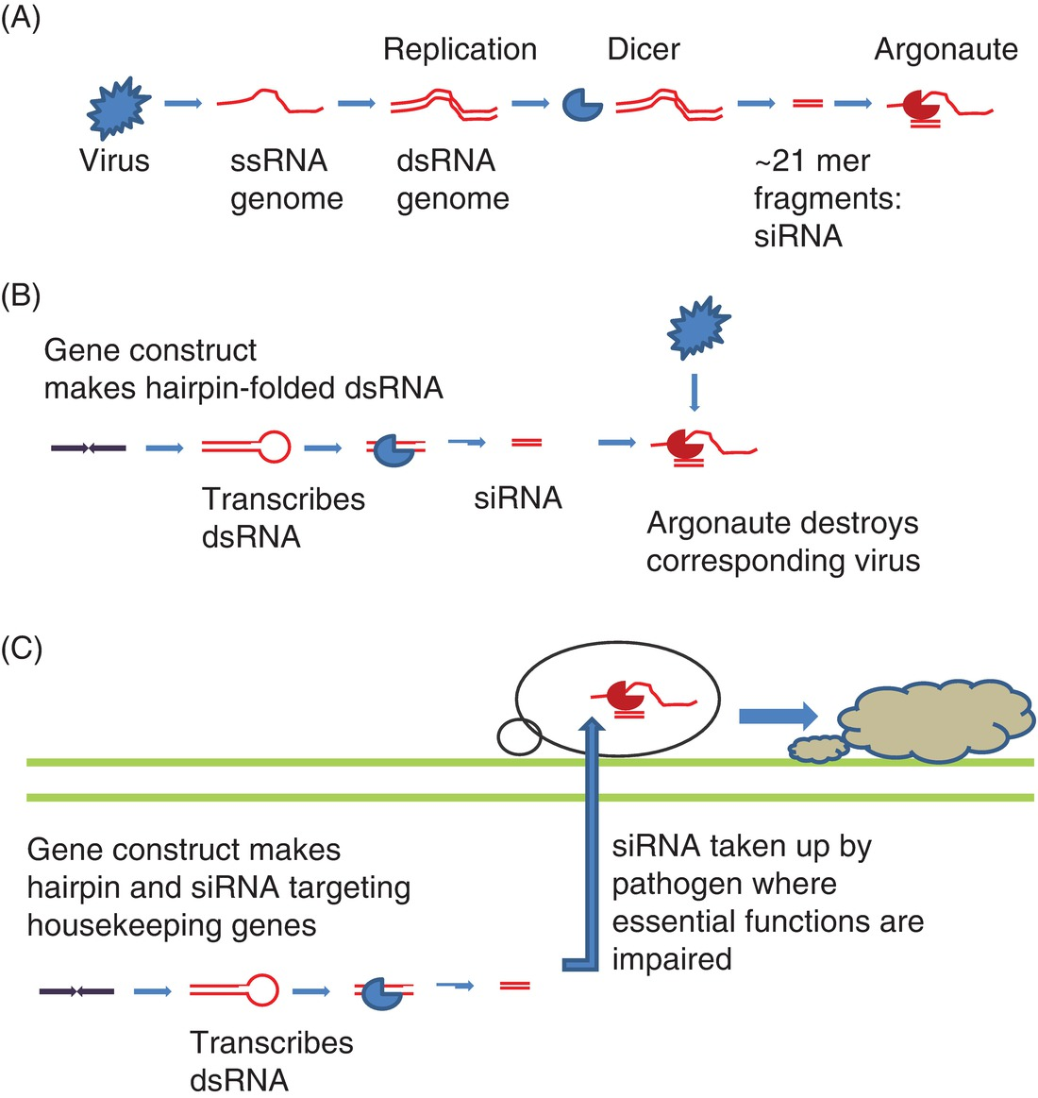
Fig. 19.2 Gene silencing in nature and transgenic plants. (A) Virus defence. (B) Virus-resistant transgenes. (C) Host-induced gene silencing (HIGS). (© D.B. Collinge.)
Plant Pathology and Plant Diseases
© Anne Marte Tronsmo, David B. Collinge, Annika Djurle, Lisa Munk, Jonathan Yuen and Arne Tronsmo 2020

Slide 4
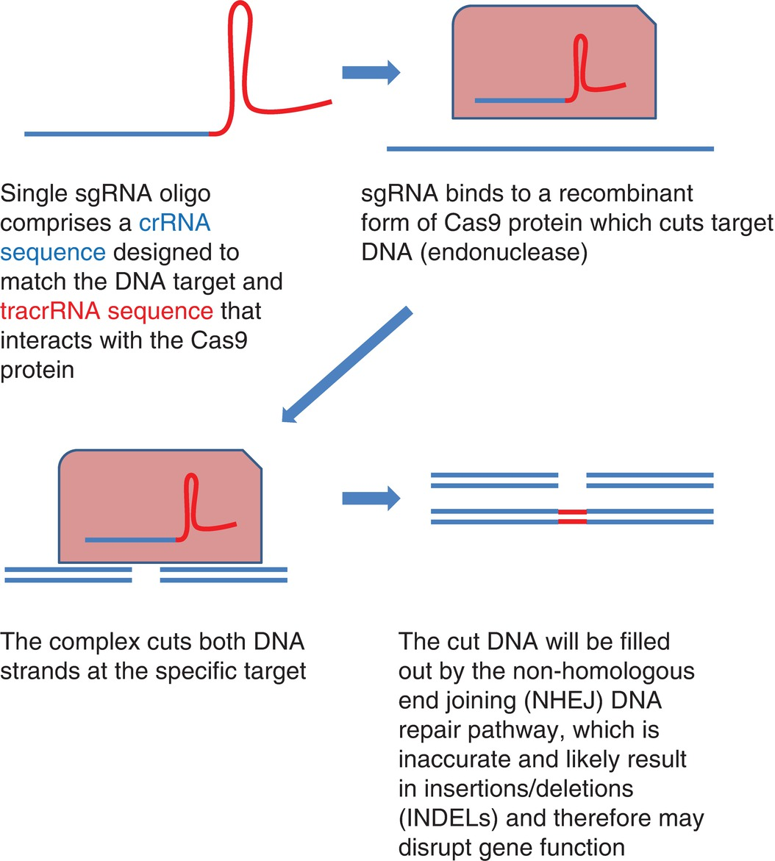
Fig. 19.3 CRISPR/Cas9: site-directed mutagenesis. (© D.B. Collinge.)
Plant Pathology and Plant Diseases
© Anne Marte Tronsmo, David B. Collinge, Annika Djurle, Lisa Munk, Jonathan Yuen and Arne Tronsmo 2020

