Slide 1
Plant Pathology and Plant Diseases
© Anne Marte Tronsmo, David B. Collinge, Annika Djurle, Lisa Munk, Jonathan Yuen and Arne Tronsmo 2020

Slide 2
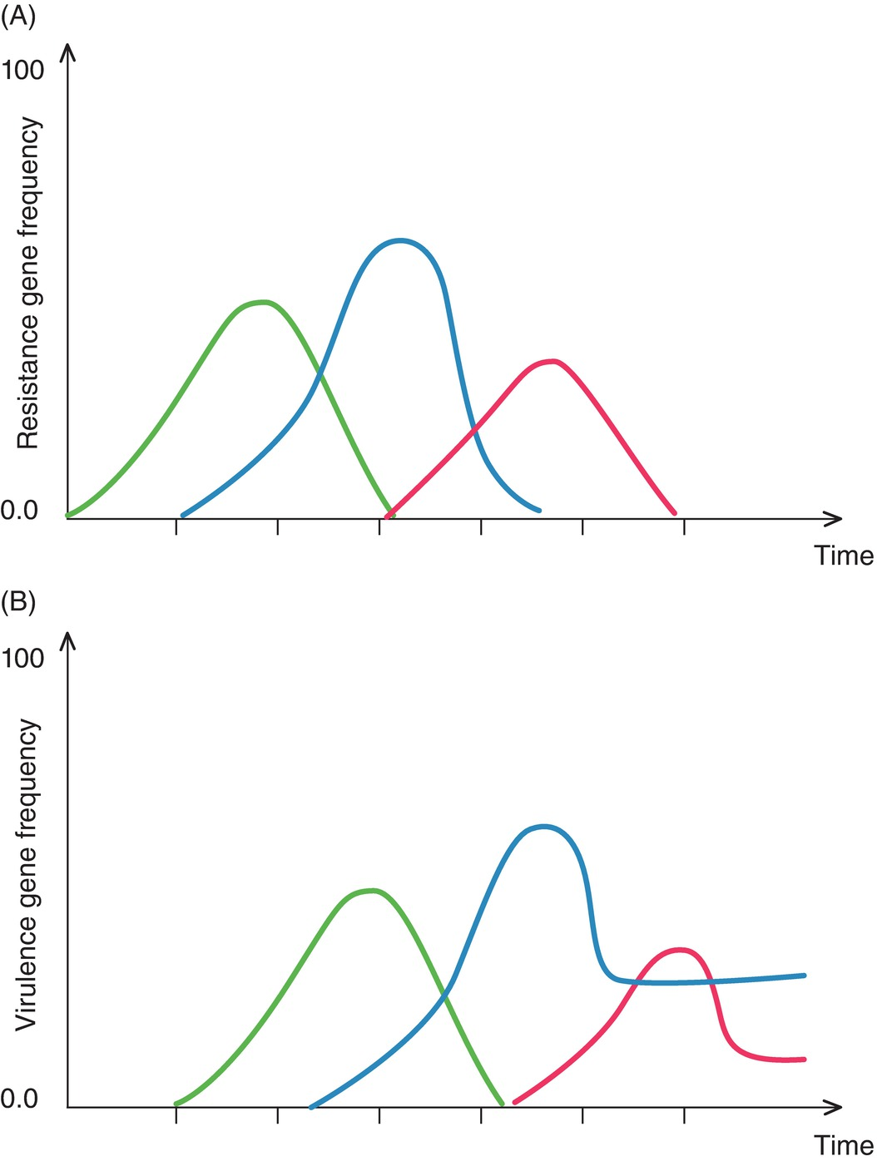
Fig. 18.1 The boom-and-bust cycle. (A) The fluctuation in frequencies of three resistance genes in variety X (green), Y (blue) and Z (red). (B) The fluctuation in the corresponding virulence genes in the pathogen population. (L. Munk.)
Plant Pathology and Plant Diseases © Anne Marte Tronsmo, David B. Collinge, Annika Djurle, Lisa Munk, Jonathan Yuen and Arne Tronsmo 2020

Slide 3
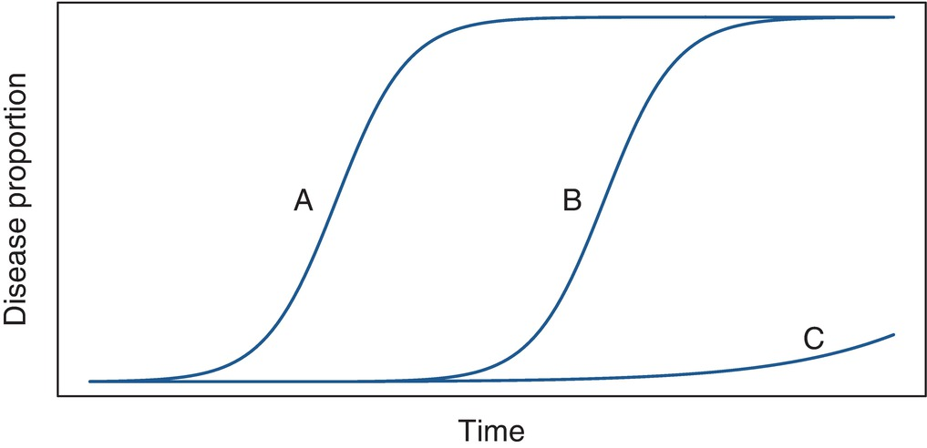
Fig. 18.2 Disease development in plant varieties with different resistance genes. (A) A variety without resistance genes. (B) A variety with an effective race-specific resistance gene. (C) A variety with race-non-specific resistance or a variety mixture composed of several varieties each possessing a resistance gene. (© J. Yuen.)
Plant Pathology and Plant Diseases © Anne Marte Tronsmo, David B. Collinge, Annika Djurle, Lisa Munk, Jonathan Yuen and Arne Tronsmo 2020

Slide 4
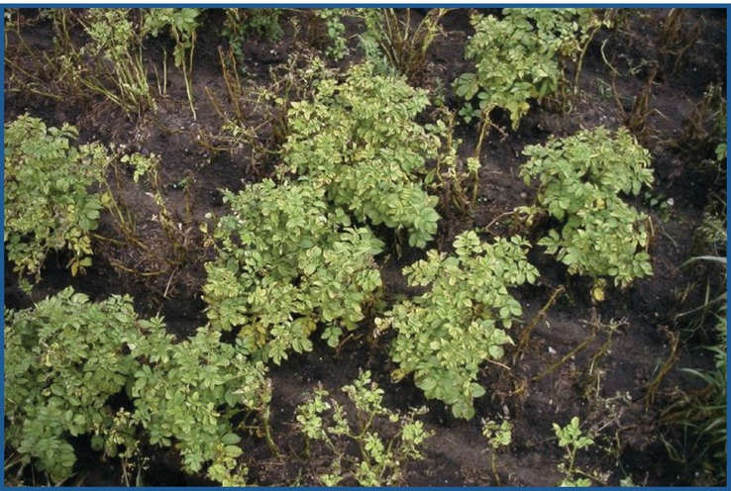
Fig. 18.3 A potato mixture exposed to natural inoculum and composed of four varieties with different levels of resistance. (© L. Munk.)
Plant Pathology and Plant Diseases © Anne Marte Tronsmo, David B. Collinge, Annika Djurle, Lisa Munk, Jonathan Yuen and Arne Tronsmo 2020

Slide 5
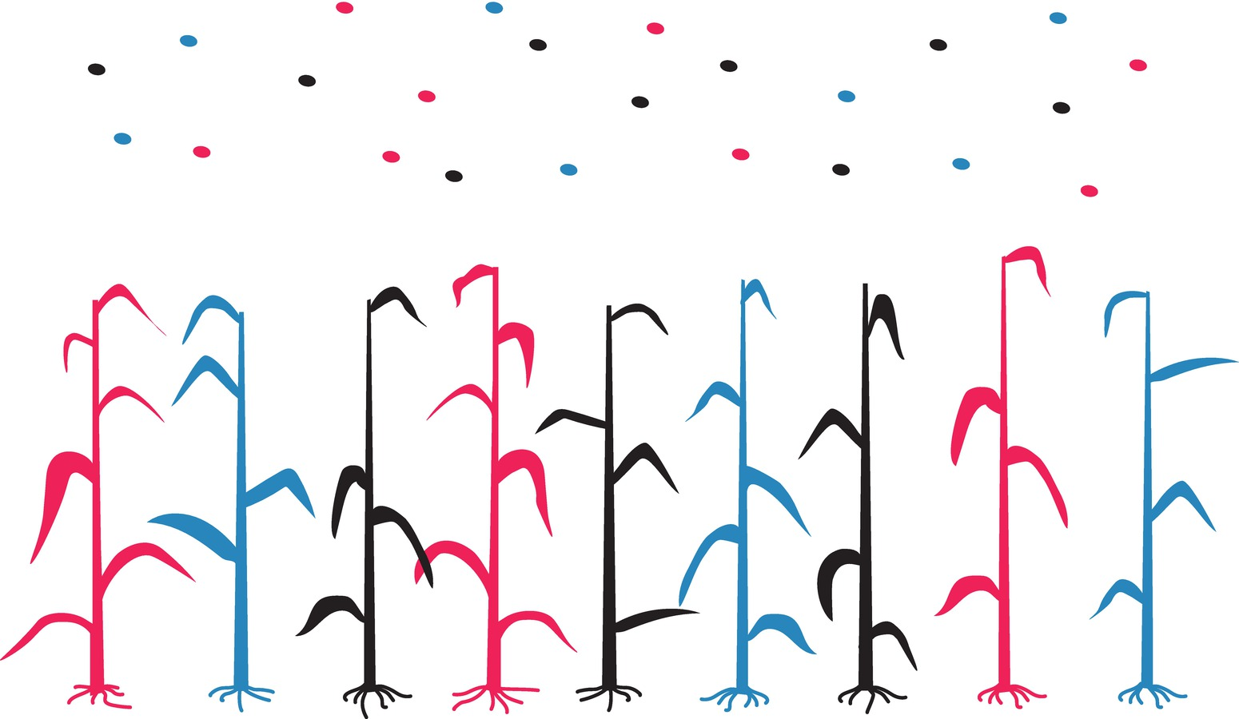
Fig. 18.4 A schematic illustration of a three-way cereal mixture, where the ‘red’, ‘black’ and ‘blue’ plants carry three different resistance genes to an air-borne pathogen. The airborne population consists of spores possessing virulence genes corresponding to the resistance gene, i.e. ‘red’ spores are able to infect ‘red’ plants, etc. (© L. Munk.)
Plant Pathology and Plant Diseases © Anne Marte Tronsmo, David B. Collinge, Annika Djurle, Lisa Munk, Jonathan Yuen and Arne Tronsmo 2020

